Slide 1
RTL Verification: Automated Statement Coverage and Mutation Testing
ECE5534: Term Project
By, Sonal Pinto

Slide 2
RTL Verification using Verilator
Verilator: Open-source HDL simulator
- translates Verilog into C++ or SystemC
- As fast as commercial simulators
Paradigm: We can use Software verification techniques for RTL verification!
Goal: Statement Coverage
- rand1 : unguided random search
- rand2: guided random search
- saga : Genetic Algorithm based search

Slide 3
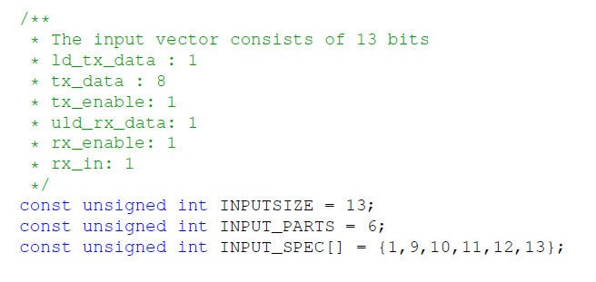
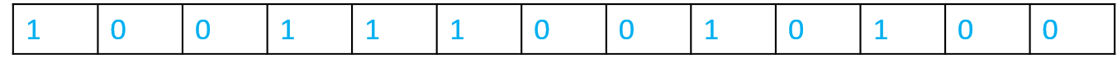
Statement Coverage Automation
The input to the model is defined as a single string of bits called, inputvector
While applying the inputvector to the Primary Inputs, the data bits are segmented as per INPUT_SPEC
Example:
A test is a list of inputvectors. Application of a test on a model, updates the coveragestate (bins for each coverage point).

Slide 4
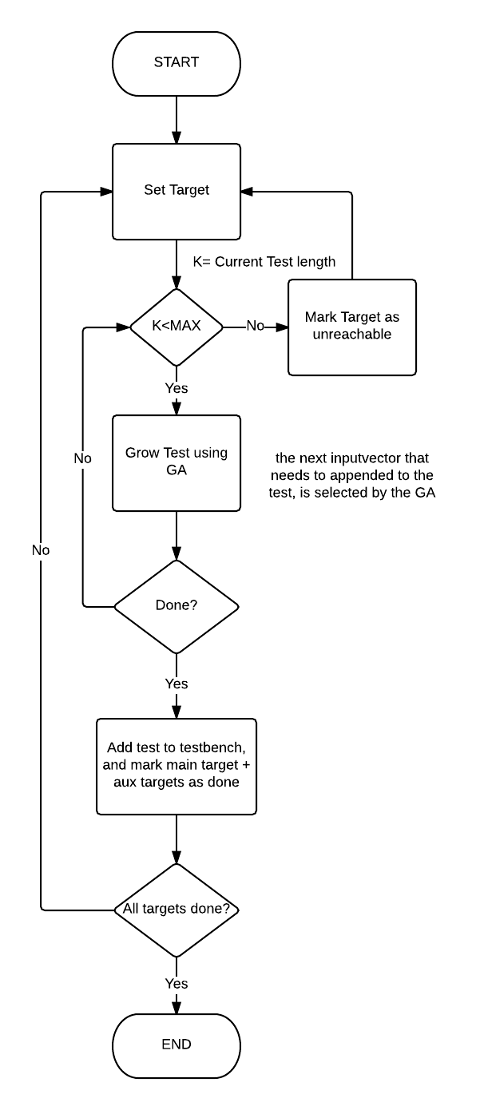
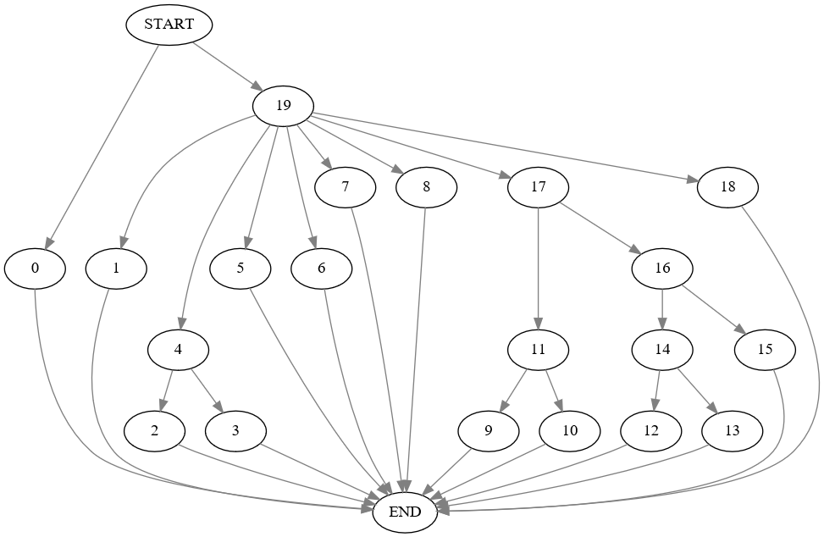
saga
Commonality Score:
Fitness for a test, is evaluated as the extent of similarity the execution of the test, has in common with the paths that would reach the target. This is a comparison of the coveragestate against every path for that target, where a higher score is assigned for having more nodes in common with the target paths.
Coverage Flow Graph for b07

Slide 5
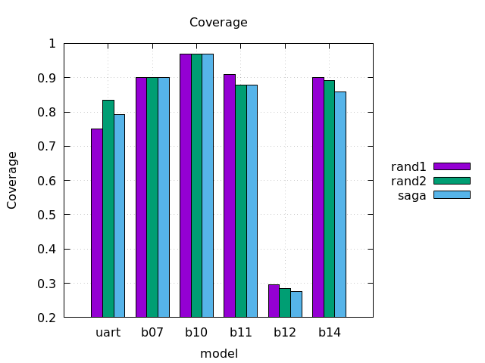
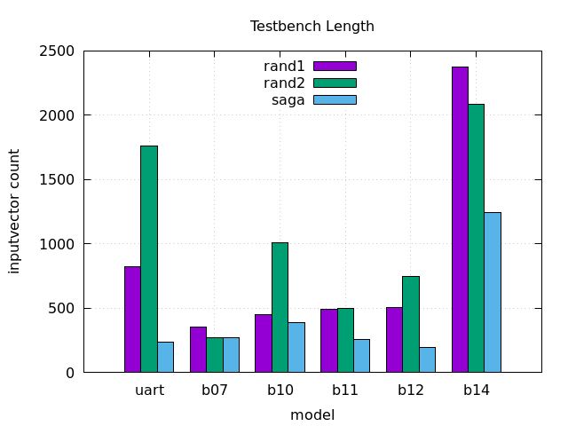
Automated Statement Coverage

Slide 6
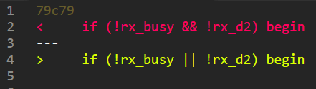
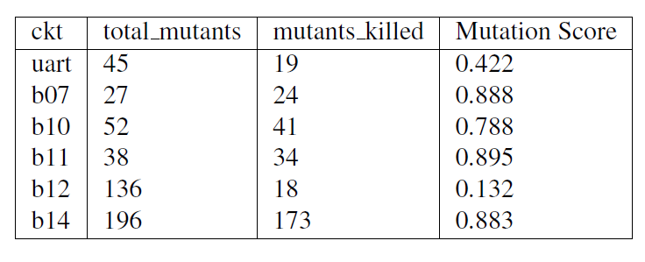
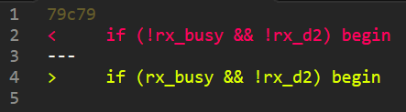
Mutation Testing
Introduce mutants into the model, and attempt to kill the mutant by evaluating the mutated model with the generated testbench
Boolean Logical Mutant
Boolean Negation Mutant
Possible correlation:
High Statement Coverage → High Mutation Score

