Slide 1
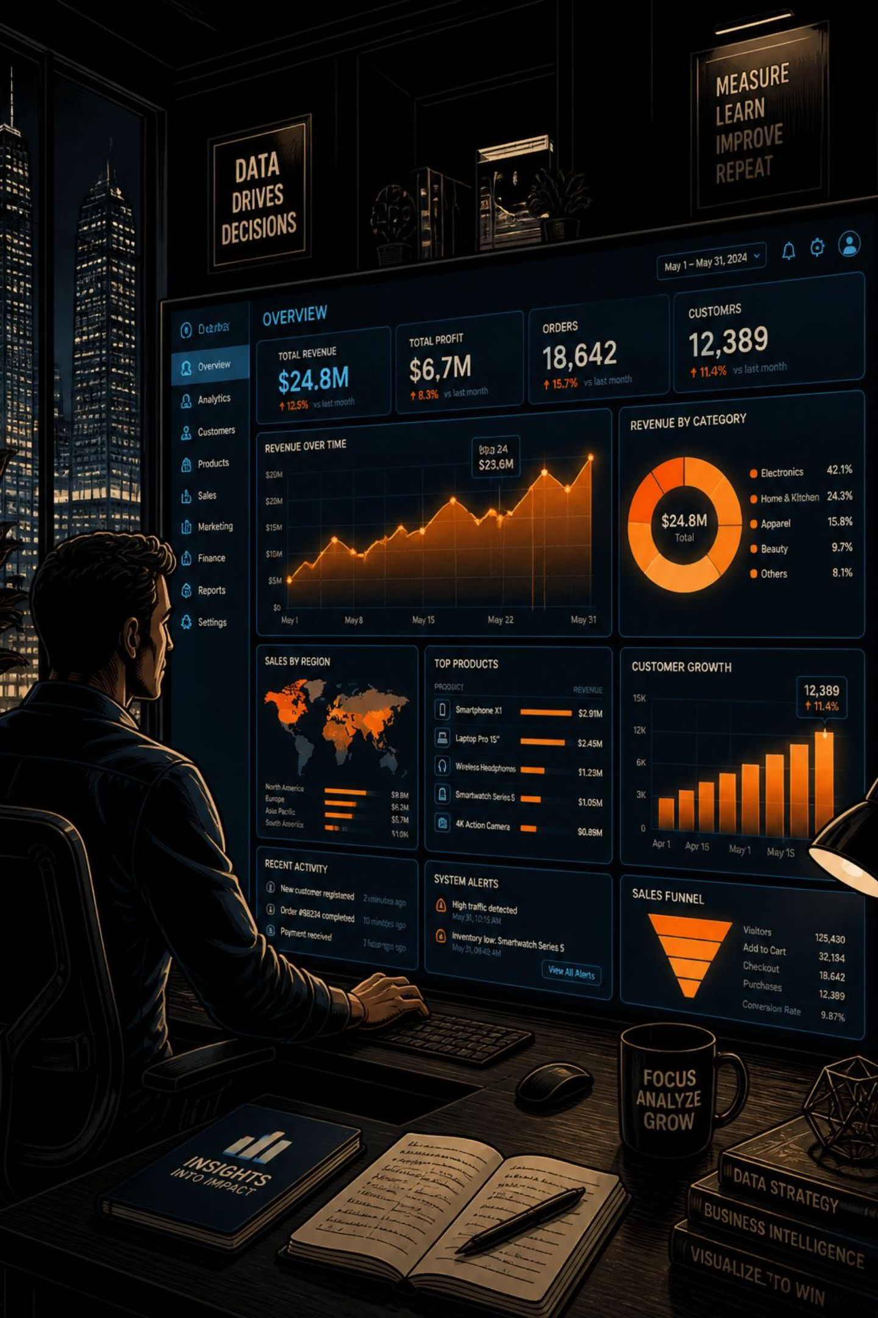
Men's T-Shirt Brand Performance Dashboard
A Power BI solution evaluating 200+ brands across discounting, profitability, pricing, and assortment depth.
INSIGH BI
PROJECT REPORT

Slide 2
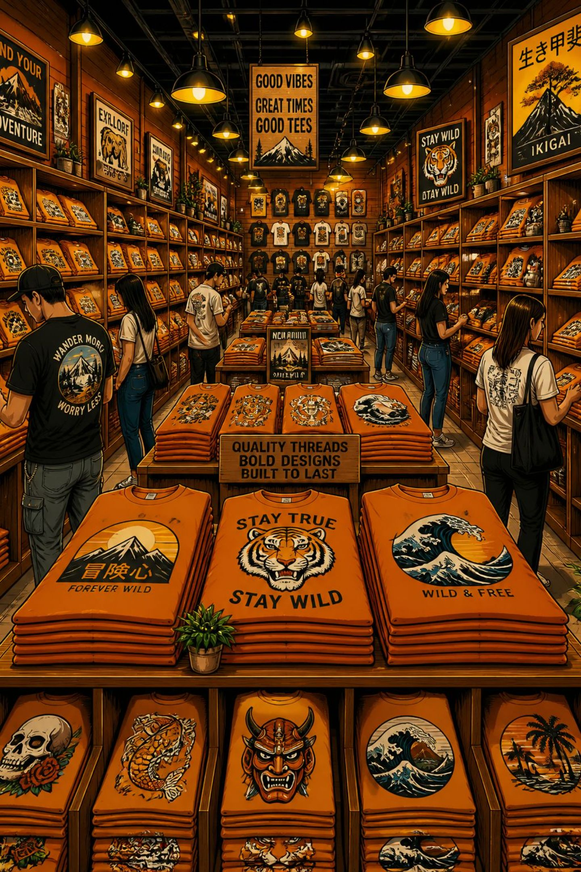
The Business Problem
The business needed a consolidated, visual way to evaluate 200+ T-shirt brands across four critical dimensions — helping stakeholders make faster, data-driven decisions on pricing, margins, and assortment strategy.
Discounting
Profitability
Pricing
Assortment Depth

Slide 3

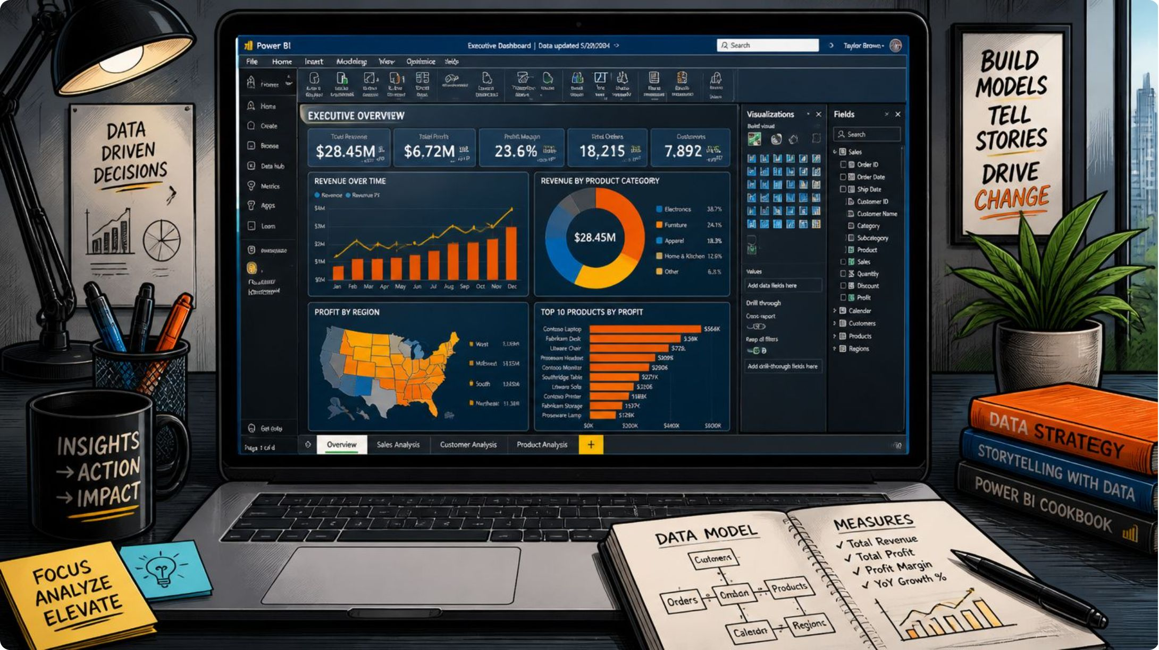

Tools & Technologies
Power BI Desktop
Data modeling, DAX measures, and report visuals
Azure
Primary data source for brand-level records
DAX
Calculated measures: Average Discount %, Average Profit %, Average Sales Price

Slide 4



Data Overview
The dataset contains brand-level records for men's T-shirts, providing the foundation for all dashboard metrics and visualizations.
Brand & Title
Original Price
Sale Price
Brand name and product title for each record
Listed retail price before any discounts applied
Actual transaction price — used to derive discount and profit metrics

Slide 5
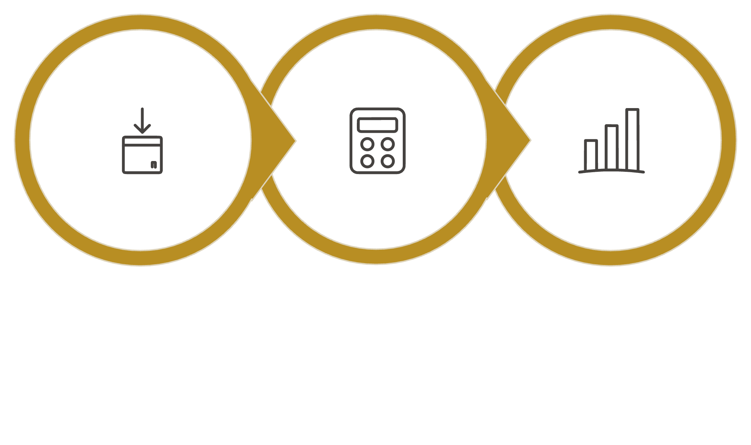
Approach & Methodology
DAX Measures
Visualization
Data Import
The report was built in two pages: a cover page with a brand slicer for navigation, and a Brand Performance page featuring five analytical visuals.

Slide 6
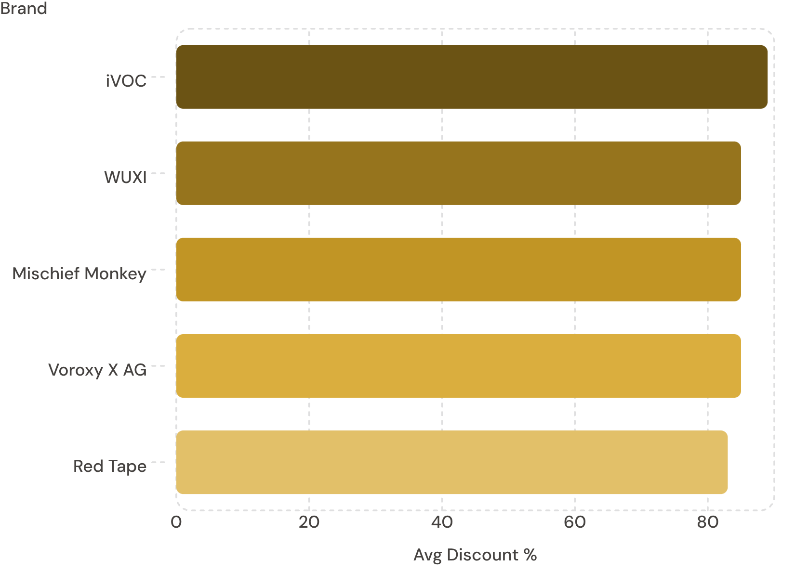
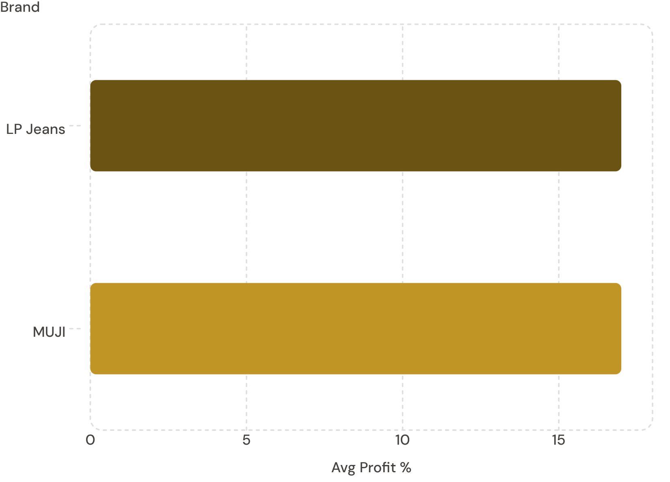
Key Insights: Discounting & Profitability
Top 5 Brands by Avg Discount %
Top 5 Brands by Avg Profit %
LP Jeans and MUJI tie for highest profit at 17%, followed by a cluster at 16%. Overall average discount across all brands is ~82.9%.

Slide 7
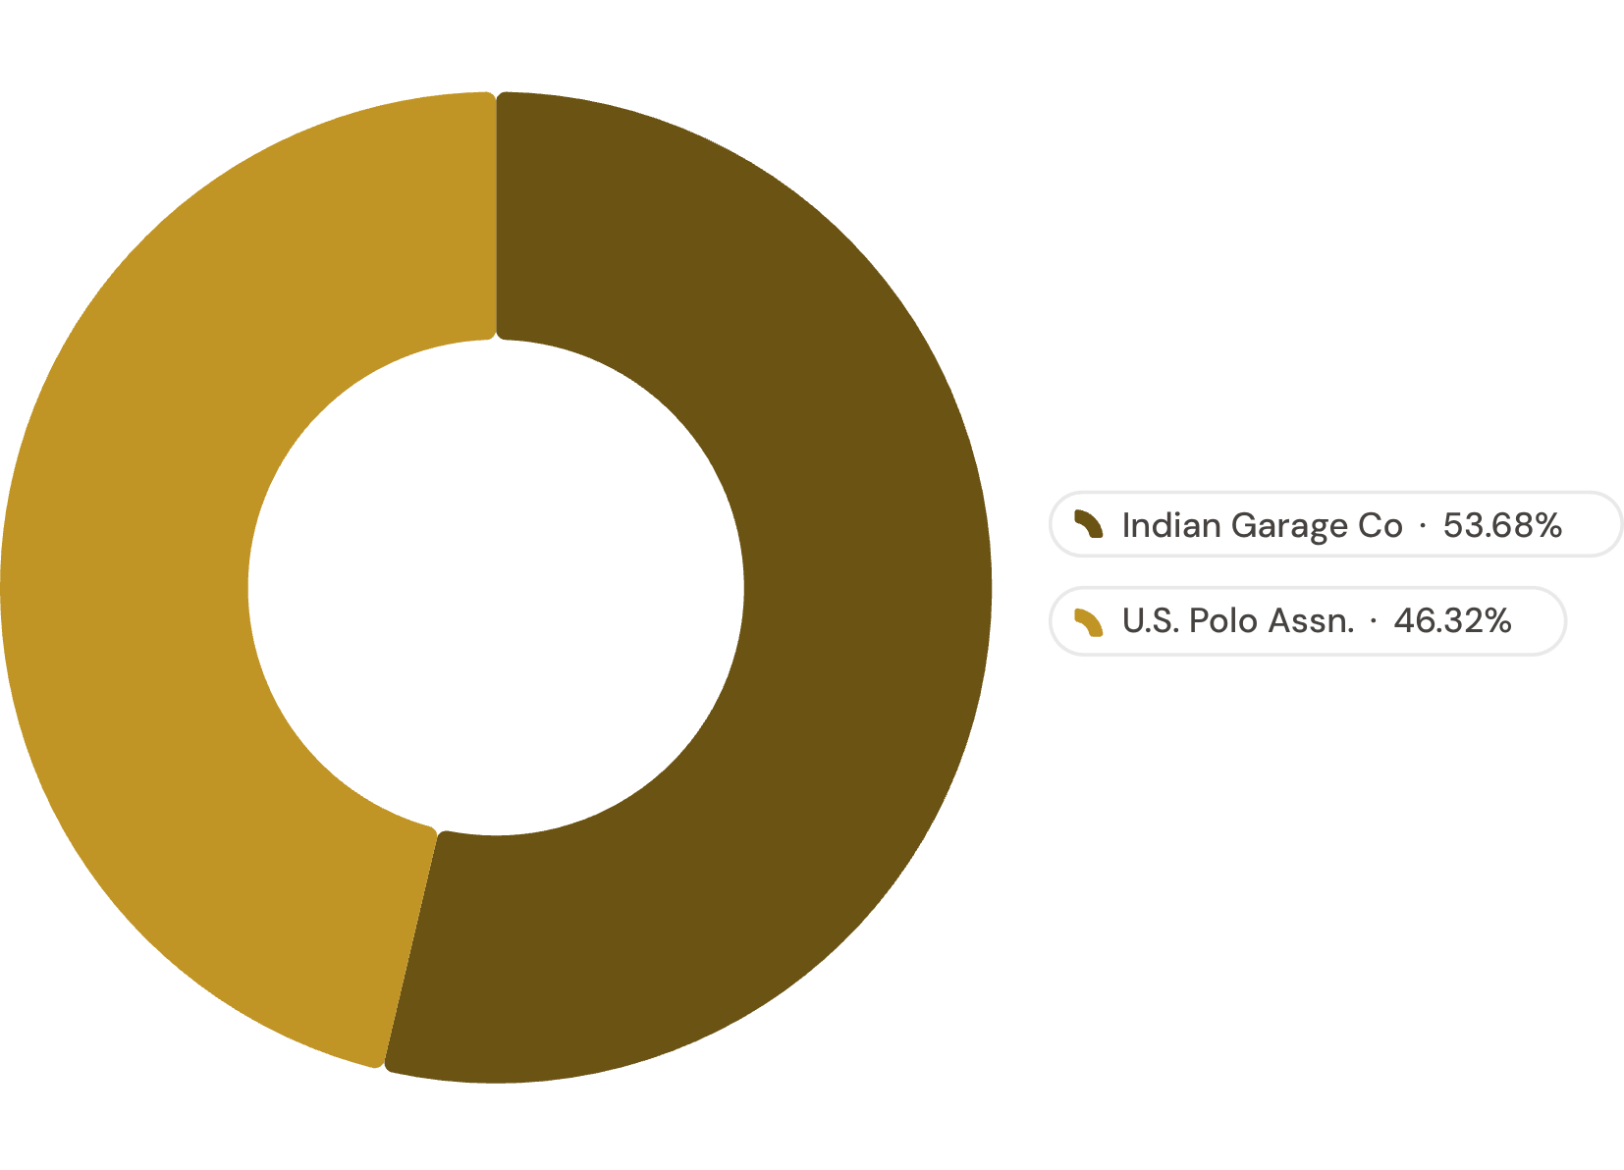
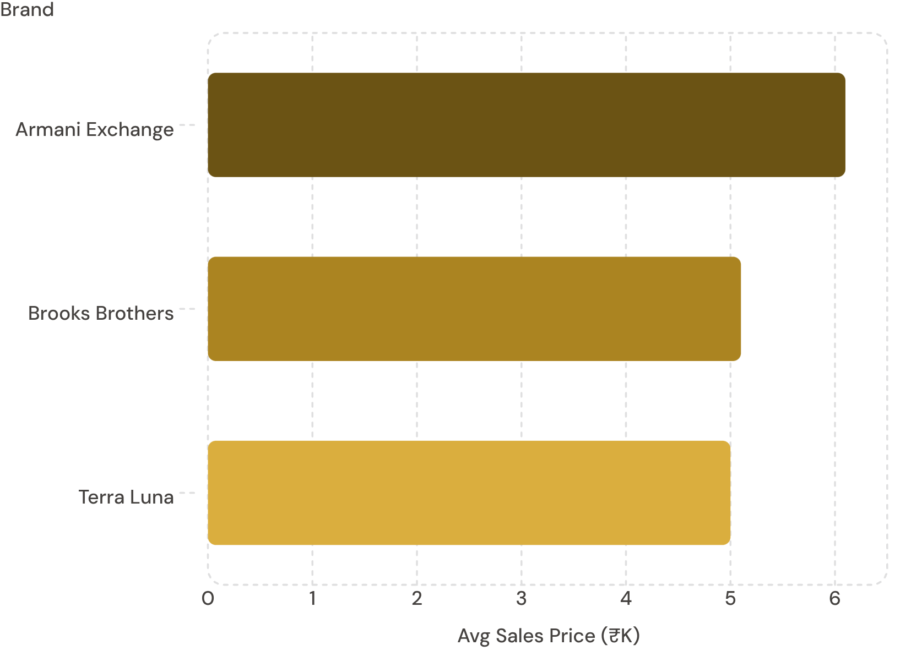
Key Insights: Assortment & Pricing
Top 5 Brands by No. of Varieties
Top 5 Brands by Avg Sales Price (₹)
Indian Garage Co leads with 51 styles (22.9%). Premium brands like Armani Exchange (₹6.1K) command the highest price points. Overall average sales price is ~₹10K.

Slide 8
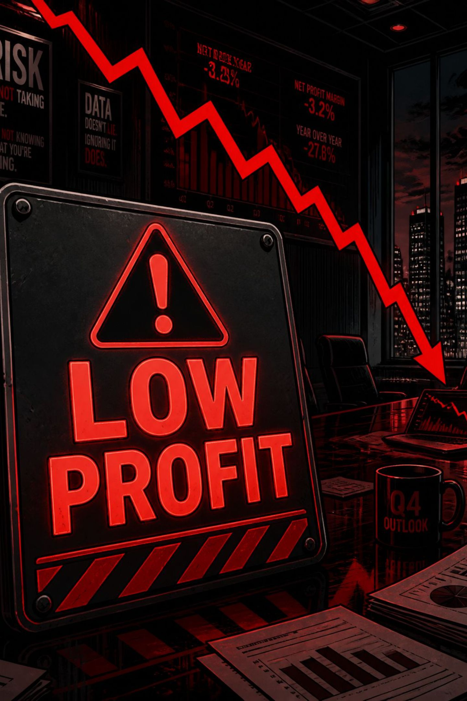

Bottom 5 Brands by Avg Profit %
Ramadhani Cloth
Gespo & Chimpaaanze
3.5% avg profit
3% avg profit each
Be Active X AG & Aapska
2% avg profit each
These brands represent the least profitable segment and may require partnership renegotiation or reduced inventory exposure.

Slide 9

Business Recommendations
Review Heavy Discounting
iVOC, WUXI, Mischief Monkey, Voroxy X AG, Red Tape — discounts of 83–89% may compress margins
Invest in High-Margin Brands
LP Jeans and MUJI (17% profit) — prioritize shelf placement and marketing spend
Reassess Low-Profit Partnerships
Renegotiate terms or reduce inventory for Ramadhani Cloth, Gespo, Chimpaaazee, Be Active X AG, Aapska
Leverage Premium Brands
Armani Exchange, Brooks Brothers — ideal for higher-margin bundling or premium campaigns
Expand High-Variety Assortments
Indian Garage Co, U.S. Polo Assn. — grow styles if sales data supports demand

Slide 10
Limitations & Future Scope
⚠ Current Limitations
🚀 Future Scope
Static extract — profit/discount figures reflect a point-in-time snapshot
Sample sizes vary by brand; some "bottom 5" brands have as few as 2 SKUs, skewing averages
No time-series or trend view in this version
Add monthly/quarterly trend pages for profit and discount
Expand beyond T-shirts to category/sub-category breakdowns
Automate data refresh via SQL/API instead of manual load
Build a unified brand scorecard combining all four metrics
Author: Sonal Undekar — QA Engineer / Test Data Engineer

