Slide 1

Data Warehousing
By
Department of computer science
(Sonal Shukla)

Slide 2
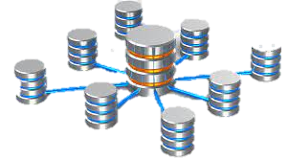
Topics
Definition
Types
Uses of data warehouse
Need of data warehouse
Advantage of data warehouse
OLAP vs. Warehousing
Data Extraction and load
Metadata
Architecture of data ware

Slide 3
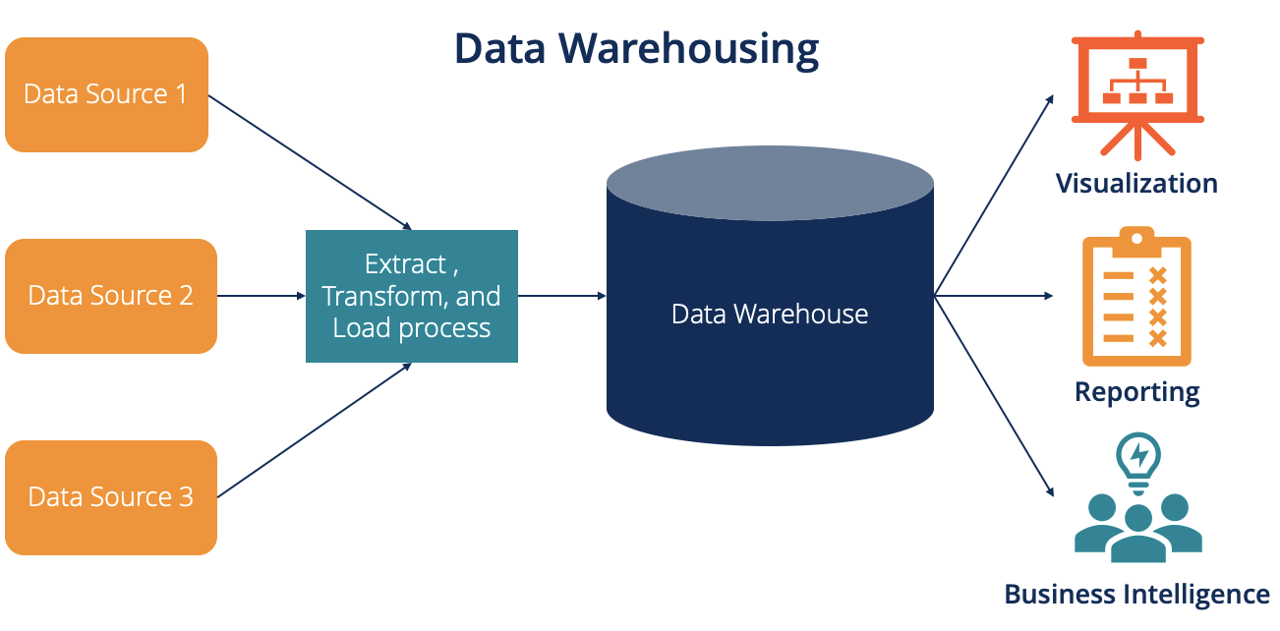
Business Intelligence
Business Intelligence is the activity which contribute to growth of any
Organization.
Business Intelligence is the act of transforming raw/operational data
Into useful information for business analysis.

Slide 4

Definition
A data warehouse is a large, centralized repository of data that is used for reporting and analysis. It is designed to support business intelligence (BI) activities by providing a single, unified view of an organization's data from various sources.

Slide 5
Types
Operational Data Store: Operational data mirror. Eg: Item in stock.
Enterprise data warehouse: Historical analysis, Complex pattern analysis.
Data Marts

Slide 6
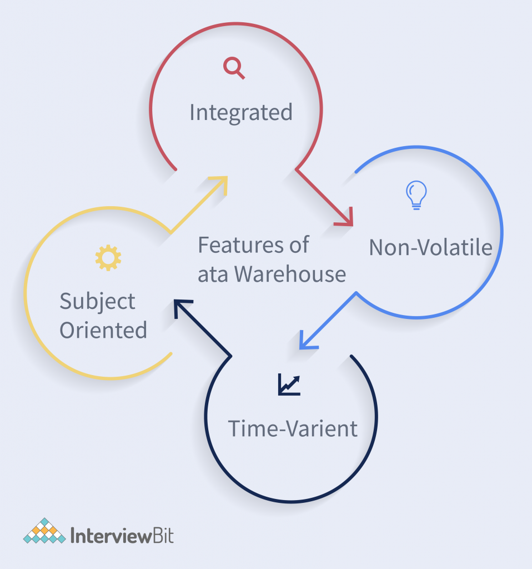

Slide 7
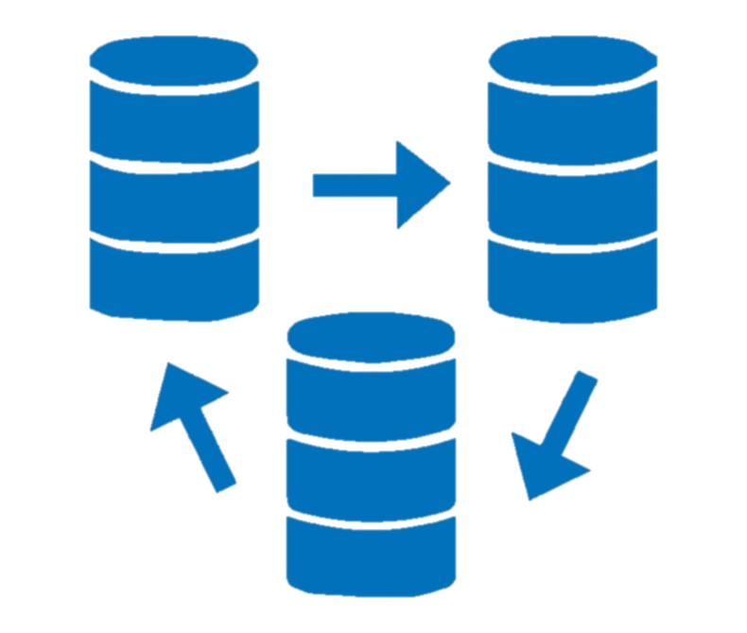
Uses of a data warehouse
Presentation of standard reports and graphs
For dimensional analysis
Data mining

Slide 8
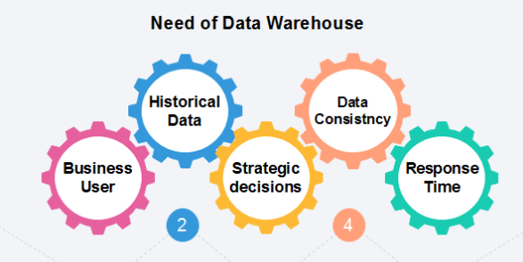
Needs of datawarehouse

Slide 9
Advantages
Lowers cost of information access
Improves customer responsiveness
Identifies hidden business opportunities
Strategic decision making
Data ware house is fast and accurate.

Slide 10
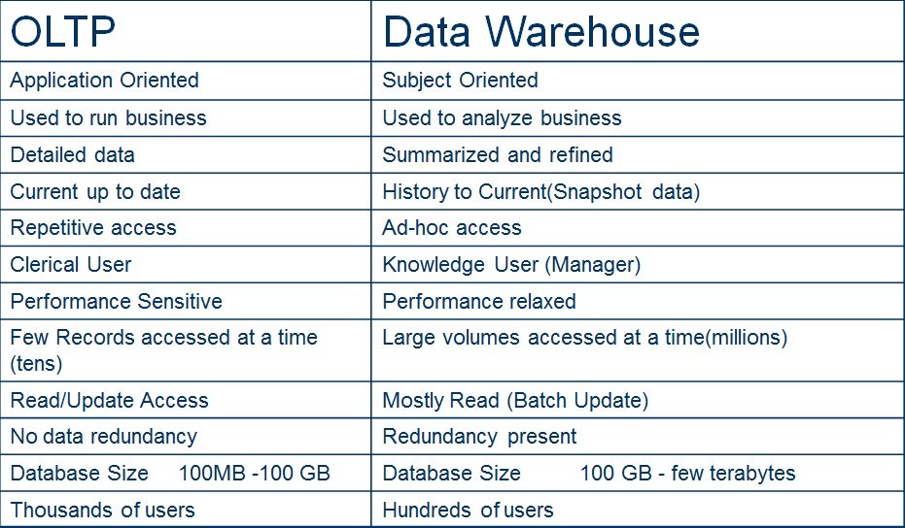
OLTP vs. Warehousing

Slide 11
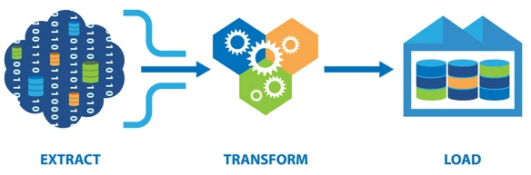
Data Extraction and Load
ETL stands for Extract, Transform, Load and it is a process used in data warehousing to extract data from various sources, transform it into a format suitable for loading into a data warehouse, and then load it into the warehouse.

Slide 12
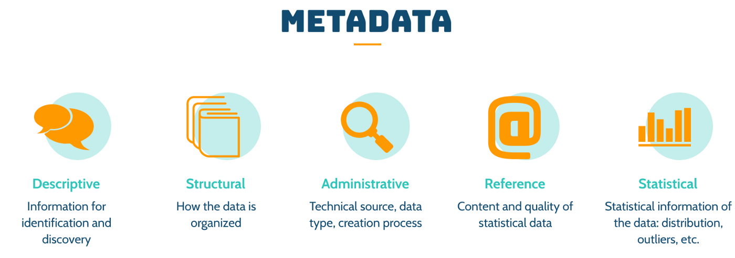
Metadata
Metadata refers to data that provides information about other data. It includes descriptive information that can be used to identify, organize, and manage data, such as the title, author, date, and format of a document. Metadata can be found in various types of digital content, such as images, audio and video files, web pages, and documents.

Slide 13
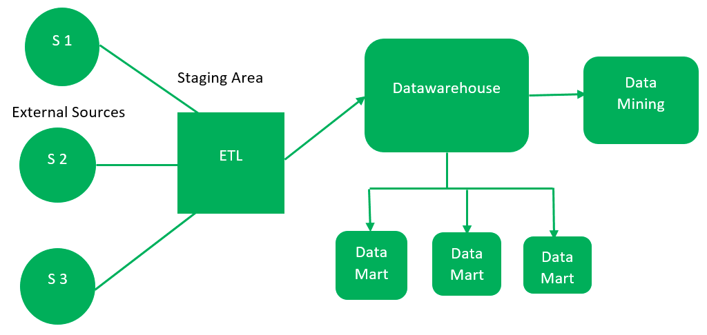
Architecture of Data warehouse
data-warehouse is a heterogeneous collection of different data sources organized under a unified schema. There are 2 approaches for constructing data-warehouse:
1.Top –down approach:-

Slide 14
External Sources – External source is a source from where data is collected irrespective of the type of data. Data can be structured, semi structured and unstructured as well.
Stage Area – Since the data, extracted from the external sources does not follow a particular format, so there is a need to validate this data to load into data warehouse.
E(Extracted): Data is extracted from External data source.
T(Transform): Data is transformed into the standard format.
L(Load): Data is loaded into data warehouse after transforming it into the standard format.
Data-warehouse – After cleansing of data, it is stored in the data warehouse as central repository. It actually stores the meta data and the actual data gets stored in the data marts. Note that data warehouse stores the data in its purest form in this top-down approach.
Data Marts – Data mart is also a part of storage component. It stores the information of a particular function of an organization which is handled by single authority.
Data Mining: – The practice of analyzing the big data present in data warehouse is data mining. It is used to find the hidden patterns that are present in the database or in data warehouse with the help of algorithm of data mining.

Slide 15
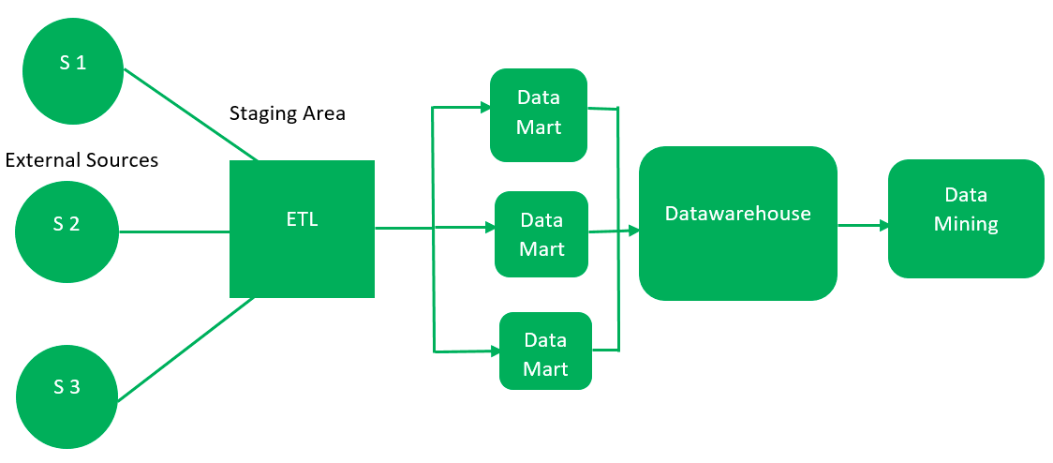
2. Bottom –Up approach:-

Slide 16
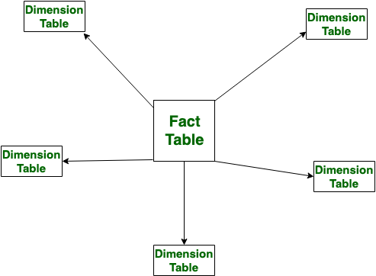
Star schema
Star schema is the type of multidimensional model which is used for data warehouse .In star schema, The fact tables and the dimension tables are contained.
In this schema fewer foreign-key join is used. This schema forms a star with fact table and dimension tables.

Slide 17

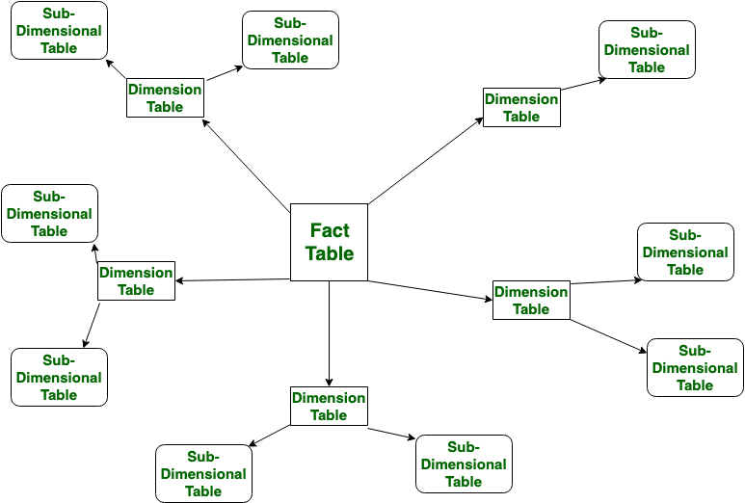
Snowflake Schema is also the type of multidimensional model which is used for data warehouse. In snowflake schema, The fact tables, dimension tables as well as sub dimension tables are contained. This schema forms a snowflake with fact tables, dimension tables as well as sub-dimension tables.

Slide 18
Thank You

