Slide 1

PRASAD INSTITUTE OF TECHNOLOGY ,JAUNPUR
A Mini Project and Internship assessment Demonstration
“ On Buddy”
Presented by:
Sonal Shukla (2001440109004)
Under The Guidance:
Prof. Abhay Naryan singh
(computer Science Department)

Slide 2
TABLE OF CONTENTS
01
Abstract
05
Results & Discussions
02
Introduction
To Project
04
Snapshots
06
Conclusions and future
scope
03
Tools &
Technology

Slide 3
Abstract:
In the modern era the automation project are grew faster and it makes our life more efficient and easiest so I decided to make a virtual friend that accompany us and also resolve our issues.
In the fast moving life people are getting busy and have least time ,even they forget many tasks that they have to do so this buddy help them to get relax and make their life relaxable.

Slide 4
Introduction:
In this project I have decided to make a virtual friend that accompany a person and do few tasks .
You can talk with the buddy , it also relax your mood by playing songs, Videos, and so on.
It also play jokes for you and you can ask date and time to buddy. Buddy will talk to you.
If you want buddy can also help you in studies you can ask any question to buddy and he provide you result by search on wikipedia and help in your studies also.

Slide 5
Tools &
Technology?

Slide 6
Tools and Technology:
Hardware Requirement :-
Windows 10
X86 64-bit CPU(Intel /AMD architecture)
4 GB RAM
5 GB free disk space
Software Requirement :-
Python IDLE
speech_recognition module
pyttsx3 module
pywhatkit module
datetime module
wikipedia module
pyjokes module
JavaScript
Text Editor

Slide 7
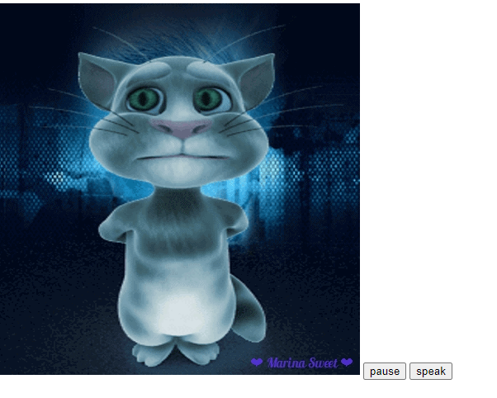
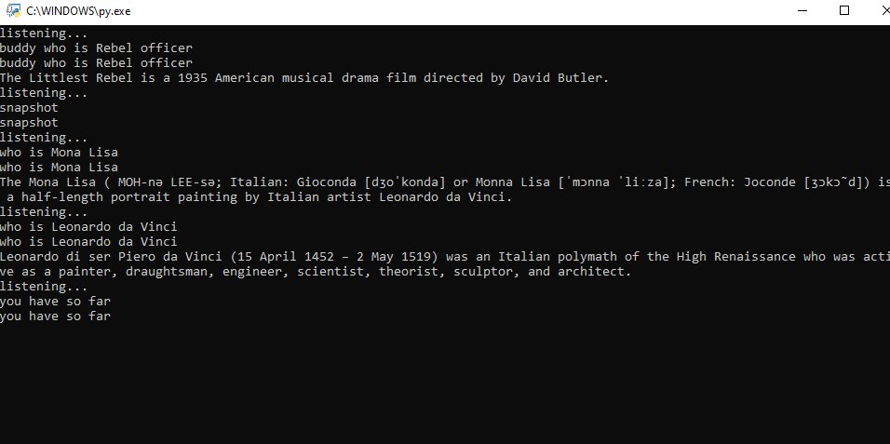
Snapshots:-

Slide 8
Result and Discussion:-
Buddy connects with the world wide web to provide results that the user has questioned. This project works on voice input and gives output through voice and displays the text on the screen. The main agenda of my Buddy.
They’re time savers as you don’t need to train them and teach the very basics. You do not have to worry after hiring and do not have to waste time on such things.
Take the help of a buddy to become more productive in your life as it can help grow your small start venture or business.
It is no longer a rare and difficult task. Now, it’s close enough to becoming a priority for almost all businesses. Having someone in person for almost all your needs is a great assistance. It is the best help anyone could have for any individual or business.
And if you want more powerful tools and techniques to manage Buddy, it is possible. You have various tools
To see how they can help you manage Buddy more easily, why not consider one for yourself?

Slide 9

Conclusion & future scope:- we are constantly upgrading the way Buddy works. a significant number of updates(opens in new tab) were announced to bring the AI assistant a ‘memory’ feature, which enables Buddy to remember important dates, as well as ‘context carry over’, which means you can ask Buddy one question followed by another. There’s more on the horizon. According to reports, a patent was also filed that would allow Buddy to respond to commands without needed a wake word. That means you could say “turn lights on Buddy” rather than saying “Buddy” before the command. Although this change raises privacy concerns (is Buddy always listening?) it could make interactions more fluid. “This technology will continue to improve, with much more natural sounding interactions, until the user feels as though they are in a conversation with another human.”

Slide 10
Many of the latest updates are focused on making conversation between you and Buddy feel more like you’re talking to a human than a computer. But it’s not just conversation skills that need to develop. The suggestions Buddy provides, and the way it helps around the home, will be important for evolving it from a smart assistant into an invaluable member of the family. “The model of interaction, at its core, is not entirely different than going on a computer and typing a question into a browser” . “Until this format changes, and becomes more intuitive and more human with the AI initiating interactions and understanding context and users, there is a large chance the functionality of the devices will plateau.”

Slide 11

THANK YOU !!! THANK YOU !!!

