Slide 1
ON
“CTS SYSTEM”
PROJECT

Slide 2
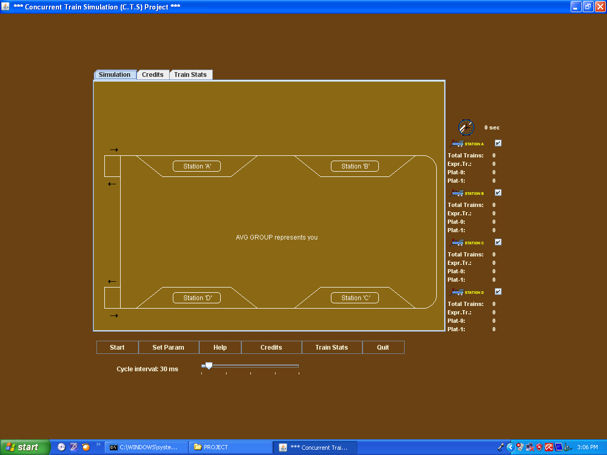
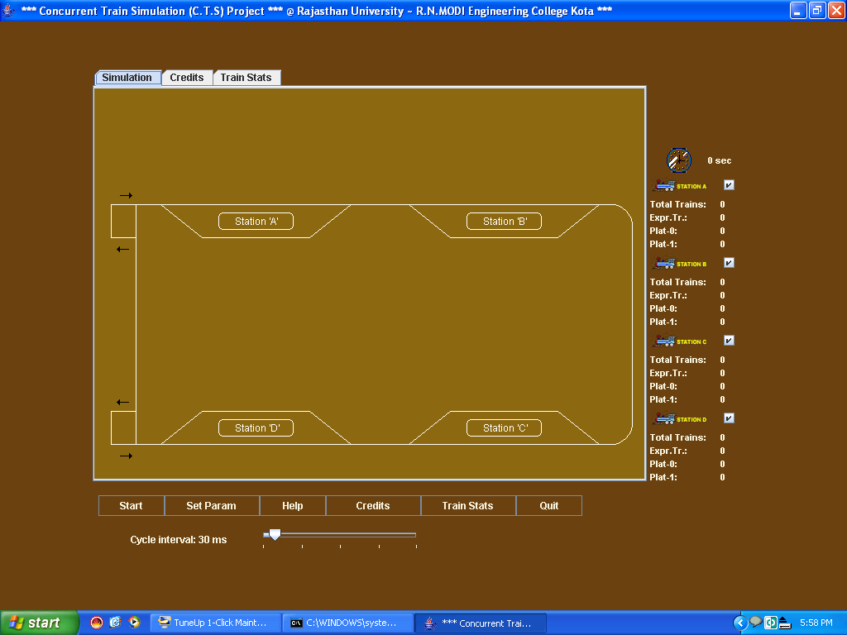
INTRODUCTION OF
“CTS SYSTEM”
CONCURENT TRAIN SIMULATION SYSTEM
“CTS SYSTEM”
CONCURENT TRAIN SIMULATION SYSTEM

Slide 3
WHY JAVA????
PLATFORM INDEPENDENT
SECURED IN NATURE
VIRUS FREE

Slide 4
BENEFITS OF
        “CTS SYSTEM”

Slide 5
FUTURE IMPLICATIONS

