Slide 1
Clothing Image Retrieval for Smarter Shopping
By :
Sonali Goyal
Charvi Sardana
Prithvi Deep Chawla

Slide 2
Motivation
The goal of this project is to use image processing to aid in shopping.
Our application allows the user to submit a photo of an article of clothing that they are interested in, and that will then return a list of similar items.
This helps the user explore their options and decide exactly what they want.
In addition, the techniques used in our application can further be expanded to other kinds of image retrieval.

Slide 3
Binarization
Binarization was important to our application, because multiple functions, such as extracting color features and outline descriptors, required a mask of the image.
Steps Of Binarization
Grayscale → Canny edge detection → Dilation → Fill
holes → Erase small regions → Erode
Since we assume that the background of the image is a mostly uniform light color, the edges detected will be the edges of the object and anything inside it. So, once we use edge to detect the Canny edges, we dilate the image to close up any gaps in the outline. We then use imfill to fill up any holes inside the object, bwareaopen to erase any small regions outside the object, and erode it back.

Slide 4
Search Method
Classify database images and main image into categories such as:
Women’s shoes
Men’s polo shirts
Calculate descriptors for each image (pre-
process databases for efficiency)
Descriptors based on the attributes:
Color
Texture
Features
Outline

Slide 5
Search Method
Calculate similarity scores for each attribute.
Weigh similarity scores, where weights are based on category.
Sum scores and output top matches.

Slide 6
Color
Convert pixels to CIELab space.
Group pixels based on hue,chroma and lightness
Sort groups,remove shadows
Select primary, secondary and decorative colors.
Compare via CIEDE2000

Slide 7
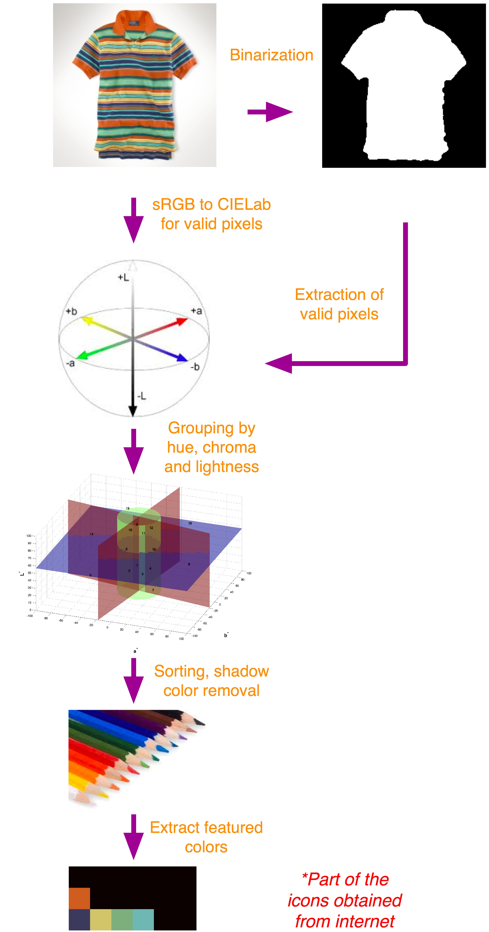

Slide 8
Texture
Take section from center of image.
Calculate Gabor filters of different frequencies and angles.
Convolve image with each one.
Calculate means and standard deviations
Compare via Euclidean distance.

Slide 9
Features
Use VLFeat’s SIFT bundle to extract features
Use VLFeat’s matching function using L2 norm.
Run RANSAC algorithm to remove non-affine transformation matches
Compare via number of matches

Slide 10
Outline
Binarize image
Trace perimeter.
Sample points and convert to complex numbers.
Take DFT of points.
Compare via Euclidean distance

Slide 11
Conclusion
The test results show that the system works well for most cases; however, some improvements are still necessary in working towards a reliable system.
Binarization, as the basis of the property detection, plays an important role in the system.
The binarization function works quite reliably except for those cases with a non-uniform background, for which the detection of edges is quite difficult.
The Gabor filter is generally useful in detecting the textures of clothing, but does not always return reliable information since texture is not necessarily equivalent to clothing design.
The outline detection is realized by using Fourier descriptors, which works very well.
The feature detection is based on SIFT, which has the advantage of scale invariance.

