Slide 1

Prediction Of PTSD Severity In Veterans
Project Guide: Dr.Mohamed Fathimal .P
Team Members:
Vishruthi A - 2022103022
Sonali Shruthi A - 2022103510
Sarashivasri S - 2022103520

Slide 2
INTRODUCTION
PTSD is a pervasive mental health condition that significantly impacts veterans' emotional, social, and physical well-being.
Traditional diagnostic methods often rely on subjective self-reports and clinical evaluations, which can lead to inconsistencies and delayed interventions.
To address these limitations, this project leverages diverse data sources, including medical records, psychological assessments, wearable sensor data, and self-reported symptoms, to build accurate, data-driven predictive models.
This project aims to predict the severity of Post-Traumatic Stress Disorder (PTSD) in veterans using machine learning (ML) techniques.
By employing high-accuracy ML algorithms, the project seeks to identify veterans at high risk of severe PTSD early, enabling timely and personalized treatment.
This approach has the potential to improve recovery outcomes, enhance quality of life, and reduce the overall burden of PTSD among veterans.

Slide 3
OBJECTIVE
To develop and implement a machine learning model that accurately predicts the severity of Post-Traumatic Stress Disorder (PTSD) in veterans by analyzing diverse data sources such as medical records, psychological assessments, wearable device data, and self-reported symptoms.
This prediction will enable healthcare providers to identify high-risk individuals early, facilitate timely intervention, and enhance personalized treatment plans, ultimately improving the recovery outcomes and quality of life for veterans
By identifying key patterns and risk factors associated with PTSD, the model enables early detection of high-risk individuals. This approach supports timely, personalized interventions, improving care quality and recovery outcomes for veterans.

Slide 4
LITERATURE SURVEY
Research Paper Title | Author(s) | Algorithms/Methods Used | Issues Encountered
1. Complex PTSD Symptom Clusters and Executive Function in UK Armed Forces Veterans: A Cross-Sectional Study | Natasha Biscoe, Emma New, Dominic Murphy | - Regression Analysis - Correlation Coefficients | - No specific issues mentioned in the study
2. A Quantitative Meta-Analysis of Neurocognitive Functioning in Posttraumatic Stress Disorder | Scott JC, Matt GE, Wrocklage KM, Crnich C, Jordan J, Southwick SM, et al | - Standardized Mean Differences (SMD) - Random Effects Model | - Variability among studies - Limited understanding of underlying mechanisms
3. Understanding the Needs of Veterans Seeking Support for Mental Health Difficulties | Murphy D, Busuttil W. | - Qualitative Analysis - Thematic Analysis | - Barriers to accessing care - Stigma and lack of awareness
4. ICD-11 Posttraumatic Stress Disorder (PTSD) and Complex PTSD (CPTSD) in Treatment-Seeking Veterans: Risk Factors and Comorbidity | Murphy D, Karatzias T, Busuttil W, Greenberg N, Shevlin M | - Descriptive Statistics - Logistic Regression | - High trauma exposure - Comorbid conditions complicating treatment
5. Co-occurring Chronic Pain and PTSD Among US Military Veterans: Prevalence, Correlates, and Functioning | Reed DE 2nd, Fischer IC, Williams RM, Na PJ, Pietrzak RH | - Descriptive Statistics - Logistic Regression | - Greater functional impairment due to co-occurrence

Slide 5
Research Paper Title | Author(s) | Algorithms Used | Issues Encountered
6. Cognitive Processing Therapy: A Meta-Analytic Review Among Veterans and Military Personnel with PTSD | Raines, A.M., Clauss, K., Schafer, K.M. et al | Meta-analytic techniques (standardized mean differences, random effects model) | Variability across studies, differences in delivery format (individual vs. group therapy), comorbid conditions
7. The International Trauma Questionnaire: Development of a Self-Report Measure of ICD-11 PTSD and Complex PTSD | Cloitre et al., 2018 M. Cloitre, M. Shevlin, C.R. Brewin, J.I. Bisson, N.P. Roberts, A. Maercker, T. Karatzias, P. Hyland | Factor analysis, reliability testing (Cronbach's alpha) | None reported
8. Psychometric properties of the PTSD checklist for dsm-5: A pilot study | J. Sveen, K. Bondjers, and M. Willebrand | Psychometric algorithms for reliability and validity analysis | Need for further validation in diverse clinical populations
9. Violence associated with combat-related posttraumatic stress disorder: The importance of anger. Psychological trauma: theory, research, practice, and policy | Novaco, R. W., & Chemtob, C. M. | Statistical methods | Challenge in isolating direct link between PTSD and violence; anger as a mediating factor
10. Suicide risk among 1.3 million veterans who were on active duty during the Iraq and Afghanistan wars | Kang, H. K., Bullman, T. A., Smolenski, D. J., Skopp, N. A., Gahm, G. A., & Reger, M. A. | Mortality data analysis, statistical methods | Difficulty in identifying specific causal factors for elevated suicide rates; need for targeted interventions for high-risk subgroups

Slide 6
Research Paper Title | Author(s) | Algorithms Used | Issues Encountered
11.The Effects of Alcohol Problems, PTSD, and Combat Exposure on Nonphysical and Physical Aggression Among Iraq and Afghanistan War Veterans | Cynthia A Stappenbeck, Julianne C Hellmuth, Tracy Simpson, Matthew Jakupcak | Regression analyses | No specific issues mentioned
12.Prevalence and Correlates of Alcohol Misuse among Returning Afghanistan and Iraq Veterans | I. Burnett-Zeigler et al. | Logistic regression | Alcohol misuse prevalence and correlates were complex to evaluate due to diverse factors impacting veterans.
13.Postdeployment Alcohol Use, Aggression, and Post-Traumatic Stress Disorder | J. M. Brown, J. Williams, R. M. Bray, and L. Hourani | Regression analyses | Complexity in understanding how alcohol and PTSD symptoms interact with aggression.
14.An Exploratory Examination of Risk-Taking Behavior and PTSD Symptom Severity in a Veteran Sample | Thad Q. Strom et al. | Correlation and regression analyses | Link between PTSD and risk-taking behaviors was not fully understood.
15.Psychometric Analysis of the PTSD Checklist-5 (PCL-5) among Treatment-Seeking Military Service Members | Jennifer H. Wortmann et al. | Confirmatory factor analysis, Reliability analyses | Validating the PCL-5 for military service members seeking treatment presented challenges.

Slide 7
Research Paper Title | Author(s) | Algorithms Used | Issues Encountered
16.Association of Predeployment Heart Rate Variability with Risk of Postdeployment PTSD in Active-Duty Marines | A. Minassian et al. | Logistic regression | Complex relationship between HRV and PTSD risk in Marines, with variability in outcomes.
17.Ecological Momentary Assessment of PTSD Symptoms and Alcohol Use in Combat Veterans | K. Possemato et al. | Mixed-effects models | The dynamic relationship between PTSD symptoms and alcohol use was complex and fluctuated over time.
18.The PTSD Checklist-Civilian Version: Reliability, Validity, and Factor Structure in a Nonclinical Sample | D. Conybeare, E. Behar, A. Solomon, M. Newman, and T. Borkovec | Factor analysis (exploratory, confirmatory) | Difficulty in establishing the factor structure due to varying PTSD symptoms in nonclinical populations.
19.An Alternative Evaluation of PTSD with Machine Learning Methods | S. I. Omurca and E. Ekinci | Decision Trees, Support Vector Machines (SVM), Random Forests | Machine learning algorithms yielded high accuracy but posed challenges in interpretability and data variability.
20.Adolescent Violence and Unintentional Injury in the United States | National Center for Children in Poverty (NCCP) | Not detailed in report | Complex risk factors related to socio-economic status, mental health, and community violence needed addressing.

Slide 8
LIST OF MODULES
1. Data Processing Modules
NumPy: For numerical computations.
Pandas: For data manipulation and preprocessing.
scikit-learn.preprocessing: For standardization, normalization, and encoding of features.
2. Machine Learning Algorithms
scikit-learn: For models like Logistic Regression, Support Vector Machines (SVM), Random Forest, Gradient Boosting, and Extremely Randomized Trees.
XGBoost: For eXtreme Gradient Boosting.
CatBoost: For efficient handling of categorical data and boosting tasks.
AdaBoost: For boosting weak learners.
3. Evaluation and Metrics
scikit-learn.metrics: For accuracy, precision, recall, F1 score, and confusion matrix calculations.

Slide 9
4. Visualization
Matplotlib: For data and result visualization.
Seaborn: For advanced statistical plotting.
5. Data Splitting and Validation
scikit-learn.model_selection: For train-test split, cross-validation, and hyperparameter tuning.
6. Data Cleaning and Handling Missing Data
scikit-learn.impute: For handling missing values.
7. Feature Engineering
scikit-learn.feature_selection: For selecting important features.
8. Data Scaling
scikit-learn.preprocessing.StandardScaler: For scaling data.

Slide 10
IMPLEMENTATION DETAILS
DATA PREPROCESSING
CATEGORICAL TO NUMERICAL VALUES
The process involves converting categorical data in a dataset into numerical formats to facilitate analysis and machine learning.
Initially, a ranking dictionary is created to assign numerical ranks to PTSD diagnostic measures based on their significance.
This mapping is applied to the 'Diagnostic Measure' column and a few others. Following that, some other categorical columns are identified and encoded using the ‘LabelEncoder’ from scikit-learn, which transforms unique categories into integers.
NORMALIZATION
Normalization is a preprocessing technique used to scale numeric data to a standard range, typically between 0 and 1.
This ensures that all features contribute equally to the analysis or machine learning process, preventing any one feature from dominating due to its scale.
The process involves importing a dataset, identifying the numeric columns, and applying Min-Max normalization to adjust their values.
The normalized dataset is then saved to a new CSV file, ensuring that the numeric features are appropriately scaled for further analysis or modeling.

Slide 11
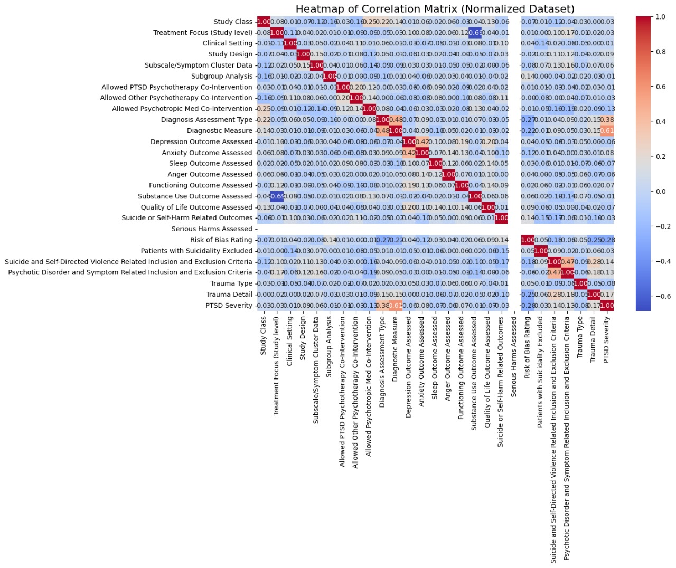
FEATURE SELECTION : CORRELATION MATRIX- HEATMAP

Slide 12
DATASET DESCRIPTION
The US Veteran dataset comprises a diverse range of features relevant to PTSD studies and outcomes, focusing on clinical and diagnostic attributes.
It includes categorical variables such as study class, treatment focus, clinical setting, and trauma type, alongside quantitative measures like subgroup analysis and various outcome assessments (e.g., depression, anxiety, sleep, anger, functioning, substance use, and quality of life).
Other fields include diagnostic tools, risk of bias ratings, inclusion/exclusion criteria for suicidality and psychotic disorders, and PTSD severity levels.
These features enable comprehensive analysis of PTSD treatment efficacy and patient outcomes, facilitating machine learning models to predict PTSD severity and identify key influencing factors.

Slide 13
Column Name | Description
Study Class | Type of intervention (e.g., psychotherapy, pharmacotherapy) used for PTSD treatment.
Treatment Focus (Study Level) | Focus of the treatment (e.g., PTSD alone or with co-occurring conditions like SUD).
Clinical Setting | Environment where PTSD treatment was given (e.g., outpatient, inpatient).
Study Design | Type of study design (e.g., RCT, cohort study).
Subscale/Symptom Cluster Data | Data on specific PTSD symptom clusters (e.g., intrusion, avoidance).
Subgroup Analysis | Whether the study included subgroup analyses (e.g., by age, gender).
Allowed PTSD Psychotherapy Co-Intervention | Whether other PTSD psychotherapies were allowed alongside the main treatment.

Slide 14
Column Name | Description
Allowed Other Psychotherapy Co-Intervention | Whether non-PTSD psychotherapies were allowed during the study.
Allowed Psychotropic Med Co-Intervention | Whether psychotropic medications were allowed as co-interventions.
Diagnosis Assessment Type | Type of diagnostic assessment used (e.g., interviews, questionnaires).
Diagnostic Measure | Specific diagnostic tool used to assess PTSD (e.g., CAPS, SCID).
Diagnostic Measure Detail | Details about the diagnostic tool used (e.g., version, criteria).
Depression Outcome Assessed | Whether depression outcomes were measured in the study.
Anxiety Outcome Assessed | Whether anxiety outcomes were measured in the study.
Sleep Outcome Assessed | Whether sleep disturbances were assessed in the study.
Anger Outcome Assessed | Whether anger was assessed as an outcome in the study.

Slide 15
:
Column Name | Description
Functioning Outcome Assessed | Whether functional outcomes (e.g., social, occupational) were measured.
Substance Use Outcome Assessed | Whether substance use outcomes were assessed.
Quality of Life Outcome Assessed | Whether quality of life was assessed in the study.
Suicide or Self-Harm Related Outcomes | Whether suicide or self-harm outcomes were measured.
Serious Harms Assessed | Whether serious harms (e.g., adverse effects) were measured.
Risk of Bias Rating | Rating of the risk of bias in the study’s methodology.
Patients with Suicidality Excluded | Whether patients with suicidality were excluded from the study.
Suicide and Self-Directed Violence Related Inclusion and Exclusion Criteria | Criteria for including or excluding participants based on suicide risk.
Psychotic Disorder and Symptom Related Inclusion and Exclusion Criteria | Whether participants with psychotic disorders were excluded.
Trauma Type | Type of trauma experienced by participants (e.g., combat, sexual assault).
Trauma Detail | Additional details about the trauma (e.g., nature, duration).
PTSD Severity | The level of PTSD severity in the participants (e.g., low, medium, high).

Slide 16
Summary Of Issues
Complex Interactions Between Variables
Difficulty understanding how co-occurring factors like PTSD, alcohol misuse, aggression, and combat exposure interact dynamically (Papers 1, 11, 13, 17).
Statistical and Analytical Limitations
Complex statistical relationships, such as mediation and moderation effects, were hard to disentangle in multi-variable contexts (Papers 5, 6, 11, 14).
Variability in outcomes and dynamic behaviors (e.g., alcohol misuse and PTSD symptoms over time) added to analytical complexity (Paper 17).
Challenges in Validating and Adapting Tools
Adapting psychometric tools like the PTSD Checklist (PCL-5) and its variants to specific populations (e.g., veterans, civilians, treatment-seeking individuals) posed challenges in ensuring reliability and validity (Papers 2,15, 18).
Data Collection and Measurement Issues
Challenges in obtaining accurate, real-time data for ecological momentary assessments (Papers 17).
Difficulty in measuring physiological predictors like heart rate variability and their predictive power (Paper 16).

Slide 17
Behavioral Complexity
Identifying and linking patterns of risk-taking, aggression, and impulsivity with PTSD severity (Papers 4, 13, 14).
Capturing and analyzing multifaceted behavioral responses to trauma (Papers 1, 11, 19).
Algorithm and Machine Learning Challenges
Integrating machine learning models like decision trees, random forests, and SVMs faced issues of interpretability and handling diverse data features (Papers 7, 19).
Context-Specific Challenges
Addressing unique risk factors such as socio-economic influences and community violence in adolescent populations (Paper 20).
Adjusting interventions to fit the needs of active-duty military personnel vs. civilians (Papers 3, 12, 16).
Intervention and Treatment Gaps
Limited understanding of how to develop integrated treatment strategies for co-occurring issues like PTSD, aggression, and substance misuse (Papers 11, 13).
Identifying effective prevention methods for long-term well-being (Paper 20).

Slide 18
OVERALL ARCHITECTURE
1. Data Collection Layer
Sources:
Medical Records
Psychological Assessments
Wearable Device Data
Self-Reported Symptoms
Purpose:
Gather diverse and comprehensive data on veterans to analyze PTSD severity.
2. Data Preprocessing Layer
Steps:
Normalization: Min-Max scaling for numerical features.
Categorical Encoding: Conversion of categorical variables to numerical formats using Label Encoding and custom mappings.
Feature Selection: Identification of significant features via correlation analysis and heatmaps.

Slide 19
3. Machine Learning Layer
Algorithms:
High-Performance Models:
Random Forest
CatBoost
XGBoost
Gradient Boosting
Baseline Models:
Logistic Regression
Naive Bayes
SVM
KNN
Clustering Algorithm: K-Means for exploratory data analysis (not for prediction).
Training:
Train models on processed data using training splits.
Evaluate performance using cross-validation and metrics.
Evaluation Metrics:
Accuracy, Precision, Recall, F1-Score.

Slide 20
4. Prediction Layer
Input:
Data from veterans (real-time or batch).
Output:
PTSD severity levels (e.g., Low, Medium, High).
5. Model Evaluation and Comparison
Steps:
Generate confusion matrices for all models.
Compare models based on evaluation metrics.
Select the best-performing model for deployment (Random Forest and CatBoost in this case).
6. Deployment Layer
Environment:
Deploy selected model(s) in clinical settings.
Interfaces:
User-friendly dashboard for healthcare professionals.
API for integration with medical record systems.

Slide 21
7. Intervention Support Layer
Integration:
Alerts for high-risk individuals.
Suggestion of personalized treatment plans based on predictions.
Feedback Loop:
Update model with new data to improve prediction accuracy over time.
8. Visualization and Reporting
Tools:
Dashboards and visualizations for interpreting predictions.
Reports:
Generate detailed patient profiles and risk factors for PTSD.
9. Future Enhancement Layer
Focus Areas:
Hybrid model development.
Incorporation of additional data sources.
Use of explainable AI techniques for better interpretability.

Slide 22
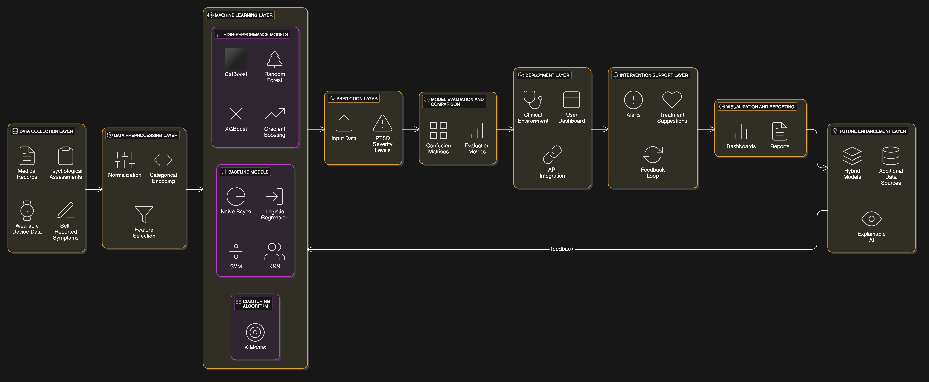
ARCHITECTURE DIAGRAM:

Slide 23
PERFORMANCE MEASURES Performance measures utilized for evaluation of the following:
Prediction of PTSD Severity: The performance measures assess the model's ability to accurately classify PTSD severity levels (e.g., High, Medium, Low) based on input features.
Model Comparisons: Performance metrics allow for comparing different models (e.g., Logistic Regression, Random Forest, SVM) to determine which performs best for your dataset.
Feature Impact: Indirectly, evaluation metrics can reflect how well the selected features contribute to accurate predictions.

Slide 24


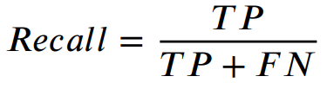
Accuracy:
Evaluates the proportion of correctly classified instances (e.g., severity levels: High/Medium/Low).
Suitable for overall performance comparison across models.
Precision:
Measures how many predicted positive cases were actual positives.
Useful if the focus is on minimizing false positives (e.g., ensuring accurate high-risk PTSD predictions).
Recall (Sensitivity):
Measures how many actual positive cases were correctly predicted.
Crucial for identifying all cases of high-severity PTSD (reducing false negatives).

Slide 25

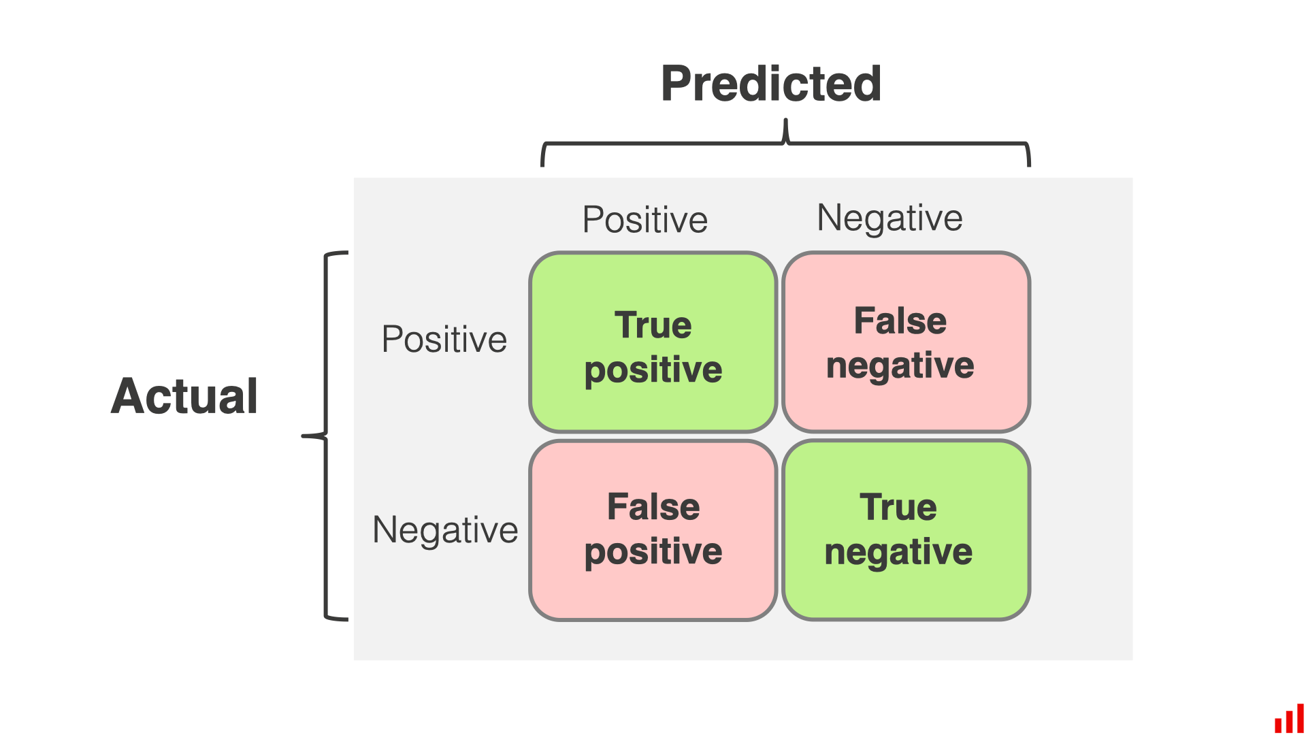
F1-Score:
Harmonic mean of Precision and Recall.
Useful when there is a class imbalance (e.g., if one PTSD severity class dominates the dataset).
Confusion Matrix:
Provides a breakdown of true positives, true negatives, false positives, and false negatives for each class.
Helps identify which classes are misclassified and where improvements are needed.

Slide 26
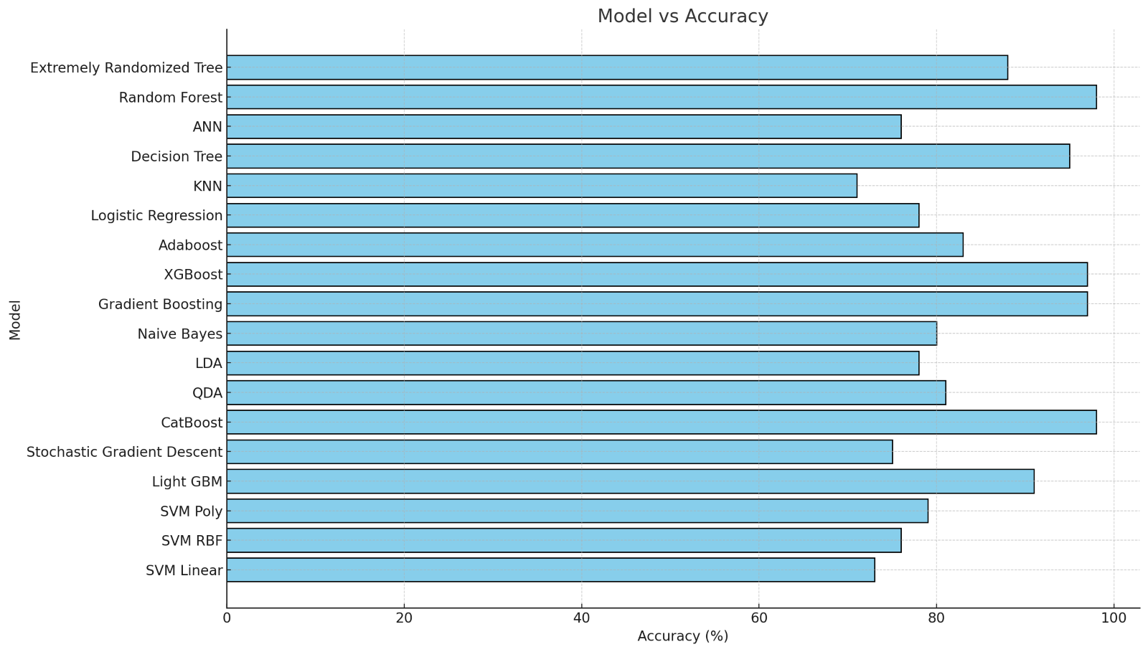
ALGORITHMS USED & ACCURACY:

Slide 27
REFERENCES
Biscoe, N., New, E. & Murphy, D. Complex PTSD symptom clusters and executive function in UK Armed Forces veterans: a cross-sectional study. BMC Psychol 12, 209 (2024). https://doi.org/10.1186/s40359-024-01713-w
Scott JC, Matt GE, Wrocklage KM, Crnich C, Jordan J, Southwick SM, et al. A quantitative meta-analysis of neurocognitive functioning in posttraumatic stress disorder. Psychol Bull. 2015;141(1):105–40.
Murphy D, Busuttil W. Understanding the needs of veterans seeking support for mental health difficulties. BMJ Mil Health. 2020 Aug;166(4):211-213. doi: 10.1136/jramc-2019-001204. Epub 2019 Apr 29. PMID: 31036746.
Murphy D, Karatzias T, Busuttil W, Greenberg N, Shevlin M. ICD-11 posttrau-matic stress disorder (PTSD) and complex PTSD (CPTSD) in treatment seeking veterans: risk factors and comorbidity. Soc Psychiatry Psychiatr Epidemiol. 2021;56(7):1289–98.
Reed DE 2nd, Fischer IC, Williams RM, Na PJ, Pietrzak RH. Co-occurring Chronic Pain and PTSD Among US Military Veterans: Prevalence, Correlates, and Functioning. J Gen Intern Med. 2024 Aug;39(11):2009-2016. doi: 10.1007/s11606-024-08803-w. Epub 2024 May 23. PMID: 38780882; PMCID: PMC11306465

Slide 28
I. Burnett-Zeigler et al., “Prevalence and correlates of alcohol misuse among returning Afghanistan and Iraq Veterans,” Addict. Behav., vol. 36, no. 8, pp. 801–806, 2011.
J. M. Brown, J. Williams, R. M. Bray, and L. Hourani, “Postdeployment Alcohol Use, Aggression, and PostTraumatic Stress Disorder,” Mil. Med., vol. 177, no. 10, pp. 1184–1190, 2012.
Wortmann, Jennifer H. et al. 2016. “Psychometric Analysis of the PTSD Checklist-5 (PCL-5) among Treatment-Seeking Military Service Members.” Psychological Assessment 28(11): 1392–1403.
K. Possemato et al., “Ecological Momentary Assessment of PTSD Symptoms and Alcohol Use in Combat Veterans,” Psychol. Addict. Behav., vol. 29, no. 4, pp. 894–905, 2015.
S. I. Omurca and E. Ekinci, “An alternative evaluation of post traumatic stress disorder with machine learning methods,” INISTA 2015 - 2015 Int. Symp. Innov. Intell. Syst. Appl. Proc., no. Ml, 2015.
“NCCP | Adolescent Violence and Unintentional Injury in the United States.” [Online]. Available: http://www.nccp.org/publications/pub_890.html. [Accessed: 26-May-2020].
D. Conybeare, E. Behar, A. Solomon, M. Newman and T. Borkovec, "The PTSD Checklist-Civilian Version: Reliability, Validity, and Factor Structure in a Nonclinical Sample", Journal of Clinical Psychology, vol. 68, no. 6, pp. 699-713, 2012.

