Slide 1
STOCK PRICE PREDICTION USING MACHINE LEARNING
Guided By: Srinivasa K G
Date: 09/07/2022
Eshita Pradhan (211000018)
Riya Yadav (211000047)
Sonali Tudu (211000056)
International Institute of Information Technology, Naya Raipur

Slide 2
Contents
Introduction
Objectives
Tool & Technologies
LSTM
Proposed Work
Dataset
Dataset Analysis
Training and Testing data
Preprocessing
Result
11. Conclusion
12. Future Scope

Slide 3
Introduction
The Stock Market has been very successful in attracting people from various backgrounds be it educational or business .
Ability to predict the future stock prices accurately is crucial job for market dealers or investors.
People often look for tools or methods that would minimize their risks and maximize their profits and hence the stock price prediction takes on an influential role in the ever challenging stock market business.

Slide 4
Objectives
A stock market prediction is described as an action of attempting to classify the future value of the company stock or other financial investment traded on the stock exchange.
The forthcoming price of a stock of the successful estimation is called the Yield significant profit.
This helps to invest wisely for making good profits.

Slide 5
Tool & Technologies
Python - powerful tools ready for scientific computing packages.
Numpy - provide scientific and higher level mathematical abstractions.
Scikit learn - numerous classification, clustering and regression algorithms.
Keras - Supports each recurrent networks and convolutional networks.

Slide 6
4. Pandas - used for data analysis and associated manipulation of tabular data in data frames.
5. Matplotlib - graphical plotting library for Python and its numerical extension NumPy.
Jupyter - include: data , data visualization, data transformation, statistical modelling, machine learning, numerical simulation, data cleaning and much more.

Slide 7
Long short term memory
It is a variety of recurrent neural networks (RNNs) that are capable of learning long-term dependencies, especially in sequence prediction problems.
LSTM has a chain organization that contains four neural networks and different memory blocks called cells.
The memory cell makes the decisions about what information to store, and when to allow reading, writing and forgetting.

Slide 8
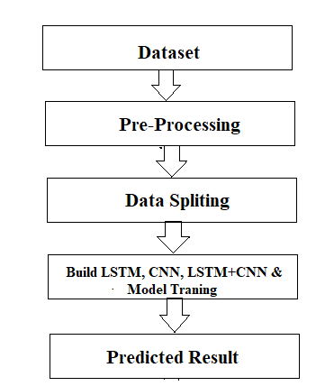
Proposed Work

Slide 9
Data Set
The dataset consists of the stock historical data from the National stock exchange (NSE) and captures the daily information of each stock from the National Stock Exchange.
We took the historical dataset of AAPL from yahoo finance.

Slide 10
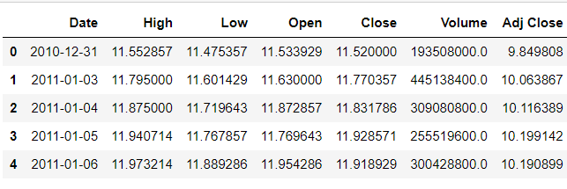
Data Set Analysis
It shows the dataset information table.

Slide 11
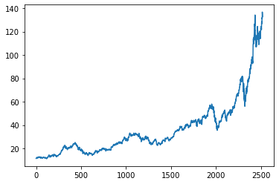
Closing Price vs time graph

Slide 12
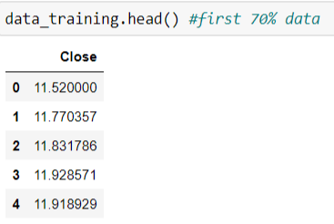
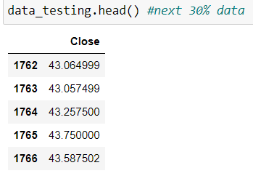
Training and Testing data
Splitting data into 70 % of training and 30% of testing data

Slide 13
Preprocessing
We used Min-Max Scaler to preprocess the dataset. In preprocessing operation removes the noise into the data and convert data into 0 to 1 form.
array([[0.00787282],
[0.01549552],
[0.01736587],
...,
[0.95569915],
[0.9593528 ],
[0.94527085]])

Slide 14
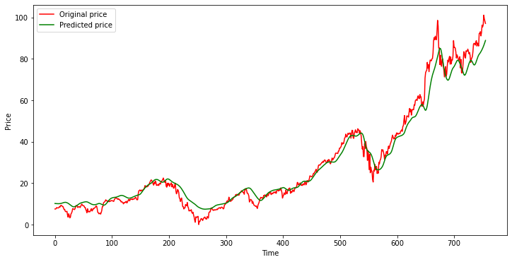
Result
Graph between Predicted price and original price

Slide 15
Conclusion
In report, we use machine learning models LSTM model,s to predict the stock future value. This is shows the proposed method is capable to distinctive around interrelation with the data.
Also, it is evident from the results that,LSTM model is capable to identify the changes in trends.

Slide 16
Future Scope
In future work, we add more stock market data and compare more model to improve accuracy of predicted stock price.
In the future, for better accuracy model can be trained with more varied and detailed data. Also, other algorithms along with proposed can be used to create a new hybrid model.

Slide 17

Thank You
..
Dr. Shyama Prasad Mukherjee International Institute of Information Technology, Naya Raipur

