Slide 1
Docker Assignment
Sonali Kumari (1622)

Slide 2
Create a Jenkins pipeline to deploy application present at: https://github.com/knoldus/node-hello

Slide 3
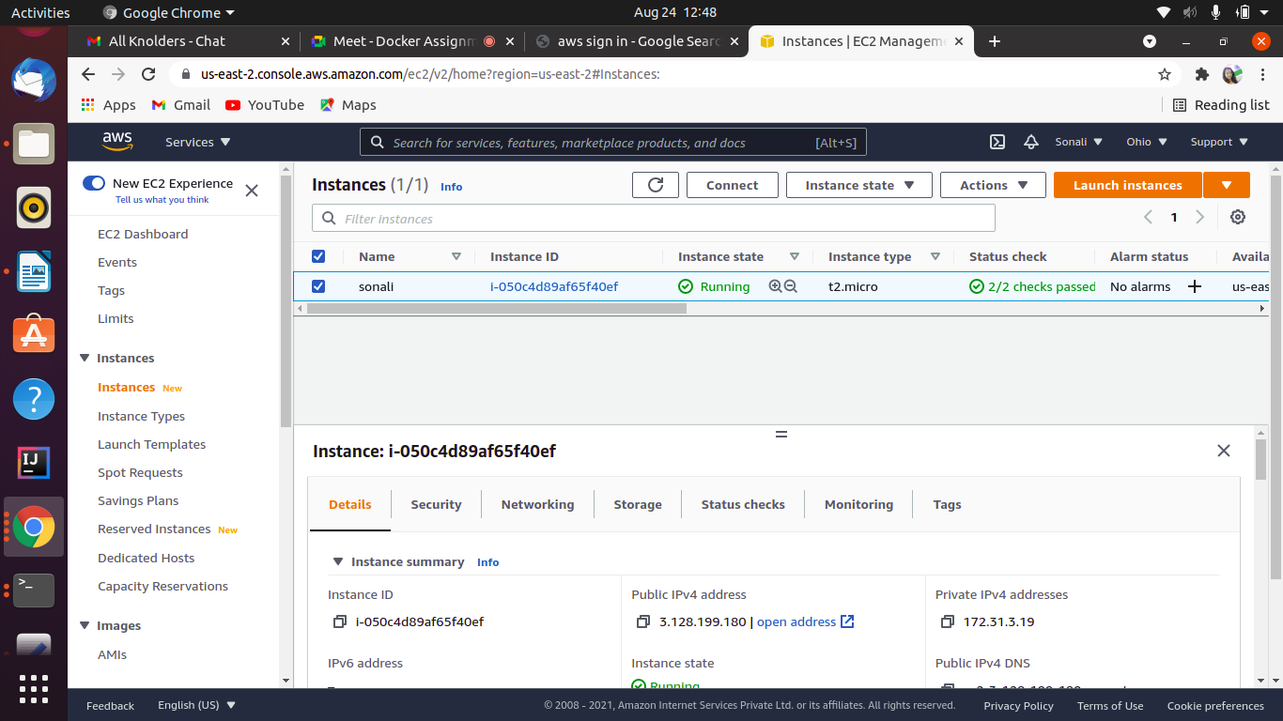

Slide 4
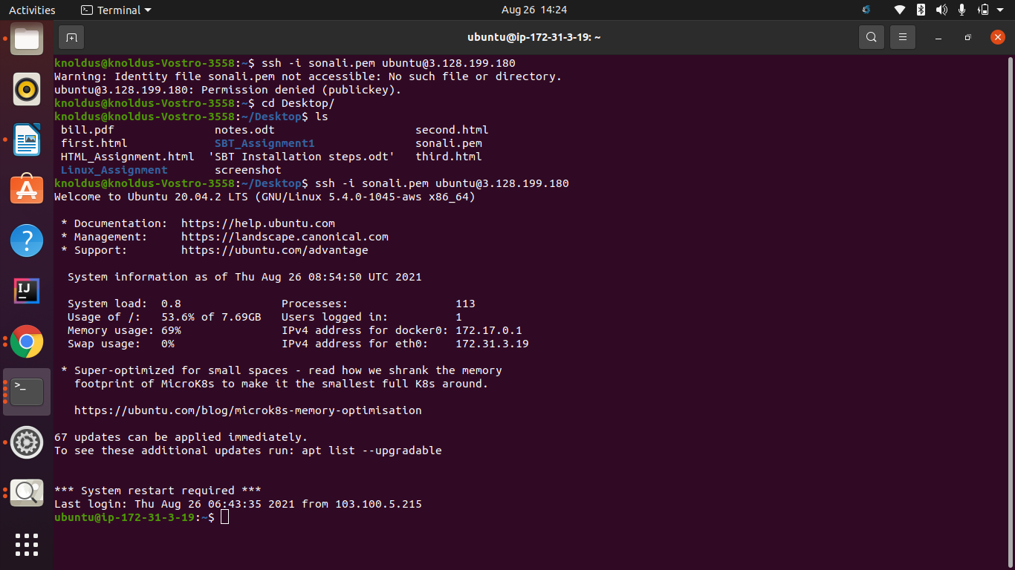

Slide 5
Required command to run the application and the ports being used are present in the Github repository.

Slide 6
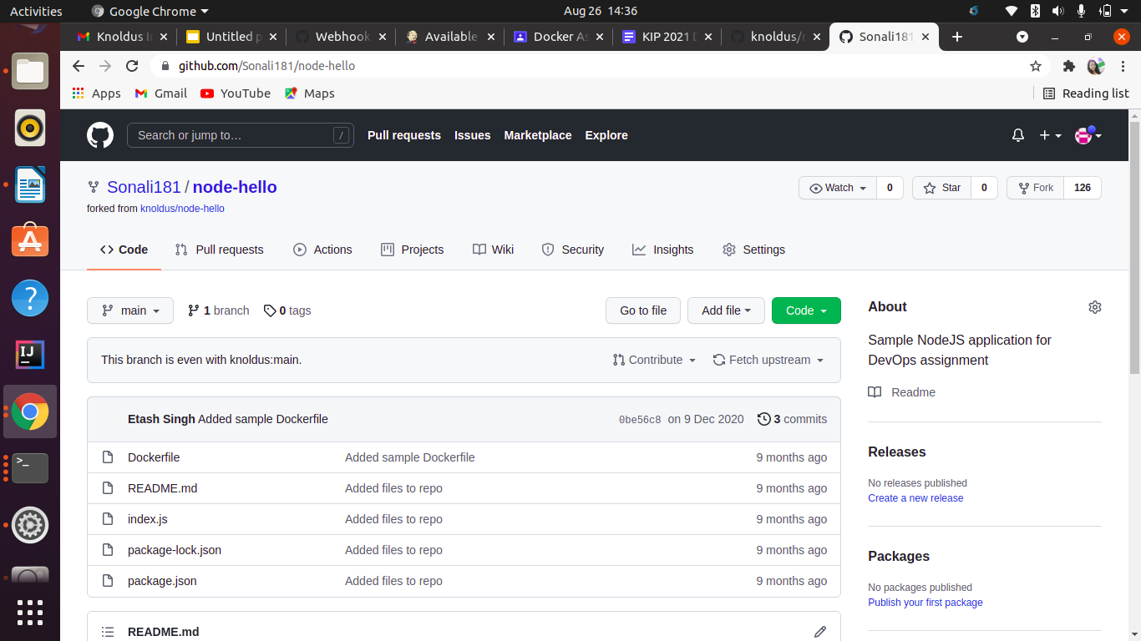

Slide 7
The application should be containerized and should be running on Docker.

Slide 8
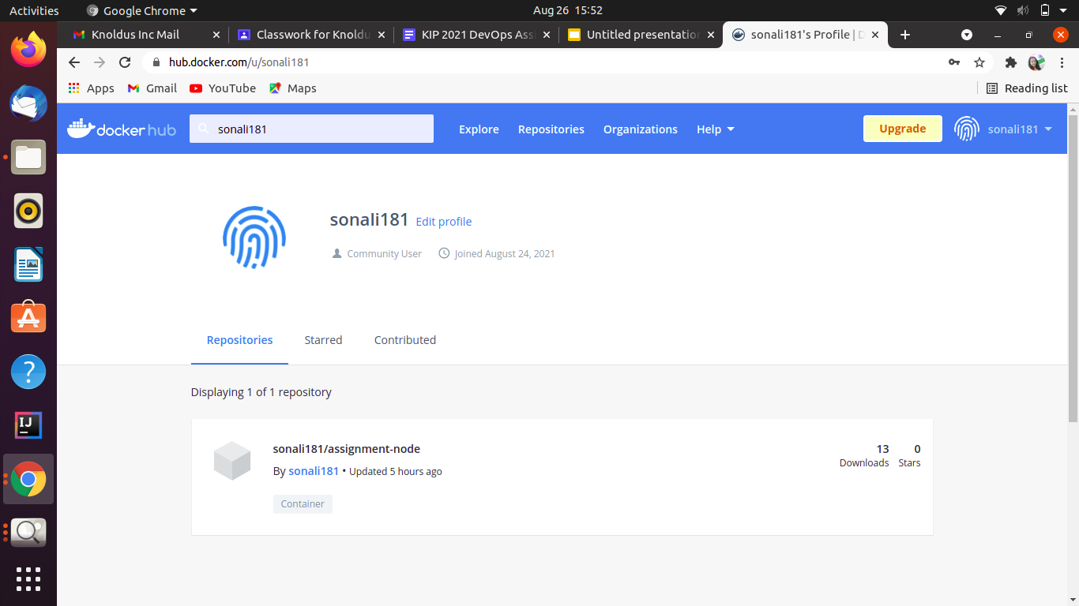

Slide 9
The image has to be pushed on
DockerHub
and should be pulled for running.

Slide 10
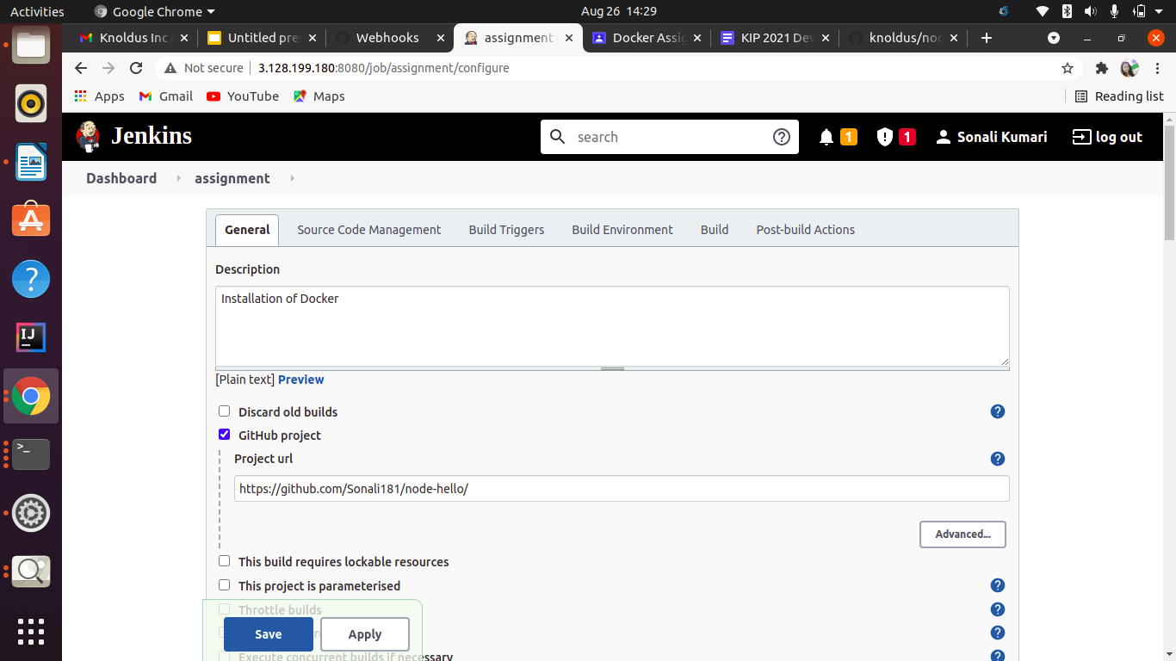

Slide 11
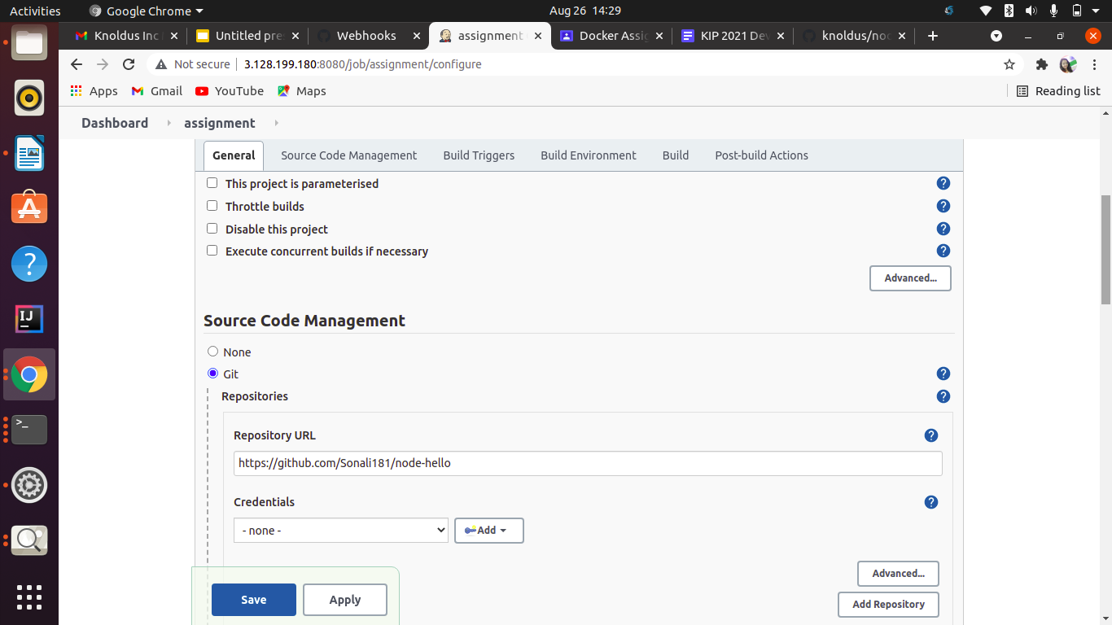

Slide 12
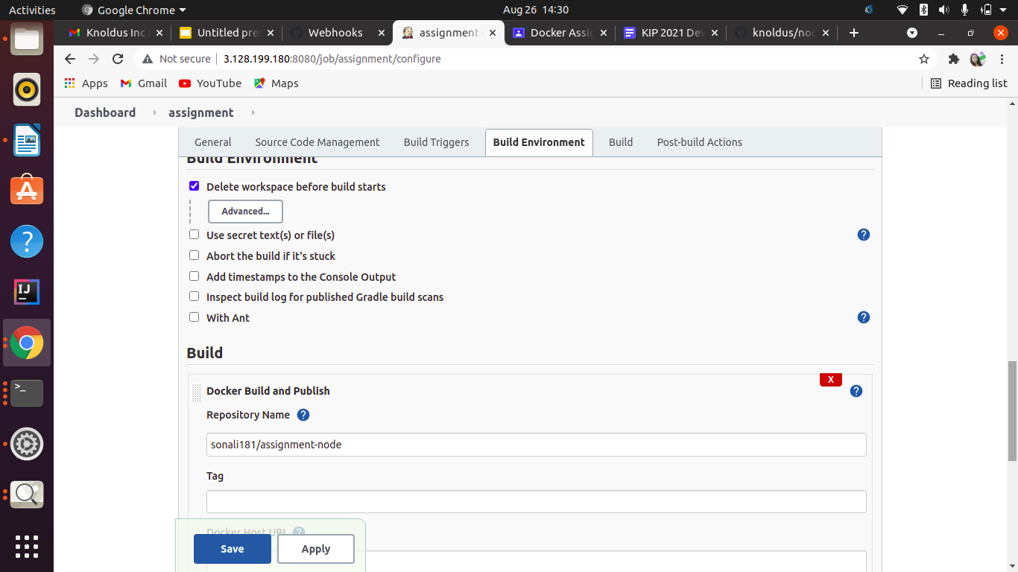

Slide 13
The ports of the application should be open for communication and accept connection on the host machine.

Slide 14
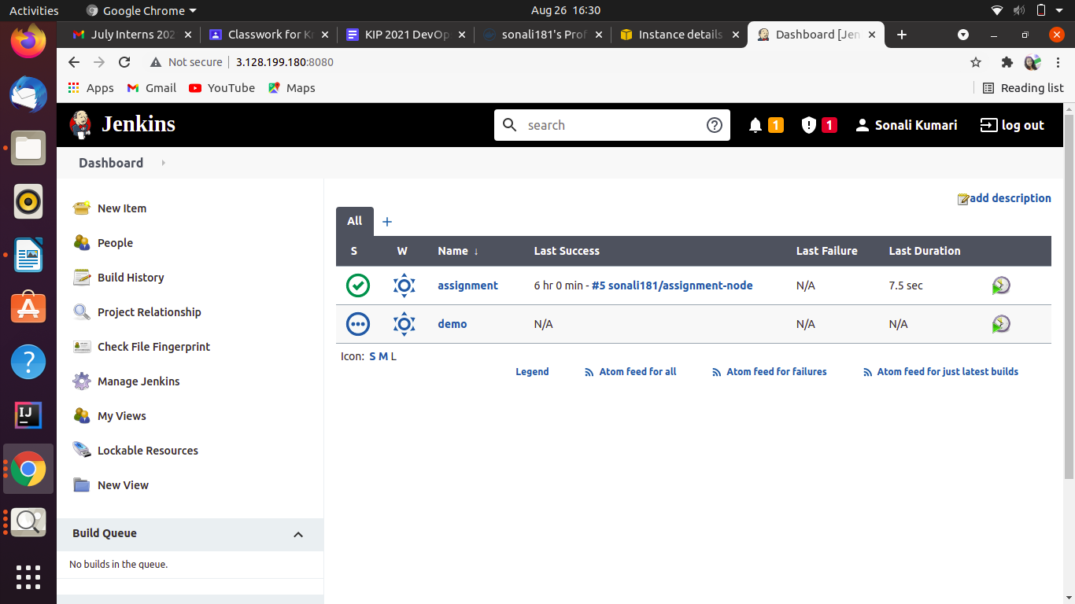

Slide 15
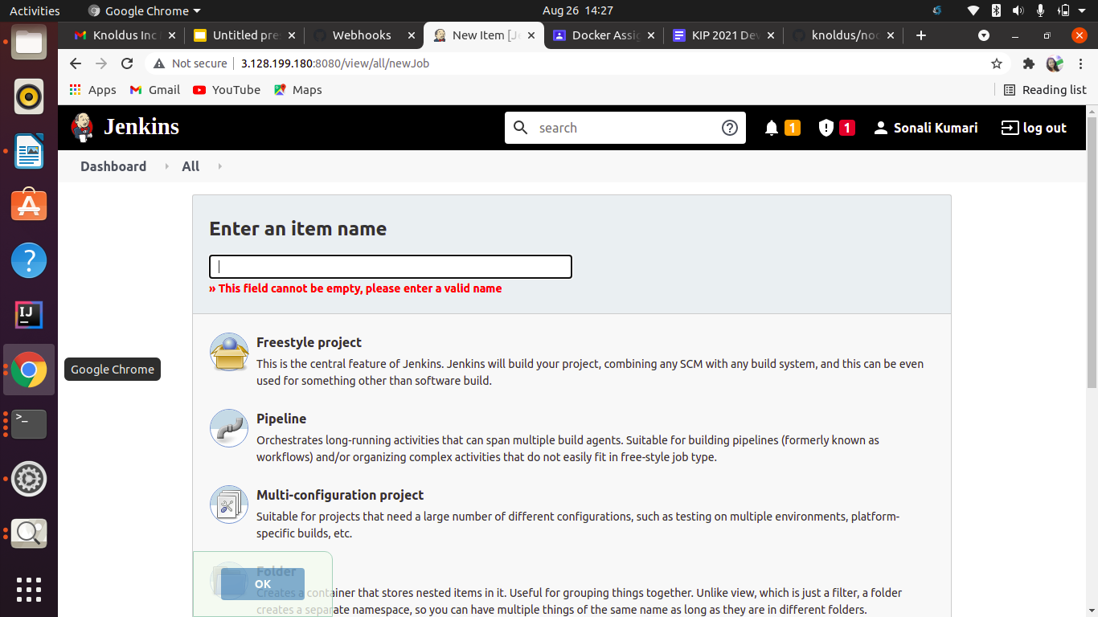
Use any type of Jenkins project.

Slide 16
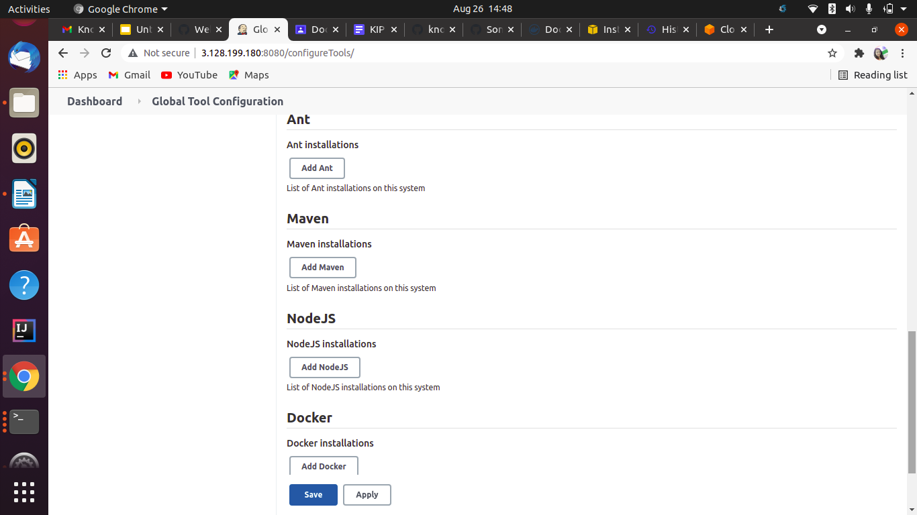
Implement use of Global Tools Configuration to use NodeJS effectively

Slide 17
Requirements:
Jenkins should be set up on a Cloud Virtual Machine and not from the local system
Any commits to the ‘main’ branch should trigger the job on Jenkins and start the build process
Use Github webhooks to trigger builds
The first part of the Jenkins job should be creating the package
The second part of the Jenkins job will be to send the package to another VM and run it there

Slide 18
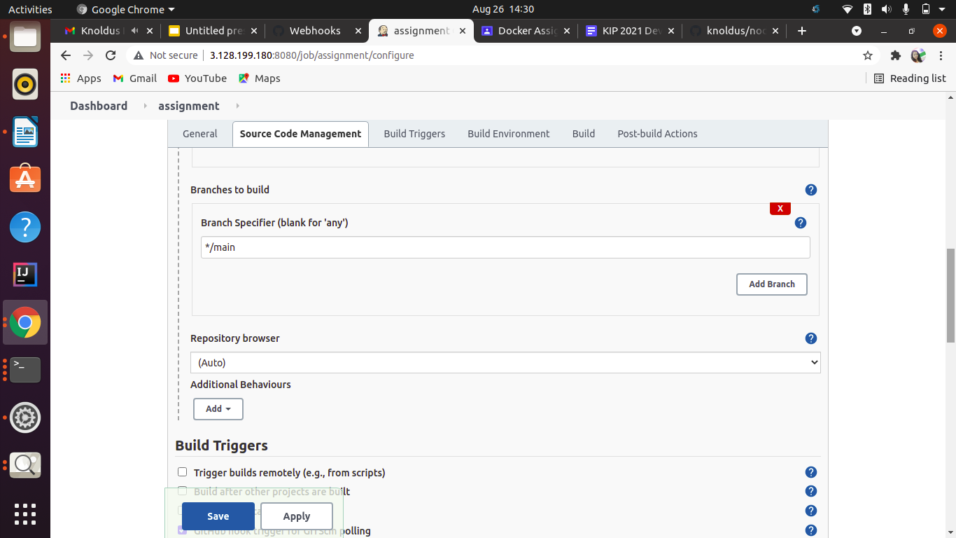

Slide 19
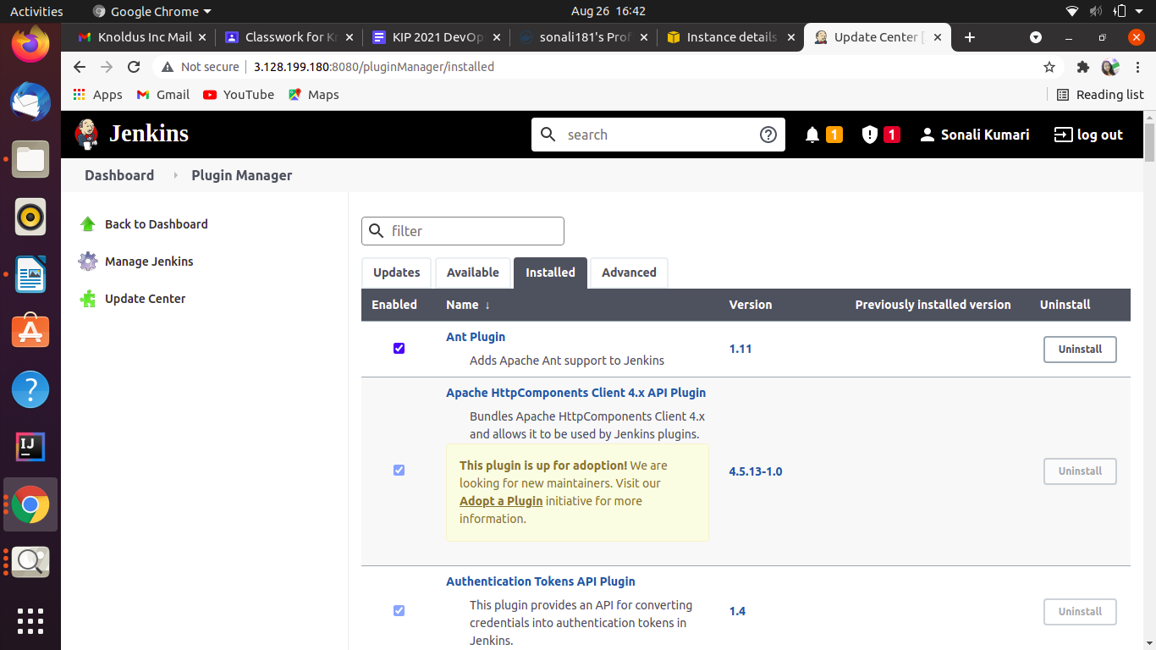

Slide 20
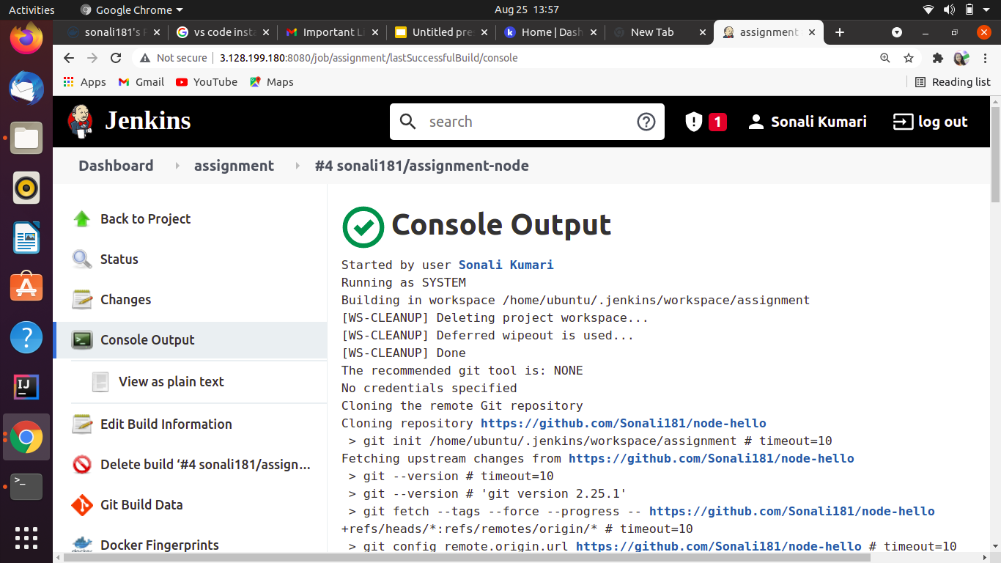

Slide 21
The validations can be performed by hitting endpoints: <VM_IP>:3000 or <VM_IP>:3001

Slide 22
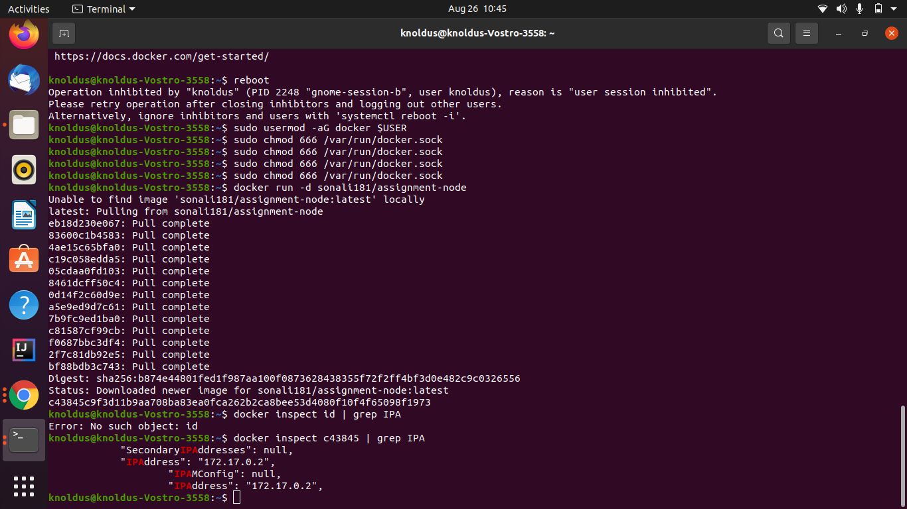

Slide 23
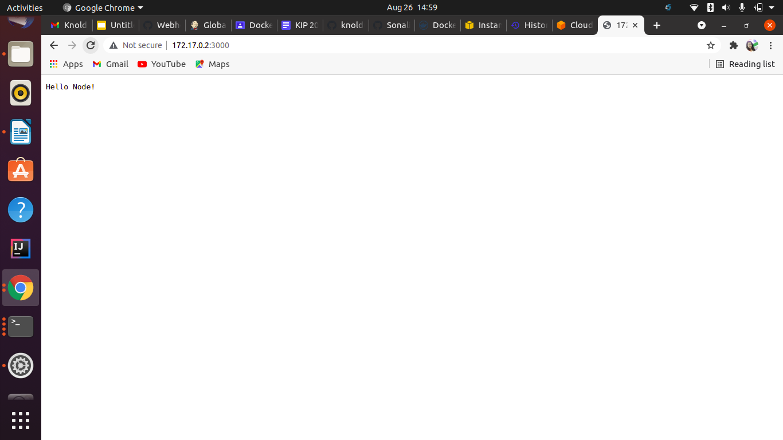

Slide 24
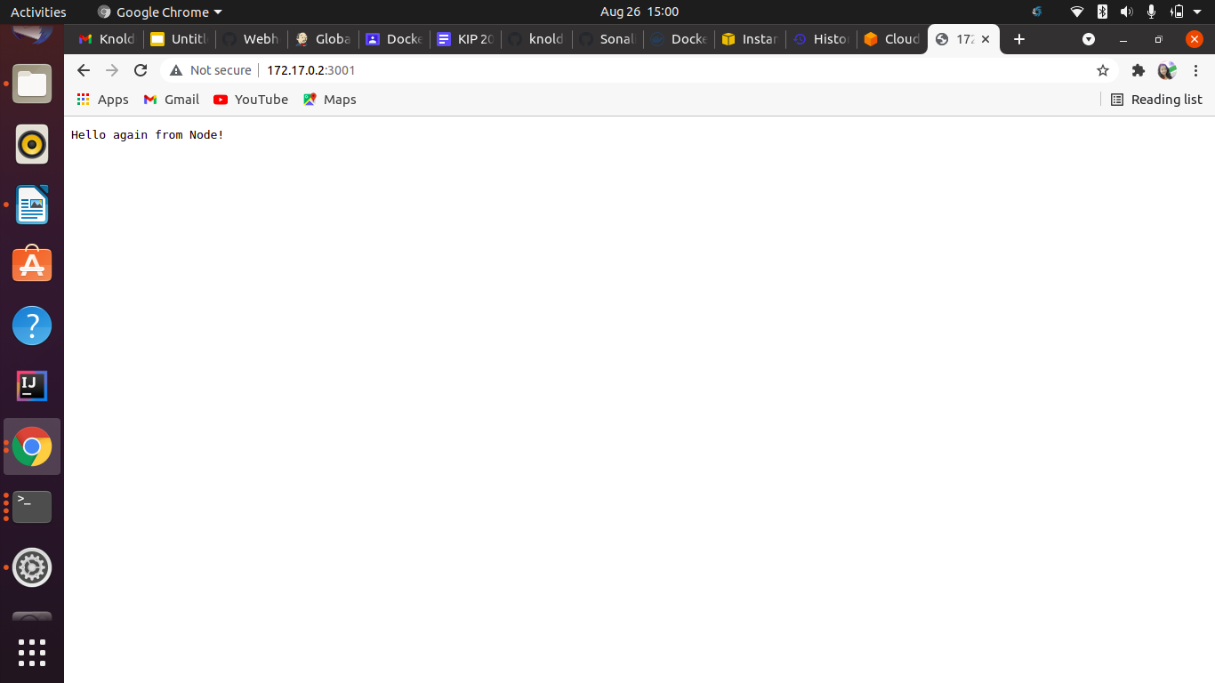

Slide 25
Thank you

