Slide 1

Startups Success Prediction

Slide 2

Startup
Startups are young companies founded by entrepreneurs to develop and innovate new products or services.
They play a vital role in driving economic growth and fostering innovation.

Slide 3
Key Components of a Startup
1
Innovative Idea 💡
2
Market Analysis and Product Validation 📈
3
Funding and Investment Opportunities 💰
A successful startup begins with a unique and disruptive idea that solves a problem or meets a need in the market.
Thoroughly analyzing the market and validating the product ensures product-market fit and increases the chances of success.
Securing funding is crucial for the growth and sustainability of startups. Investment opportunities can fuel innovation and expansion.

Slide 4

Challenges Faced by Startups
1
Limited Resources and Budgets 📉
2
Competition in the Market 🏢
3
Scaling and Growth Challenges 📈
Startups often face resource constraints and limited budgets, which require efficient allocation and creative solutions.
The competitive landscape is fierce, and startups must differentiate themselves to gain market share and attract customers.
As startups grow, they encounter various challenges such as scaling operations, managing teams, and maintaining profitability.

Slide 5
Strategies for Startup Success
Building a Strong Team 👥
Effective Marketing and Branding 📣
Continuous Learning and Adaptation 📚
Assembling a talented and diverse team is crucial for a startup's success. Each team member should bring unique skills and align with the company's vision.
Creating a compelling brand story and implementing effective marketing strategies helps startups to attract customers and gain market traction.
Startups must embrace a culture of learning, adapt quickly to market changes, and iterate their products based on customer feedback.

Slide 6



Successful Startups
Airbnb
Uber
Tesla

Slide 7
Aim
To develop a machine learning model for predicting startup success.

Slide 8
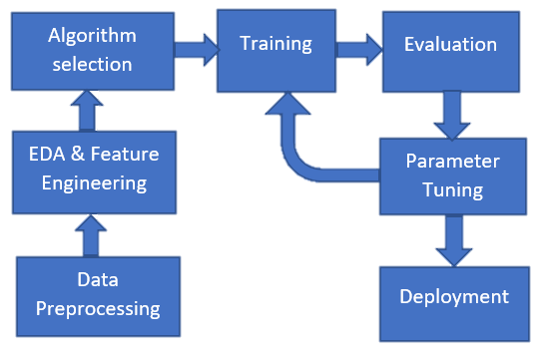
Methodology
Data
Collection

Slide 9
About data
The data contains industry trends, investment insights and individual company information. There are 48 columns/features. Some of the features are:
age_first_funding_year – quantitative
age_last_funding_year – quantitative
relationships – quantitative
funding_rounds – quantitative
funding_total_usd – quantitative
milestones – quantitative
age_first_milestone_year – quantitative
age_last_milestone_year – quantitative
state – categorical
industry_type – categorical
has_VC – categorical
has_angel – categorical
has_roundA – categorical
has_roundB – categorical
has_roundC – categorical
has_roundD – categorical
avg_participants – quantitative
is_top500 – categorical
status(acquired/closed) – categorical (the target variable, if a startup is ‘acquired’ by some other organization, means the startup succeed)

Slide 10
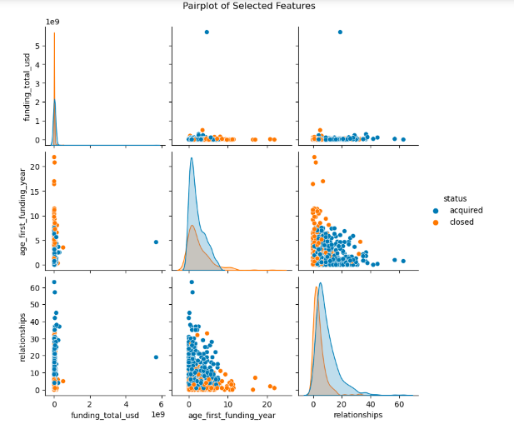
Visualization

Slide 11
Algorithms Used
Logistic regression
K-Nearest Neighbors (KNN)
Support Vector Machines
Decision tree
Random Forest

Slide 12
Result
Model | Precision | Recall | F1 Score | Accuracy
Logistic Regression | 0.80 | 0.90 | 0.70 | 0.79
K-Nearest Neighbors | 0.65 | 0.81 | 0.72 | 0.62
Support Vector Machine | 0.61 | 1.00 | 0.75 | 0.60
Decision Tree Classification | 0.72 | 0.70 | 0.71 | 0.65
Random Forest Classification | 0.79 | 0.993 | 0.85 | 0.80

Slide 13
Conclusion
Logistic Regression:
Good if we need to understand how the model makes predictions. It's not the most accurate here, but it's easier to interpret.
K-Nearest Neighbors (KNN):
A decent choice that works well in a variety of situations. Here it is the best model.
Support Vector Machine (SVM):
Great at finding the positive cases, but it might include some false positives. Choose it when catching all the important cases is crucial, even if it means making a few mistakes.

Slide 14


Thanks

