Slide 1
Machine Learning
Machine learning is a subset of artificial intelligence that focuses on developing algorithms and models that enable computers to learn from and make predictions or decisions based on data without being explicitly programmed. In short, it's about teaching computers to learn from data and make intelligent choices.
Some popular machine learning algorithms used in data science include:
Linear Regression
Logistic Regression
Decision Trees
Random Forest
Support Vector Machines (SVM)
K-Nearest Neighbors (KNN)
7. Naive Bayes
8. K-Means Clustering
9. Principal Component Analysis (PCA)
10. Gradient Boosting Algorithms (e.g., XGBoost, LightGBM)
11. Neural Networks (Deep Learning)

Slide 2
Linear Regression
In machine learning, linear regression is a supervised learning algorithm used for modeling the relationship between a dependent variable and one or more independent variables by fitting a linear equation to the observed data.
The goal is to find the best-fitting line (or hyperplane in higher dimensions) that minimizes the difference between predicted and actual values, allowing us to make predictions or understand the impact of independent variables on the dependent variable.
It's commonly used for tasks like predicting numerical outcomes or understanding the strength and direction of relationships between variables.

Slide 3
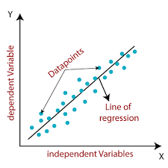
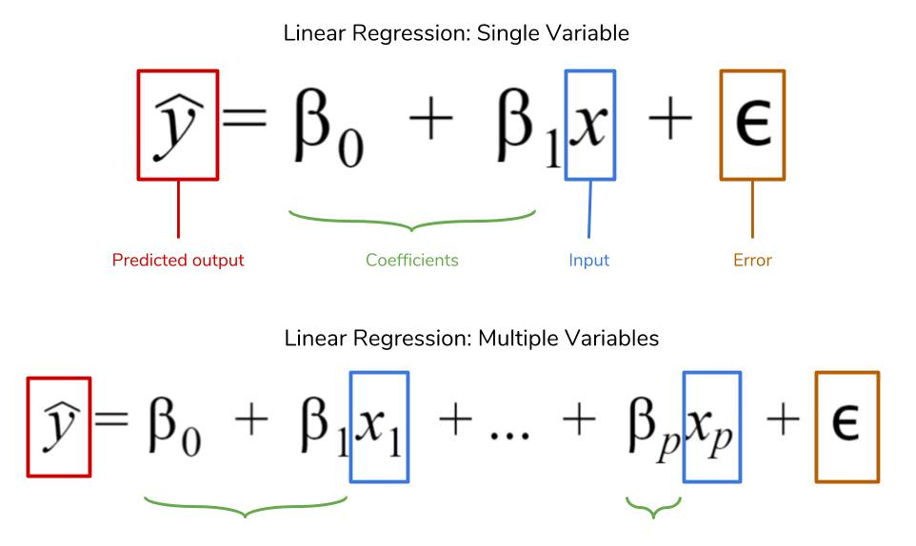
Linear Regression :
1. Single Variable
2. Multiple Variable

Slide 4
About Dataset
This dataset is created to estimate chances of graduate admission from an Indian perspective. Our analysis will help us in understand what factors are important in graduate admissions and how these factors are interrelated among themselves. It will also help predict one's chances of admission given the rest of the variables.

Slide 5
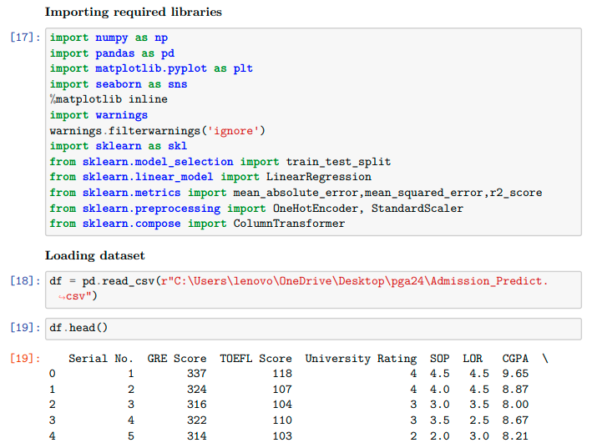
Linear Regression - Project

Slide 6
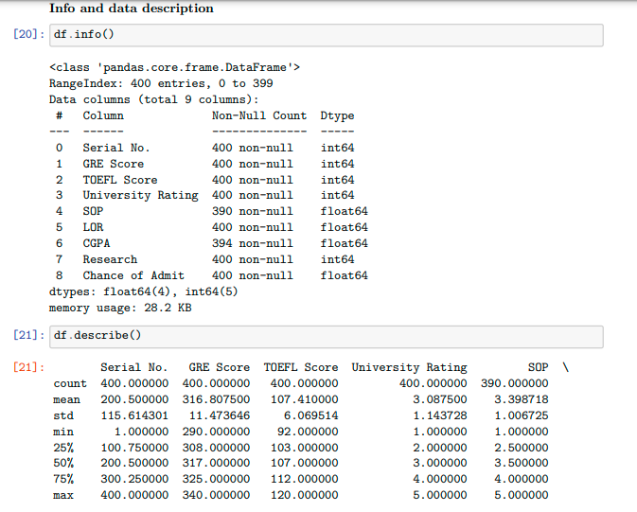
Info and data description

Slide 7
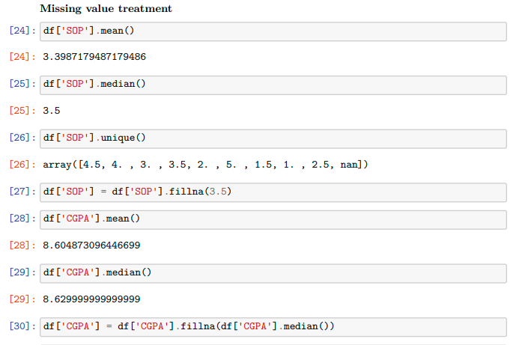
Missing Value Treatment

Slide 8
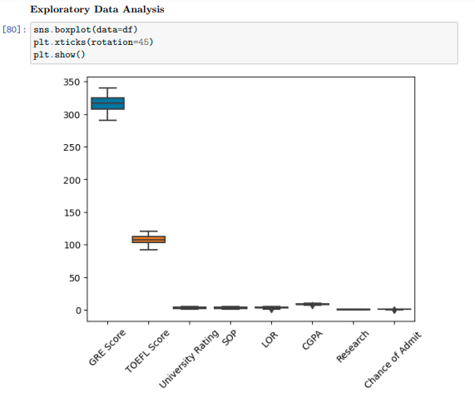
Data Visualization

Slide 9
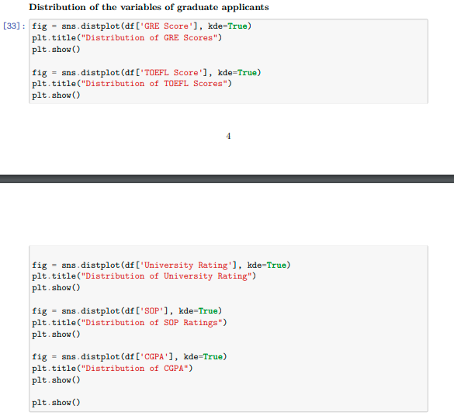

Slide 10
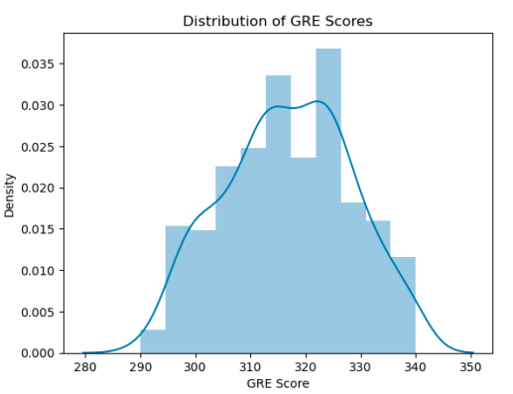
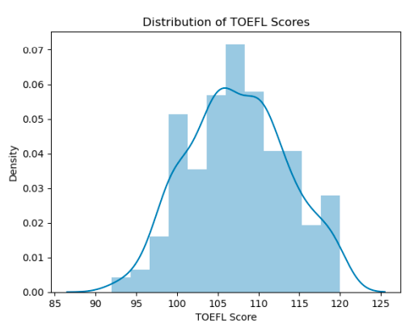
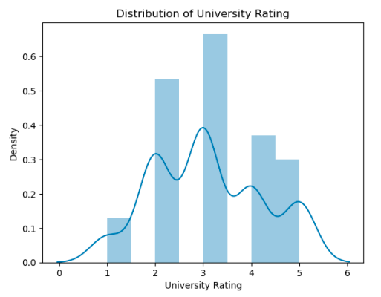
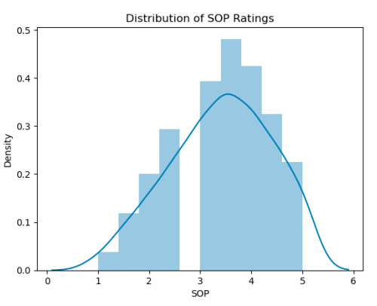

Slide 11
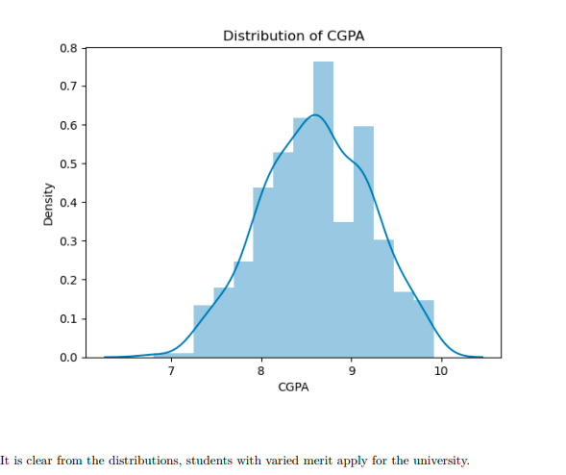

Slide 12
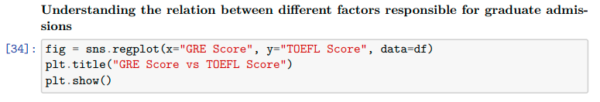

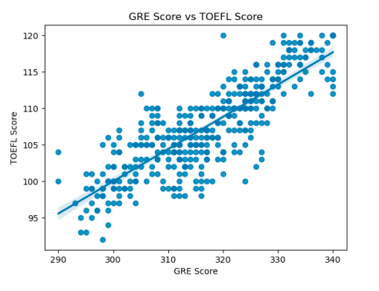
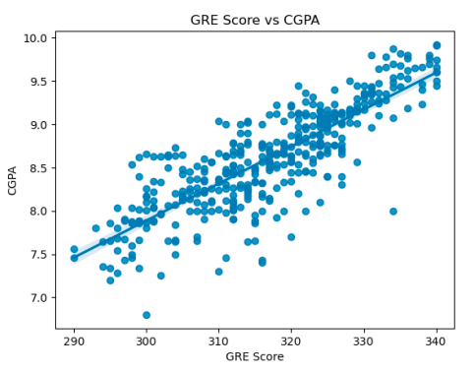

Slide 13


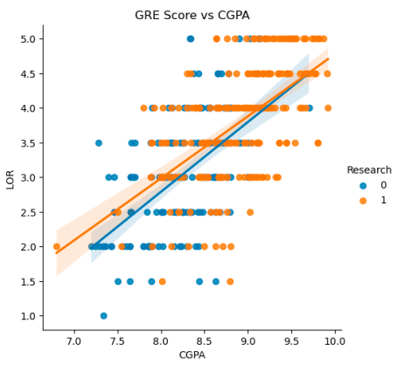
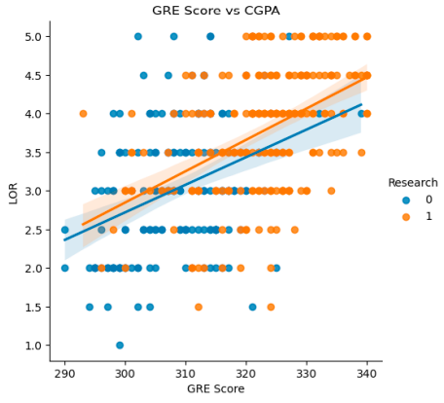

Slide 14


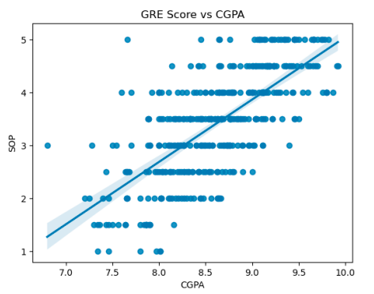
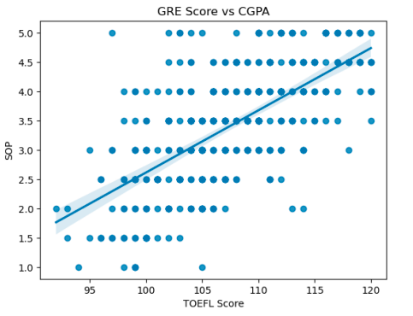

Slide 15

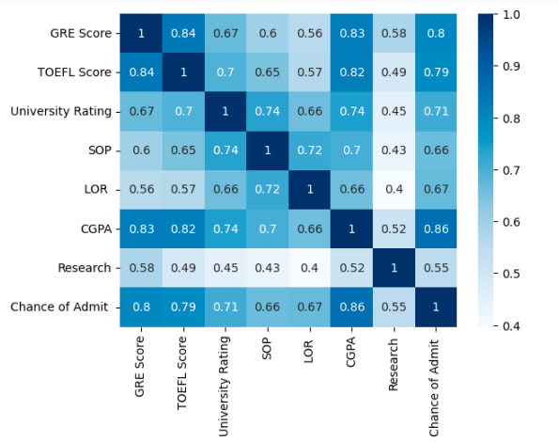

Slide 16
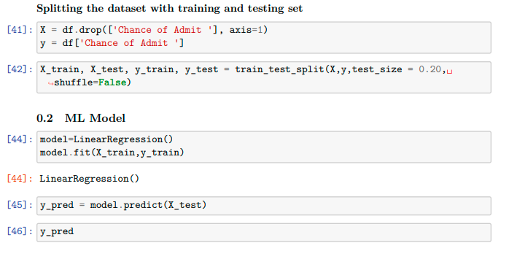
ML Model

Slide 17
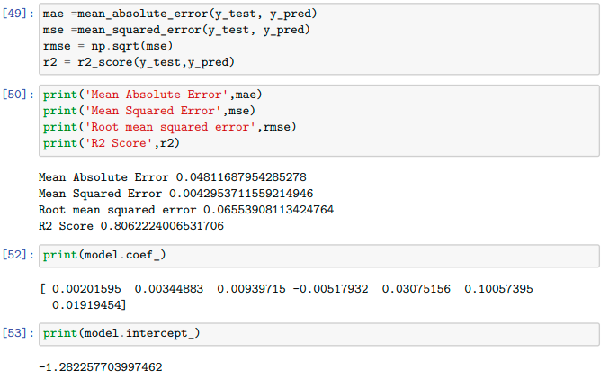

Slide 18
Linear Regression Model
Linear regression is a type of supervised machine learning algorithm that models the relationship between a dependent variable (target) and one or more independent variables (features) by fitting a linear equation to the observed data.

Slide 19
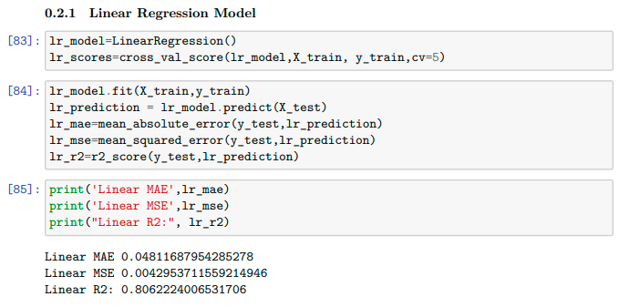

Slide 20
Lasso Regression Model (L1 Regularization)
Similar to ridge regression but uses a different regularization term.
It can be used for feature selection as it tends to set some coefficient values to zero, effectively eliminating irrelevant features.

Slide 21
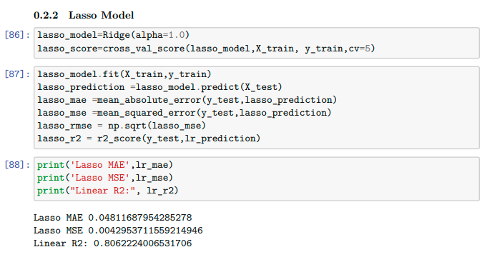

Slide 22
Ridge Regression Model (L2 Regularization)
A variation of linear regression that adds a penalty term to the linear regression cost function to prevent overfitting.
It includes a regularization parameter (alpha) that controls the strength of the penalty on the coefficients.
Helps reduce the impact of multicollinearity (high correlation between independent variables).

Slide 23
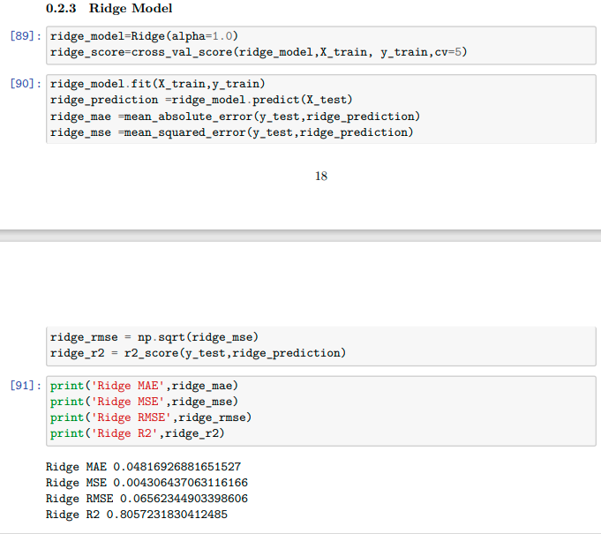

Slide 24
MM Estimator : Huber Regression
MM Estimator (Minimum-Maximum Estimator) is a robust regression technique that combines the strengths of both Least Squares (LS) and Minimum Absolute Deviation (MAD) estimators to reduce the impact of outliers.
Huber Regression is a specific type of MM estimator used in linear regression. It minimizes a loss function that transitions from squared error to absolute error at a specified threshold (δ), making it less sensitive to outliers while still providing efficient parameter estimates.

Slide 25
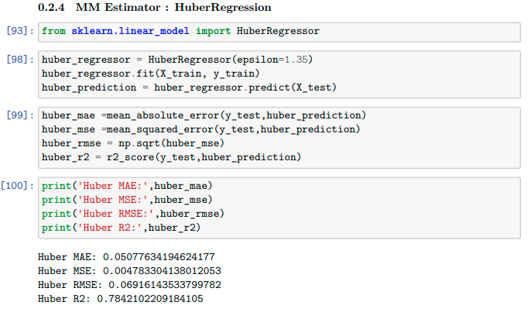

Slide 26
M Estimate
M estimate is a robust statistical technique used in regression to reduce the influence of outliers by minimizing a specific loss function that adapts to the data, making it less sensitive to extreme values.

Slide 27
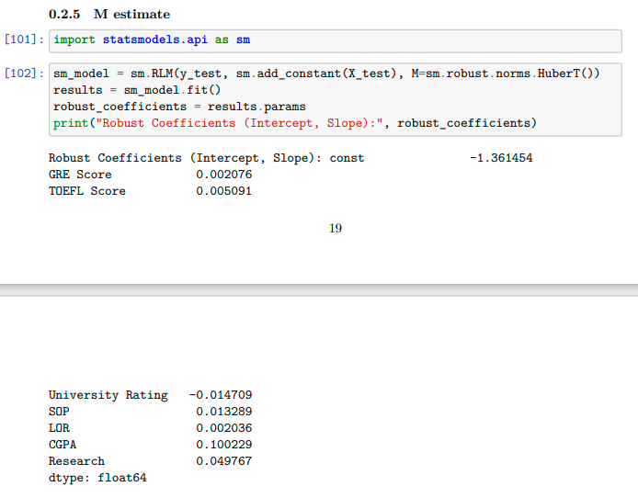

Slide 28
M Estimate
M estimate is a robust statistical technique used in regression to reduce the influence of outliers by minimizing a specific loss function that adapts to the data, making it less sensitive to extreme values.

Slide 29
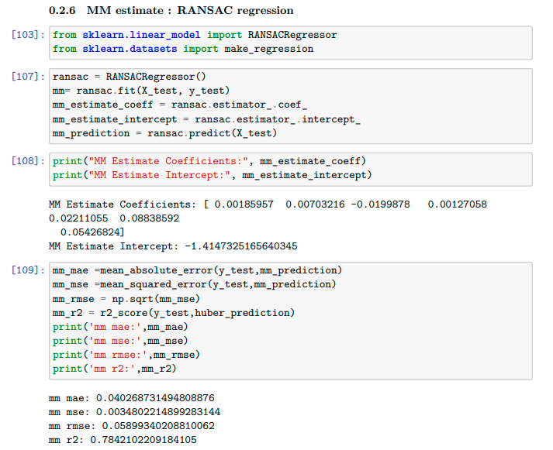

Slide 30
Lts Estimate
LTS (Least Trimmed Squares) Estimate is a robust statistical technique in regression that minimizes the sum of squares of a subset of data points while excluding outliers. It is less affected by extreme values in the dataset, providing robust parameter estimates.

Slide 31
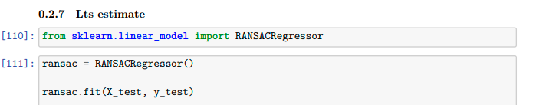
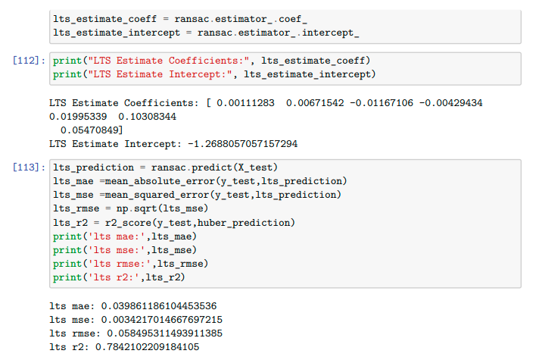

Slide 32
S Estimate
S Estimate is a robust statistical method in regression that minimizes the sum of absolute residuals, reducing the impact of outliers and providing more robust parameter estimates compared to the least squares method.

Slide 33
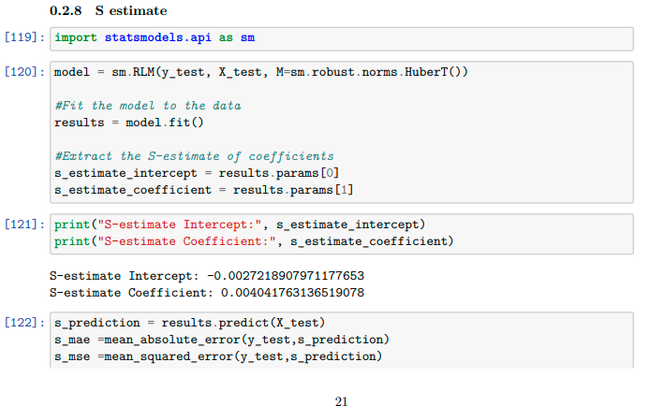
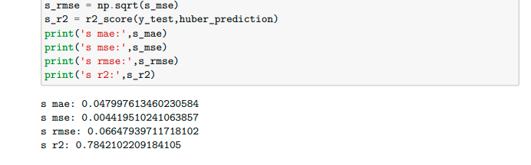

Slide 34
Theil-Sen Regressor
Theil-Sen Regressor is a robust linear regression method that calculates the median slope from all possible pairs of data points. It's resistant to outliers and provides robust estimates of the slope and intercept, making it useful when dealing with data that may contain extreme values.

Slide 35
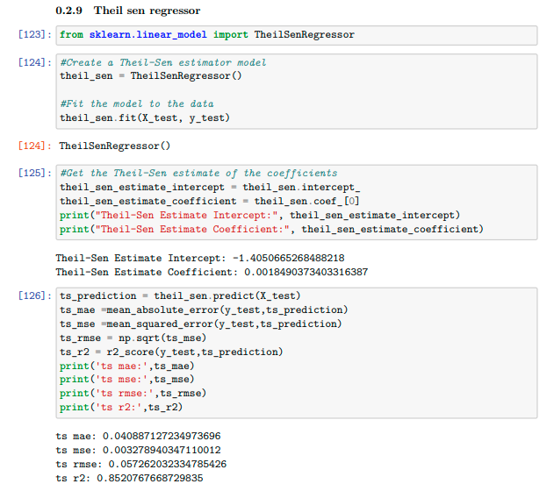

Slide 36
Thank You

