Slide 1

A PRESENTATION ON ONLINE BOOK STORE
PJ COLLAGE OF MANAGEMENT AND TECHNOLOGY, BBSR
Final Year Project Presentation
By: Shubhasini Das

Slide 2
Introduction
An online platform for purchasing books.
Allows users to register, browse, and purchase books.
Admin can manage book inventory and sales history.

Slide 3
Problem Statement
Manual book shopping is time-consuming and less accessible.
Inventory and sales are difficult to manage manually.
Limited reach of physical bookstores.

Slide 4
Proposed Solution
A centralized web application to buy and manage books.
Real-time inventory management for admins.
Seamless shopping experience for users with payment receipt.

Slide 5
Technology Stack
Frontend: HTML, CSS
Backend: Core Java, Servlet
Database: MySQL
Chosen for educational relevance and ease of use.

Slide 6
System Architecture / Flow
User: Register/Login → Browse → Add to Cart → Buy → Payment Receipt
Admin: Login → Manage Books → View Sales History

Slide 7
Modules Overview
Admin Module:
- Add, remove, update books
- Manage inventory and view sales
Customer Module:
- Register, login, buy books, receive receipt

Slide 8

Screenshots / UI
Home Page

Slide 9
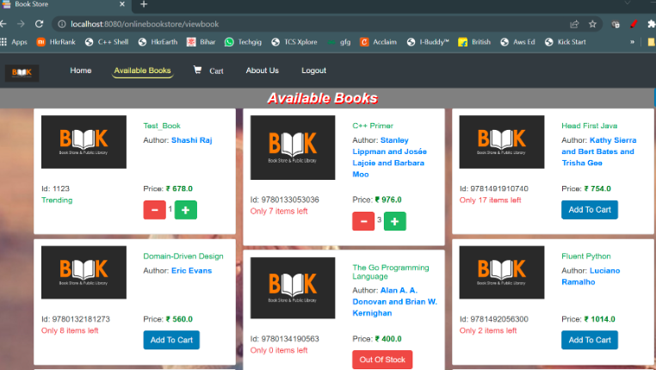
View Book

Slide 10
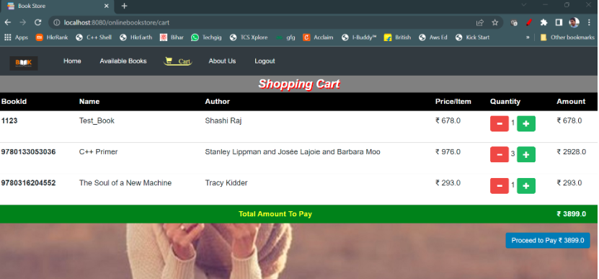
Shopping Cart

Slide 11
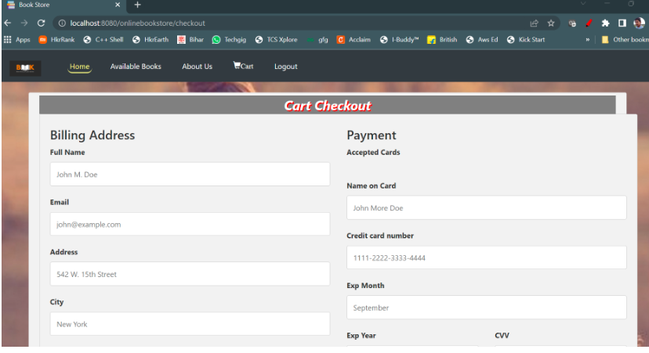
Checkout page

Slide 12
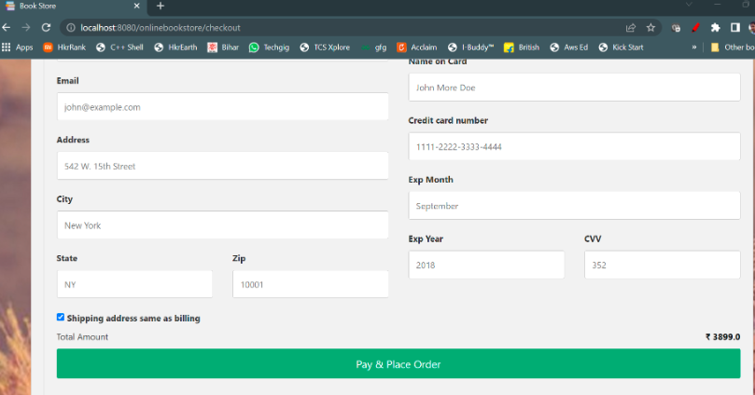
Cart checkout

Slide 13
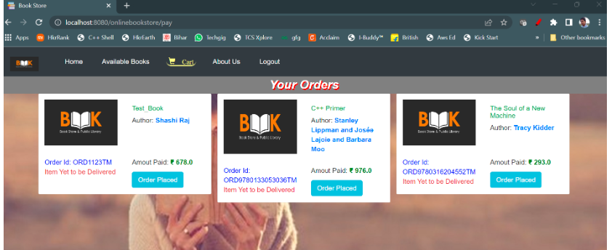
Order Page

Slide 14
Challenges & Learnings
Challenges: Session handling, DB integration.
Learned full-stack development using Java & MySQL.
Gained practical experience in servlet-based apps.

Slide 15
Conclusion & Future Scope
Efficient book shopping and inventory control.
Can integrate payment gateways and mobile apps in future.
Thank You!

