Slide 1
Hotel Case Study
This report present business insights based on Data Analysis done on sales data collected over a period of time.
Presented by Sonali Zote

Slide 2
Introduction
The Hotel Sales Dataset contains the details of hotel booking of customers.
booking_id : By which Booking has been made.
customer_id : Id of a customer done hotel booking
Status: Shows the status customers Booking is done or not.
check_in: Date when the customer checks-in into the hotel.
check_out: Date when the customer checks-out from the hotel.

Slide 3
Introduction
no_of_rooms: Toatal rooms booked by the customer.
hotel_id: It is the Id in which the customer has booked the room.
Amount: Amount paid by the Customer.
Discount: Discount given to the customer while booking.
date_of_booking: The date when the booking of a customer for a room has been done.

Slide 4
Introduction
The Hotel City Dataset contains the details of hotel_id and city.
hotel_id: It is the Id in which the customer has booked the room.
City: Where it is located.

Slide 5
Business Objective
Identify customer segments based on booking patterns, spending behaviour to create targeted marketing campaigns
Analyze booking trends and discount patterns to optimize pricing strategies for different cities
Assess booking patterns to improve operational efficiency such as hotel staffing, resource management.

Slide 6
Key Business Metrics
1.a. Average amount spent per booking for each customer, C
1.b. Frequency of bookings and cancellation rate for each customer
2.a. Average booking amount per city
2.b Average discounts across cities peak versus off-season demand across cities
3.a. Average length of stay, seasonal demand patterns (Monthly/Quarterly stay patterns)

Slide 7
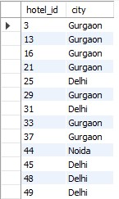
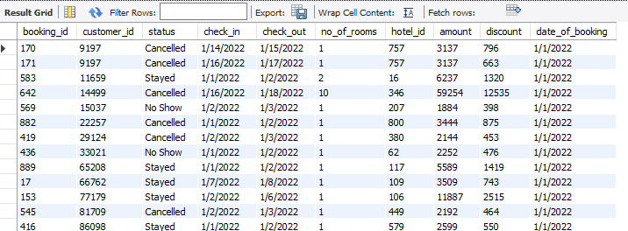
Datasets
City Table: 357 Records
Sales Table: 2889 Records

Slide 8
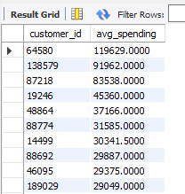
1.a. Average amount spent per booking for each customer, C
SELECT customer_id,
AVG(amount) AS avg_spending
FROM hotel_sales
GROUP BY customer_id
ORDER BY avg_spending DESC;

Slide 9
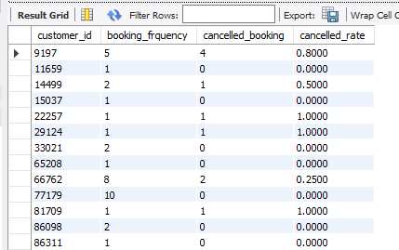
1.b. Frequency of bookings and cancellation rate for each customer
SELECT
customer_id,
COUNT(booking_id) AS booking_frquency,
COUNT(IF(status = 'Cancelled',1,NULL)) AS cancelled_booking,
CASE
WHEN COUNT(status) = 0 THEN 0 ELSE COUNT(IF(status = 'Cancelled',1,NULL)) / COUNT(status) END AS cancelled_rate
FROM hotel_sales
GROUP BY customer_id;

Slide 10
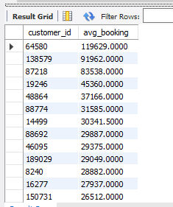
2.a. Average booking amount per city
SELECT customer_id,
AVG(amount) AS avg_booking
FROM hotel_sales
GROUP BY customer_id
ORDER BY avg_booking DESC;

Slide 11
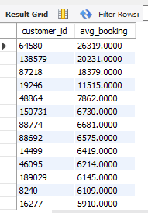
2.b Average discounts across cities peak versus off-season demand across cities
SELECT customer_id,
AVG(discount) AS avg_booking
FROM hotel_sales
GROUP BY customer_id
ORDER BY avg_booking DESC;

Slide 12
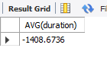
3.a. Average length of stay, seasonal demand patterns (Monthly/Quaterly stay patterns)
SELECT AVG(duration)
FROM hotel_sales;

Slide 13
THANK YOU

