Slide 1
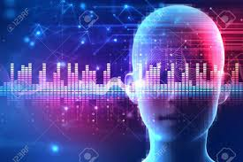
Capstone Presentation - Speech Accent Recognition

Slide 2
Problem statement
People from different parts of the world speak in different accent and hence it is difficult for AI enabled devices like Alexa , Google home or even Self Driving cars to understand user commands.
This project aims to recognize and classify speaker accents by AI enabled devices.

Slide 3
Gathering data

Slide 4
Gathering initial data
Initial dataset was obtained from Kaggle https://www.kaggle.com/rtatman/speech-accent-archive.
Dataset had around 2000 audio files and a CSV file.
CSV File contained biographical information about speaker.

Slide 5
Gathering initial data
Audio files contained below paragraph spoken by all the speakers in duration about 20-30 seconds.
“Please call Stella. Ask her to bring these things with her from the store: Six spoons of fresh snow peas, five thick slabs of blue cheese, and maybe a snack for her brother Bob. We also need a small plastic snake and a big toy frog for the kids. She can scoop these things into three red bags, and we will go meet her Wednesday at the train station.”

Slide 6
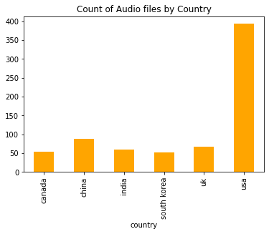
Available Data
Most number of audio files available from USA , followed by China , UK , India , Canada and South Korea

Slide 7

Original data story
Original data is hosted @ https://accent.gmu.edu/
This data is created and maintained by George Mason University’s department of English Speech Accent Archive

Slide 8
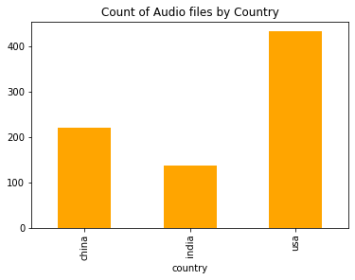
Gathering more data
Additional data was gathered from Speech Accent Archive
Data was scraped using BeautifulSoup
Data was cleaned and filtered

Slide 9
Studying Audio Data

Slide 10
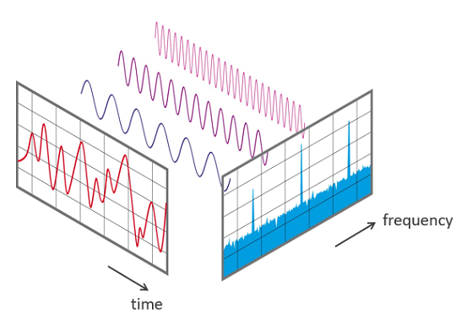
What is Audio Data
Audio is combination of
Duration
Sampling rate
Amplitude
Frequency
Source : https://commons.wikimedia.org/wiki/File:FFT-Time-Frequency-View.png

Slide 11
Audio Features
Feature – According to dictionary is: a distinctive attribute or aspect of something.
Some Features you can extract from audio are :
Audio Wave
MFCC – Mel Frequency Cepstral Coefficients
Log Mel-spectogram
Chroma

Slide 12
Audio Data EDA

Slide 13
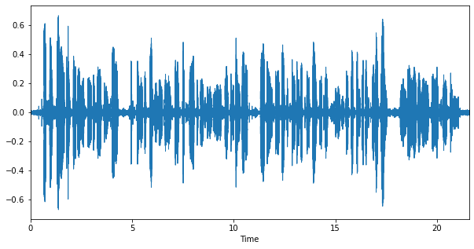
Audio Wave plot from audio file

Slide 14
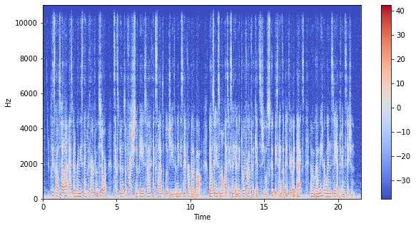
Spectogram from audio file

Slide 15
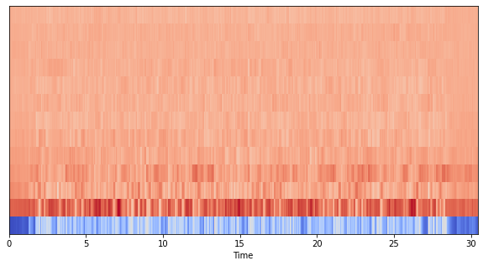
MFCC from audio file

Slide 16
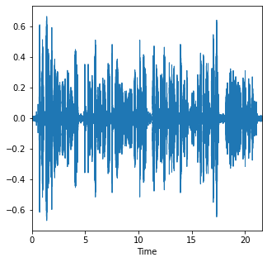
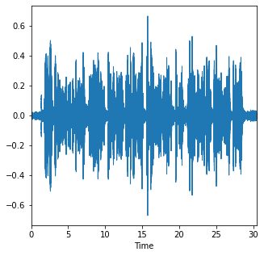
Comparison of audio wave for speakers from 4 different countries
USA
China

Slide 17
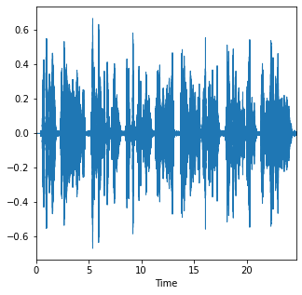
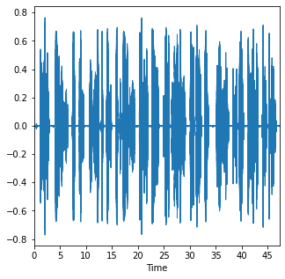
Comparison of audio wave for speakers from 4 different countries
UK
India

Slide 18
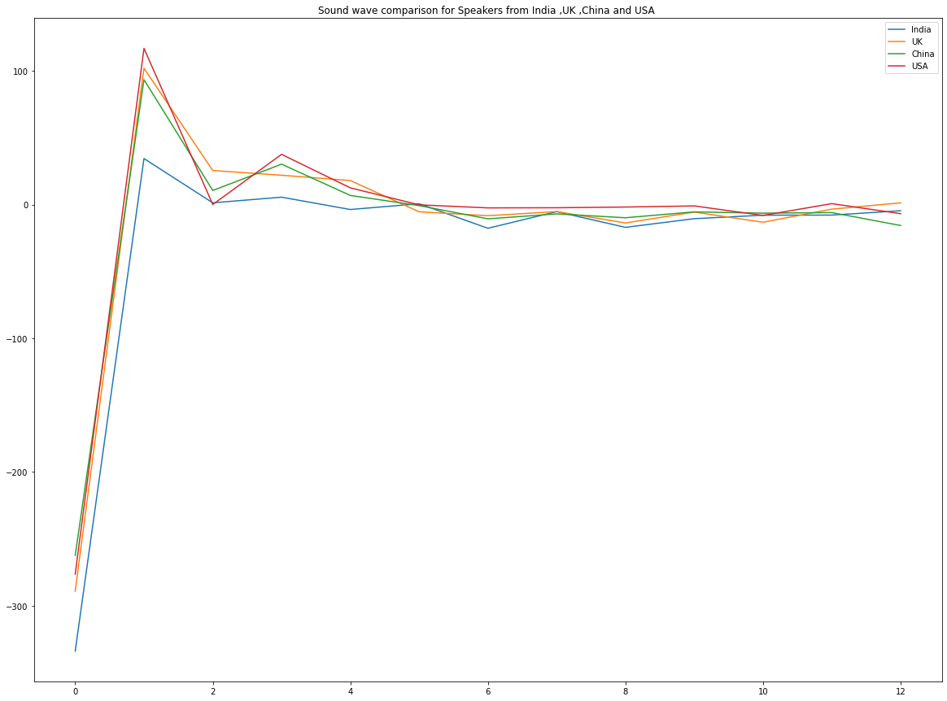
Comparison of audio wave for speakers from 4 different countries

Slide 19
Building and testing Models

Slide 20
Prepare for modeling
Below steps were followed to prepare audio data for modeling
Load audio file using librosa (library for working with audio)
Extract audio features from audio file using librosa. sampling rate used to extract - 44KH
Used MFCC feature from each audio file since it is common feature used for speech recognition.
Convert this to a vectorized array for modeling.

Slide 21
Prepare for modeling
Classes for model Baseline for each class
1) American 54%
2) Chinies 27%
3) Indian 17%

Slide 22
Different models experimented
Feed Forward Neural Network – to check baseline
Simple Vector Machine – LinearSVC
Adaboost with DecisionTreeClassifier
Convolutional Neural Network (CNN) with regularization
CNN with SMOTE
CNN with Undersampling

Slide 23
Best performing models
 | Train Accuracy | Test Accuracy | Predictability (Y/N)
SVM | 68 % | 63 % | Y
CNN with SMOTE | 62 % | 63 % | Y
CNN with Regularization | 63 % | 61 % | N

Slide 24
Other metrics
 | Precision |  | Recall |  | f1 score
SVM | American | 75 | American | 75 | American | 75
 | Chinese | 55 | Chinese | 67 | Chinese | 60
 | Indian | 35 | Indian | 22 | Indian | 27
CNN with SMOTE | American | 72 | American | 60 | American | 65
 | Chinese | 49 | Chinese | 54 | Chinese | 51
 | Indian | 36 | Indian | 49 | Indian | 41
CNN with Regularization | American | 65 | American | 86 | American | 74
 | Chinese | 52 | Chinese | 51 | Chinese | 52
 | Indian | 00 | Indian | 00 | Indian | 00

Slide 25
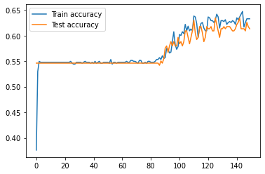
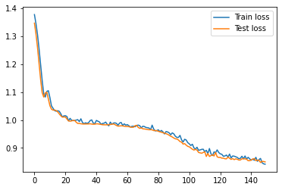
Accuracy and loss - CNN with Regularization

Slide 26
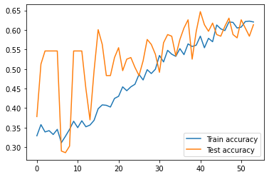
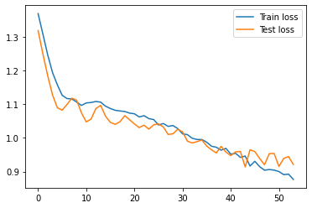
Accuracy and loss CNN with SMOTE

Slide 27
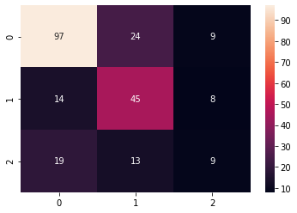
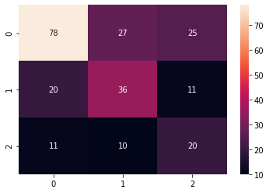
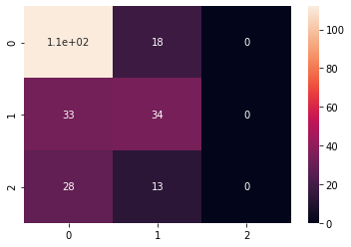
Heatmap for 3 top models
0 - American 1 - Chinese 2 - Indian
SVM
CNN With SMOTE
CNN with Reg

Slide 28
Conclusion

Slide 29
Summary
SVM is best performing model - good accuracy and optimal precision and recall for all classes.
After using balancing technique SMOTE , precision and recall gets better, and CNN can predict all 3 classes with slight compromise on accuracy.
Data is insufficient and imbalanced.
Due to imbalanced data CNN gives biased results and does not predict 1 class at all.

Slide 30
Next Steps
Gather more data and try to add more classes.
Convert this into a web app for better demonstration.
Try different approach for classification , e.g., try to vectorize with a single word for each user’s pronunciation.
More research with different datasets.

Slide 31
Credits
Special thanks to those that made these awesome resources freely available:
https://www.kaggle.com/rtatman/speech-accent-archive
https://www.kdnuggets.com/2020/02/audio-data-analysis-deep-learning-python-part-1.html
https://github.com/yatharthgarg/Speech-Accent-Recognition
https://medium.com/prathena/the-dummys-guide-to-mfcc-aceab2450fd

Slide 32
Thanks!
Any questions?

