Slide 1

Dataset Name
Sales Data Set ( Salesdata.csv )
Problem Statement
To predict Item_Outlet_Sales
It is combination of Object and Numeric variables.
Number of Rows : 14204
Number of Columns : 12
Y-variable : Item_Outlet_Sales (Numeric variable )

Slide 2

Check for NULLS and Blanks
Columns with “NULL”
Columns with “ NULL ” - 3
Item_Weight, Outlet_Size, Item_Outlet_Sales
Dropped columns
Item_Identifier', Outlet_Identifier
The NULLS in Item_Weight column are replaced
by median

Slide 3

Split dataset into training and testing set.
Split the training dataset into train and test set (0.7,0.3)
Then split train and test set into train_x, train_y, test_x, test_y
Build Model using OLS Algorithm
Check Assumptions of Linear Regression
K-fold Cross Validation
Predict the Regression on the test set
Find MSE and RMSE
Compare actual and predicted values
Feature selection using High Score
Build new model with Significant variables on the same training set
Select best model and do the predictions on actual testing set

Slide 4

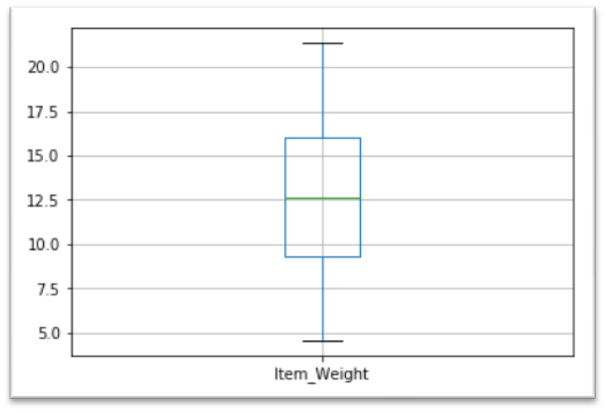
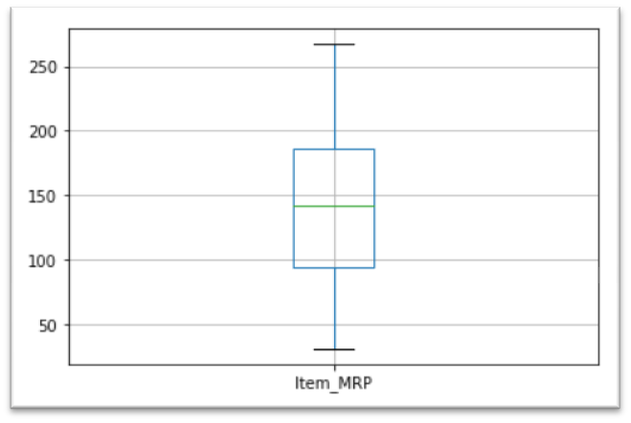
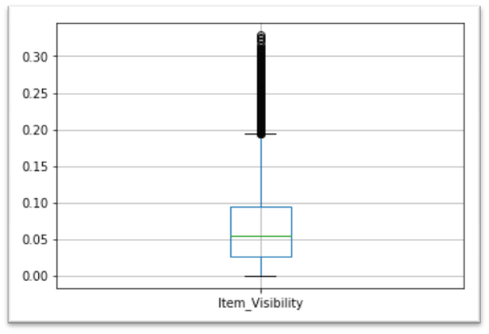
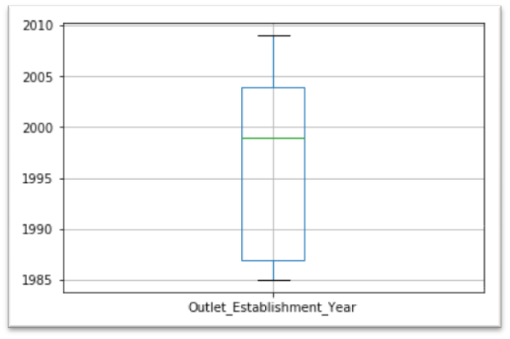

Slide 5

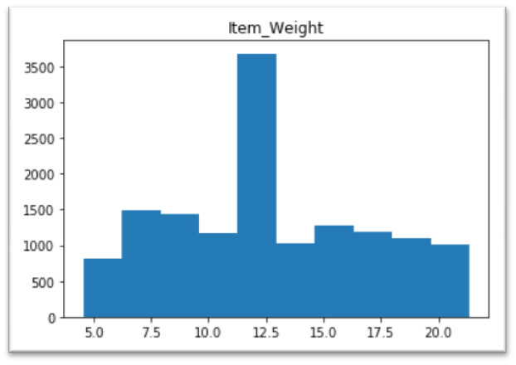
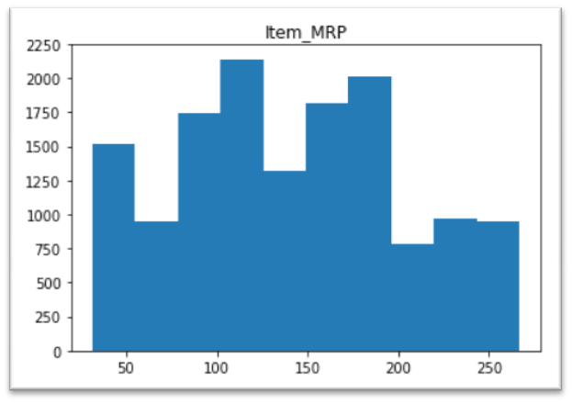
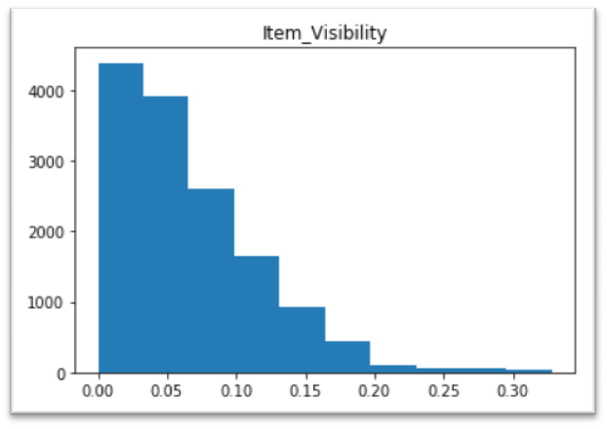
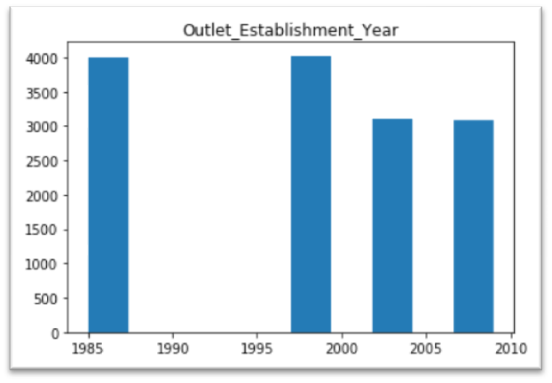

Slide 6

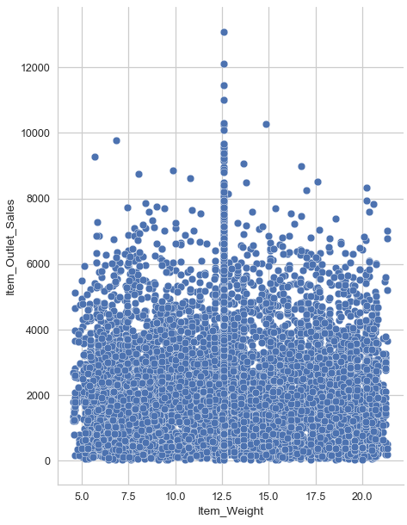
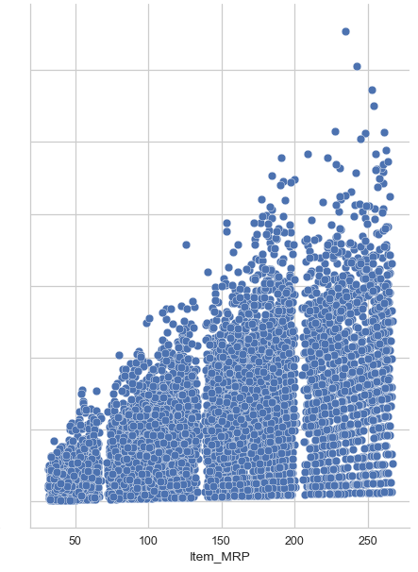
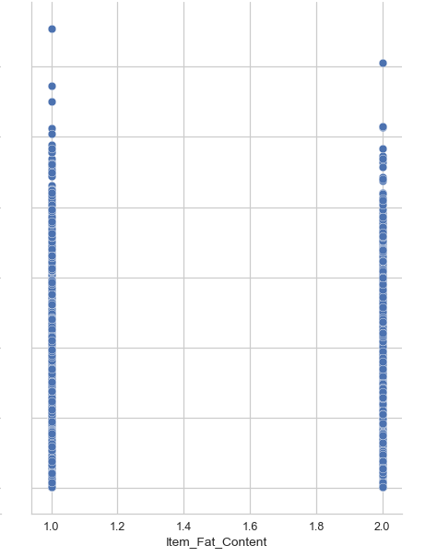
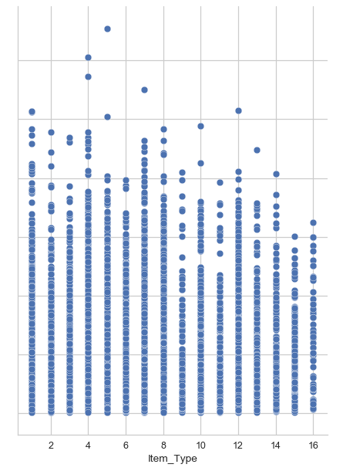
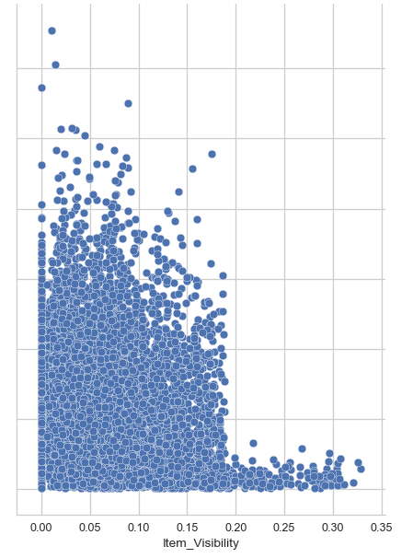
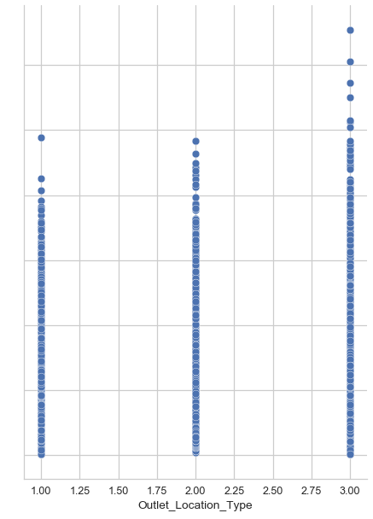
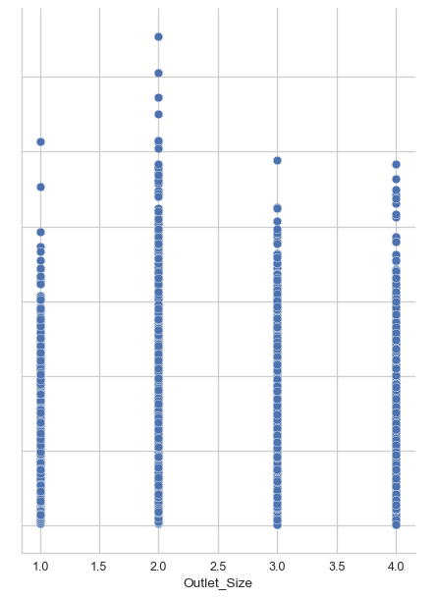
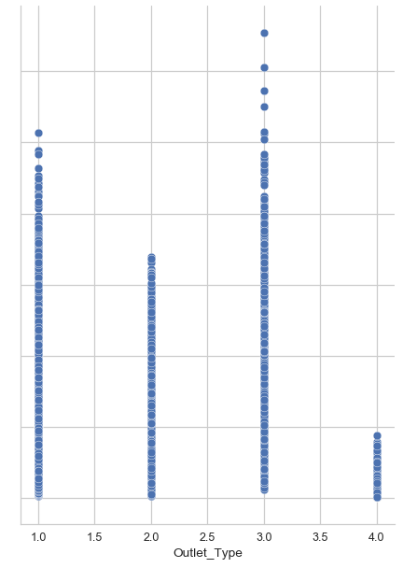

Slide 7

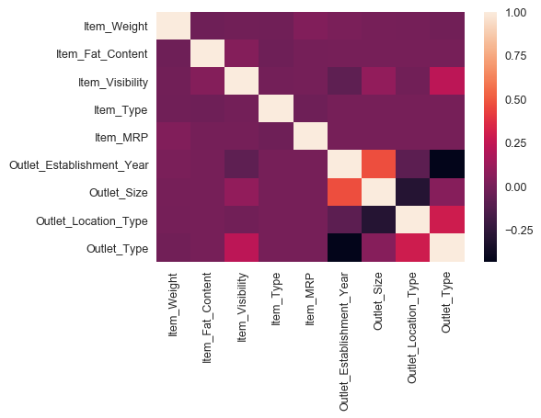

Slide 8

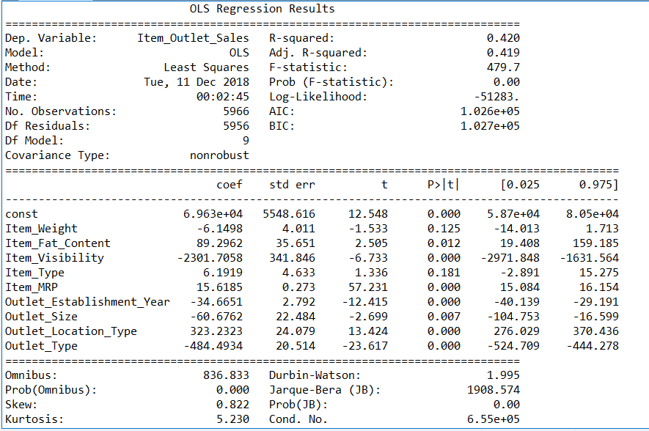

Slide 9

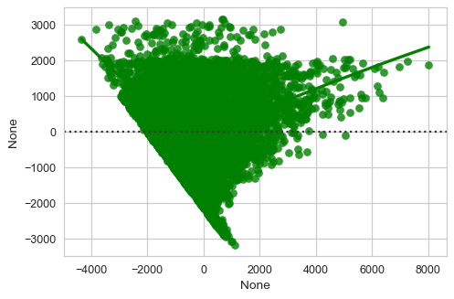

Slide 10

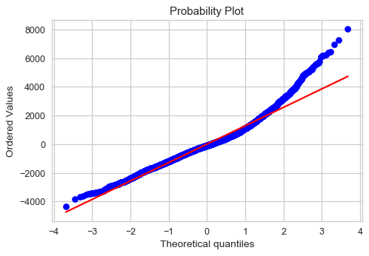

Slide 11

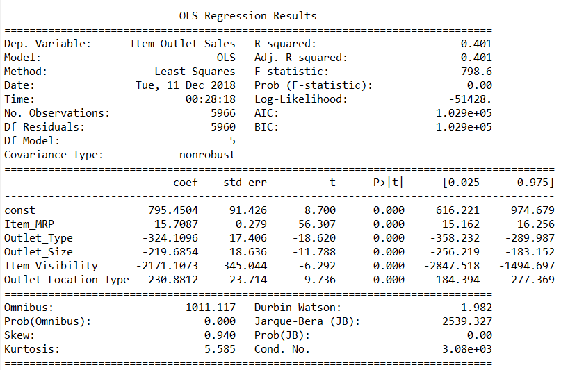

Slide 12

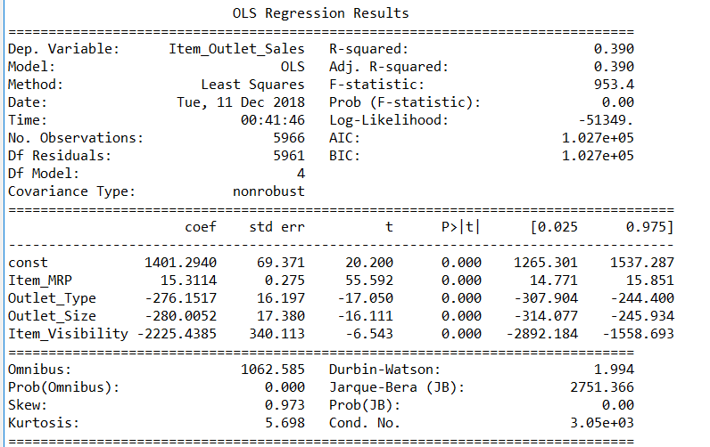

Slide 13

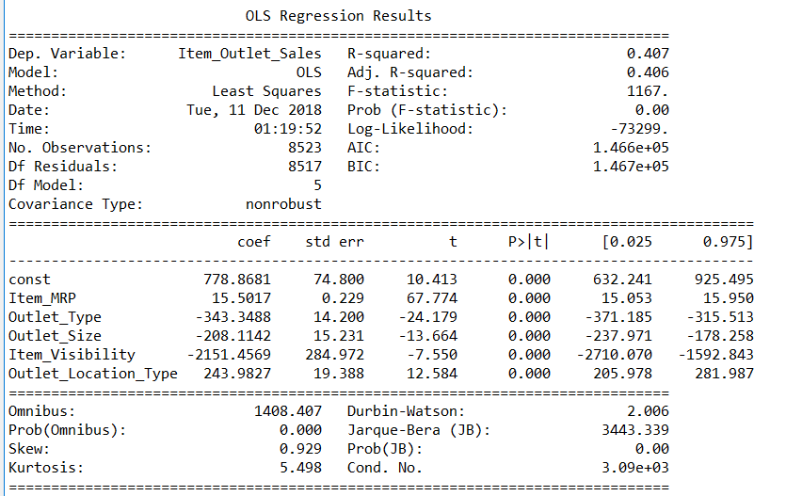
Test model on Actual testing dataset using Model - 2

Slide 14

Models | R² | AIC | MSE | RMSE
MODEL - 1 | 0.420 | 1.026e+05 | 1628025.0258668745 | 1275.9408394854656
MODEL - 2 | 0.401 | 1.029e+05 | 1565218.303404723 | 1251.0868488657065
MODEL - 3 | 0.390 | 1.027e+05 | 1780332.5517238223 | 1334.2910296197836
MODEL - 4 | 0.407 | 1.466e+05 | 1718915.3042268357 | 1311.074103255356

Slide 15

From given comparison table, I have concluded that Model-2 is better model.
Model-2 has less MSE and RMSE as our aim is to reduce the MSE

