Slide 1

AIRLINE PASSENGERS & THEIR SENTIMENTS ANALYSIS

Slide 2

Contents
Case Study (Understanding the data)
Objectives (motive behind this analysis)
Data Analysis (interpreting the data through diff graph and models)
Findings
Insights/Conclusion
Scope of improvements

Slide 3
Case Study
The data consists of 25000+ customers' feedback rating to an airline.
The passengers are categorized based on gender, age, seat class, purpose of travel, distance of travel and loyalty status.
The ratings are given out of 5, to 12 facilities and services a passenger experienced from booking the flight till collecting baggage.

Slide 4
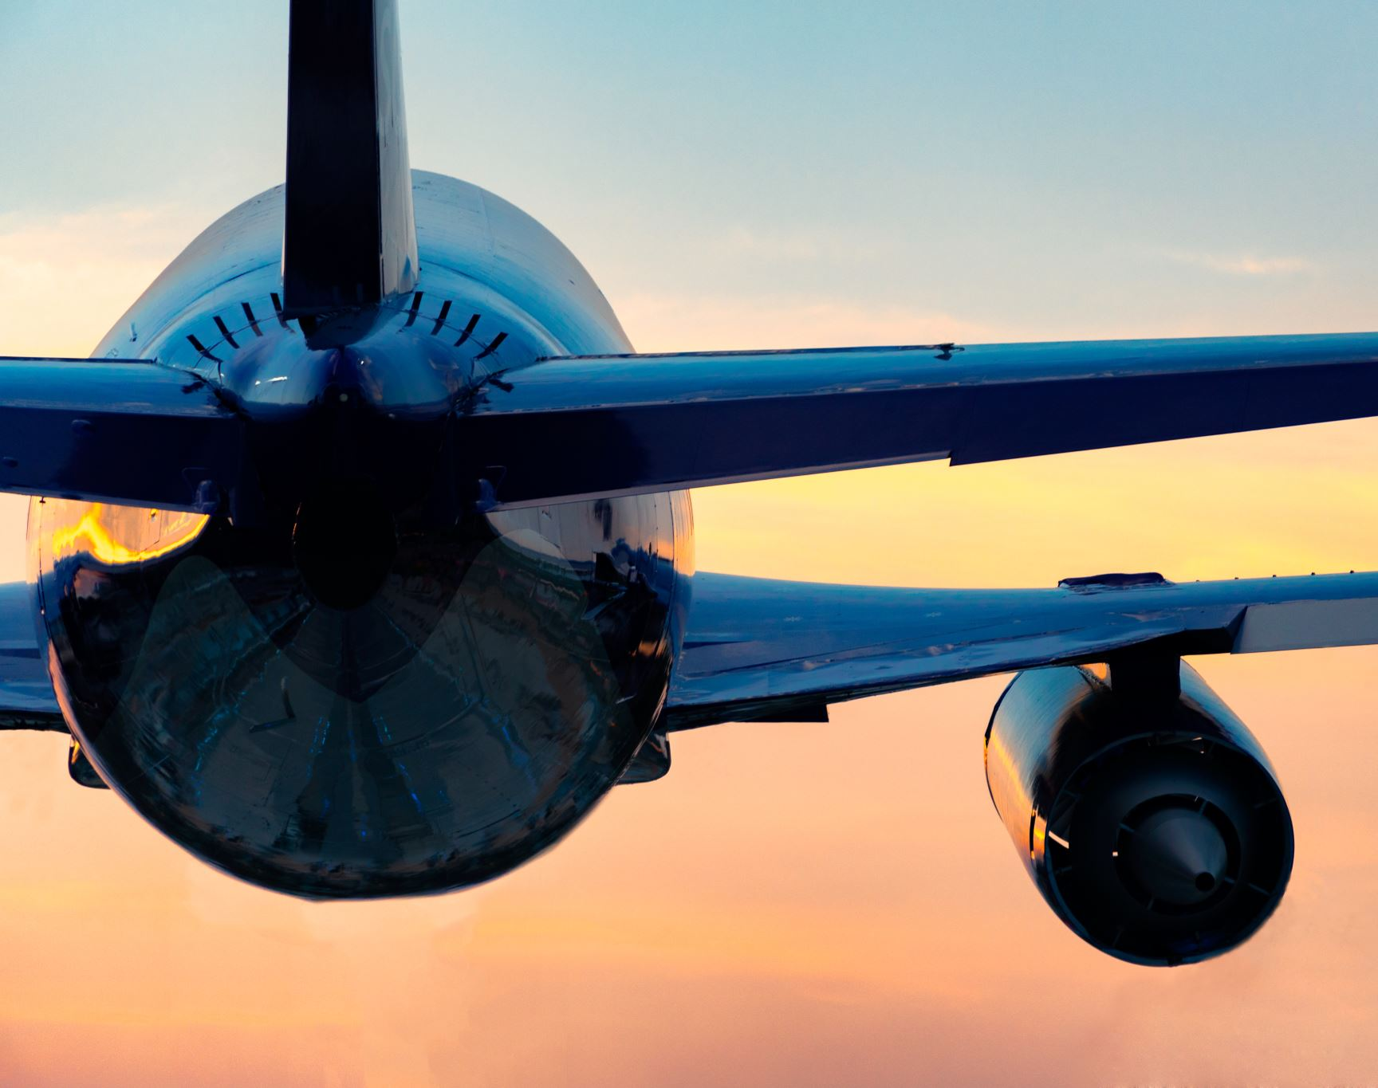
Objectives
Find out which services and facilities are lowly rated by the major category of passengers.
Which category of passengers majorly flying with the airline?
How to improve passenger count, service quality and ratings?

Slide 5
Data Analysis
Part 1
To identify the categories of current highest passenger count
Part 2
To identify low rated service and facilities by Part 1 passengers for improvement

Slide 6
DA : Part-1 : Passengers categorization
Gender | Age | Purpose of Travel | Seat Class | Flight Distance | Loyalty Program Status
Male | <=27 - Gen_Z or below | Business | Eco | <2500 km (may domestic flight) | Enrolled
Female | 27-42(millennials) | Personal | Eco Plus | >=2500 km (may international flight) | Unenrolled
 | 42> - Gen_X and above |  | Business

Slide 7
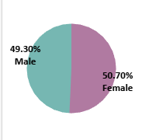
PASSENGERS CATEGORIZED AS PER GENDER AGAINST PURPOSE OF TRAVEL
FINDING :
Passenger count is approximately equally divided amongst male (49.30%) and female passenger(50.70%).

Slide 8
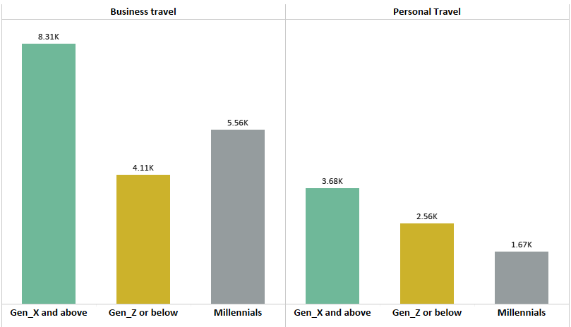
PASSENGERS CATEGORIZED AS PER AGE GROUP AGAINST PURPOSE OF TRAVEL
FINDING :
Passengers who are Gen_X and above our major customers followed by Millennials.

Slide 9
PASSENGERS CATEGORIZED AS PER FLIGHT DISTANCE AGAINST PURPOSE OF TRAVEL
FINDING :
For both purpose Passenger count for domestic flights are more than international flight.

Slide 10
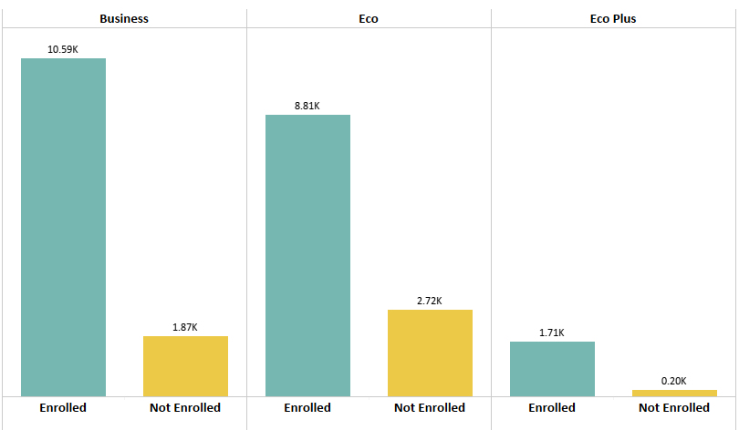
PASSENGERS CATEGORIZED AS PER LOYALTY PROGRAM AND SEAT CLASS
FINDING :
81.53% of total passengers are enrolled in Loyalty Program and 18.47% passengers are new or unenrolled.
Major passengers enrolled for Loyalty Program from Business and Eco class.

Slide 11
DETERMINING TARGET PASSENGERS' CATEGORIES BASED ON FINDINGS
61.69% of total passengers are:
In Business or economy class
Flight distance <= 2500 km
Enrolled in loyalty Program
Passenger count is approximately equally divided amongst male (49.30%) and female passenger(50.70%).
81.53% of total passengers are enrolled in Loyalty Program and 18.47% passengers are new or unenrolled.
Major passengers enrolled for Loyalty Program from Business and Eco class.
For both purpose Passenger count for domestic flights are more than international flight.
We should encourage more passengers to participate in Loyalty Program for better improvement.

Slide 12
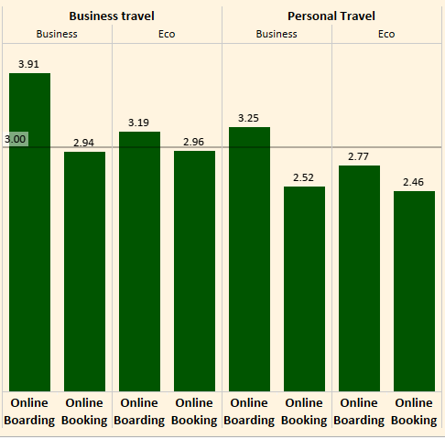
PRE-FLIGHT FACILITY RATINGS

Slide 13
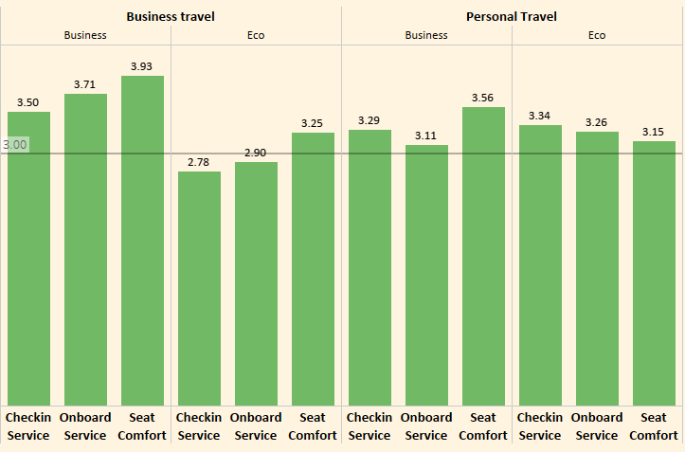
ON-BOARDING FACILITY RATINGS

Slide 14
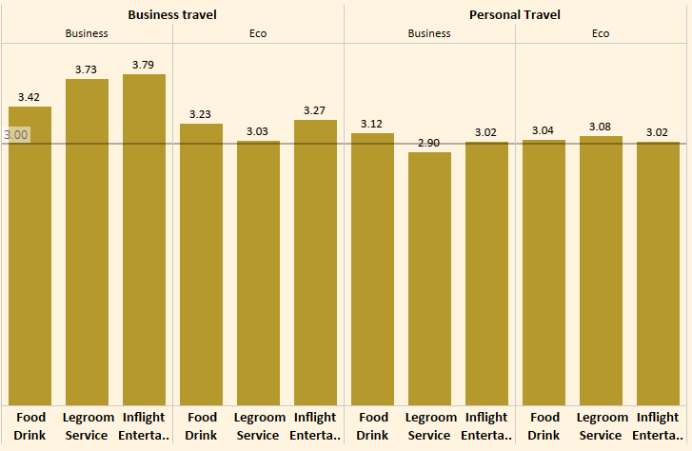
IN-FLIGHT FACILITY RATINGS

Slide 15
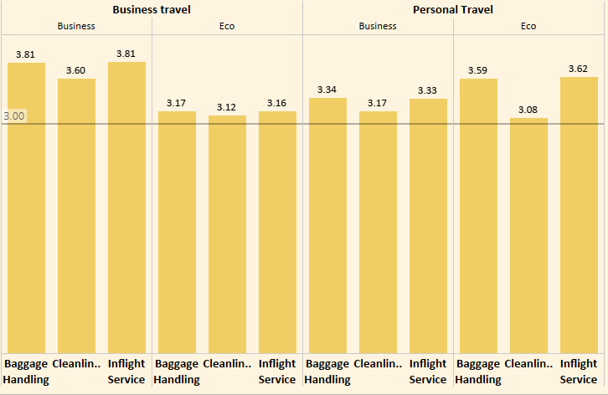
POST-FLIGHT FACILITY RATINGS

Slide 16
Scope of Improvements
Pre-Flight Facilities | On-Boarding Facilities | In-Flight Facilities | Post-Flight Facilities
Online booking App and Web-check In should be improved. | Seats are comfortable. | Food and beverages are good. | Baggage Handling service is good.
Online Boarding service should be improved for Personal Travelers from Eco class. | On-Boarding service should be improved for Business Travelers from Eco Class. | In Flight entertainment is good. | Cleanliness ratings are good.
 | Check In service for Business travelers from Eco Class. | Legroom also has sufficient space. | In Flight service is good for all travelers.

Slide 17
Applications used for analysis
SQL Workbench: used for data analysis and derive meaningful information
Tableau: used for Graphical Representation of data
PowerPoint: used for describing findings and scope of improvement in presentation manner

