Slide 1

BANASTHALI VIDYAPITH UNIVERSITY, UNIVERSITY IN BANASTHALI, RAJASTHAN DEPARTMENT OF INFORMATION TECHNOLOGY Internship on “Mass Mail Dispatcher” Presented by Name: Sonali Samdarshini USN: BTBTI19001 Under the Guidance of:
Proff. Saurabh Mukherjee
Professor
(Faculty of Mathematics and Computing)

Slide 2
AGENDA
About the Organization
About the Department
Tasks Performed
Tools/Technologies
Implementation
Results
Reflection Notes
Conclusion

Slide 3
About the Organization
Exposys Data Labs is a world leader in Robotics, Universe Intelligence (UI), Artificial Intelligence (AI) research and its applications that directly impact Planet Earth and human life.
Exposys Data Labs aims to Solve real world business problems like Automation, Big Data and data Science.
It is based in Bulgaria, New York and India
Exposys Data Labs is one among the forerunners who launched the new generation of Digital Learning platform in India. IT strategies technology-enhanced educational instructional practice by grooming Aspirants domain skills with cutting edge technologies and processes to help them become industry ready Technocrats and Business Managers.
Experts in various technologies help businesses to identify issues, oppurtunities and prototype solutions using trending technologies like AI, ML, Deep Learning and Data Science.

Slide 4
VISION: Its vision is to develop solutions to major world problems, such as education availability deficiency, insubstantial allocation of programming resources and software engineers, and portfolio management in the Financial Services Industry. As a whole, Exposys Data Labs aims to find solutions to these complicated problems in the coming months as we come up with cutting-edge ideas and apply them to the problematic issues we face today.
MISSION: Exposys Data Labs is not about only humans our mission is to build technology for all beings on mother earth and our focus is to make sure all our technology is harmless to our mother earth in all possible ways
To Tap and train best brainpower to give solutions for real challenges of the world

Slide 5
About the Department
A UI/UX , and front-end web developer is responsible for applying interactive and visual design principles on websites and web application for a positive and cohensive user experience. These developers uses HTML, CSS, and other design tools to achieve responsive designs.
UI/UX ,and front-end developers are often assisted by back-end web developers, who are responsible for server-side application integration
and logic.

Slide 6
Tasks Performed
Worked on Frontend bugs and improved UI.
Created a simple website , Mass Mail Dispatcher where we can send bulk of email on a single click.
Worked on features such as Emailjs.
Tech used : HTML , CSS , Bootstrap , JavaScript .
Work in a team and coordinate accordingly.

Slide 7

Tools/Technologies
Front End Development:
The part of a website that the user interacts with directly is termed the front end.
It is also referred to as the ‘sender side’ of the application.
HTML, CSS, and JavaScript are the languages used for Front End development.
Responsiveness and performance are two main objectives of the Front End.

Slide 8
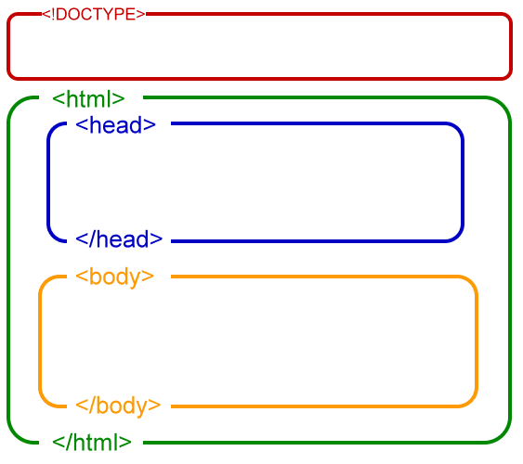
HTML
The Hyper Text Markup Language is the standard markup language for documents designed to be displayed in a web browser.
It can be assisted by technologies such as Cascading Style Sheets (CSS) and scripting languages such as Javascript.
Web Browsers receive HTML documents from a web server or from local storage and render the documents into multimedia web pages.
HTML describes the structure of a web page semantically and originally included cues for the appearance of the document.

Slide 9
CSS
Cascading Style Sheets (CSS) is a style sheet language used for describing the presentation of a document written in a markup language such as HTML.
CSS is designed to enable the separation of presentation and content, including layout, colors, and fonts.
CSS also has rules for alternate formatting if the content is accessed on a mobile device.
JavaScript
JavaScript often abbreviated JS, is a programming language that is one of the core technologies of the World Wide Web, alongside HTML and CSS.
Over 97% of websites use JavaScript on the client side for web page behavior, often incorporating third-party libraries.
It has application programming interfaces (APIs) for working with text, dates, regular expressions, standard data structures, and the Document Object Model (DOM).
The most popular runtime system for this usage is Node.js.

Slide 10
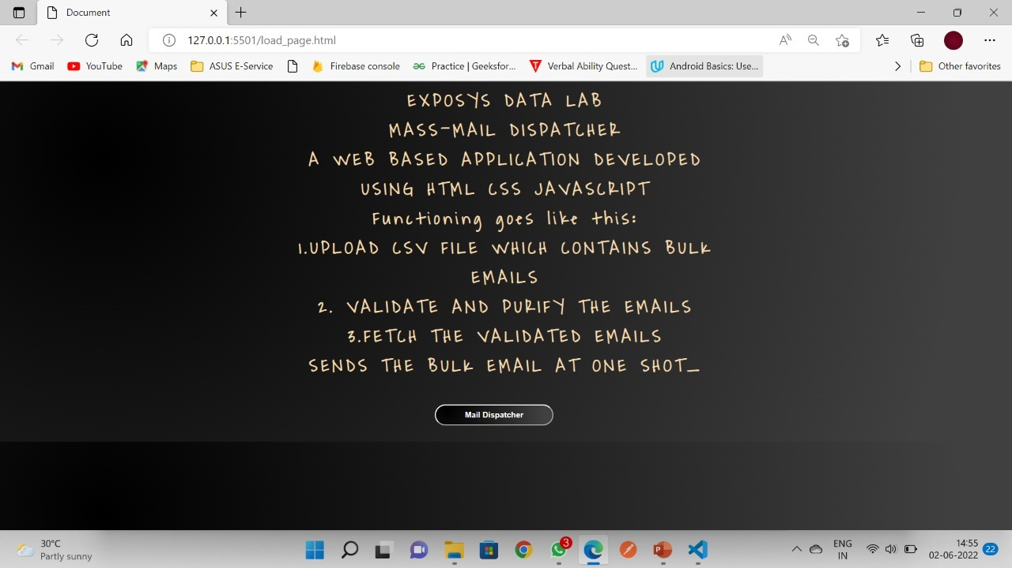
Implementation
There will be a mail dispatcher button on homepage. On clicking the button, the user will land on the mail dispatcher page where user can upload the csv file which contains mail id to be send the mail .

Slide 11
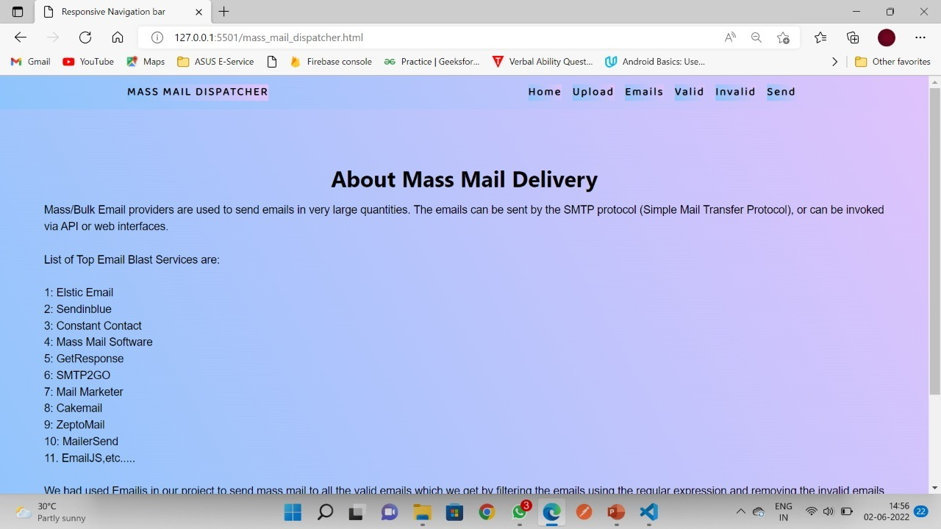

Slide 12
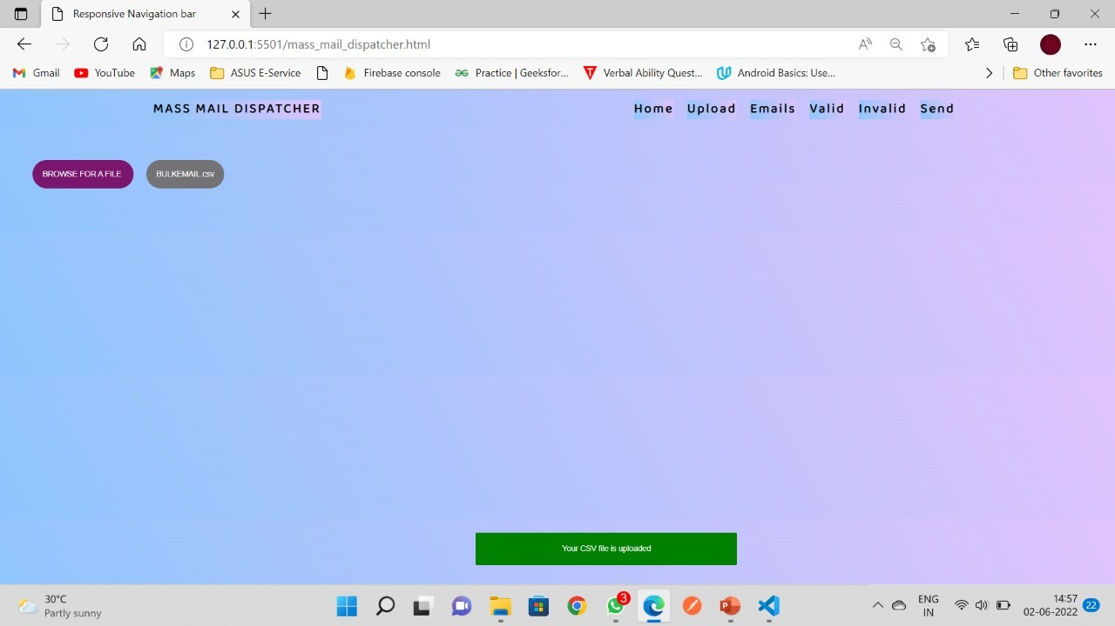
By clicking on browse for a file , user can upload csv file from device which will contain all the email id's user wants to send the mail and

Slide 13
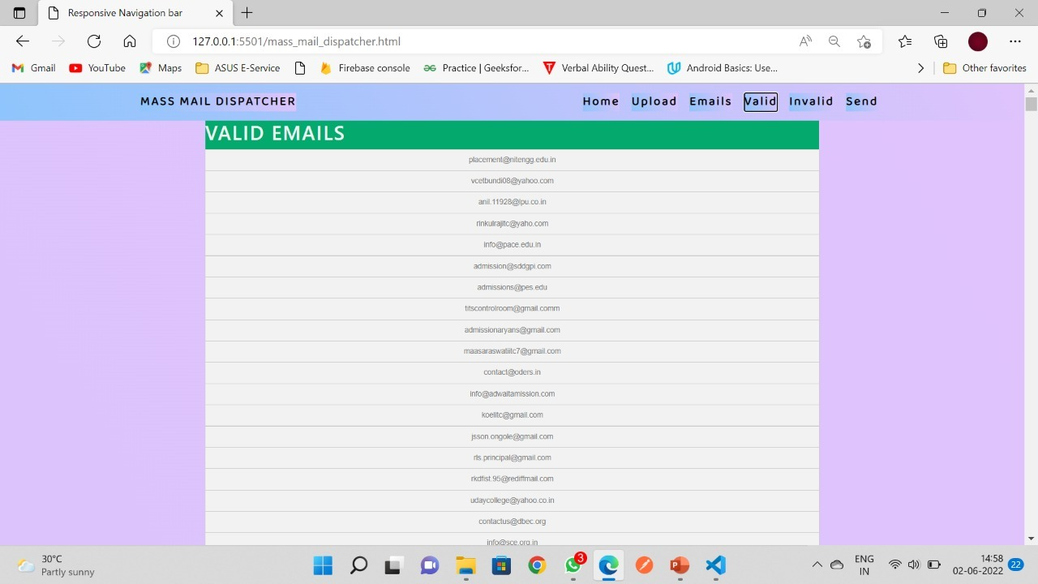

Slide 14
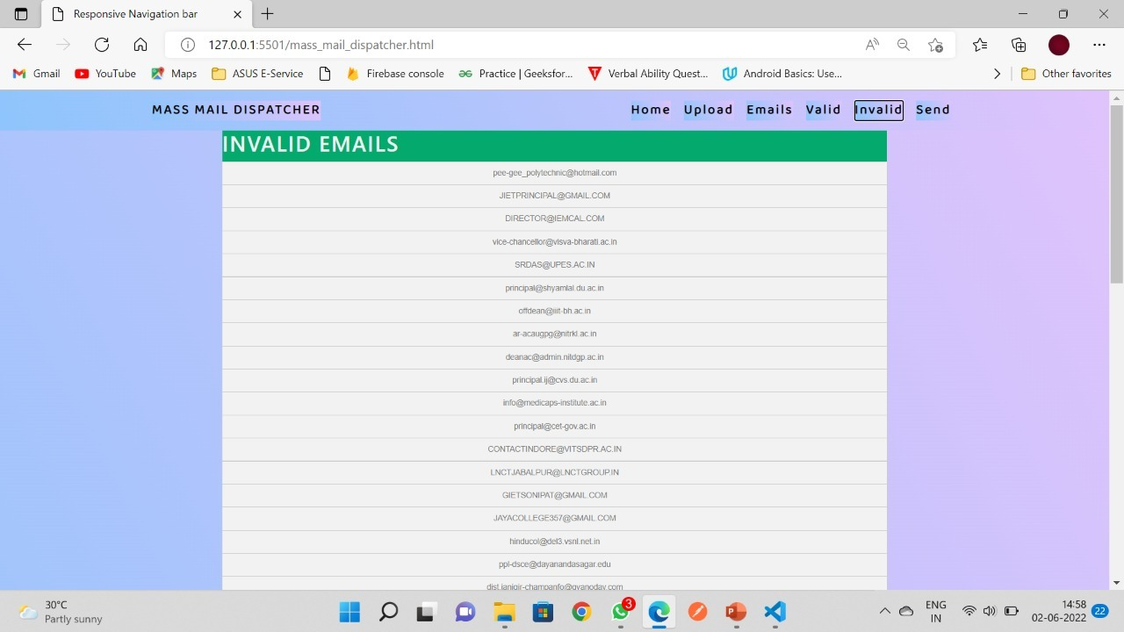

Slide 15
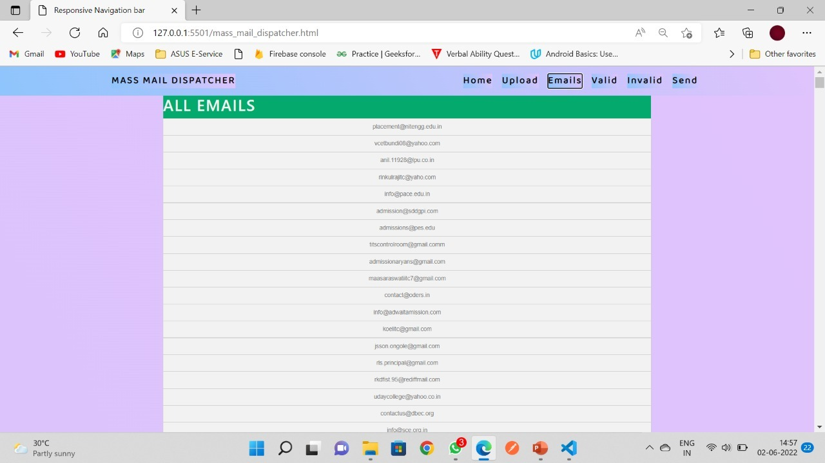

Slide 16
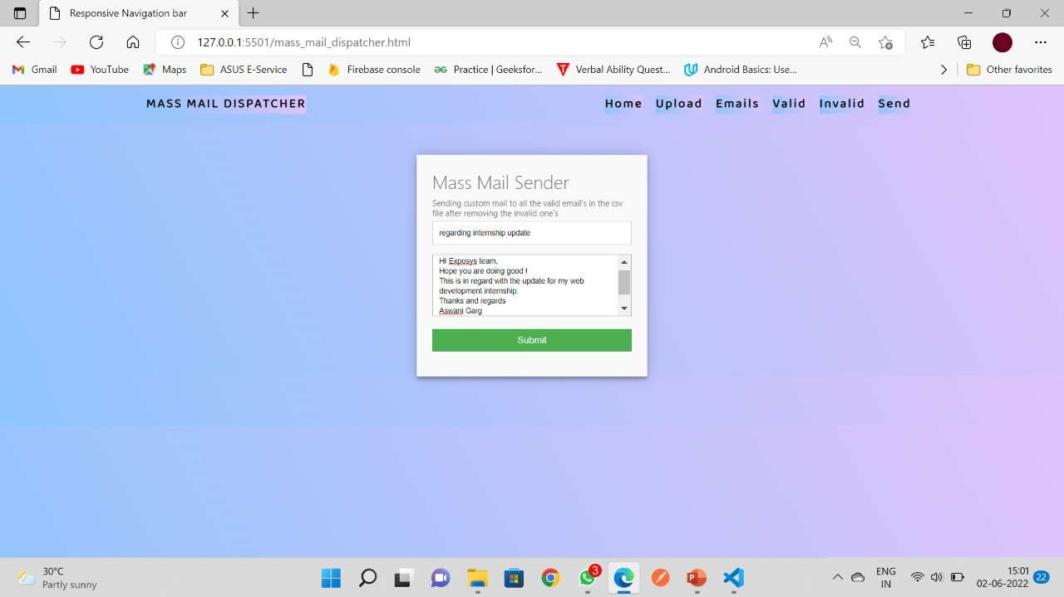
By clicking send button , a pop-screen will come out , where user can add subject of mail and the mail user want to send to all valid email-id's in just one stroke.

Slide 17
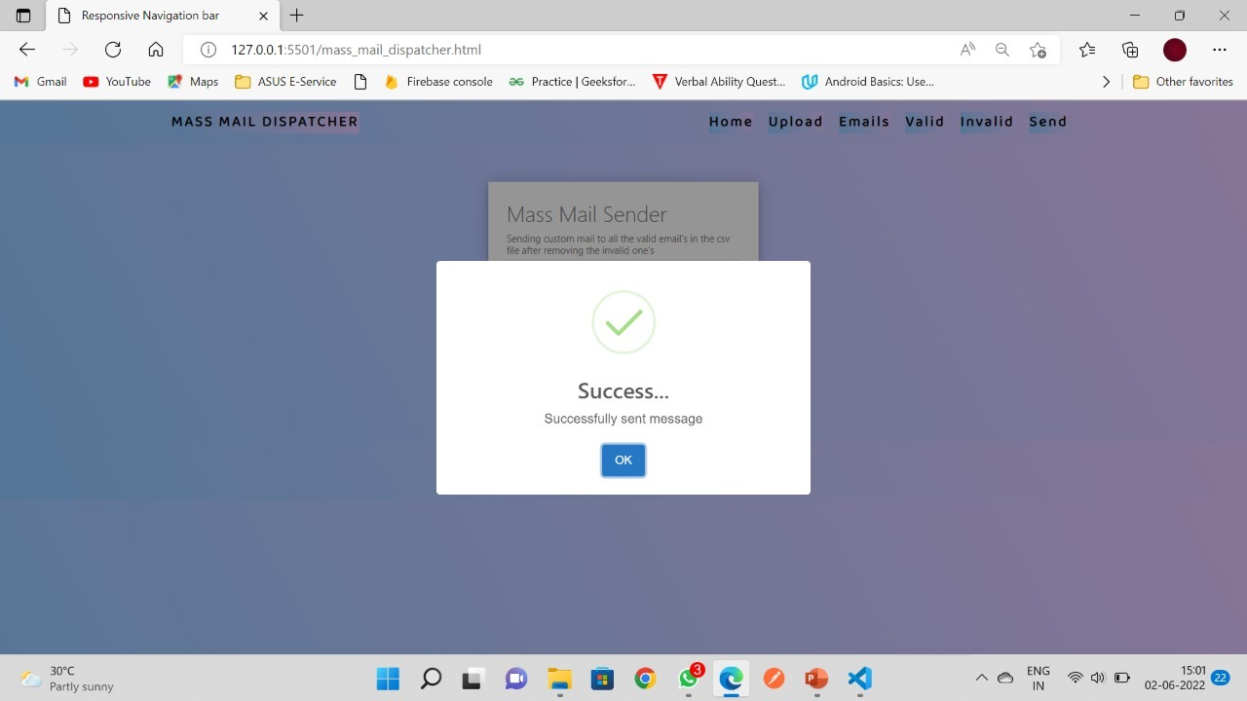
Result

Slide 18
Reflection Notes
I am thankful to having the opportunity to work with The Exposys Data labs because I discovered a program that I would like to work with and at the same time gained fabulous ideas to develop projects on Web Development. The time I spent at Exposys Data labs as an intern was a memorable one for me as it was rich in experience sharing and helped me discover my potential. I had so many experiences and opportunities that I personally believe will forever shape and influence my professional life while fostering personal growth and development. To enhance my knowledge and skills, The Exposys Data labs gave me the opportunity to intern with their project for a period of 4 weeks. It has been a great pleasure working and getting qualified with colorful grades from The Exposys Data labs as it has provided me a great opportunity to learn leadership skills.

Slide 19
Conclusion
I am grateful to have been able to get the opportunity to pursue my industrial training at The Exposys Data
Labs. I had a good learning experience at The Exposys Data Labs.

Slide 20


