Slide 1
How Do ECB Interest Rate Changes
Shape Customer Behaviour
and Portfolio Risk in European Banking?
4
MSc Data Science & Data Analytics Sonali Singh – 25253051 https://github.com/SonaliSingh26/ST606-Msc-in-Data-Science-and-Analytics-Project-Dissertation-

Slide 2
What Motivated This Thesis?
" I am fascinated by what banks actually do every day and the answer is their products. Term deposits, loans, campaigns that is the engine of banking income.
Banking is Product-Driven
ECB Rates Change Everything
Real Data, Real Decisions
A bank's primary income comes from selling the right products to the right customers at the right moment. This thesis is about exactly that process.
When the ECB cuts rates, customer behaviour shifts dramatically. Understanding that link is critical for any bank's commercial strategy.
Using actual Portuguese bank data from the 2008–2010 rate cycle gives this work genuine commercial relevance not just academic exercise.

Slide 3
Research Overview
A Portuguese bank made 41,188 calls (2008–2010) asking customers to open a term deposit.
The ECB cut rates from 5% to below 1% during the same period, a natural experiment.
How do customers cluster into distinct profiles, and how do profiles differ in ECB rate sensitivity?
RQ1
Component 1: Customer Segmentation
How do ECB rate changes dynamically influence subscription behaviour over time?
RQ2
Component 2: Dynamic Rate Modelling
How can portfolio risk be quantified and stress-tested under ECB rate shock scenarios?
RQ3
Component 3: Value-at-Risk (Future Work)

Slide 4
Dataset: UCI Bank Marketing
41,188
21
11.3%
24
Customer Records
Features
Subscription Rate
Monthly Periods
Column | Data Type | What it represents | Role in Thesis
euribor3m | Numeric (float) | 3-month ECB benchmark rate (0.63%–5.04%) | Core ECB variable — all 3 components
banking_product_adopted | Binary (yes/no) | Did the customer subscribe to a term deposit? | Target variable
age, job, education | Numeric / Categorical | Customer demographics | Segmentation features (RQ1)
poutcome | Categorical | Outcome of previous campaign contact | Strongest predictor — 65% sub rate if 'success'
emp.var.rate, nr.employed | Numeric (float) | Macro employment indicators (VIF > 30) | Dropped — collinear with euribor3m
duration | Numeric (int) | Call length in seconds | Excluded — post-call leakage

Slide 5
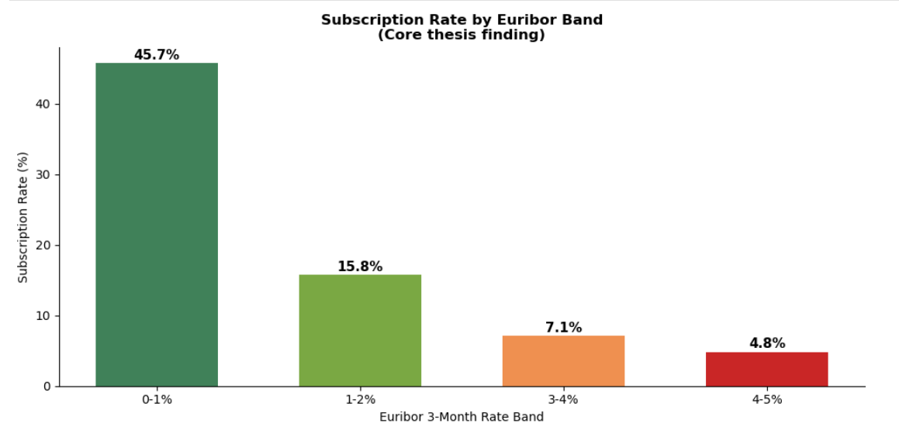
EDA: Core Finding — Euribor Rate vs Subscription
Key Finding
45.7%
subscription rate when Euribor is below 1%
4.8%
subscription rate when Euribor is above 4%
~10×
difference in subscription driven purely by rate environment

Slide 6
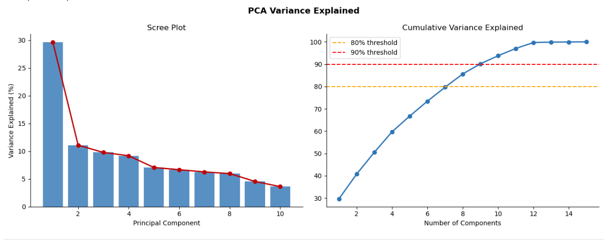
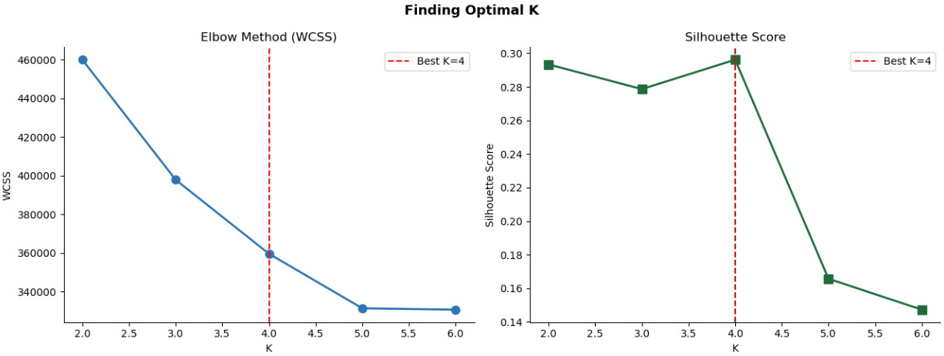
Component 1: Dimensionality Reduction & Optimal K
PCA: 8 components explain 80% of variance. 2 components used for visualisation (40.7%).
Elbow + Silhouette both peak at K=4, confirms 4 clusters is the right choice.
K = 4
ARI = 0.9992
Silhouette = 0.296
p < 0.001
Optimal clusters
(both methods)
K-Means vs Hierarchical
near-perfect agreement
Statistically well-
separated clusters
All features
significant (ANOVA)

Slide 7
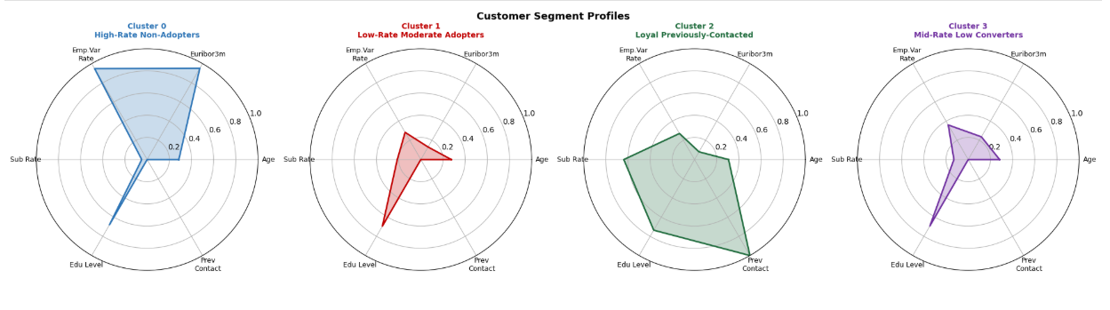
Component 1: Customer Segment Profiles
Segment | Size | Sub Rate | What this segment means for the bank
High-Rate Non-Adopters | 65.4% | 4.9% | Largest group. Contacted during high-rate periods. Rate cuts will NOT convert them.
Low-Rate Moderate Adopters | 20.9% | 21.2% | Key campaign target. Respond strongly when ECB cuts rates.
Loyal Previously-Contacted | 3.7% | 63.8% | Highest-value micro-segment. Prior success predicts repeat uptake.
Mid-Rate Low Converters | 10.0% | 12.9% | Moderate rate environment, moderate response. Secondary opportunity.

Slide 8
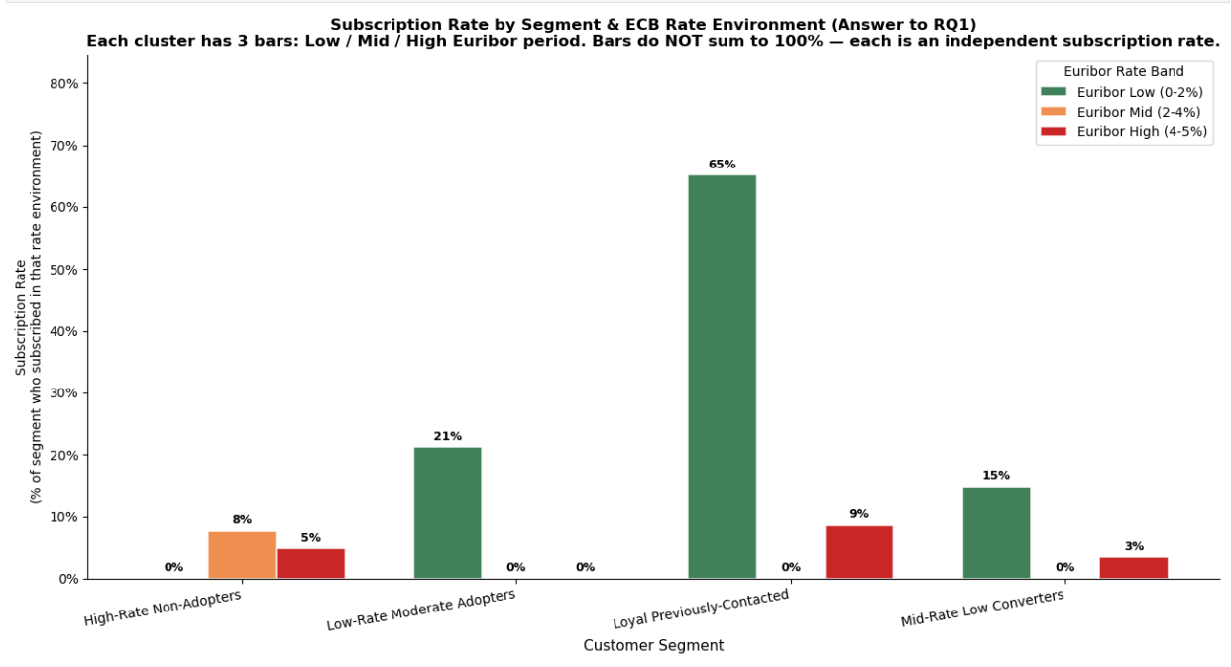
RQ1 Answer: Rate Sensitivity by Segment
Conclusion:
Each cluster = a group of customers from Component1
3 bars per cluster = sub rate when Euribor was Low / Mid / High
Bars do NOT sum to 100%, each is independent
Loyal Previously-Contacted: 65% sub rate in low-rate periods
High-Rate Non-Adopters: near 0% regardless rate cuts won't help
Low-Rate Moderate Adopters activated only when rates fall

Slide 9
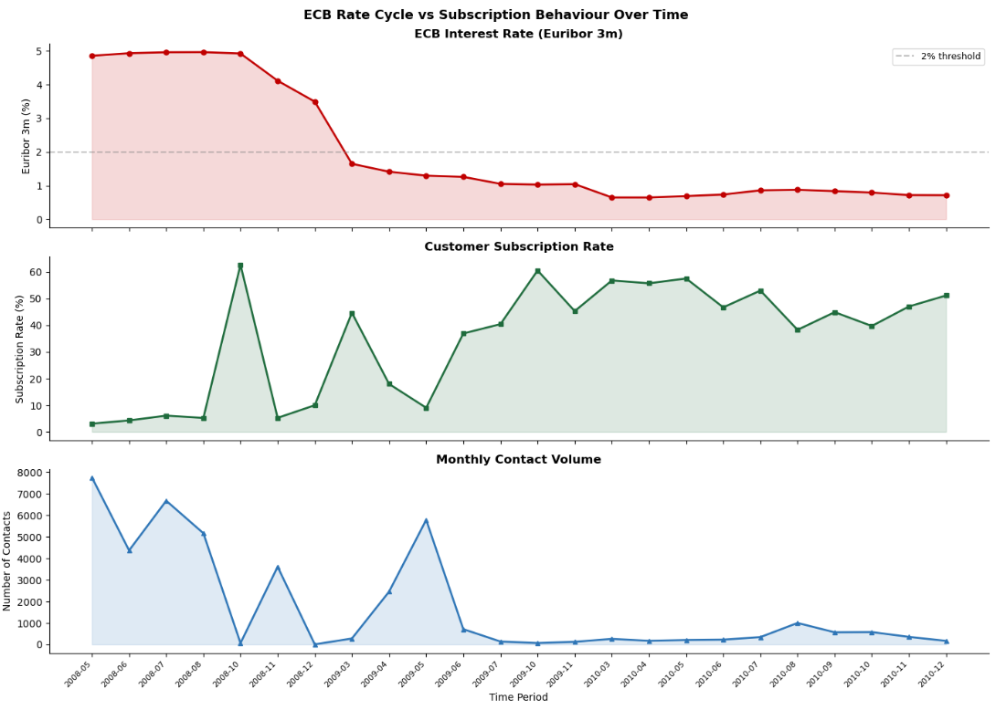
Component 2: ECB Rate Cycle vs Subscription Behaviour Over Time
Time Series Foundation
41,176 rows collapsed to 24 monthly observations
Top panel: ECB Euribor 3m — falls from 5% to <1%
Middle panel: subscription rate rises as rates fall
Inverse relationship visible in the raw data
All 3 variables non-stationary → first differenced
Granger causality p > 0.6 small sample (n=23) limits power
VAR validated by AICc + rolling cross-validation

Slide 10
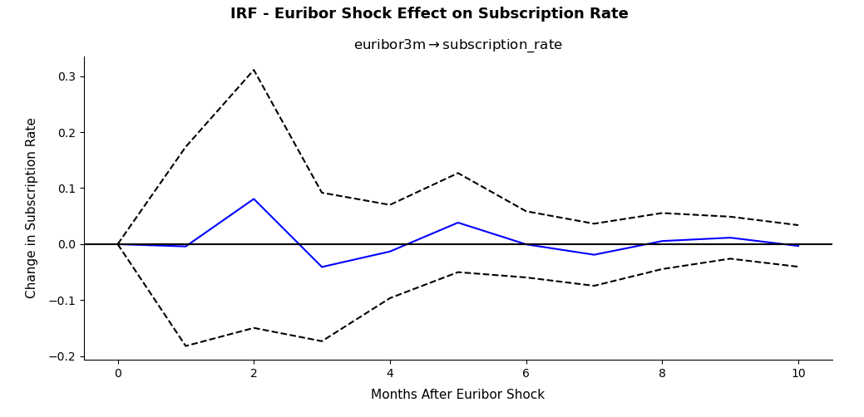
Component 2: IRF — Euribor Shock Response
IRF Results:
Blue line = subscription rate response to 1-unit Euribor shock
Dashed lines = 95% confidence interval
Effect peaks at month 2 (t+2)
Decays to zero over 6–8 months
~2 quarter lag from ECB policy to customer behaviour
Wide CIs expected, only 23 monthly observations

Slide 11
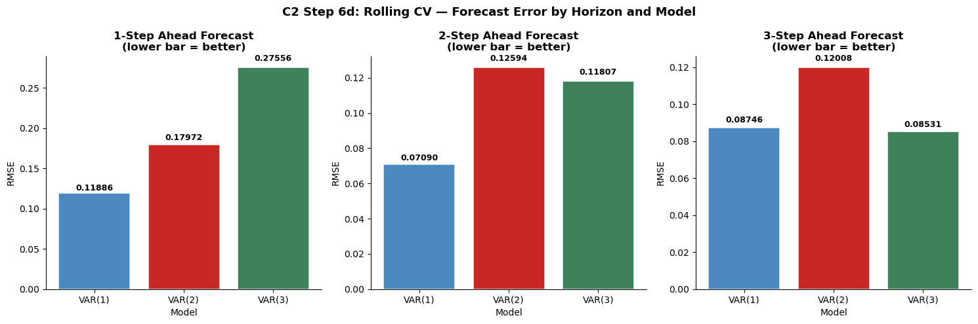
Component 2: VAR Validation — Rolling Cross-Validation
VAR Selection
1. VAR(1) wins at 1-step and 2-step horizons
2. VAR(3) competitive at 3-step
3. AICc also selects VAR(1)
4. VAR(1) is most conservative choice for n=23
5. Lower RMSE = better forecast

Slide 12
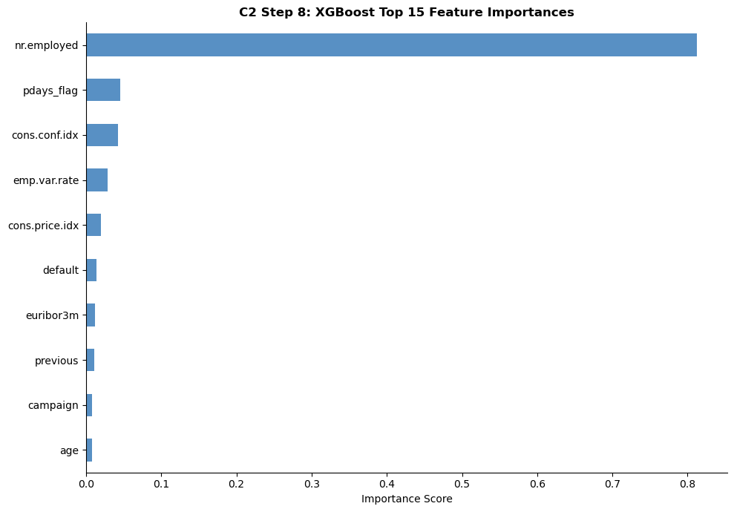
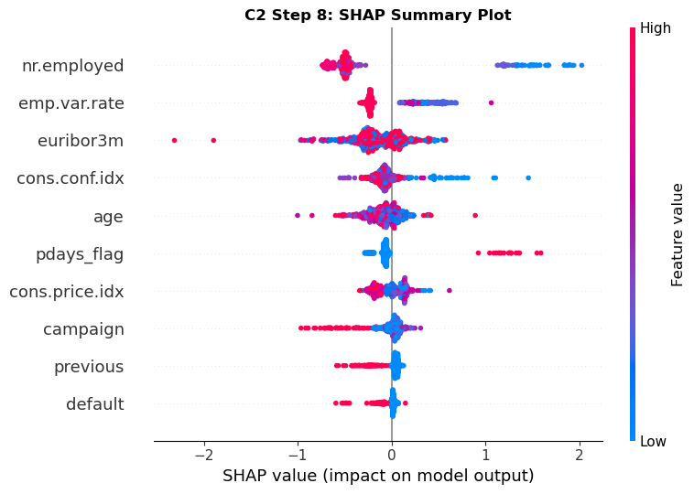
Component 2: XGBoost Feature Importance & SHAP
Feature importance shows nr.employed dominates (0.81) a proxy for the macro environment. SHAP confirms direction: high nr.employed suppresses subscriptions.

Slide 13
Key Findings
Customer Segmentation
1. 4 customer segments , ARI = 0.9992 between K-Means and Hierarchical Clustering
RQ1
2. Loyal Previously-Contacted: 63.8% subscription most valuable segment
3. High-Rate Non-Adopters: 65% of customers, 4.9% sub rate ,rate cuts will not activate them
Dynamic Rate Modelling
1. ECB rate environment causes ~10× variation in subscription behaviour
RQ2
2. VAR(1) preferred, selected by both AICc and rolling cross-validation
3. IRF: rate shock effect peaks at month 2 (t+2), decays over 6–8 months
RQ1 and RQ2 are directly linked: segment membership determines how strongly ECB rate changes affect individual customers.

Slide 14
Conclusion
Contributions
1. ECB rate environment causes ~10× variation in subscription behaviour
2. Four statistically significant clusters having varying rate responsiveness
3. The cluster-based VAR model works better for the Low Rate Moderate cluster
4. VaR framework developed linking clustering to risk assessment
Limitations & Next Steps
1. Sample size of 24 months affects results of Granger causality test
2. Autocorrelation found in subscription equation resulting from low sample size
3. Lack of significance of Granger test result due to low sample size
4. VaR framework development completed; implementation is the next step

Slide 15
Component 3: Value-at-Risk — Framework & Next Steps
Statistical Methods
Validation & Stress Testing
1. Historical VaR : no distributional assumptions
1. Kupiec backtesting : verify breach rate vs confidence level
2. Parametric VaR : assumes normal distribution
2. Isolation Forest : anomalous months in rate behaviour
3. Monte Carlo VaR : 10,000 simulated scenarios
3. Stress test each segment: +50bp, +100bp, +200bp shocks
4. CVaR (Expected Shortfall) : tail risk measure
4. Directly links RQ 1 segments to portfolio risk
5. GARCH(1,1) : time-varying volatility
5. Answers RQ3: which segments are most exposed to rate hikes?

Slide 16
Thank You
Questions & Discussion

