Slide 1
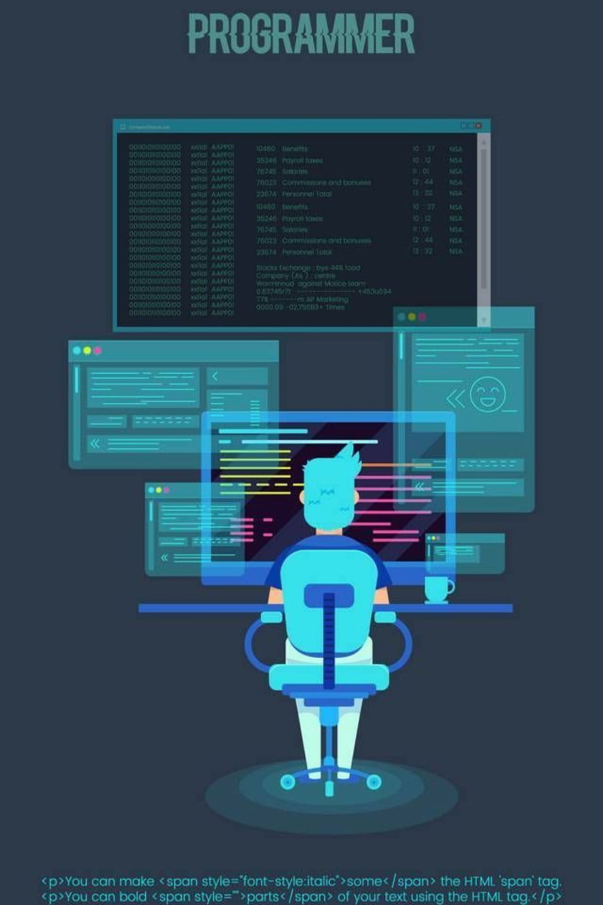

Aligarh Muslim University
Department of
Computer Science
PRESENTS
IT FEST
On 30 Aug 2024
Venue : Department of Computer Science
10 A.M. to 06 P.M.
Join us for an exciting IT Fest!
Explore tech innovations, competitions, and fun.
Don't miss out! Save the date!

