Slide 1
Software Testing Course
Submitted By- Sonal Bhujbal
Guided By-Mohana Priya

Slide 2
Contents
HTML
CSS
JavaScript
Manual Testing
Automation Testing
Selenium
Cucumber
TestNG
Java OOPs concept
DBMS

Slide 3
HTML
HTML stands for Hyper Text Markup Language
HTML is the standard markup language for creating Web pages
HTML describes the structure of a Web page
HTML consists of a series of elements
HTML elements tell the browser how to display the content
HTML elements label pieces of content such as "this is a heading", "this is a paragraph", "this is a link", etc.

Slide 4
HTML Tags
HTML Headings
HTML paragraph
HTML Links
HTML images
HTML comments
Text formatting tags
HTML Style attributes
HTML Tables
Lists
Forms
Frames
HTML video, audio, plug-in

Slide 5
HTML Layout Elements
header> - Defines a header for a document or a section
<nav> - Defines a set of navigation links
<section> - Defines a section in a document
<article> - Defines an independent, self-contained content
<aside> - Defines content aside from the content (like a sidebar)
<footer> - Defines a footer for a document or a section
<details> - Defines additional details that the user can open and close on demand
<summary> - Defines a heading for the <details> element

Slide 6
List
There are three types of lists
Ordered list
An ordered list starts with <ol> tag and each list item start with <li> tag. It is numbered format by default.
Unordered list
An ordered list starts with <ul> tag and each list item start with <li> tag. List starts with bullets, small black circles format by default.
Description List
An description list contains description of list.
<dl> description lists
<dt> describes terms or names
<dd> description of each list

Slide 7
Forms
It is used to collect user inputs.
<form>
.
form elements
.
</form>
<Video>Element
<video width="320" height="240" controls>
<source src="movie.mp4" type="video/mp4">
</video>
<audio>Element
<audio controls>
<source src="horse.ogg" type="audio/ogg">
</audio>
HTML youtube
<iframe width="420" height="315"
src="https://www.youtube.com/embed/tgbNymZ7vqY">
</iframe>
HTML plugins
<object width="100%" height="500px" data="snippet.html">
</object>

Slide 8
Type | Description
<input type="text"> | Displays a single-line text input field
<input type="radio"> | Displays a radio button (for selecting one of many choices)
<input type="checkbox"> | Displays a checkbox (for selecting zero or more of many choices)
<input type="submit"> | Displays a submit button (for submitting the form)
<input type="button"> | Displays a clickable button

Slide 9
CSS
CSS stands for Cascading Style Sheets.
CSS saves a lot of work. It can control the layout of multiple web pages all at once.
Cascading Style Sheets (CSS) is used to format the layout of a webpage.
With CSS, you can control the color, font, the size of text, the spacing between elements, how elements are positioned and laid out, what background images or background colors are to be used, different displays for different devices and screen sizes, and much more!

Slide 10
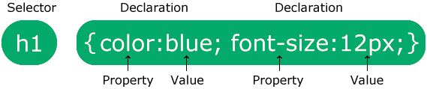
Syntax:

Slide 11
CSS Box Model
All HTML elements can be considered as boxes.
The CSS box model is essentially a box that wraps around every HTML element. It consists of: margins, borders, padding, and the actual content.
There are two types
Inline boxes
Block boxes
Content - The content of the box, where text and images appear
Padding - Clears an area around the content. The padding is transparent
Border - A border that goes around the padding and content
Margin - Clears an area outside the border. The margin is transparent

Slide 12
JavaScript
JavaScript is the world's most popular programming language.
JavaScript is the programming language of the Web.
JavaScript is easy to learn.
This tutorial will teach you JavaScript from basic to advanced.

Slide 13
Advantages of JavaScript
The merits of using JavaScript are −
Less server interaction − You can validate user input before sending the page off to the server. This saves server traffic, which means less load on your server.
Immediate feedback to the visitors − They don't have to wait for a page reload to see if they have forgotten to enter something.
Increased interactivity − You can create interfaces that react when the user hovers over them with a mouse or activates them via the keyboard.
Richer interfaces − You can use JavaScript to include such items as drag-and-drop components and sliders to give a Rich Interface to your site visitors.

Slide 14
SDLC

Slide 15
STLC

Slide 16
Testing
Manual Testing is one of the most fundamental testing processes as it can find both visible and hidden defects of the software. The difference between expected output and output, given by the software, is defined as a defect. The developer fixed the defects and handed it to the tester for retesting.
Types of Manual Testing
There are various methods used for manual testing. Each technique is used according to its testing criteria. Types of manual testing are given below:
White Box Testing
Black Box Testing
Gray Box Testing

Slide 17
Types of Testing
White-box testing
The white box testing is done by Developer, where they check every line of a code before giving it to the Test Engineer. Since the code is visible for the Developer during the testing, that's why it is also known as White box testing.
Black box testing
The black box testing is done by the Test Engineer, where they can check the functionality of an application or the software according to the customer /client's needs. In this, the code is not visible while performing the testing; that's why it is known as black-box testing.
Gray Box testing
Gray box testing is a combination of white box and Black box testing. It can be performed by a person who knew both coding and testing. And if the single person performs white box, as well as black-box testing for the application, is known as Gray box testing.

Slide 18
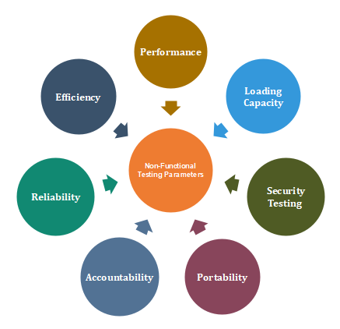
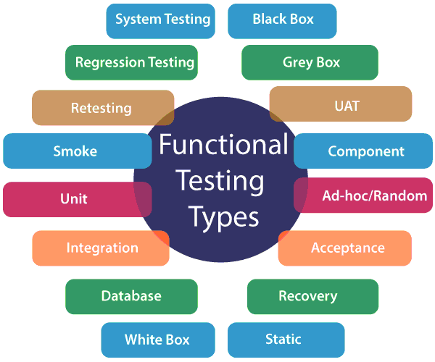
Types of Black box
There are two types of testing:
Functional Testing
Non-Functional Testing

Slide 19
Bug Life Cycle
Defect Life Cycle or Bug Life Cycle in software testing is the specific set of states that defect or bug goes through in its entire life. The purpose of Defect life cycle is to easily coordinate and communicate current status of defect which changes to various assignees and make the defect fixing process systematic and efficient.

Slide 20
Java OOPs Concepts
Inheritance
When one object acquires all the properties and behaviors of a parent object, it is known as inheritance. It provides code reusability. It is used to achieve runtime polymorphism.
Polymorphism
If one task is performed in different ways, it is known as polymorphism. For example: to convince the customer differently, to draw something, for example, shape, triangle, rectangle, etc.
Abstraction
Hiding internal details and showing functionality is known as abstraction. For example phone call, we don't know the internal processing.
Encapsulation
Binding (or wrapping) code and data together into a single unit are known as encapsulation. For example, a capsule, it is wrapped with different medicines.
A java class is the example of encapsulation. Java bean is the fully encapsulated class because all the data members are private here.

Slide 21
DBMS
The database is a collection of inter-related data which is used to retrieve, insert and delete the data efficiently. It is also used to organize the data in the form of a table, schema, views, and reports, etc.
SQL-Structured Query language
It has 5 commands as Follows:
DDL-Data definition Language
DQL-Data Query Language
DML-Data manipulation language
DCL-Data Control Language
TCL-Transaction Control language

Slide 22
DDL-Data definition Language
It has 6 commands
Create-Used to create database, table
Ex. create database database_name;
Alter-Used to change structure of database
Ex. Alter table
Drop-Used to delete object or database
Ex. Drop table table_name;
Truncate-Used to remove all records from table
Ex. Truncate table table_name;
Comment-used to Add comment
Rename-Used to change name of table.

Slide 23
DQL-Data Query Language
It is also known as data retrieval lang.
Select: Used to retrieve data from database
Ex select * from table_name;
Data Control Language:
It has 2 commands
Grant-Access privilege the database
Revoke-Withdraw the access privileges

Slide 24
Data Manipulation Language:
Insert: Insert data to database
Ex insert into table_name(col 1 datatype,col2 datatype,….col n datatype) values(value1,value2,….value n);
Delete-Used to delete records from table or database
Ex. Delete from table_name [where condition];
Update-Used to update existing data within table
Lock-It is Table control concurrency
Call-call PL/SQL
Transaction Control Language:
It has 3 commands
Commit-commit the transaction
Savepoint-set the savepoint within transaction
Rollback-To get Savepoint

Slide 25
Automation Testing
Automation Testing is a software testing technique that performs using special automated testing software tools to execute a test case suite.
Automation Testing Process

Slide 26
Types of Automated Testing
Smoke Testing
Unit Testing
Integration Testing
Functional Testing
Keyword Testing
Regression Testing
Data Driven Testing
Black Box Testing

Slide 27
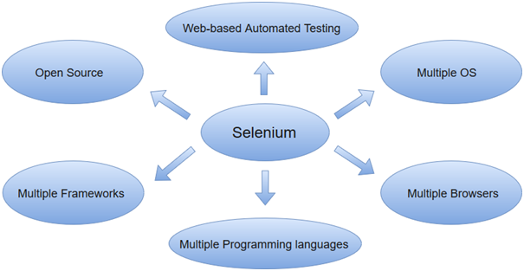
Selenium
Selenium is a popular open-source web-based automation tool.

Slide 28
Cucumber
Cucumber is a testing tool that supports Behavior Driven Development (BDD). It offers a way to write tests that anybody can understand, regardless of their technical knowledge. In BDD, users (business analysts, product owners) first write scenarios or acceptance tests that describe the behavior of the system from the customer’s perspective, for review and sign-off by the product owners before developers write their codes.
Code
package runner;
import org.junit.runner.RunWith;
import io.cucumber.junit.CucumberOptions;
import io.cucumber.junit.Cucumber;
@RunWith(Cucumber.class)
@CucumberOptions(features="src/test/java",glue= {"instagramTest"})
public class Runner {
}

Slide 29
Test NG

Slide 30
Conclusion
I come to know that HTML,CSS, JavaScript, DBMS concept, testing Concept , Selenium.
I am able to write code with the help of java and selenium.
By using selenium , I come to know how to automate webpages using selenium , cucumber and TestNG.

