Slide 1
Stack Data Structure
Sonam Wangmo

Slide 2
Learning Objectives
Define stack data structure and its principle.
Write the solution of the problem presented.
Reflect the real-world applications of stack

Slide 3
What is Stack Data Structure ???
Stack is called a Last-in-Last-out(LIFO) collection. This means that the last thing we added(pushed) is the first thing that gets pulled(popped) off.
A stack is a sequence of items that are accessible at only one end of the sequence.

Slide 4

Example of Stack

Slide 5
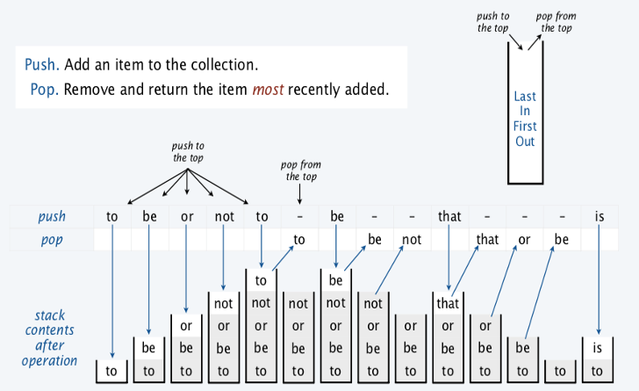
Example of Stack

Slide 6
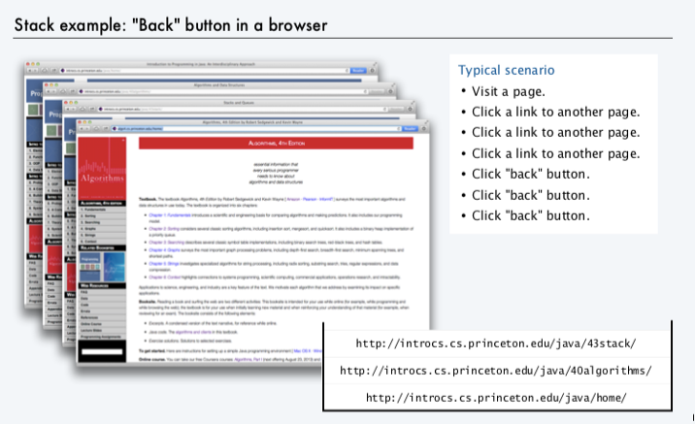
Stack Applications

Slide 7
Demonstration of Stack
https://ds1-iiith.vlabs.ac.in/exp/stacks-queues/stacks/stackdemo.html

Slide 8
Activity – Pair Work (10 minutes)
Problem: A and B are playing a game. In this game, both of them are initially provided with a list of n numbers. (Both have the same list but their own copy).
Now, they both have a different strategy to play the game. A picks the element from start of his list. B picks from the end of his list.
You need to generate the result in form of an output list.
Method to be followed at each step to build the output list is:
If the number picked by A is bigger than B then this step's output is 1 . B removes the number that was picked from their list.
If the number picked by A is smaller than B then this step's output is 2 . A removes the number that was picked from their list.
If both have the same number then this step's output is 0 . Both A and B remove the number that was picked from their list.
This game ends when at least one of them has no more elements to be picked i.e. when the list gets empty.
Discuss the situation and come up with some solutions

Slide 9


Summarise the concepts learnt in the class.
ⓘ Start presenting to display the poll results on this slide.
Notes:
📣 This is Slido interaction slide, please don't delete it. ✅ Click on 'Present with Slido' and the poll will launch automatically when you get to this slide.

Slide 10
THANK YOU

