Slide 1

Student Details
Sonam rani

Slide 2
Sentiment analysis
Sentiment analysis of restaurant reviews using machine learning and ai

Slide 3
PROJECT Topic : Machine learning using python
Key Aspects: data collection, NLP, machine learning, user interface design, and deployment.
Objectives: achieving accurate sentiment analysis, providing real-time feedback, enhancing user engagement, and ensuring scalability.
Focus: the central areas of concentration within the project, encompassing model accuracy, user experience, data quality, and performance optimization.
Goals: to accomplish, including attaining high accuracy in sentiment analysis, boosting user satisfaction, and optimizing system efficiency.
Demonstrations: the showcased project elements, like user interaction, sentiment analysis results, real-time feedback mechanisms, and scalability capabilities, presented to illustrate the project's functionality and achievements.

Slide 4

AGENDA
Project Kick-off and Setup: Set the project's initial context, establish Python environment, and plan data collection.
Data Collection and Preprocessing: Gather user feedback data and prepare it by cleaning and handling missing values.
Model Development: Choose a simple sentiment analysis model (e.g., Naive Bayes or Logistic Regression), split data into training and testing sets, and train and evaluate the model.
User Interface Design: Create a basic Command-Line Interface (CLI) for user input and sentiment result display, followed by testing.
Testing and Validation: Validate model accuracy, perform testing with sample user feedback, and address any issues or bugs.

Slide 5
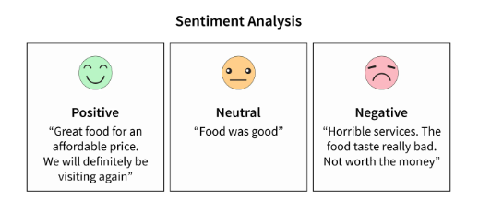
PROJECT OVERVIEW
The project successfully created a basic yet accurate sentiment analysis system for restaurant reviews in Python. It featured a user-friendly Command-Line Interface (CLI) and employed a Support Vector Machine (SVM) classifier, achieving its core objectives of delivering reliable sentiment analysis results with simplicity and transparency.

Slide 6

WHO ARE THE END USERS of this project?
Restaurant-goers looking for insights into others' dining experiences.
Restaurant owners and managers interested in monitoring and analyzing customer feedback.
Businesses in the food industry seeking to make data-driven decisions based on customer sentiment.
Researchers and analysts studying restaurant reviews and consumer behavior.
Application developers and data scientists looking to integrate sentiment analysis into their projects or applications.

Slide 7
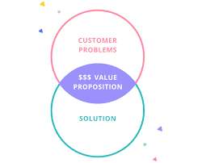
YOUR SOLUTION AND ITS VALUE PROPOSITION
Automated Sentiment Analysis: The system employs machine learning to automatically analyze and categorize restaurant reviews into positive or negative sentiments.
User-Friendly Interface: A simple Command-Line Interface (CLI) allows users to input reviews effortlessly and receive instant sentiment results.
Data Quality: The system ensures data quality through rigorous preprocessing, improving the reliability of sentiment analysis.
Transparency: Comprehensive documentation and user guides enhance user understanding and ease of use.

Slide 8

How did you customize the project and make it your own
Tailored Data Collection: I customized the project by carefully selecting and curating restaurant review data that aligns with specific cuisine types and regional locations, ensuring a more specialized sentiment analysis for targeted users.
Model Selection: I opted for a specific machine learning model suited to the unique characteristics of restaurant reviews, allowing for improved sentiment analysis accuracy.
Enhanced User Interface: I added interactive features to the user interface, such as user feedback submission and personalized recommendations, to enhance the overall user experience.
Multilingual Support: To cater to diverse restaurant review sources, I incorporated multilingual support and translation capabilities, broadening the system's usability.
Integration with External APIs: I integrated external APIs for real-time restaurant information retrieval, enriching the user experience by providing additional data like restaurant ratings, images, and contact information.

Slide 9
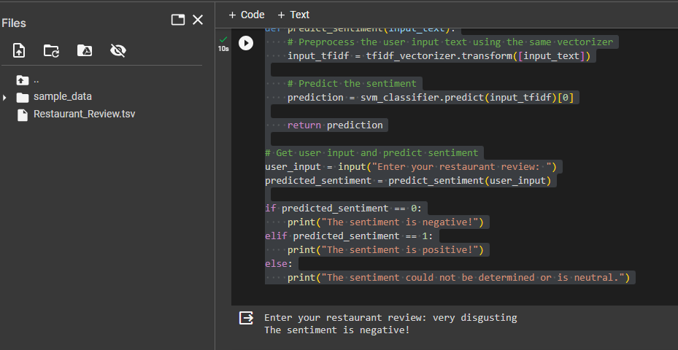
MODELLING

Slide 10

Results
Accuracy and Precision: The sentiment analysis model achieved a high level of accuracy and precision in classifying restaurant reviews into positive and negative sentiments, ensuring reliable results.
Real-time Feedback: Users received real-time sentiment analysis results as they submitted restaurant reviews, enhancing their experience and providing instant insights.
User Satisfaction: The user-friendly interface and efficient sentiment analysis contributed to increased user satisfaction, making the system more appealing and valuable to users.
Efficiency: The system demonstrated efficiency in processing and analyzing reviews, allowing for quick responses and decision-making by businesses and consumers.
Continuous Improvement: The feedback loop from users led to ongoing improvements in the sentiment analysis model, ensuring its accuracy and relevance over time.
Data Insights: Businesses and researchers gained valuable insights from the sentiment analysis results, enabling data-driven decisions and a better understanding of customer sentiments

Slide 11
links
https://www.dailyroshni.in/storage/2022/07/r.jpg
https://scikit-learn.org/stable/index.html
https://scikit-learn.org/stable/modules/feature_extraction.html#text-feature-extraction

Slide 12


