Slide 1
Minor project - 1
HEALTH REPORT ANALYZER
– A Machine Learning-Based Disease Prediction Platform
SUBMITTED TO – Mr. VIPIN RATHI
(ASSISTANT PROFESSOR , DU)
Presented by – Saurav kumar
College Roll no. – 20222745
University roll no. – 22020107019
Course – b. Voc (SD)
SEMESTER – V

Slide 2
PROJECT OVERVIEW
Description :
A machine learning project designed for disease prediction
Analyses health reports to predict the five disease.
Scalable for additional disease in the future.
Core Functionality :
User inputs data from health reports.
Predicts diseases based on the provided data.
Features :
Choose Disease Prediction Model :
User can select from a list of diseases.
“To Know More” Buttons :
Linked to Government and reliable health websites for detailed disease information.
Disease predictor :
Compares user-provided data with pre-trained datasets for predictions.

Slide 3
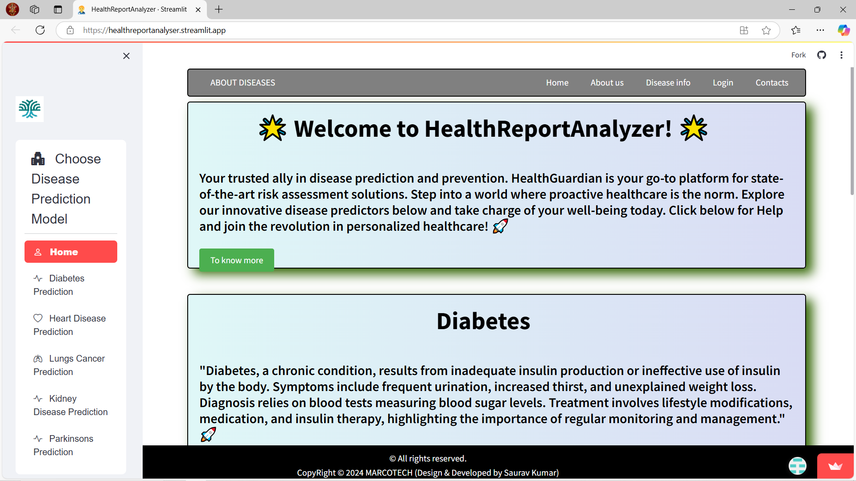
Health Report Analyzer Home Page
GitHub Link - HealthReportAnalyzer

Slide 4
TECHNOLOGY USED
Technology :
Language and Tools :
Python, HTML, CSS, JavaScript.
Machine Learning frameworks.
Libraries:
TensorFlow, Keras, Scikit-Learn.
Platform:
Streamlit (for web application )
Prerequisites
Required installations :
Streamlit
TensorFlow
Streamlit_option_menu
Keras
Scikit-learn

Slide 5
USES TECHNOLOGIES
Implementation Steps
Clone the GitHub repository:
git clone - gihub repository : HealthReportAnalyzer
Setup:
Navigate to the project folder
– cd HealthReportAnalyzer
Install dependencies:
npm install (e.g. $ pip install streamlit )
Start the application:
npm start (e.g. $ Streamlit run ) https://github.com/SonamSaurav/Minor_Project_1/tree/main/HealthReportAnalyzer
You Can also visit : Streamlit to check the website

Slide 6
Future Potential
Expand disease coverage beyond five current models.
Integrate real-time health data from wearable devices.
Develop multilingual interfaces for global accessibility.
Enhance prediction accuracy with larger datasets.

Slide 7
Thank you !
Acknowledgments
Guide: Mr. Vipin Rathi (Asst. Professor , DU )
Institute : Ramanujan College, University of Delhi

