Slide 1

Implementation of the Coverage Path Planning for Robot-assisted Damage Control Surgery with Remote Center-of-motion Constraints
Jiawei Ge, and Michael Kam
Department of Mechanical Engineering, University of Maryland, College Park

Slide 2
Outline
Introduction
Methodology
Critical point
Cell decomposition
Inter-cell exhaustive walk (DFS)
In-cell cpp (Boustrophedon)
Remote center-of-motion
Block diagram of control loop
Experimental setup
Result
Coverage path planning (MATLAB)
Remote center-of motion (Gazebo)
Robot implementation (iiwa kuka)
Future work
Coverage path planning (CPP)
Remote center-of-motion (RCM)
P1

Slide 3
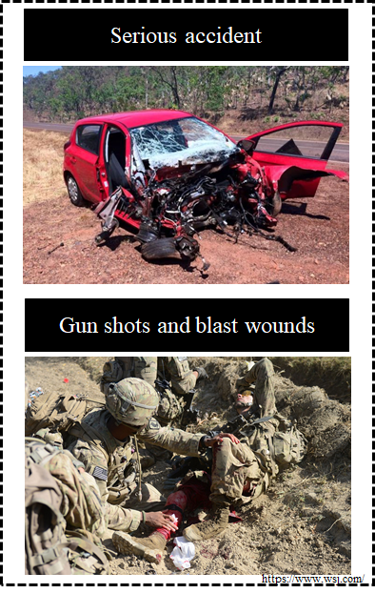
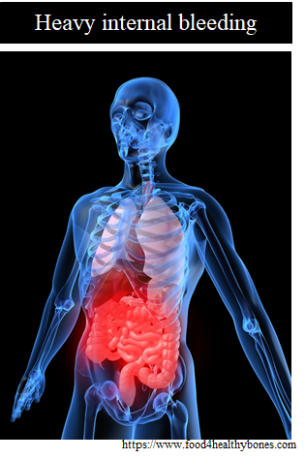
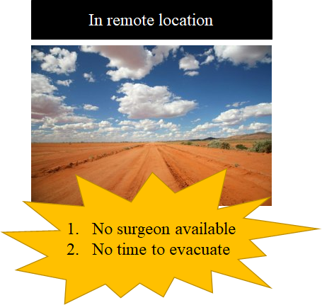

Introduction
P2
Notes:
Imaging a soldier on the battlefield with gunshout wound in his liver area, as you see at the picture.
This type of the wound is deadly because it will cause hemorrhage, which means he might look too much blood and die.
However, since you are in the remote region and you don’t have the surgeon available, we need another way to stop bleeding

Slide 4
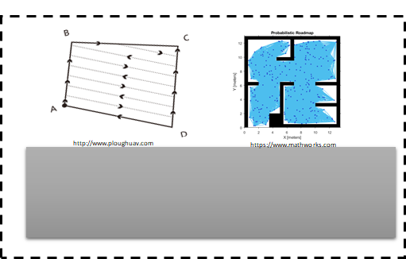
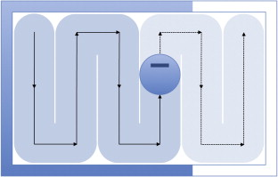
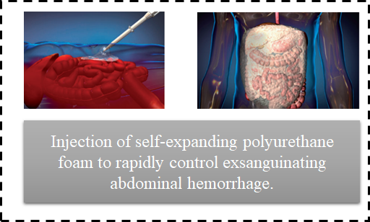
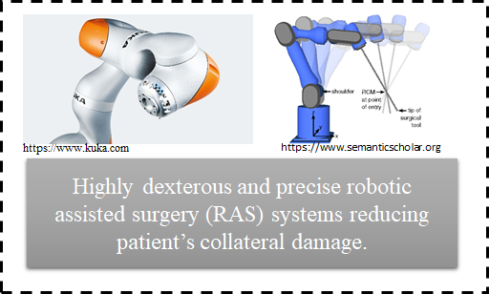
Goal
Coverage path plan (CPP) to command a robot to traversal the free space with the minimal total moving distance.
P3
Reference [1]
Notes:
One of the novel solution is to inject a self-expanding foam in to patient. Once the foam is injected, it quickly expand and fill the cavity and apply pressure to stabilize the patient and stop hemorrhage. We would like to cover as much area as possible sow We choose the coverage path planning to compute the path to cover the area using matlab. Since we only can perform motion in a single port, we use 7 degree of freedom robot to complete the task and simulate the result on gazebo and the real robot on RRL.

Slide 5
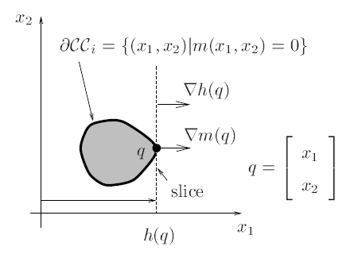
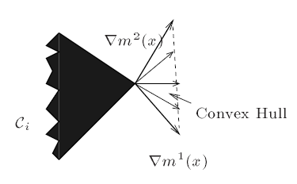
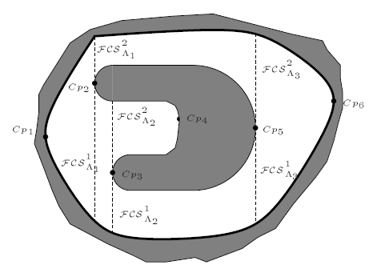
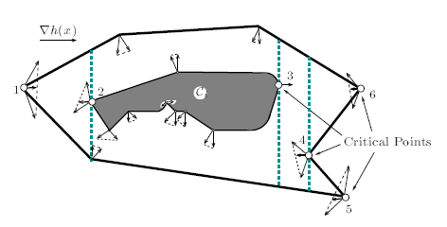
Methodology(i): Critical Points
Smooth Boundary
Non-smooth Boundary
P4
Reference [2]
Notes:
Upright line, sweep, sweep direction is horizontal. / direction of surface normal of the boundary.
non-smooth point, convex hull, sweep direction,

Slide 6
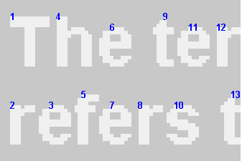
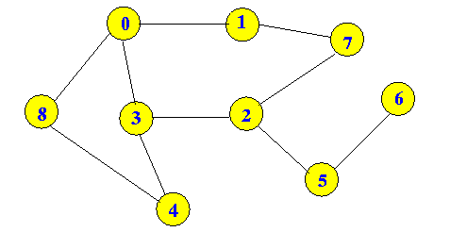
Methodology(ii):
Cell Decomposition
Methodology(iii):
Inter-cell Exhaustive Walk (DFS)
Matlab function: bwlabel.
Path: 0-1-7-2-3-4-8-4-3-2-5-6
P5
Notes:
column -wise search from left to right.

Slide 7
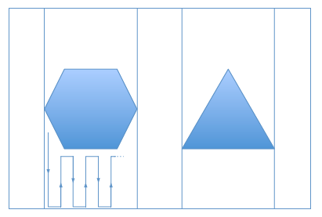
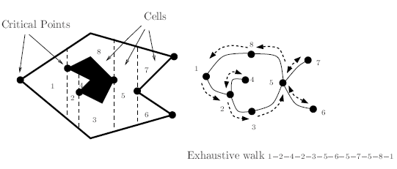
Methodology(iv): In-cell CPP (Boustrophedon)
Quick Summary from Method i to iv
“Mowing the lawn” pattern
P6
Reference [3]

Slide 8
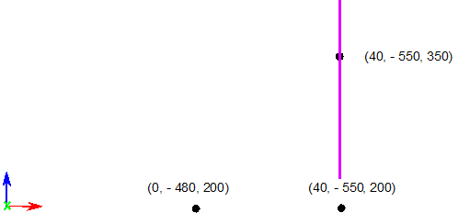
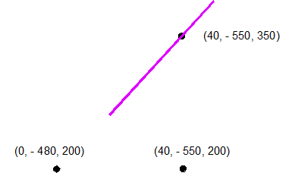
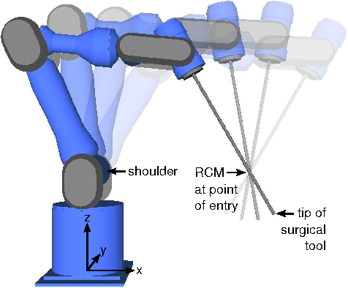
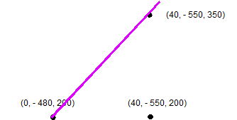
Methodology(v): Remote center-of-motion
1.Start point
2.Rotation
4. Next point
3.Translation
P7
Notes:
After we get the path from the coverage path planner, we then need to perform the robot to move across the path.
However, due to the constraint of the single port, the robot need to perform a motion based on that location, and it’s called remote center of motion.

Slide 9
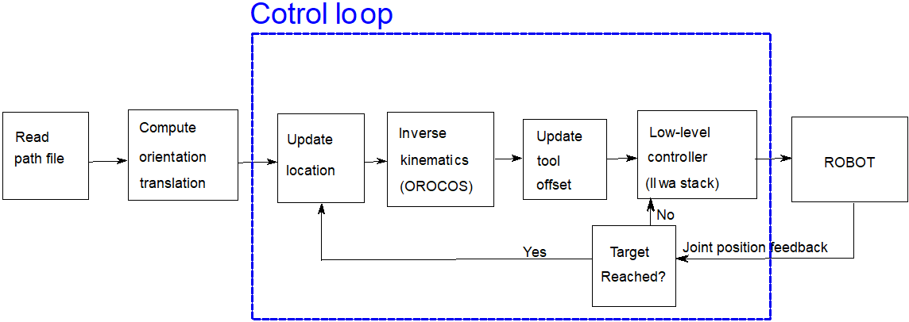
Methodology(vi): Block diagram of control loop
Control loop
P8
Notes:
Here is our control loop for controlling the kuka. First, we read the path file which contains point information.

Slide 10
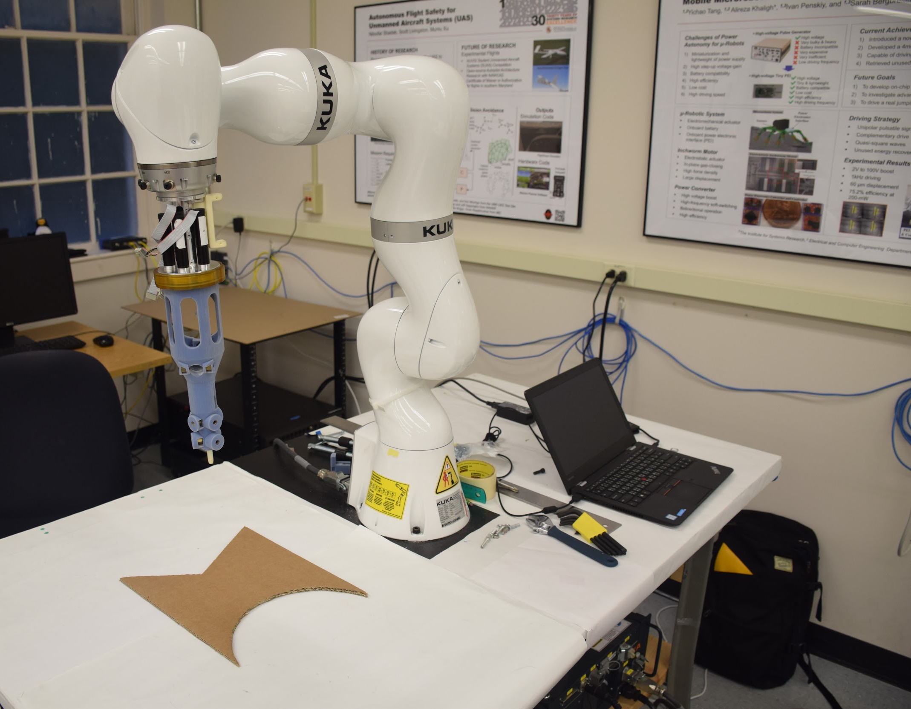
Experimental setup
RCM location: (0.4, -0.55, 0.35) m
Tool length: 0.397 m
iiwa kuka
Foaming tool
Position controller
Kuka sunrise controller
Target covered region
P9
Notes:
In RRL

Slide 11
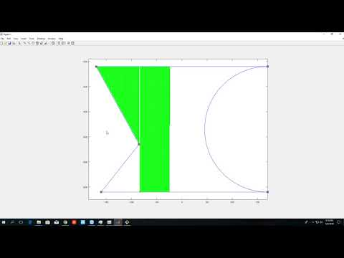
Result(i) Coverage path planning (MATLAB)
P10
Notes:
Meaning of the path: tool tip trajectory.

Slide 12
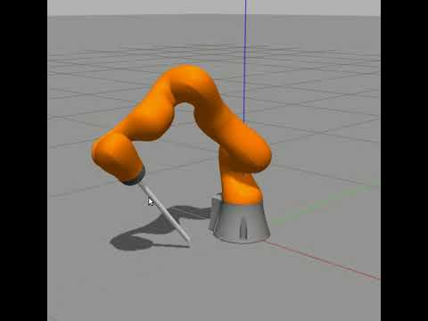
Result(ii) Remote center-of motion (Gazebo)
P11

Slide 13
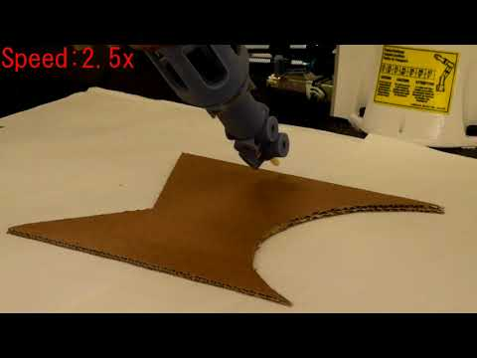
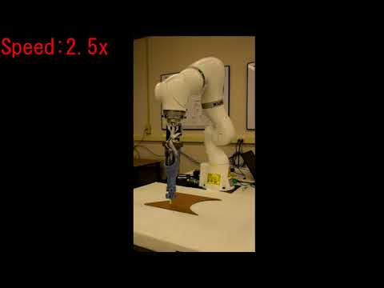
Result(iii) Robot implementation (iiwa kuka)
P12

Slide 14
Future work
Linear interpolation
Velocity control
Speed
Tracking error of the path
P13

Slide 15
Reference
A. P. Rago, U. Sharma, M. Duggan, and D. R. King. “Percutaneous damage control with selfexpanding foam: pre-hospital rescue from abdominal exsanguination”, Trauma, 2016; 18(2):8591
E. U. Acar, H. Choset, A. A. Rizzi, P. N. Atkar, and D. Hull, “Morse decompositions for coverage tasks,” The International Journal of Robotics Research, vol. 21, no. 4, pp. 331–344, 2002.
Galceran E, Carreras M. A survey on coverage path planning for robotics. Robotics and Autonomous systems. 2013 Dec 1;61(12):1258-76.
P14

Slide 16
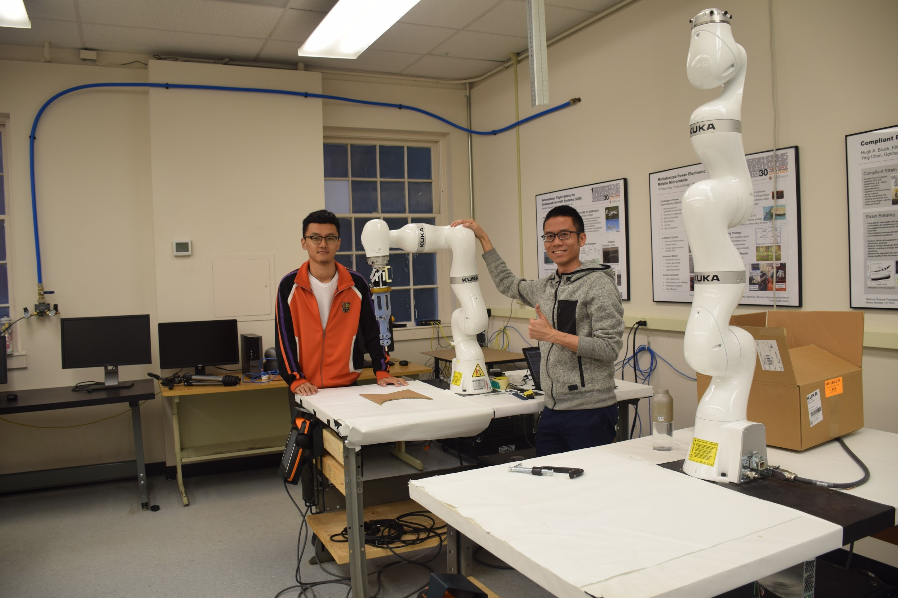
Q & A
P15

