Slide 1
Maven with Life CYClE

Slide 2
Maven is a project management and comprehension tool that provides developers a complete build lifecycle framework. Development team can automate the project's build infrastructure in almost no time as Maven uses a standard directory layout and a default build lifecycle.

Slide 3
Maven project structure and contents are declared in an xml file, pom.xml, referred as Project Object Model (POM), which is the fundamental unit of the entire Maven system.
Maven uses Convention over Configuration, which means developers are not required to create build process themselves.

Slide 4
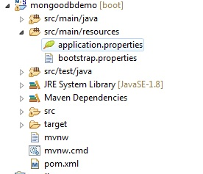

Slide 5
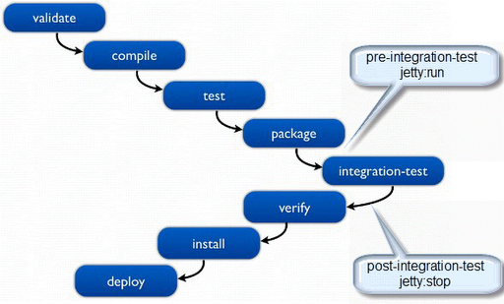
Maven life cycle

Slide 6
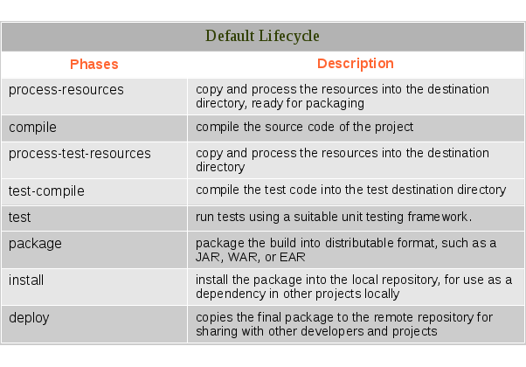

Slide 7
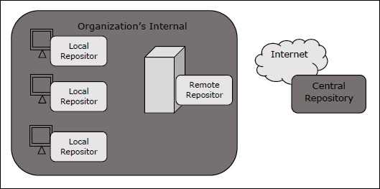
Maven Repository

Slide 8
Maven Plugin
Maven is actually a plugin execution framework where every task is actually done by plugins. Maven Plugins are generally used to −
create jar file
create war file
compile code files
unit testing of code
create project documentation
create project reports

Slide 9
Structure Of POM.XML

Slide 10
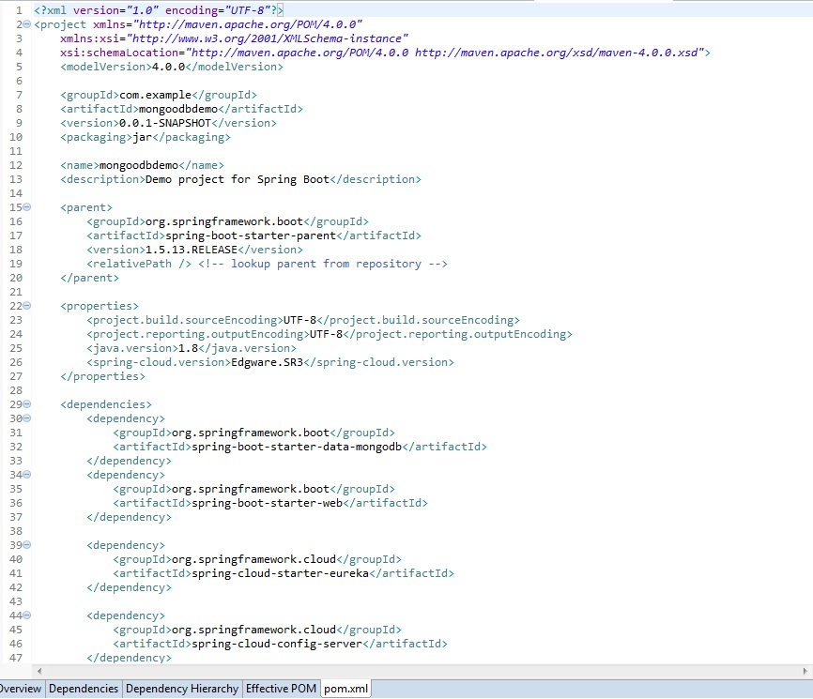

Slide 11
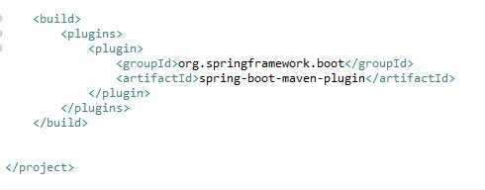

Slide 12


