Slide 1
Bike-sharing rental process Project(PRCP-1018)

Slide 2
CUSTOMER CASE STUDY
Background:
Bike sharing systems are new generation of traditional bike rentals where whole process from membership, rental and return
back has become automatic. Through these systems, user is able to easily rent a bike from a particular position and return
back at another position. Currently, there are about over 500 bike-sharing programs around the world which is composed of
over 500 thousands bicycles. Today, there exists great interest in these systems due to their important role in traffic,
environmental and health issues.
Apart from interesting real world applications of bike sharing systems, the characteristics of data being generated by
these systems make them attractive for the research. Opposed to other transport services such as bus or subway, the duration
of travel, departure and arrival position is explicitly recorded in these systems. This feature turns bike sharing system into
a virtual sensor network that can be used for sensing mobility in the city. Hence, it is expected that most of important
events in the city could be detected via monitoring these data.

Slide 3
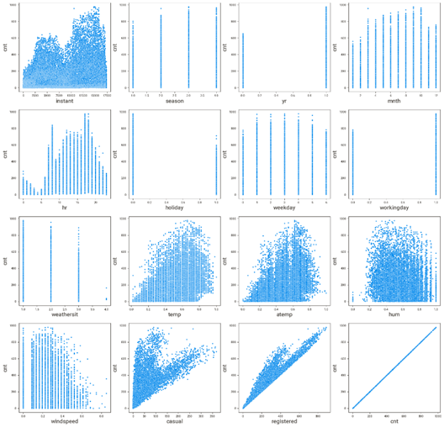
DATA EXPLORATION (Hour.csv)
All coding done in Python 3
Extensive use of pandas , numpy , matplotlib , seaborn, sweetviz and sklearn packages.
This dataset contains 17 different features on 17379 observation.
There have categorical and numerical features.
Target variables was ‘cnt’,which was count of total rental bikes including both casual and registered.

Slide 4
DATA EXPLORATION CONT...
Pandas package was imported and a dataframe was created.
Numerical variables were visualized by matplotlib,seaborn and sweetviz package to analyse its distribution and its relation with the total rental bikes including both casual and registered.
Sweetviz package also used to check kurtosis and skewness of each features. The data is asymmetric.
The relationship between the dependent and independent variables look fairly linear. Thus, our linearity assumption is satisfied
Categorical variables have been converted into numerical variables and visualized by matplotlib and seaborn package to analyse its distribution.
The relation between bike users and season across a year.Season 1,2,3,4 represents springer, summer, fall, winter respectively.
There have not missing values in categorical and numerical attributes.
From the box plot, we can observed that few outliers are present in ‘holiday’,’weathersit’ and ‘hum’.Heavy outliers are presented in the ‘windspeed’,’’casual’,’registered’ and ’cnt’.

Slide 5
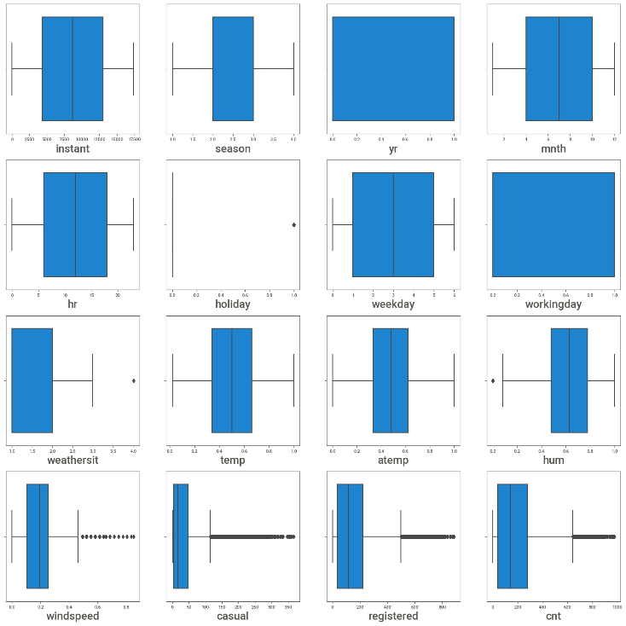
DATA EXPLORATION CONT…
Heatmap using seaborn package was created to show us correlations between the independent variables and the target variable outcome.
'temp' is highly correlated with 'atemp',whereas 'cnt' and 'registered' also. 'atemp',’casual’ and ‘registered’ will be dropped as they might have carried same information.
‘mnth’ and ‘season’ have correlated with each other.’yr’ and ‘instant’ same as them.

Slide 6
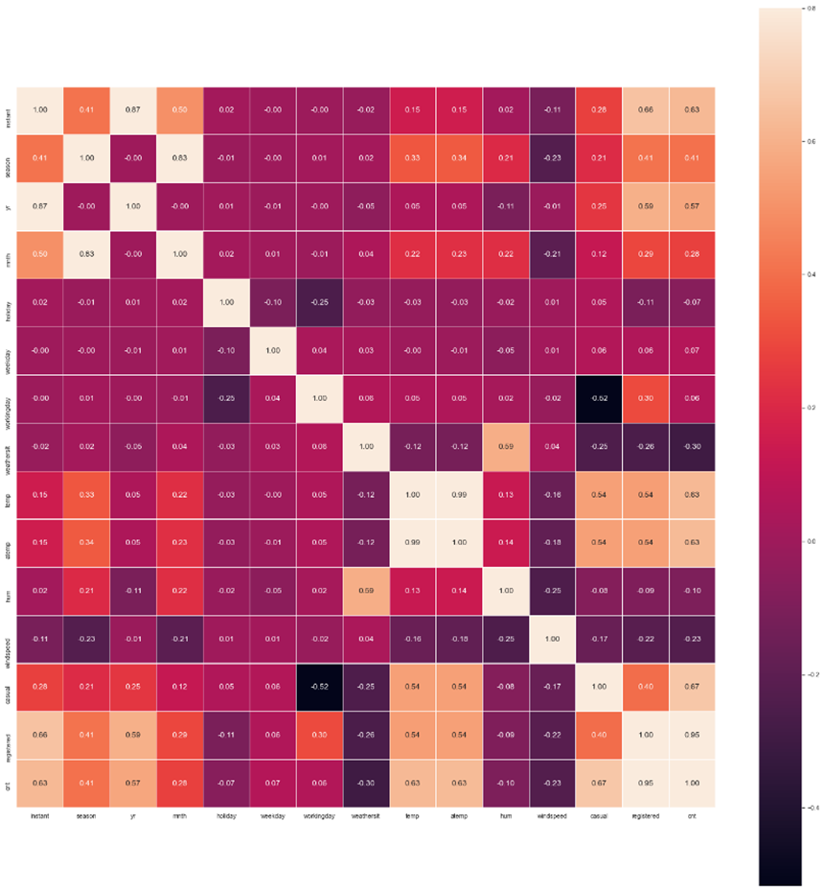
FeATURE SELECTION
In this pipeline at first we check for highly correlated feature using heatmap
From the heatmap we can see that ‘instant’ and ‘dteday’ , ‘Temp’ and ‘atemp’, ‘registered’ and ‘cnt’ are highly correlated to each other, we need to drop one of them.
Then we need to remove constant features, that means those features with standard deviation=0, in this dataset we do not have any constant feature to drop off.
In this dataset we have one unique ID feature that is ‘instant’, we need to drop that one.

Slide 7
Model building(hour)
MODEL | R2 SCORE | TRAIN ADJUSTED R2 SCORE | TEST ADJUSTED R2 SCORE
Linear Regression | 0.61 | 0.60 | 0.59
KNN | 0.74 | 0.73 | 0.73
Bagging Regression | 0.97 | 0.96 | 0.96
Random Forest Regression | 0.96 | 0.98 | 0.95
Decision Tree | 0.92 | 1.0 | 0.91
GBDT | 0.91 | 0.90 | 0.90
XGBDT | 0.96 | 0.96 | 0.96
The Bike Rental Program is a regressive problem involves the prediction of count of total rental bikes including both casual and registered users.
The data is observed to be much neater this time. There seems to be no missing entries and other unknown values are found. The data is standardised to remove the skewness, kurtosis and to improve the performance of the model.
The Regression models used here are the following.
1) Linear Regression2) Decision Tree Regressor3) Random Forest Regressor4) KNN Regressor5) Gradient Boosting Regressor6) XG Boost Regressor7) Bagging Regressor
The major parameter used for evaluating the model are r2 score and adjusted r2score. R² shows how well terms (data points) fit a curve or line. Adjusted R² also indicates how well terms fit a curve or line, but adjusts for the number of terms in a model. R2 score is taken on both training and testing data. For a good model adjusted r2 score is less than r2 score. Different models and their performance are tabulated below.

Slide 8
Model building(day)
MODEL | R2 SCORE | TRAIN R2 SCORE | TEST R2 SCORE
Linear Regression | 0.88 | 0.88 | 0.87
Decision Tree Regressor | 0.88 | 1.0 | 0.83
Random Forest Regressor | 0.93 | 0.97 | 0.92
XGBoost Regressor | 0.93 | 0.93 | 0.92
K neighbors Regressor | 0.86 | 0.85 | 0.84
GBoost Regressor | 0.92 | 0.91 | 0.91
Bagging Regressor | 0.94 | 0.93 | 0.93
The Bike Rental Program is a regressive problem involves the prediction of count of total rental bikes including both casual and registered users.
The data is observed to be much neater this time. There seems to be no missing entries and other unknown values are found. The data is standardised to remove the skewness, kurtosis and to improve the performance of the model.
DAY
The Regression models used here are the following.
1)LinearRegression2)DecisionTree Regressor3)Random ForestRegressor4)XGBoostRegressor5)KNeighbors Regressor6) GBoost Regressor7)Bagging Regressor

Slide 9
Result
The final model chosen is Bagging Regressor using best estimator as random forest as it shows the best performance of test adjusted r2 score above 96% for hourly bike rental dataset and for daily bike rental dataset test adjusted r2 score above 93%.

Slide 10
RECOMMENDATIONS
Here are some ideas of future work to improve the performance of the data model further:
Distribution adjustment of the target variable: Some predictive models assume a normal distribution of the target variable - a transformation in the data preprocessing could improve the performance of such methods.
Large scale dataset implementation of random forests. For large scale datasets (> 10 Mio. samples) the used sklearn python implementation of random forests will extremely slow down if it is unable to hold all samples in the working memory or can run into serious memory problems. A solution could be the woody implementation with top trees for pre-classification and flat random forests implemented in C at the leaves of the top trees.

Slide 11

QUESTIONS

Slide 12
OUR TEAM
MOHAMED SHAFEEQ VP
SONALI KUNDU
LOH XIAO TONG

Slide 13
THANK YOU

