Slide 1
SMART WATER IRRIGATION & Management USING iot
By Mayur Sonawane

Slide 2
Problem statement-
For Farms and parks, we need to check the water level and Water PH manually
Unnecessary supply of water
Improper management of water
Not able to analyze data regarding water issues
Notes:
Problem Statement - In the public places like public parks, gardens or farms, we have to supply water according to need of the plants. So each time we have to manually check water percentage in soil, water purity and water requirement for plant. Also sometimes there will be unnecessary supply of water from water resources to farms and parks which is not required. This is the wastage of water so we cannot manage the water.
Residential outdoor water use in the United States accounts for more than 9 billion gallons of water each day, mainly for landscape irrigation. Experts estimate that as much as 50 percent of this water is wasted due to overwatering caused by inefficiencies in irrigation methods and systems. Irrigation control technologies can significantly reduce overwatering by applying water only when plants need it.

Slide 3
Solution-
Use of Sensors to check water level, water PH
- Water level
(If Water level is below the Water Threshold, then send request to Supervisor and he will request to Labor)
-Water PH
(For Farm or Park, water PH falls in between 6 to 9)
-Sensor Status
(this checks the status of sensor whether it is working fine or not)
Notes:
In the public places like amusement parks, gardens or farms, we have to supply water according to needs of the plant. So each time we have to manually check water percentage in soil, water purity and water requirement for plant.
Also sometimes there will be unnecessary supply of water from water resources to farms and parks which is not required. This is the wastage of water.
An IOT based solution can be devised for this problem wherein Sensors will give the reading of the quantity and quality of water(such as PH).Based on the sensor output software application will send the alerts to Supervisor of the farm or garden so that they can take appropriate actions.
In case of special weather conditions and water scarcity, application will inform to higher authorities. In turn higher authorities will be able to get the weather updates and accordingly they can take required action regarding water supply.
Reports can also be generated by the application so as to give details of the water used for particular farm,garden or plant and their future requirements can also be predicted.

Slide 4
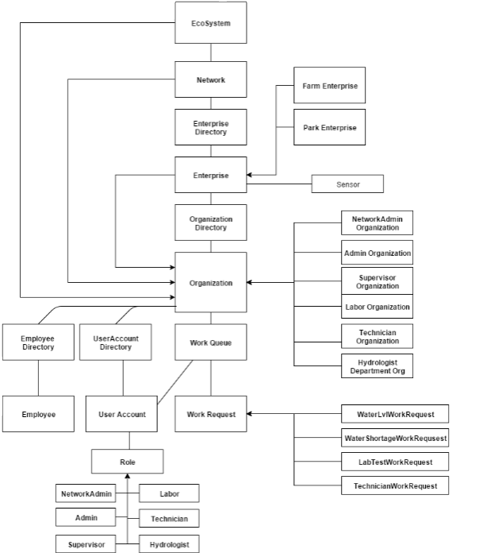
Object model

Slide 5
Key roles
Supervisor :- Manage and send request to particular role as per sensor data.
Manage Reports and send it to Higher management.
Labor :- Release the water to Sensor which one provided in Request as per requirement.
Hydrologist : - If PH is not in range of 6 to 9 then, it will work on it and set it to Normal PH 7.
Technician : - If there is any technical problem in Sensors, then work on it make them workable
Network Admin :- Process the request and release water for Enterprises which is under that Network.
Enterprise Admin :- He will set the Enterprise Water measures and creates the Employees.

Slide 6
Key features
Supervisor :-
Sensors data will get displayed in the table automatically
Generate and print Reports.
Send Reports to Higher management through Email
Network Admin:-
Water getting released after checking the amount of water available and required to Enterprise
Check all measures of Enterprise Water and release the water after analyzing the measures.
Check the Reports
Checking the forecast, which will help him to analyze the weather and release the water according to it

Slide 7
Extra Features
Random value generator after specific time.
Pie chart showing measures of Enterprise Water
Generate Reports and print it.
Report attachments to emails
Accessing Gmail and forecast through application
Notes:
Unique Employee ID generated
Unique UserAccount generated
Supervisor can not access others request if already assigned it

Slide 8
Refrences
http://www.portolavalley.net/sustainability/water-conservation/smart-irrigation
https://en.wikipedia.org/wiki/Water_resource_management#Managing_water_in_urban_settings
http://water.usgs.gov/wrri/AnnualReports/2005/FY2005_AL_Annual_Report.pdf

