Slide 1
Hit Data Analysis
- Mayur Sonawane

Slide 2
Use Case
Python application to answer client's questions
Hit Level Data
Business problem-
Revenue by external search engine
Best performed Searched Words
Expectation-
Input – Hit Data File Path
Output - [YYYY-mm-dd]_SearchKeywordPerformance.tab
Additional Insights helpful to client

Slide 3
Overview
Python application with unit test cases
Infra as a code for AWS cloud services
Infra as a code for Databricks with AWS cloud services
Output file as per client requirements
e.g. 2021-11-17_SearchKeywordPerformance.tab
Additional insights

Slide 4
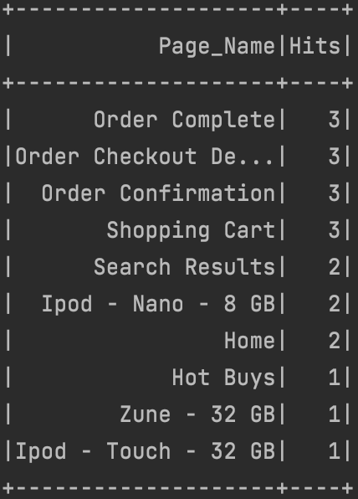
Additional Insights
Most visited pages by Ip's
Can help identify pages for advertisements
Most Visited Pages

Slide 5
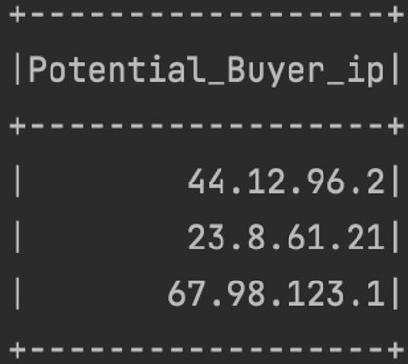
Additional Insights
Ip's which viewed products or added products into cart but not purchased yet
Can help identify potential buyers
Potential Buyers

Slide 6
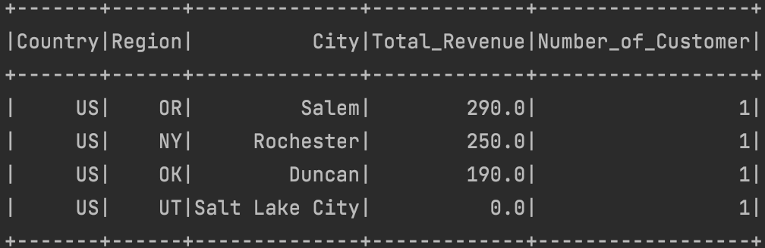
Additional Insights
Total Revenue collected by regions and # of customers
Can help identify
Future Sales Target
Improve Customer Base
Total Revenue and Number of Customer's by Location

Slide 7
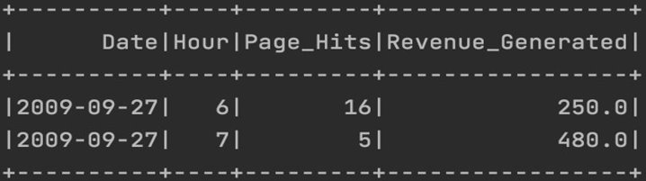
Additional Insights
Busy hour of the day by number of hits
Can help identify
Promotion Time
Resource Allocation
Busy Hour of the Day

Slide 8
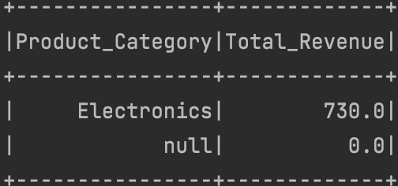
Additional Insights
Revenue by category
Can help identify
Category demands
Revenue by Product Category

Slide 9
Solution
Code - GitHub
Tech stack -
Python – PySpark
Databricks
AWS
GitHub
Mac OS
PEP8 Standards
Pycharm
Auth0

Slide 10
Improvements
More code coverage
Build Unit test suite & reports
Understand client's other challenges
Develop capabilty for resusable purpose
Provide more insights with countineous discussion

Slide 11
Thanks!

