Slide 1

Absolute Binding Free Energy Calculations of Monosaccharide and Oligosaccharide Ligands of Concanavalin A
Sondos Musleh,^{1,2} Irfan Alibay,³ Philip C. Biggin,³ and Richard A. Bryce¹
¹Division of Pharmacy & Optometry, School of Health Sciences, Faculty of Biology, Medicine & Health, University of Manchester, Manchester M13 9PT, UK
²Department of Medicinal Chemistry & Pharmacognosy, Faculty of Pharmacy, Jordan University of Science and Technology, P.O. Box 3030, Irbid, 22110, Jordan
³Department of Biochemistry, The University of Oxford, South Parks Road, Oxford, OX1 3QU, UK

Slide 2
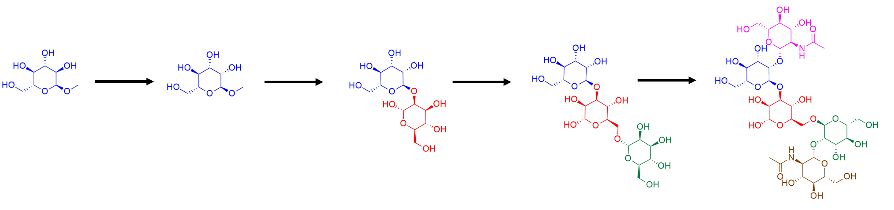
Introduction & Methods
ABFEs are a promising tool for computing drug-protein ΔG_{bind}
Can we compute carbohydrate-protein ΔG_{bind} and ΔΔG_{bind} accurately using ABFEs?
consider test case of carbohydrate ligands of lectin concanavalin A (conA):
Methods:
CHARMM force field in GROMACS 2021.2
annihilated interactions with complex and solvent using 44 + 21 λ windows
Boresch restraints derived with MDRestraintsGenerator code
2 ns equilibration / 20 ns MD simulation per window
ΔG calculated with MBAR
5 replicas per ligand, statistical uncertainty as standard error of mean

Slide 3
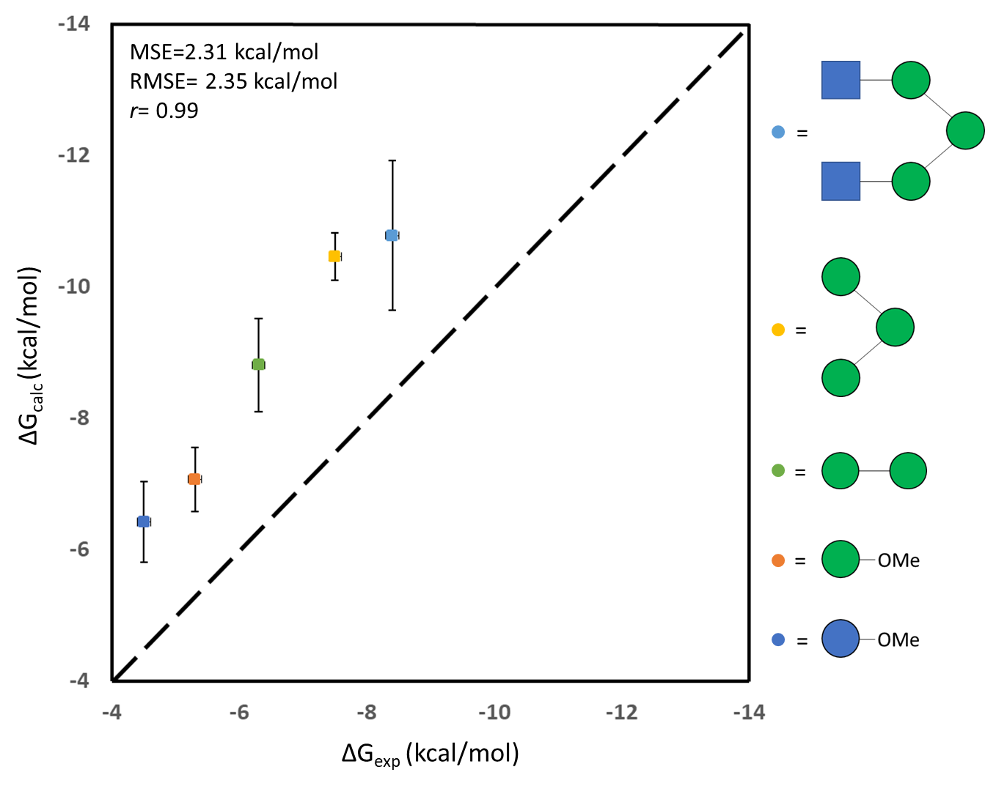
Computed ΔG_{bind} from ABFE Method
Obtain correlation of r=0.99 for ΔG_{bind} of the five carbohydrate ligands
Systematic overestimation of ΔG_{bind}, with MSE of 2.3 kcal/mol
Largest uncertainty in estimate obtained for largest ligand (pentasaccharide)
low ligand efficiency in binding to conA

Slide 4
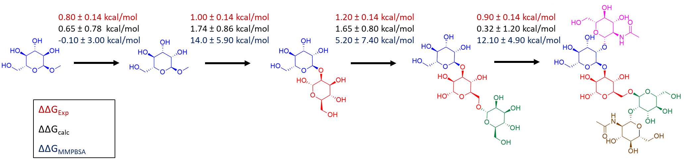
Estimated ΔΔG_{bind} from ABFEs
ΔΔG_{bind} constructed from ABFEs shows correct trend shown in all cases:
Computed ΔΔG_{bind} from ABFEs significantly improved over MMPBSA.
Zlotnikov ID, Kudryashova EV. Computer simulation of the Receptor–Ligand Interactions of Mannose Receptor CD206 in Comparison with the Lectin Concanavalin A Model. Biochemistry (Moscow). 2022;87(1):54-69.

Slide 5
Conclusions
Carbohydrate-protein ΔG_{bind} from ABFEs:
accurate qualitatively but overestimated quantitatively
Computed ΔΔG_{bind} from ABFEs:
for small and large changes in carbohydrate structure correctly captured
outperforming MMPBSA in accuracy
Challenges in computing carbohydrate-protein ABFEs include:
weakly bound and highly flexible ligands
suitable sampling of weakly bound ligands
balancing protein and solvent interactions of highly polar ligands

