Slide 1



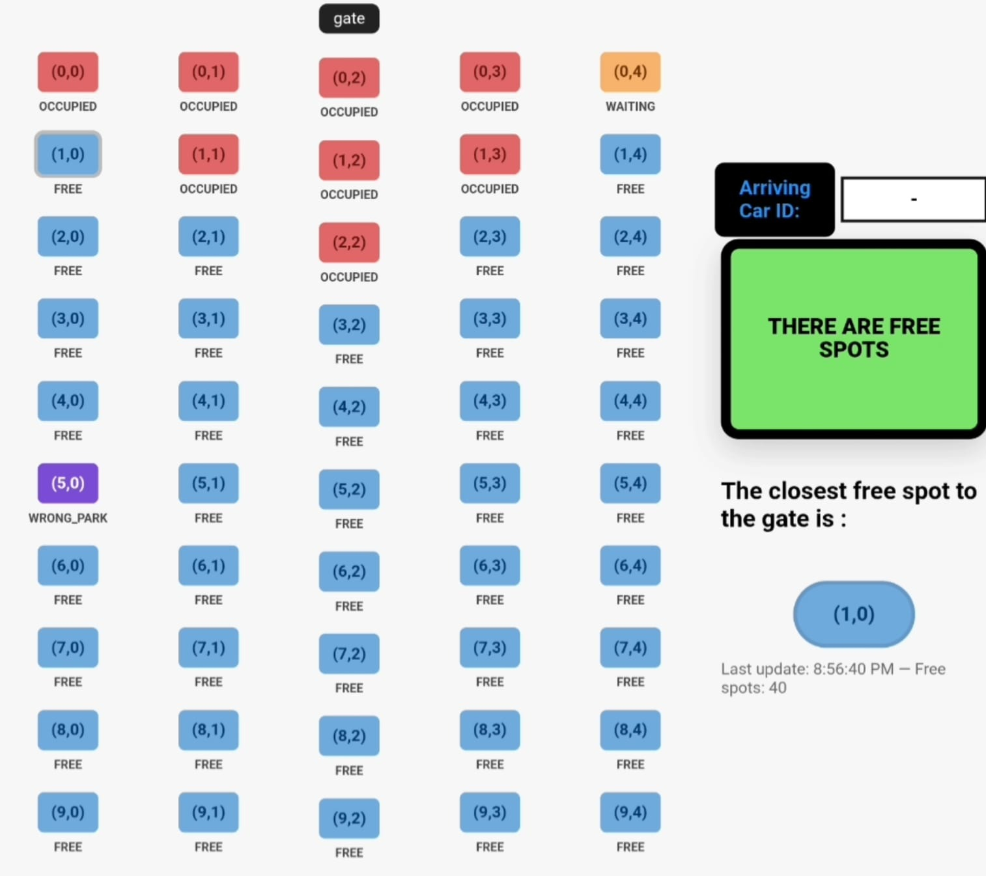
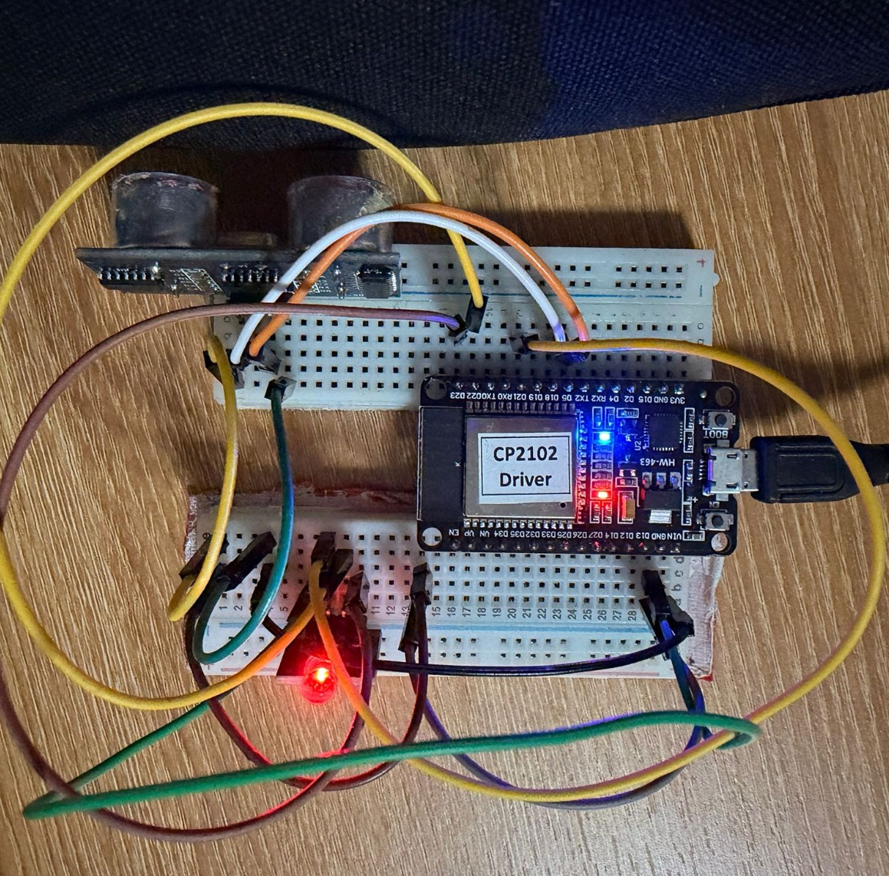
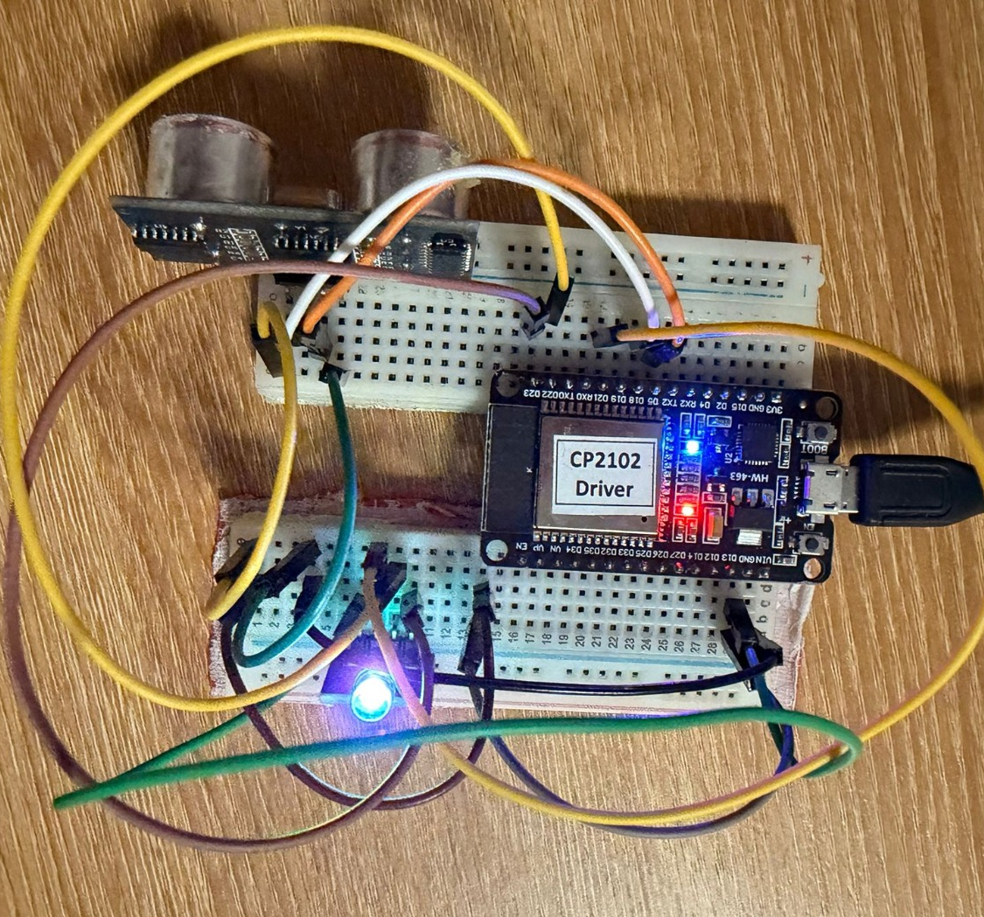
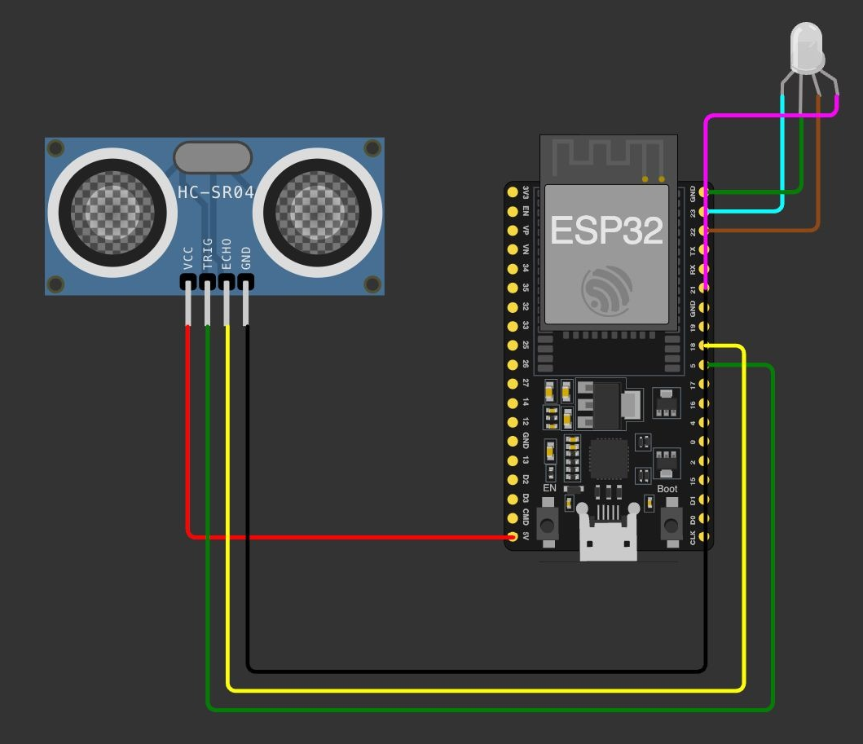
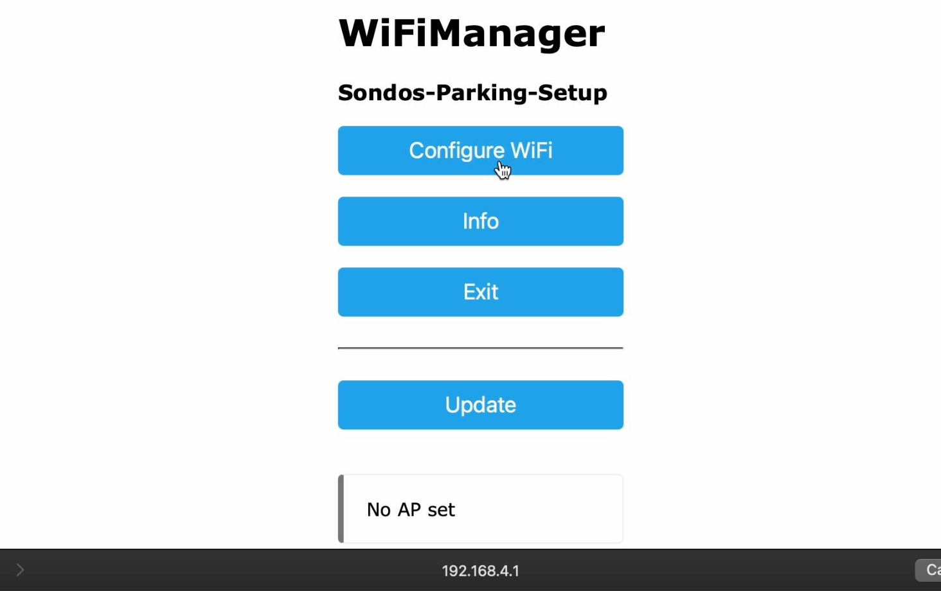
Smart Parking Lot Management
Save time with smart parking automation
Drivers and lot operators lose time and revenue because manual parking management cannot show real-time spot availability.
An IoT-based parking lot management system that detects spot occupancy, automates gate control, and shows real-time availability on an entrance display.
Instant spot-occupancy sensing via wireless sensors, automated gate control, and a live entrance display showing real-time availability.
The system directs each driver straight to the closest available spot in real time.
ESP-32 connected to distance sensor and a led
User App for parking lot manager
Monitoring parking lot in real-time and visualizing its status according to cloud-hosted database
Real Hardware
Sensor identified an object in front of it.
The led to turns red.
Sensor identified there is no object
The led to turns blue.
Hardware Wiring Diagram
Team member names: Sondos Taha and Yuval Zaidiner
Instructor name: Ido Ram

