Slide 1

Makeup Classification project poster
Group 15
Computer vision final project
Supervised by: Dr. Amirhossein Monjazeb

Slide 2
Makeup Classification project poster
Group 15
Computer vision final project
Supervised by: Dr. Amirhossein Monjazeb
Introduction
Recently, most classification problems assumed that images have high resolution in order to extract features. In addition, most of the algorisms require large amounts of datasets to be able to learn. That’s where transfer learning was introduced to allow low resolution and less amount of dataset to be learned based on other learned models. It is basically a model trained on a huge high-resolution dataset having the needed model parameters in the last 2 or 3 layers to learn them in addition. Since we try to solve a makeup classification problem with a low number of instances (500) and 10 classes with low resolution (64*64), we aim to apply multiple methods including transfer learning to classify our objects.

Slide 3
Makeup Classification project poster
Group 15
Computer vision final project
Supervised by: Dr. Amirhossein Monjazeb
Introduction
Recently, most classification problems assumed that images have high resolution in order to extract features. In addition, most of the algorisms require large amounts of datasets to be able to learn. That’s where transfer learning was introduced to allow low resolution and less amount of dataset to be learned based on other learned models. It is basically a model trained on a huge high-resolution dataset having the needed model parameters in the last 2 or 3 layers to learn them in addition. Since we try to solve a makeup classification problem with a low number of instances (500) and 10 classes with low resolution (64*64), we aim to apply multiple methods including transfer learning to classify our objects.
Literature review and architecture
Multiple research papers introduced solutions for low-resolution data classification such as the following:
1- transfer learning to solve the LR problem without finetuning the convent filters, just extracting features from high-resolution and low-resolution images, then feeding them to a feature transfer network with 2 layers [1].
2- image super-resolution (SR) using the VDSR network [2,3]

Slide 4
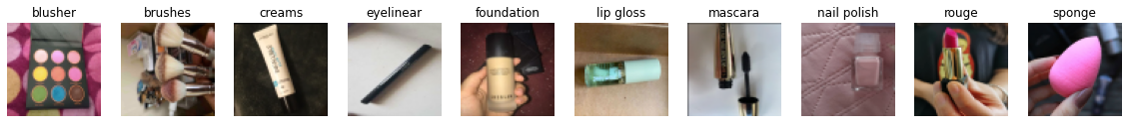
Makeup Classification project poster
Group 15
Computer vision final project
Supervised by: Dr. Amirhossein Monjazeb
Introduction
Recently, most classification problems assumed that images have high resolution in order to extract features. In addition, most of the algorisms require large amounts of datasets to be able to learn. That’s where transfer learning was introduced to allow low resolution and less amount of dataset to be learned based on other learned models. It is basically a model trained on a huge high-resolution dataset having the needed model parameters in the last 2 or 3 layers to learn them in addition. Since we try to solve a makeup classification problem with a low number of instances (500) and 10 classes with low resolution (64*64), we aim to apply multiple methods including transfer learning to classify our objects.
Literature review and architecture
Multiple research papers introduced solutions for low-resolution data classification such as the following:
1- transfer learning to solve the LR problem without finetuning the convent filters, just extracting features from high-resolution and low-resolution images, then feeding them to a feature transfer network with 2 layers [1].
2- image super-resolution (SR) using the VDSR network [2,3]

Slide 5
Makeup Classification project poster
Group 15
Computer vision final project
Supervised by: Dr. Amirhossein Monjazeb
Introduction
Methods
Recently, most classification problems assumed that images have high resolution in order to extract features. In addition, most of the algorisms require large amounts of datasets to be able to learn. That’s where transfer learning was introduced to allow low resolution and less amount of dataset to be learned based on other learned models. It is basically a model trained on a huge high-resolution dataset having the needed model parameters in the last 2 or 3 layers to learn them in addition. Since we try to solve a makeup classification problem with a low number of instances (500) and 10 classes with low resolution (64*64), we aim to apply multiple methods including transfer learning to classify our objects.
The following pre-trained models were applied for both the pre-trained model and the enhanced model.
1- MobileNet Model
2- Inception Model
3- Resnet
Baseline model:
The dataset was fed directly to the models after being resized, then the 3 FCL with 50 epochs, Adam optimizer with LR=0.0001, and loss function: Sparse categorical entropy. Relu activation was used with the hidden layers and softmax for the last one.
Enhanced model:
An enhanced deep super-resolution network (EDSR) technique was applied to enhance the 64*64*3 images. Then they were fed to the pre-trained models.
The hyperparameter tuning is done for each model separately.
Literature review and architecture
Multiple research papers introduced solutions for low-resolution data classification such as the following:
1- transfer learning to solve the LR problem without finetuning the convent filters, just extracting features from high-resolution and low-resolution images, then feeding them to a feature transfer network with 2 layers [1].
2- image super-resolution (SR) using the VDSR network [2,3]

Slide 6
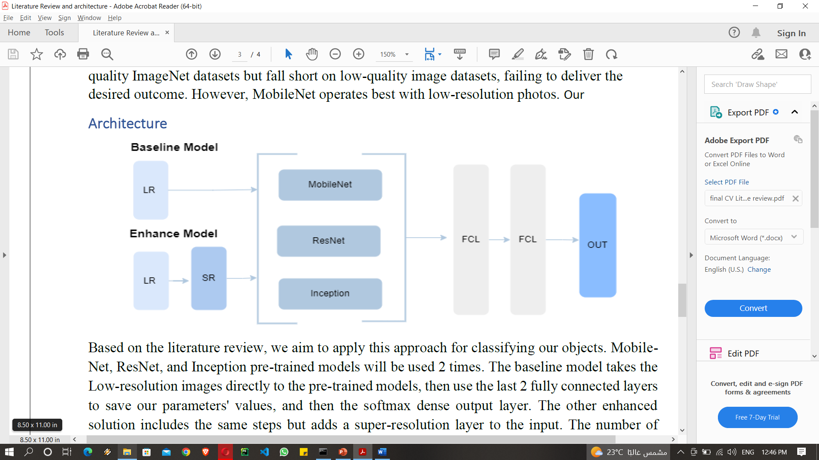
Makeup Classification project poster
Group 15
Computer vision final project
Supervised by: Dr. Amirhossein Monjazeb
Introduction
Methods
Recently, most classification problems assumed that images have high resolution in order to extract features. In addition, most of the algorisms require large amounts of datasets to be able to learn. That’s where transfer learning was introduced to allow low resolution and less amount of dataset to be learned based on other learned models. It is basically a model trained on a huge high-resolution dataset having the needed model parameters in the last 2 or 3 layers to learn them in addition. Since we try to solve a makeup classification problem with a low number of instances (500) and 10 classes with low resolution (64*64), we aim to apply multiple methods including transfer learning to classify our objects.
The following pre-trained models were applied for both the pre-trained model and the enhanced model.
1- MobileNet Model
2- Inception Model
3- Resnet
Baseline model:
The dataset was fed directly to the models after being resized, then the 3 FCL with 50 epochs, Adam optimizer with LR=0.0001, and loss function: Sparse categorical entropy. Relu activation was used with the hidden layers and softmax for the last one.
Literature review and architecture
Enhanced model:
An enhanced deep super-resolution network (EDSR) technique was applied to enhance the 64*64*3 images. Then they were fed to the pre-trained models.
The hyperparameter tuning is done for each model separately.
Multiple research papers introduced solutions for low-resolution data classification such as the following:
1- transfer learning to solve the LR problem without finetuning the convent filters, just extracting features from high-resolution and low-resolution images, then feeding them to a feature transfer network with 2 layers [1].
2- image super-resolution (SR) using the VDSR network [2,3]

Slide 7
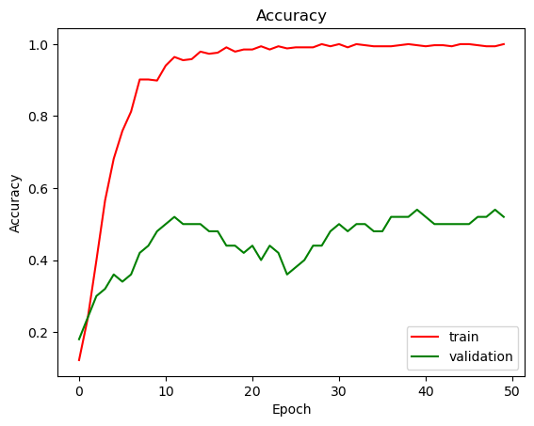
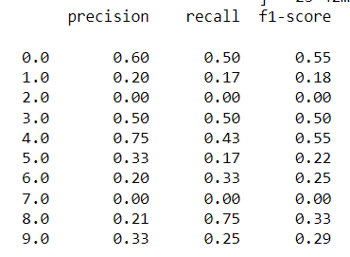
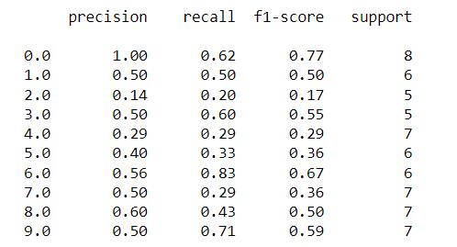
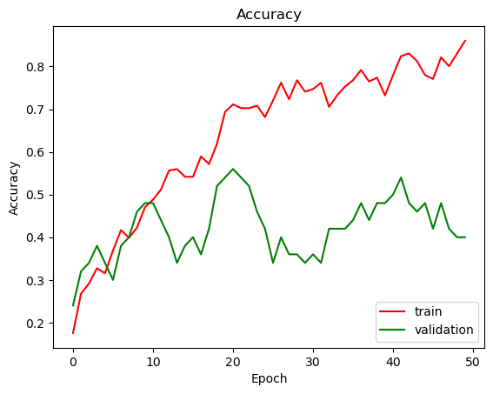
Makeup Classification project poster
Group 15
Computer vision final project
Supervised by: Dr. Amirhossein Monjazeb
Introduction
Methods
Results
Recently, most classification problems assumed that images have high resolution in order to extract features. In addition, most of the algorisms require large amounts of datasets to be able to learn. That’s where transfer learning was introduced to allow low resolution and less amount of dataset to be learned based on other learned models. It is basically a model trained on a huge high-resolution dataset having the needed model parameters in the last 2 or 3 layers to learn them in addition. Since we try to solve a makeup classification problem with a low number of instances (500) and 10 classes with low resolution (64*64), we aim to apply multiple methods including transfer learning to classify our objects.
The following pre-trained models were applied for both the pre-trained model and the enhanced model.
1- MobileNet Model
2- Inception Model
3- Resnet
Baseline model:
The dataset was fed directly to the models after being resized, then the 3 FCL with 50 epochs, Adam optimizer with LR=0.0001, and loss function: Sparse categorical entropy. Relu activation was used with the hidden layers and softmax for the last one.
Baseline model:
Literature review and architecture
Enhanced model:
An enhanced deep super-resolution network (EDSR) technique was applied to enhance the 64*64*3 images. Then they were fed to the pre-trained models.
The hyperparameter tuning is done for each model separately.
Multiple research papers introduced solutions for low-resolution data classification such as the following:
1- transfer learning to solve the LR problem without finetuning the convent filters, just extracting features from high-resolution and low-resolution images, then feeding them to a feature transfer network with 2 layers [1].
2- image super-resolution (SR) using the VDSR network [2,3]
Enhanced model:

Slide 8
Makeup Classification project poster
Group 15
Computer vision final project
Supervised by: Dr. Amirhossein Monjazeb
Introduction
Methods
Results
Recently, most classification problems assumed that images have high resolution in order to extract features. In addition, most of the algorisms require large amounts of datasets to be able to learn. That’s where transfer learning was introduced to allow low resolution and less amount of dataset to be learned based on other learned models. It is basically a model trained on a huge high-resolution dataset having the needed model parameters in the last 2 or 3 layers to learn them in addition. Since we try to solve a makeup classification problem with a low number of instances (500) and 10 classes with low resolution (64*64), we aim to apply multiple methods including transfer learning to classify our objects.
The following pre-trained models were applied for both the pre-trained model and the enhanced model.
1- MobileNet Model
2- Inception Model
3- Resnet
Baseline model:
The dataset was fed directly to the models after being resized, then the 3 FCL with 50 epochs, Adam optimizer with LR=0.0001, and loss function: Sparse categorical entropy. Relu activation was used with the hidden layers and softmax for the last one.
Baseline model:
Enhanced model:
Enhanced model:
An enhanced deep super-resolution network (EDSR) technique was applied to enhance the 64*64*3 images. Then they were fed to the pre-trained models.
The hyperparameter tuning is done for each model separately.
Conclusion
Literature review and architecture
The best model for the baseline approach is the Mobil-Net with an accuracy of 45%, however, it suffers from overfitting. ResNet reached only 30%, inception net reached 0.38%. After applying SR, the accuracy reached 53%, which is not so high but still higher than the baseline. In addition, the inception model got the accuracy of 50%
Multiple research papers introduced solutions for low-resolution data classification such as the following:
1- transfer learning to solve the LR problem without finetuning the convent filters, just extracting features from high-resolution and low-resolution images, then feeding them to a feature transfer network with 2 layers [1].
2- image super-resolution (SR) using the VDSR network [2,3]

Slide 9
Makeup Classification project poster
Group 15
Computer vision final project
Supervised by: Dr. Amirhossein Monjazeb
Introduction
Methods
Results
Recently, most classification problems assumed that images have high resolution in order to extract features. In addition, most of the algorisms require large amounts of datasets to be able to learn. That’s where transfer learning was introduced to allow low resolution and less amount of dataset to be learned based on other learned models. It is basically a model trained on a huge high-resolution dataset having the needed model parameters in the last 2 or 3 layers to learn them in addition. Since we try to solve a makeup classification problem with a low number of instances (500) and 10 classes with low resolution (64*64), we aim to apply multiple methods including transfer learning to classify our objects.
The following pre-trained models were applied for both the pre-trained model and the enhanced model.
1- MobileNet Model
2- Inception Model
3- Resnet
Baseline model:
The dataset was fed directly to the models after being resized, then the 3 FCL with 50 epochs, Adam optimizer with LR=0.0001, and loss function: Sparse categorical entropy. Relu activation was used with the hidden layers and softmax for the last one.
Baseline model:
Enhanced model:
Conclusion
The best model for the baseline approach is the Mobil-Net with an accuracy of 45%, however, it suffers from overfitting. ResNet reached only 30%, inception net reached 0.38%. After applying SR, the accuracy reached 53%, which is not so high but still higher than the baseline. In addition, the inception model got the accuracy of 50%
Literature review and architecture
Enhanced model:
An enhanced deep super-resolution network (EDSR) technique was applied to enhance the 64*64*3 images. Then they were fed to the pre-trained models.
The hyperparameter tuning is done for each model separately.
Multiple research papers introduced solutions for low-resolution data classification such as the following:
1- transfer learning to solve the LR problem without finetuning the convent filters, just extracting features from high-resolution and low-resolution images, then feeding them to a feature transfer network with 2 layers [1].
2- image super-resolution (SR) using the VDSR network [2,3]
Limitations
1- The dataset was not available online and the collected one was not so clear and in small size (500)
2- The 64*64 size that we should work on with this quality of images didn’t support high performance even with retraining layers of inception model

Slide 10
Makeup Classification project poster
Group 15
Computer vision final project
Supervised by: Dr. Amirhossein Monjazeb
Introduction
Methods
Results
Recently, most classification problems assumed that images have high resolution in order to extract features. In addition, most of the algorisms require large amounts of datasets to be able to learn. That’s where transfer learning was introduced to allow low resolution and less amount of dataset to be learned based on other learned models. It is basically a model trained on a huge high-resolution dataset having the needed model parameters in the last 2 or 3 layers to learn them in addition. Since we try to solve a makeup classification problem with a low number of instances (500) and 10 classes with low resolution (64*64), we aim to apply multiple methods including transfer learning to classify our objects.
The following pre-trained models were applied for both the pre-trained model and the enhanced model.
1- MobileNet Model
2- Inception Model
3- Resnet
Baseline model:
The dataset was fed directly to the models after being resized, then the 3 FCL with 50 epochs, Adam optimizer with LR=0.0001, and loss function: Sparse categorical entropy. Relu activation was used with the hidden layers and softmax for the last one.
Baseline model:
Enhanced model:
Conclusion
The best model for the baseline approach is the Mobil-Net with an accuracy of 45%, however, it suffers from overfitting. ResNet reached only 30%, inception net reached 0.38%. After applying SR, the accuracy reached 53%, which is not so high but still higher than the baseline. In addition, the inception model got the accuracy of 50%
Literature review and architecture
Enhanced model:
An enhanced deep super-resolution network (EDSR) technique was applied to enhance the 64*64*3 images. Then they were fed to the pre-trained models.
The hyperparameter tuning is done for each model separately.
Multiple research papers introduced solutions for low-resolution data classification such as the following:
1- transfer learning to solve the LR problem without finetuning the convent filters, just extracting features from high-resolution and low-resolution images, then feeding them to a feature transfer network with 2 layers [1].
2- image super-resolution (SR) using the VDSR network [2,3]
Limitations
1- The dataset was not available online and the collected one was not so clear and in small size (500)
2- The 64*64 size that we should work on with this quality of images didn’t support high performance even with retraining layers of inception model
References
1- Wu, Y., Zhang, Z. and Wang, G. (2019) “Unsupervised deep feature transfer for low resolution image classification,” arXiv [cs.CV]. Available at: https://openaccess.thecvf.com/content_ICCVW_2019/papers/RLQ/Wu_Unsupervised_Deep_Feature_Transfer_for_Low_Resolution_Image_Classification_ICCVW_2019_paper.pdf (Accessed: October 25, 2022).
2- Koziarski, M. and Cyganek, B. (2018) “Impact of low resolution on image recognition with deep neural networks: An experimental study,” International Journal of Applied Mathematics and Computer Science, 28(4), pp. 735–744. doi: 10.2478/amcs-2018-0056.
3- Cai, D. et al. (2017) “Convolutional low-resolution fine-grained classification,” arXiv [cs.CV]. Available at: http://arxiv.org/abs/1703.05393 (Accessed: October 25, 2022).
4- Kabir, M. M. et al. (2020) “An evolution of CNN object classifiers on low-resolution images,” in 2020 IEEE 17th International Conference on Smart Communities: Improving Quality of Life Using ICT, IoT and AI (HONET). IEEE, pp. 209–213.

