Slide 1
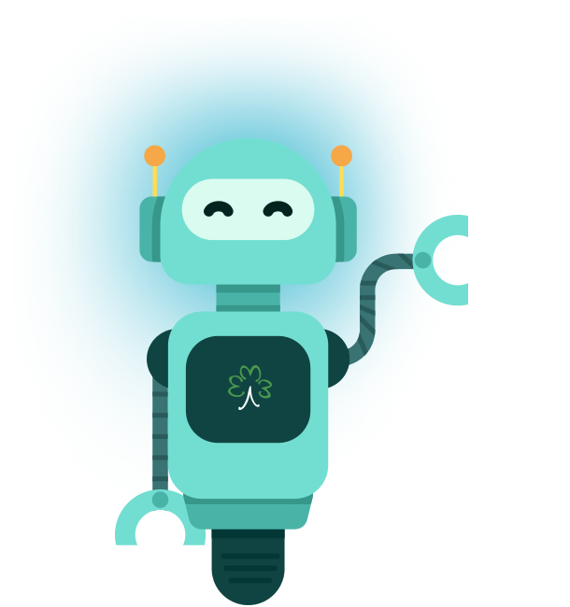
Smart watch chatbot
Team 6

Slide 2

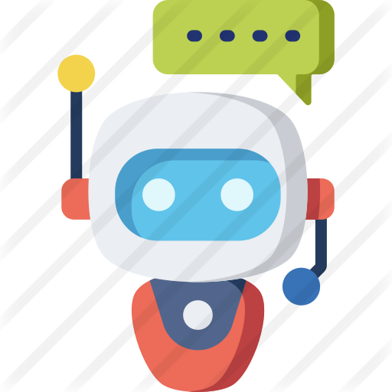
Chatbot Domain
Answering users’ questions about smart watches.

Slide 3
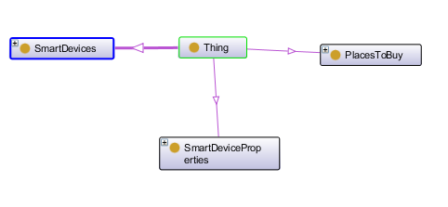
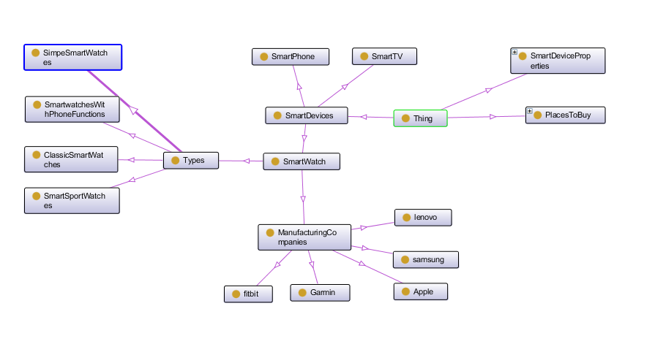
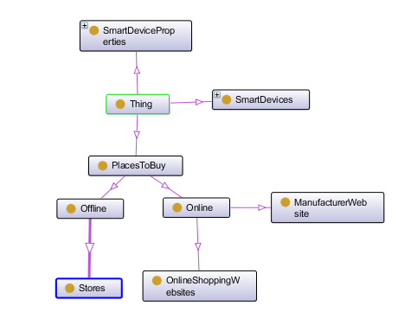
Domain Ontology

Slide 4
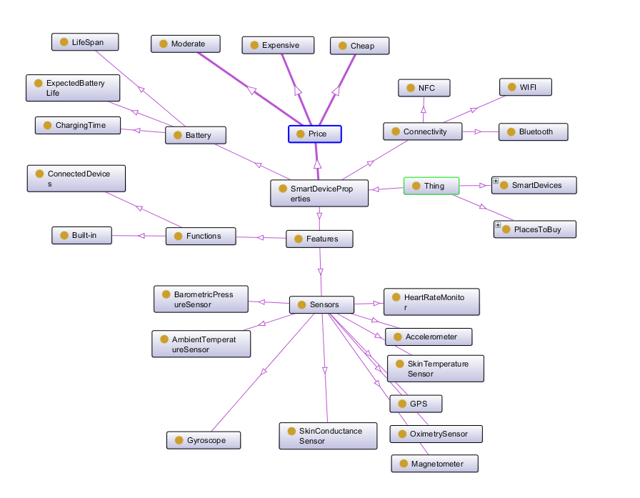
Domain Ontology

Slide 5
Competency questions
What are the features included in smart watch?
What is the expected battery life of smart watch?
What companies produces smart watch?
What are types of smart watch?
Where can I buy smart watch?
How much does smart watch cost?

Slide 6
Test Cases Sample
Question | What are the features included in smart watch?
Test cases | What sensors are integrated in smart watch? What are the benefits of buying smart watches? How can smart watch improve my life? Why do I need to buy smart watch? Is smart watch useful?

Slide 7
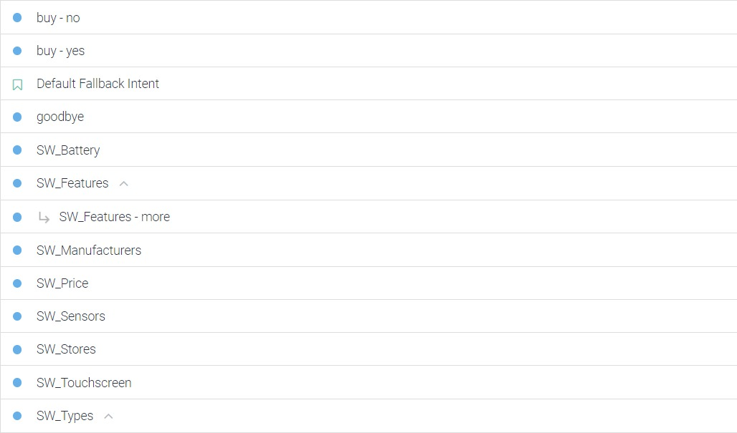
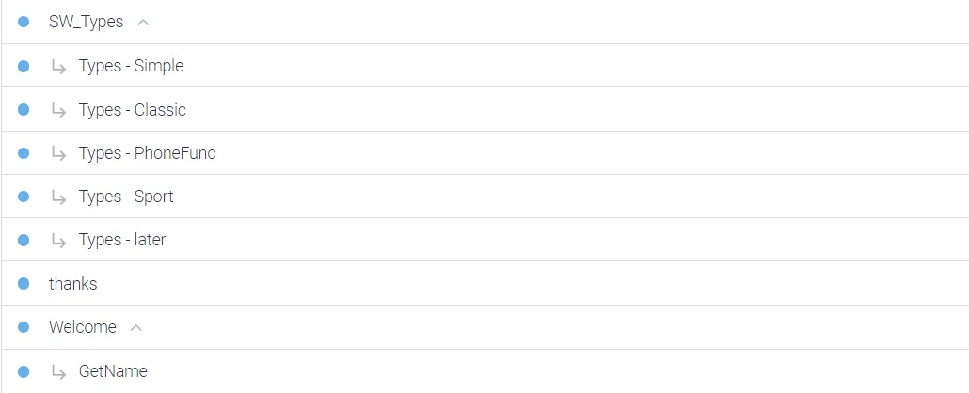
Intent Development

Slide 8
Evaluation
Testing Questions
Total: 34
Irrelevant answers: 2

Slide 9
Evaluation
Conversation flow
When the chatbot welcomes the user and asks for his name, some names are not recognized.
When the user asks for the reason to buy smart watches, then keeps asking more, the chatbot does not understand the question.

Slide 10
Thank You

