Slide 1
Simulation and Synthetic Data Generation of Deformable Objects
Tomáš Barančok

Slide 2
Motivation
Getting large high-quality datasets is overall difficult
This is especially the case if we want to work with transparent objects and even more if we want them deformed
There are papers that already solve this issue for generation of non-transparent objects and also for glass objects (this approach is easily applicable to any transparent object)

Slide 3
Goal
To create an application or several scripts that allow for automated creation of rendered images of deformed transparent bottles (e.g. plastic bottle) for synthetic dataset creation

Slide 4
Related Work
Automated 3D Dataset Generation for Arbitrary Objects – a work that proposes a workflow for aligning scanned meshes onto a background to create synthetic data
Synthetic Dataset Rendering with Parametric Transparent and Translucent Objects – a bachelors thesis that proposes a workflow for creating synthetic data for transparent objects and also how to set parameters for realistic lighting
Clear Grasp – method for position estimation of translucent objects
ISAAC Sim – environment for creation and rendering of various types of synthetic data

Slide 5
Methodology (depending on approach)
Blender 5.0
Unreal Engine 5 – still a possibility in final steps
All scripts will be written in python 3.11 or 3.12 depending on the need for compatibility with bpy

Slide 6
Blender
free and open-source 3D computer graphics software tool
used for creating animated films, visual effects, art, 3D-printed models, motion graphics, interactive 3D applications, and virtual reality

Slide 7
Unreal Engine
a 3D computer graphics game engine
Unreal Engine 5 features Nanite, a virtualized geometry system that allows game developers to use arbitrarily high quality meshes with automatically generated Level of Detail, and Lumen, a dynamic global illumination and reflections system that uses software and hardware ray tracing

Slide 8
Workflow
Object Creation
Object
Rendering
Blender
- bending, deforming
Blender
- parametric creation
- texture application
Blender / UE
- scene creation
- object scattering
Object
Deformation

Slide 9
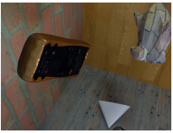
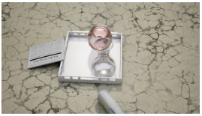
Images
Example scene from
Automated 3D Dataset Generation for Arbitrary Objects
Example scene from Synthetic Dataset Rendering with Parametric Transparent and Translucent Objects

Slide 10
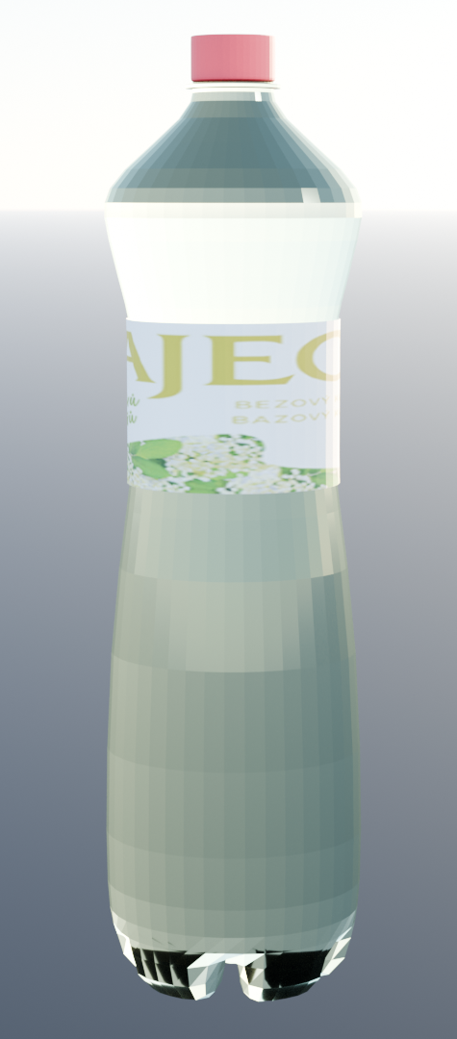
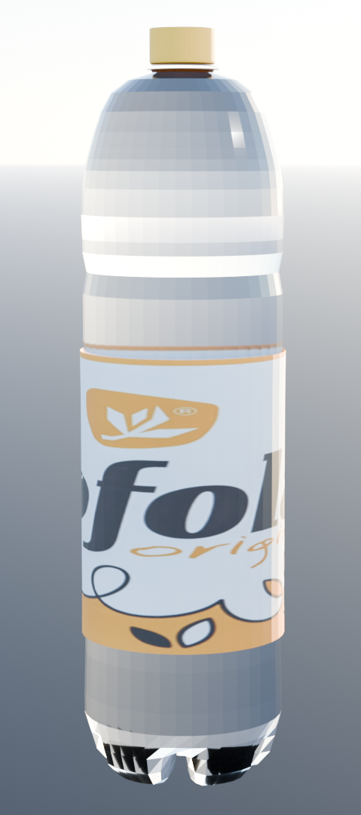
Object Creation
29 ring parameters
bottle cap color
label texture
plastic color

Slide 11
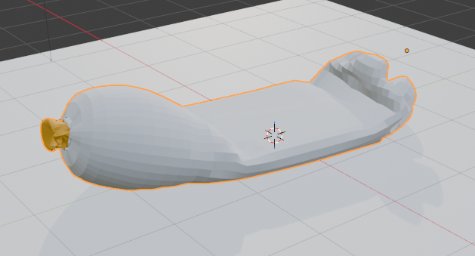
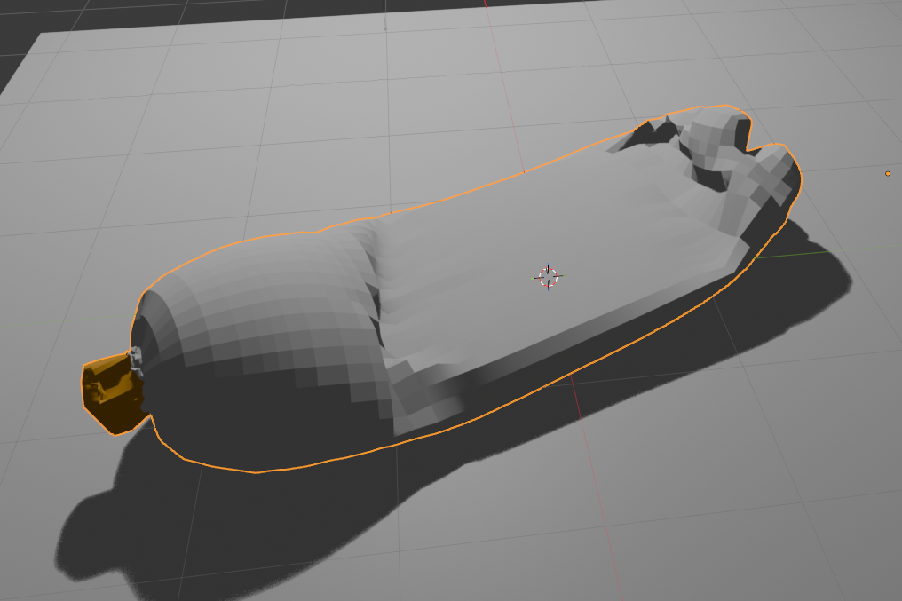
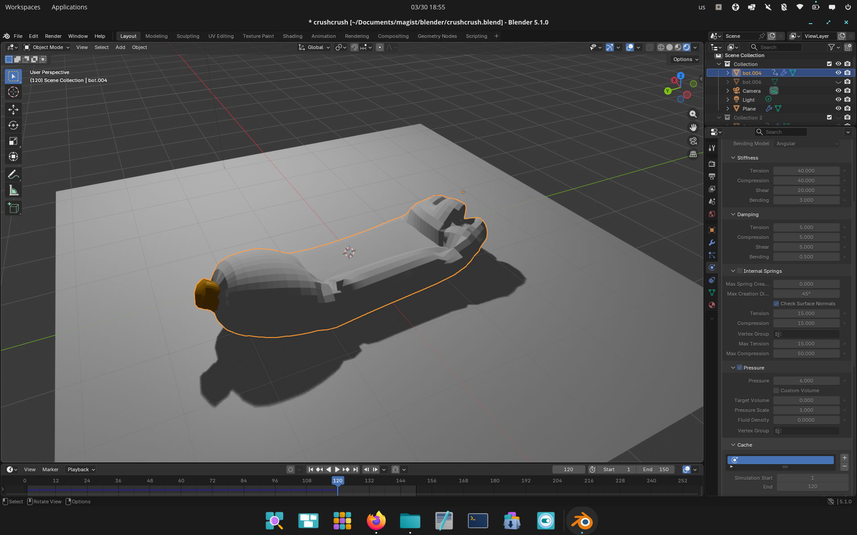
Object Deformation: Cloth Physics
cloth object with internal pressure
not very good, has numerous issues
4

Slide 12
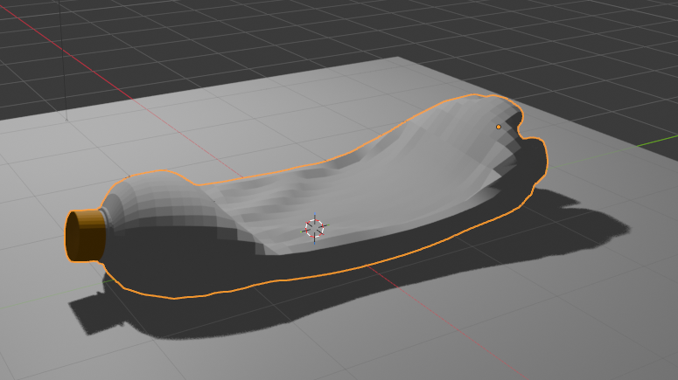
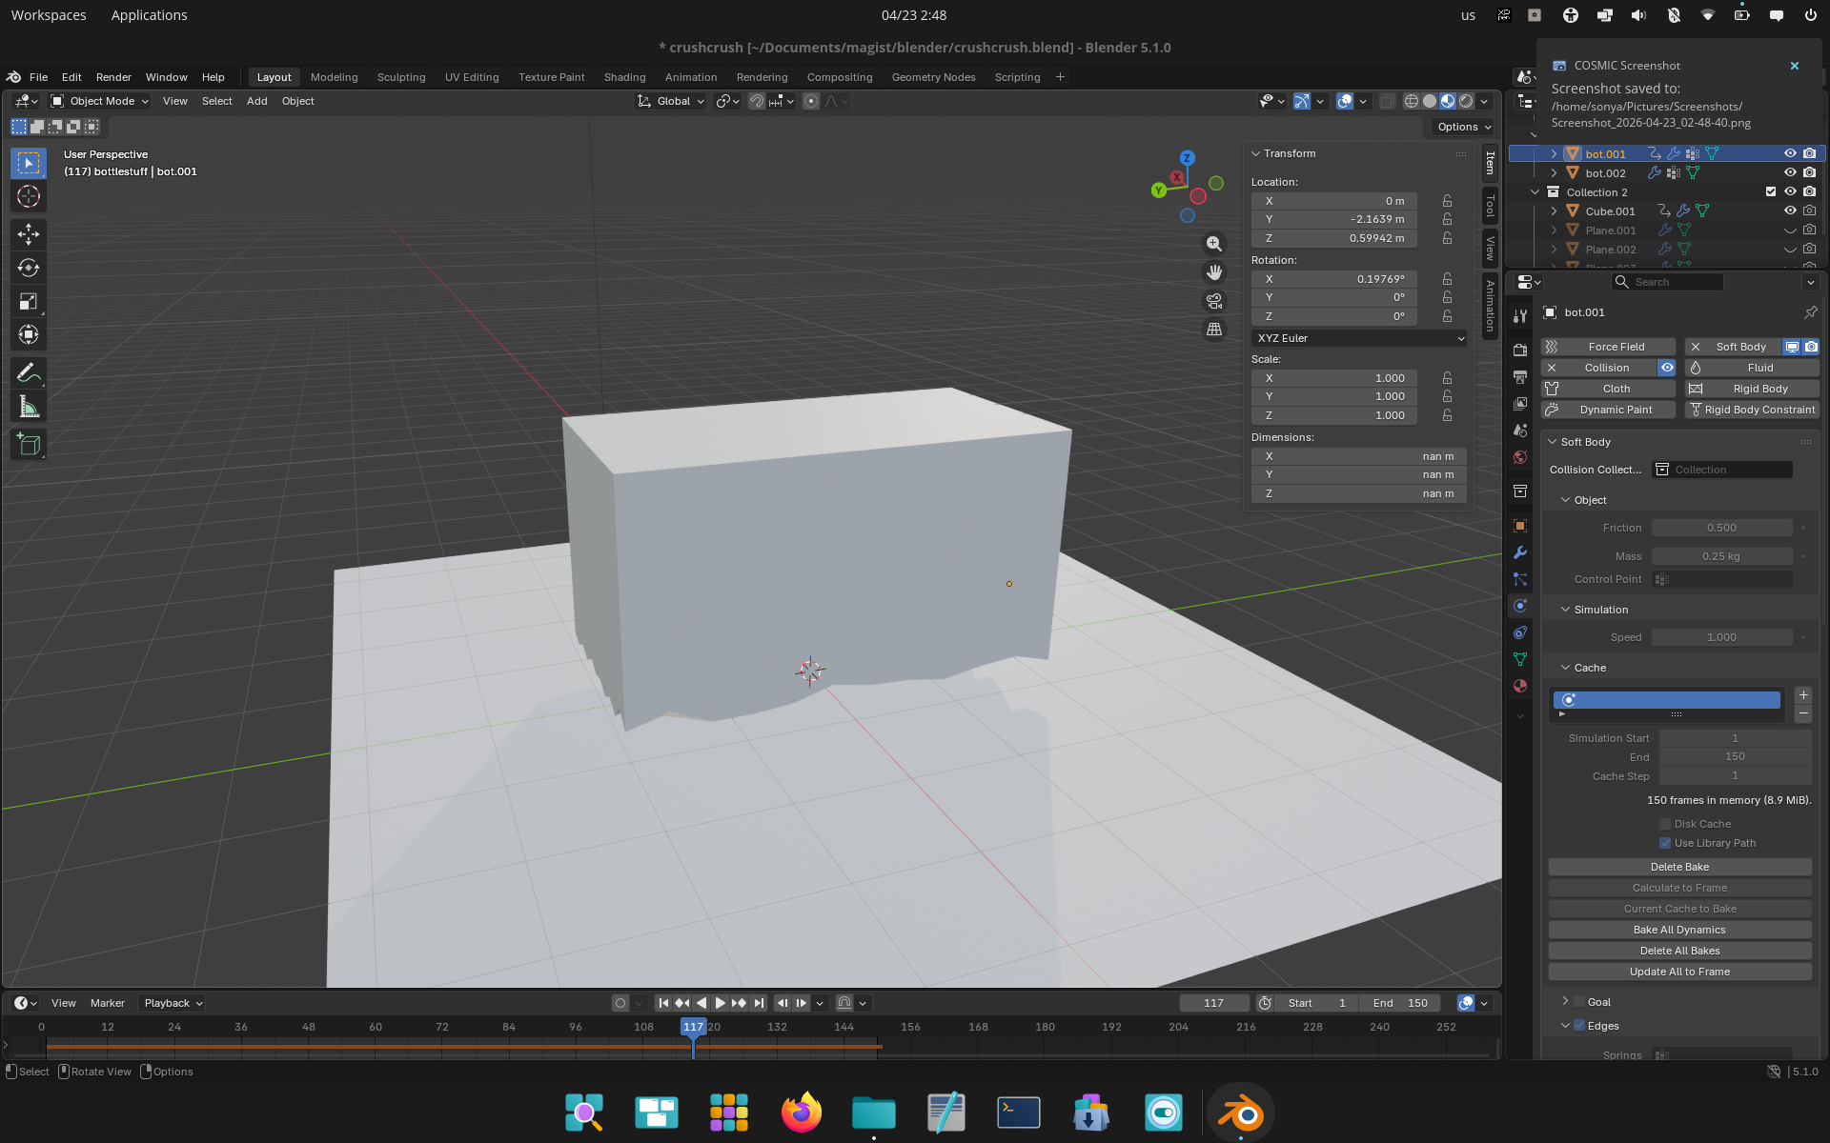
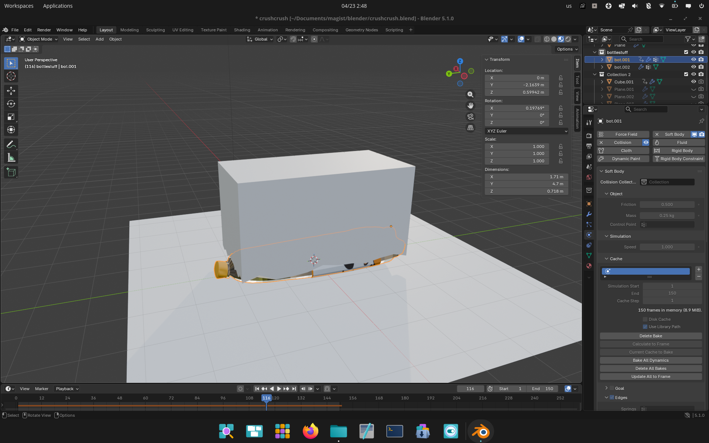
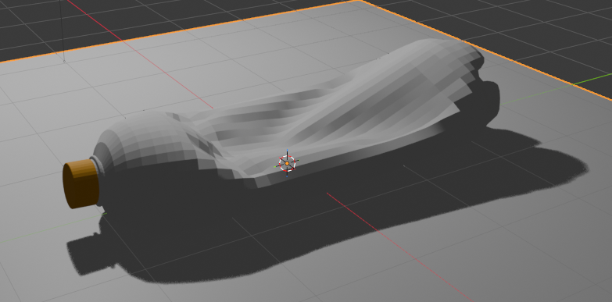
Object Deformation: Soft-body Physics
our go-to
realistic but has some issues

Slide 13
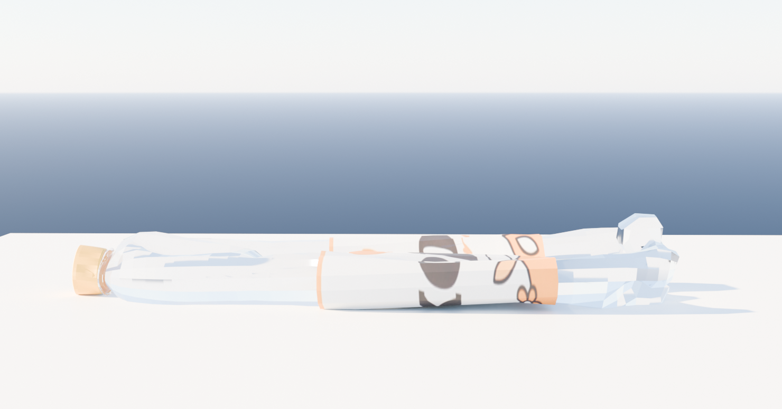
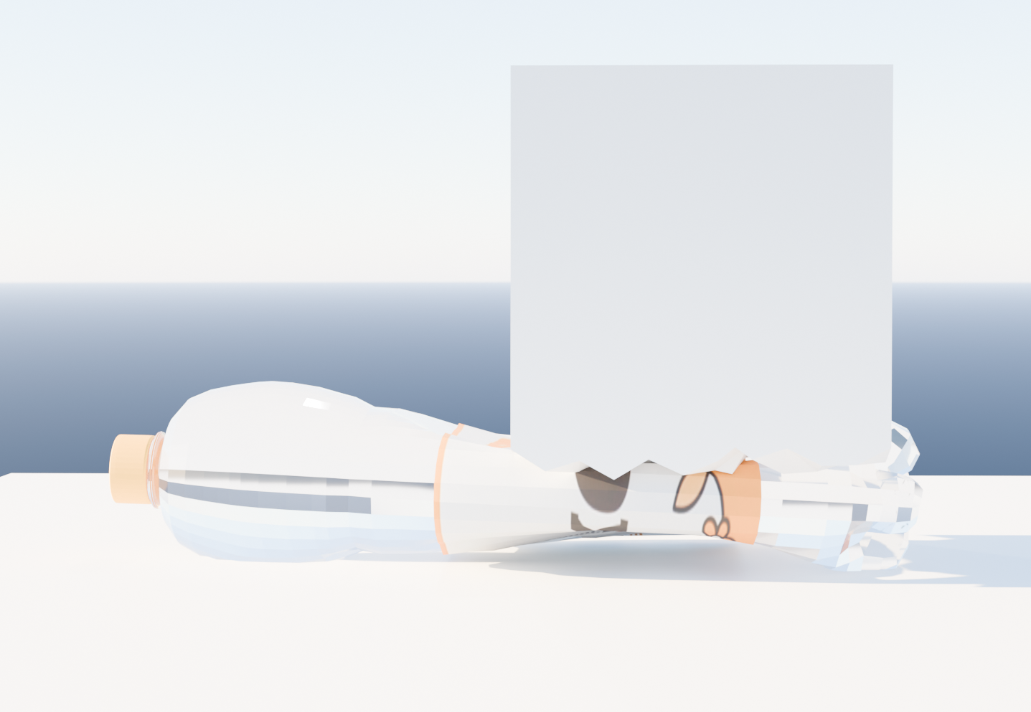
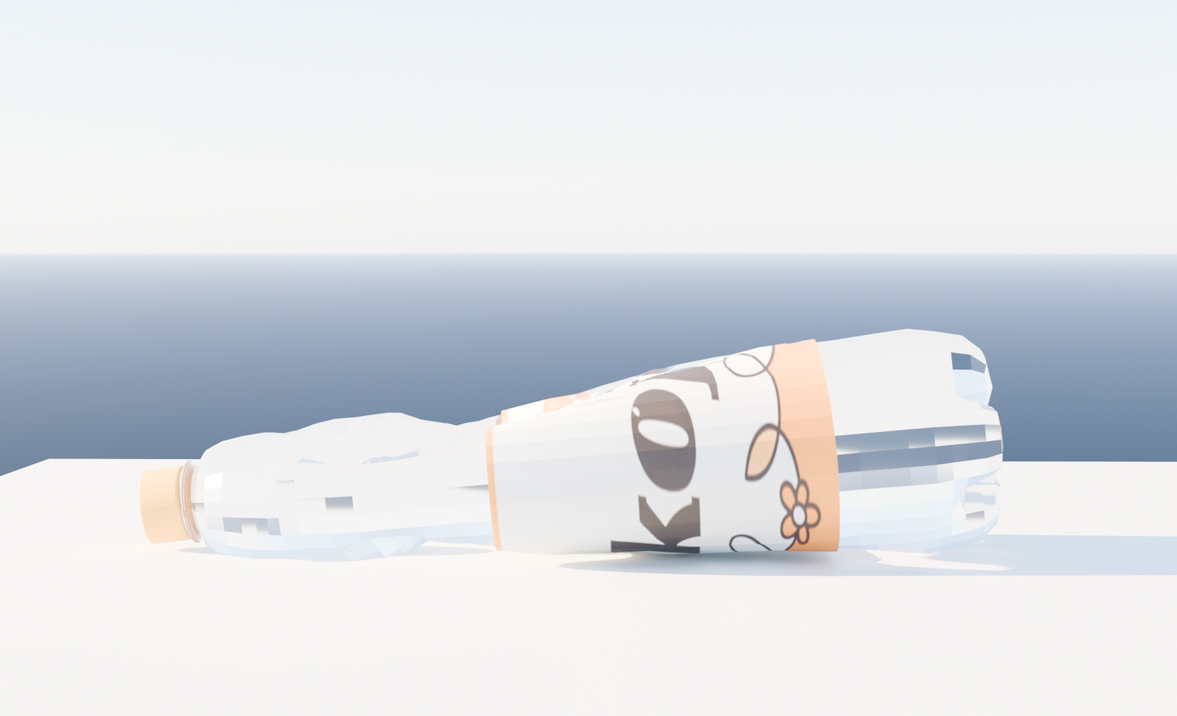
Object Rendering
currently placeholder rendering using Cycles

Slide 14
Future Objectives
explore various rendering approaches, Blender shaders, Mitsuba, …
object scattering using the likes of mentioned related works
evaluate the accuracy of our created data compared to reality
(potentially) generate and test a dataset

Slide 15
Thank you for your attention

Slide 16
References
Synthetic Dataset Rendering with Parametric Transparent and Translucent Objects - Michal Kubirita, Comenius University in Bratislava Faculty of Mathematics, Physics and Informatics, 2024
Automated 3D Dataset Generation for Arbitrary Objects - Paul Schulz , Thorsten Hempel, Ayoub Al-Hamadi, 2017
Surface Reconstruction of Transparent Objects from Gaussian Radiance Fields - Peter Kravar, 2025

