Slide 1
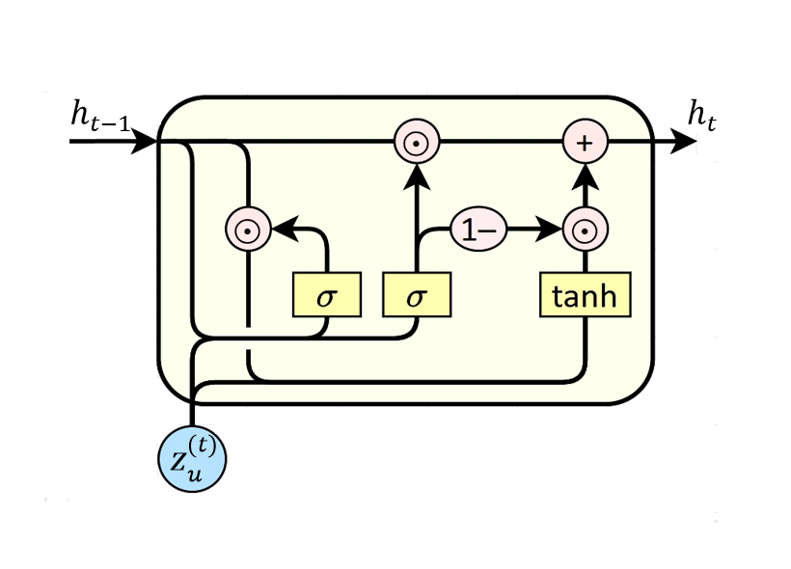
















$L$-Step Behavioral Sequence
GRU
User-Day Aggregation Features (Dim=19)
$$x_{u}^{(t−L+1)}$$
$$x_{u}^{(t−L)}$$
...
$$x_{u}^{(t)}$$
Cloud
Audit Logs
$$\{z_{u}^{(t−L+1)},z_{u}^{(t−L)},...,z_{u}^{(t)}\}$$
$G_{t}=(V_{t},E_{t})$
Target-Day Interaction Graph Construction
MLP
Anomaly score
$$p=σ(s_{u}^{(t)})$$
Explicit
Interaction Graph
Implicit
GAT Encoder
Normal/Attack

