Slide 1
Formal Methods
Yinzhi Cao
Lehigh University

Slide 2
Some Different Approaches to Formal Analysis (of safety properties of concurrent systems defined as transition relations)
. . . to be demonstrated on a concrete example Namely, Lamport’s Bakery Algorithm
Explicit, symbolic, bounded model checking
Deduction (theorem proving)
Abstraction and model checking
Automated abstraction (failure tolerant theorem proving)
Bounded model checking (for infinite state systems)
Focus is on pragmatics and tools (many demos), not theory
If there is time and interest, will also look at test generation, static analysis, and timed systems

Slide 3
Formal Methods: Analogy with Engineering Mathematics
Engineers in traditional disciplines build mathematical models of their designs
And use calculation to establish that the design, in the context of a modeled environment, satisfies its requirements
Only useful when mechanized (e.g., CFD)
Used in the design loop (exploration, debugging)
  Model, calculate, interpret, repeat
Also used in certification
  Verify by calculation that the modeled system satisfies certain requirements
Need to be sure that model faithfully represents the design, design is implemented correctly, environment is modeled faithfully, and calculations are performed without error

Slide 4
Formal Methods: Analogy with Engineering Math (ctd.)
Formal methods: same idea, applied to computational systems
The applied math of Computer Science is formal logic
•
So the models are formal descriptions in some logical system
E.g., a program reinterpreted as a mathematical formula rather than instructions to a machine
And calculation is mechanized by automated deduction: theorem proving, model checking, static analysis, etc.
Formal calculations (can) cover all modeled behaviors
If the model is accurate, this provides verification
•
If the model is approximate, can still be good for debugging (aka. refutation)

Slide 5

Formal Methods:
In Pictures
Testing/Simulation
Formal Analysis
Real System Partial coverage
Formal Model Complete coverage
(of the modeled system)
Accurate model: Approximate model:
verification debugging

Slide 6
Comparison with Simulation, Testing etc.
Simulation also considers a model of the system (designed for execution rather than analysis)
Testing considers the real thing
Both differ from formal methods in that they examine only some of the possible behaviors
For continuous systems, verification by extrapolation from partial tests is valid, but for discrete systems, it is not
Can make only statistical projections, and it’s expensive
  114,000 years on test for 10⁻⁹
Limit to evidence provided by testing is about 10⁻⁴
In most applications, testing is used for debugging rather than verification

Slide 7
Comparison with Simulation, Testing etc. (ctd)
Debugging depends on choosing right test cases
  Can be improved by explicit coverage measures
  Good coverage is almost impossible when the environment can introduce huge numbers of different behaviors
(e.g., fault arrivals, real-time, asynchronous interactions)
So depends on skill, luck
Since formal methods can consider all behaviors, certain to find the bugs
  Provided the model, environment, and the properties checked are sufficiently accurate to manifest them
So depends on skill, luck
Experience is you find more bugs (and more high-value bugs) by exploring all behaviors of an approximate model than by exploring some behaviors of a more accurate one

Slide 8
Formal Calculations: The Basic Challenge
Build mathematical model of system and deduce properties by calculation
The applied math of computer science is formal logic
So calculation is done by automated deduction
Where all problems are NP-hard, most are superexponential
₂.
..
}n
n
(2² ), nonelementary (2²
), or undecidable
Why? Have to search a massive space of discrete possibilities
Which exactly mirrors why it’s so hard to provide assurance for computational systems
But at least we’ve reduced the problem to a previously unsolved problem!

Slide 9
Formal Calculations: Meeting The Basic Challenge
Ways to cope with the massive computational complexity
Use human guidance
  That’s interactive theorem proving—e.g., PVS
Restrict attention to specific kinds of problems
  E.g., model checking—focuses on state machines etc.
Use approximate models, incomplete search
  model checkers are often used this way
Aim at something other than verification
  E.g., bug finding, test case generation
Verify weak properties
  That’s what static analysis typically does
Give up soundness and/or completeness
  Again, that’s what static analysis typically does

Slide 10
Let’s do an example: Bakery

Slide 11
The Bakery Algorithm for Distributed Mutual Exclusion
Idea is based on the way people queue for service in US delicatessens and bakeries (or Vietnam Airlines in HCMC)
A machine dispenses tickets printed with numbers that increase monotonically
People who want service take a ticket
The unserved person with the lowest numbered ticket is served next
  Safe: at most one person is served
(i.e., is in the “critical section”) at a time
  Live: each person is eventually served
Preserve the idea without centralized ticket dispenser

Slide 12
Works for n ≥ 1 processes
Informal Protocol Description
Each process has a ticket register, initially zero
When it wants to enter its critical section, a process sets its ticket greater than that of any other process
Then it waits until its ticket is smaller than that of any other process with a nonzero ticket
At which point it enters its critical section
Resets its ticket to zero when it exits its critical section
Show that at most one process is in its critical section at any time (i.e., mutual exclusion)

Slide 13
Formal Modeling and Analysis
Build a mathematical model of the protocol
Analyze it for a desired property
Must choose how much detail to include in the model
  Too much detail: analysis may be infeasible
  Too little detail: analysis may be inaccurate
(i.e., fail to detect bugs, or report spurious ones)
  Must also choose a modeling style that supports intended form of analysis
Requires judgment (skill, luck) to do this

Slide 14
Modeling the Example System and its Properties: Accuracy and Level of Detail
The protocol uses shared memory and is sensitive to the atomicity of concurrent reads and writes
And to the memory model (on multiprocessors with relaxed memory models, reads and writes from different processors may be reordered)
And to any faults the memory may exhibit
If we wish to examine the mutual exclusion property of a particular implementation of the protocol, we will need to represent the memory model, fault model, and atomicity employed—which will be quite challenging
Abstractly (or at first), we may prefer to focus on the behavior of the protocol in an ideal environment with fault-free sequentially consistent atomic memory

Slide 15
Also, although the protocol is suitable for n processes, we may prefer to focus on the important special case n = 2
Modeling the Example System and its Properties (ctd.)
And although each process will perform activities other than the given protocol, we will abstract these details away and assume each process is in one of three phases
idle: performing work outside its critical section
trying: critical:
to enter its critical section
performing work inside its critical section

Slide 16
Formalizing the Model (continued)
We will need to model a system state comprising For each process:
  The value of its ticket, which is a natural number
  The phase it is in—recorded in its “program counter” which takes values idle, trying, critical
Then we model the (possibly nondeterministic) transitions in the system state produced by each protocol step
And check that the desired property is always preserved

Slide 17
bakery : CONTEXT = BEGIN
phase : TYPE = {idle, trying, critical}; ticket: TYPE = NATURAL;
A Formal Description of the Protocol (in SAL)
process : MODULE = BEGIN
INPUT other_t: ticket OUTPUT my_t: ticket OUTPUT pc: phase
INITIALIZATION
pc = idle; my_t = 0

Slide 18
TRANSITION [
try: pc = idle -->
More Formal Protocol Description (continued)
pc’ = trying
[]
enter: pc = trying AND (other_t = 0 OR my_t < other_t) --> pc’ = critical
[]
my_t’
= other_t + 1;
leave:
pc = critical --> my_t’ = 0;
pc’ = idle
] END;

Slide 19
P1 : MODULE = RENAME pc TO pc1 IN process;
More Formal Protocol Description (continued again)
P2 : MODULE = RENAME other_t TO my_t,
my_t TO other_t,
pc TO pc2 IN process;
system : MODULE = P1 [] P2;
safety: THEOREM
system |- G(NOT (pc1 = critical AND pc2 = critical));
END

Slide 20
Analyzing the Specification Using Model Checking
They are called model checkers because they check whether a system, interpreted as an automaton, is a (Kripke) model of a property expressed as a temporal logic formula
The simplest type of model checker is one that does explicit state exploration
  Basically, a simulator that remembers the states it’s seen before and backtracks to explore all of them (either depth-first, breadth-first, or a combination)
  Defeated by the state explosion problem at around a few tens of millions of states
To get further, need symbolic representations (a short formula can represent many explicit states)
  Symbolic model checkers use BDDs
  Bounded model checkers use SAT and SMT solvers

Slide 21
Explicit State Reachability Analysis
Keep a set of all states visited so far, and a list of all states whose successors have not yet been calculated
  Initialize both with the initial states
Pick a state off the list and calculate all its successors
  i.e., run all possible one-step simulations from that state Throw away those seen before
Add new ones to the set and the list
Check each new state for the desired (invariant) properties
  More complex properties use Bu¨chi automaton in parallel
Iterate to termination, or some state fails a property
  Or run out of memory, time, patience
On failure, counterexample (backtrace) manifests problem

Slide 22
We’ll use sal-esmc
Analyzing the Spec’n Using Explicit State Model Checking
An explicit-state LTL model checker for SAL
Not part of the SAL distribution, just used for demos Later, we’ll look at symbolic and bounded model checking
This is an infinite-state specification, so cannot enumerate the whole state space, but sal-esmc will do its best. . .
sal-esmc -v 3 bakery safety building execution engine...
num. bits used to encode a state: 44 verifying property using depth-first search...
computing set of initial states... number of initial states: 1
number of visited states: 1001, states to process: 1001, depth: 749 number of visited states: 10001, states to process: 10001, depth: 7499 number of visited states: 20001, states to process: 20001, depth: 14999
...

Slide 23
Bug Finding Using Explicit State Model Checking
So verification will take forever
•
But can be useful for finding bugs: if we remove the +1
adjustment to the tickets, we get a counterexample
INVALID, generating counterexample...
number of visited states: 7, verification time: 0.02 secs
------------------------
my_t = 0 other_t = 0 pc1 = idle pc2 = idle
------------------------
pc2 = trying
------------------------
pc2 = critical
------------------------
pc1 = trying
------------------------
my_t = 0 other_t = 0 pc1 = critical pc2 = critical

Slide 24
Verification by Finite State Model Checking
For traditional methods of model checking, we need to make the state space finite
Use property preserving abstractions (later)
Or drastic simplification (“downscaling”)
  We’ve already done this to some extent, by fixing the number of processors, n, as 2
  We also need to set an upper bound on the tickets
We’ll start at 8, then raise the limit to 80, 800, . . . until the search becomes too slow
We have to modify the protocol to bound the tickets
  So it’s not the same protocol
  May miss some bugs, or get spurious ones
  But it’s a useful check

Slide 25
bakery : CONTEXT = BEGIN
The Bounded Specification in SAL
phase : TYPE | = | {idle, trying, | critical};
max: NATURAL | = | 8;
ticket: TYPE | = | [0..max];
process : MODULE = BEGIN
INPUT other_t: ticket OUTPUT my_t: ticket OUTPUT pc: phase
INITIALIZATION
pc = idle; my_t = 0

Slide 26
TRANSITION [
try: pc = idle AND other_t < max --> my_t’ = other_t + 1;
The Bounded Specification in SAL (continued)
pc’ = trying
[]
enter: pc = trying AND (other_t = 0 OR my_t < other_t) --> pc’ = critical
[]
leave: pc = critical -->
my_t’ = 0; pc’ = idle
] END;

Slide 27
P1 : MODULE = RENAME pc TO pc1 IN process;
The Bounded Specification in SAL (continued again)
P2 : MODULE = RENAME other_t TO my_t,
my_t TO other_t,
pc TO pc2 IN process;
system : MODULE = P1 [] P2;
safety: THEOREM
system |- G(NOT (pc1 = critical AND pc2 = critical));
END

Slide 28
For max = 800, sal-esmc reports
Results of Model Checking
sal-esmc -v 3 smallbakery safety
num. bits used to encode a state: 24 verifying property using depth-first search...
computing set of initial states...
number | of | initial | states: | 1
number | of | visited | states: | 1001, | states | to | process: | 1001, depth: 749
number | of | visited | states: | 2001, | states | to | process: | 2001, depth: 1499
number | of | visited | states: | 3001, | states | to | process: | 3001, depth: 2249
number | of | visited | states: | 4002, | states | to | process: | 804, depth: 602
number | of | visited | states: | 5002, | states | to | process: | 1804, depth: 1352
number | of | visited | states: | 6002, | states | to | process: | 2804, depth: 2102
number | of | visited | states: | 6397
verification time: 0.54 secs proved.
For max = 8000, number of visited states grows to 63,997, and time to 23.86 secs

Slide 29
More Explicit State Checks
Sometimes properties are true for the wrong reason
It is prudent to introduce a bug and make sure it is detected before declaring victory
  We can remove the +1 adjustment to tickets and get a counterexample as before
We can check that the counters are capable of increasing indefinitely by adding the invariant
unbounded: THEOREM system |- G(my_t < max);
(After undoing the deliberate errors just introduced)
We get another counterexample
The pattern is: P1 tries, then the following sequence repeats
P1 enters, P2 tries, P1 quits, P2 enters, P1 tries, P2 quits

Slide 30
Benefits of Explicit State Model Checking
Can only explore a few million states, but that’s enough when there are plenty of bugs to find
Can use hashing (supertrace) to go further
Can have arbitrarily complex transition relation
  Language can include any datatypes and operations supported by the API
Breadth first search finds short counterexamples
  Can write special search strategies to target specific cases, or to ignore others (symmetry, partial order)
LTL is handled via Bu¨chi automata
Can evaluate functions, not just predicates, on the reachable states: can calculate worst-cases, do optimization
But it runs out of steam on big examples

Slide 31
Analysis by Symbolic Model Checking (SMC)
We could take a symbolic representation of the transition relation and repeatedly compose it with itself until it reaches a fixpoint (must exist for finite systems)
That would give us a representation of the reachable states, from which we could check safety properties directly
  Again, LTL is handled via Bu¨chi automata
Reduced Ordered Binary Decision Diagrams (BDDs) are a suitable representation for doing this
This is the basic idea of symbolic model checking
  In practice, use different methods of calculation, depending on the type of property being checked
Can construct counterexamples for false properties
Can (sometimes) handle huge statespaces very efficiently

Slide 32
Symbolic Model Checking (ctd)
Our symbolic representation is a purely Boolean one
So we have to compile the transition relation down to what is essentially a circuit
  Bounded integers represented by bitvectors of suitable size
  Addition requires the circuit for a boolean adder
  Similarly for other datatypes and operations
We are doing a kind of circuit synthesis
May fail for large or complex transition relations
BDD operations depend on finding a good variable ordering
Automated heuristics usually effective to about 600 state bits
After that, manual ordering, special tricks are needed
Seldom get beyond 1,000 state bits

Slide 33
We’ll use sal-smc, uses CUDD for its BDD operations
Symbolic Model Checking with SAL
For max = 80
sal-smc smallbakery safety
Requires 46 BDD variables, 240 iterations, 637 states, 2.9 seconds to get to proved
For max = 8000, it’d be tedious doing as above, but
sal-smc smallbakery safety --backward
Requires 70 BDD variables, 5 iterations, 131,180,871 states,
0.5 seconds to get to proved
Symbolic model checking is “automatic”
But requires dial twiddling

Slide 34
More Checks With Symbolic Model Checking
Do the tickets always increase without bound?
bounded: LEMMA system |- F(my_t > 3);
The counterexample to this liveness property is a prefix, followed by a loop (lasso)
The pattern is P1 tries, enters, leaves, and then repeats
Does P1 ever get into the critical region?
liveness: THEOREM system |- F(pc1 = critical);
Same counterexample as above (with P2 rather than P1)
If it tries, does it always succeed?
response: THEOREM system |-
G(pc1 = trying => F(pc1 = critical)); Proved

Slide 35
Yet More Checks With Symbolic Model Checking
If it tries infinitely often, does it eventually succeed infinitely often?
weak_fair: THEOREM system |-
F(G(pc1 = trying)) => G(F(pc1 = critical)) Proved
If it tries continuously, does it eventually succeed infinitely often?
strong_fair: THEOREM system |-
G(F(pc1 = trying)) => G(F(pc1 = critical)) Proved
These properties are getting complicated
We should look at LTL

Slide 36
Linear Temporal Logic
A language for specifying properties of the execution traces of a system
Given a system specified by initiality predicate I and transition relation T , a trace is an infinite sequence of states s = s₀, s₁, . . . , s_{i}, . . . where I(s₀) and T (s_{i}, s_{i+1})
The semantics of LTL defines whether a trace s satisfies a formula p (written as s |= p)
The base cases are when p is a predicate on states, and the operators X (next), and U (strong until)
s |= φ, where φ is a predicate on states, iff φ is true on the initial state, i.e., φ(s₀)
s |= X(p) iff w |= p where w = s₁, . . . , s_{i}, . . .
• s |= U (p, q) iff ∃n : s = s₀, s₁, . . . s_{n}.w,
∀i ∈ {0, ..., n} : s_{i}, . . . s_{n}.w |= p, and w |= q

Slide 37
Linear Temporal Logic (ctd)
R (release), G (always), F (eventually), B (before), and W (weak until) are defined in terms of these
R(p, q) = NOT U(NOT p, NOT q) G(p) = R(FALSE, p)
F(p) = U(TRUE, p)
B(p, q) = R(p, NOT q)
W(p, q) = G(p) OR U(p, q)
Iterated next state can be defined in SAL
XXXX(a:boolean): boolean = X(X(X(X(a))));
Or even
posnat: TYPE = {x: natural | x>0};
Xn(a: boolean, n: posnat): boolean =
IF n = 1 THEN X(a) ELSE Xn(X(a), n-1) ENDIF;
X24(a: boolean): boolean = Xn(a, 24);

Slide 38
G(F(expr)): expr is true infinitely often
Fairness etc.
G(F(NOT en OR oc)): if en is enabled continuously, then oc
will occur infinitely often
  Weak fairness, often sufficient for progress in asynchronous systems
  Easier as G(F(NOT en) OR F(oc)) or G(G(en) => F(oc))
G(F(en)) => G(F(oc)): if en is enabled infinitely often, then
oc will occur infinitely often
  Strong fairness, often necessary for synchronous interaction
G(en => F(oc)): everytime en is true, eventually oc will also be true; this is a response formula
init => G(expr): expr is always true in any trace that begins with a state satisfying init

Slide 39
Complex LTL Formulas
Can vizualize complex LTL formulas as Bu¨chi automata
ltl2buchi smallbakery response -dotty
dotty is broken in Ubuntu 8.04, so we have to do
ltl2buchi smallbakery response | neato -tps | gv -
There are web pages giving LTL for common requirements
Other property languages
  CTL: computation tree logic is a branching time logic
⋆ LTL and CTL are incomparable
⋆ SAL accepts CTL syntax on the common fragment
PSL: Accellera Property Specification Language is a language developed by industry
For safety properties, may prefer a synchronous observer
  Module that observes the system, sets error flag when it sees a violation
  Model check for G(NOT error)

Slide 40
Using a different example, sal-smc -v 3 om1 validity
From Symbolic to Bounded Model Checking
Oral Messages algorithm with n “relays”
With 3 relays, 10,749,517,287 reachable states
With 4 relays, 66,708,834,289,920 reachable states
With 5 relays, run out of patience waiting for counterexample
Bounded model checkers are specialized to finding counterexamples
Sometimes can handle bigger problems than SMC

Slide 41
Given system specified by initiality predicate I and transition relation T on states S
Analysis by Bounded Model Checking (BMC)
Is there a counterexample to property P in k steps or less?
• Can try k = 1, 2, . . .
Find assignment to states s₀, . . . , s_{k} satisfying
I(s₀) ∧ T (s₀, s₁) ∧ T (s₁, s₂) ∧ · · · ∧ T (s_{k−1}, s_{k} ) ∧ ¬(P (s₁) ∧ · · · ∧ P (s_{k} ))
Given a Boolean encoding of I, T , and P (i.e., circuit), this is a propositional satisfiability (SAT) problem
SAT solvers have become amazingly fast recently (see later)
BMC uses same front end reduction to a Boolean representation as SMC, but a different back end
BMC generally needs less tinkering than SMC

Slide 42
We’ll use sal-bmc, Yices as its SAT solver (can use many others); the depth k defaults to 10
Bounded Model Checking with SAL
Finds the counterexample in the OM1 example in a few seconds
sal-bmc -v 3 om1 validity -d 3
And also all these examples
sal-bmc | -v | 3 | smallbakery | liveness
sal-bmc | -v | 3 | smallbakery | bounded
sal-bmc | -v | 3 | smallbakery | unbounded -d 20
But what about the true property?
sal-bmc -v 3 smallbakery safety -d 20
Can keep increasing the depth, but what does that tell us?

Slide 43
We should require that s₀, . . . , s_{k} a are distinct
Extending BMC to Verification
Otherwise there’s a shorter counterexample
And we should not allow any but s₀ to satisfy I
  Otherwise there’s a shorter counterexample
If there’s no path of length k satisfying these two constraints, and no counterexample has been found of length less than k, then we have verified P
  By finding its finite diameter
Seldom feasible in practice

Slide 44
Ordinary inductive invariance (for P ):
Alternatively, Automated Induction via BMC
Basis: I(s₀) ⊃ P (s₀)
Step: P (r₀) ∧ T (r₀, r₁) ⊃ P (r₁)
Extend to induction of depth k:
Basis: No counterexample of length k or less
Step:
P (r₀) ∧ T (r₀, r₁) ∧ P (r₁) ∧ · · · ∧ P (r_{k−1}) ∧ T (r_{k−1}, r_{k} ) ⊃ P (r_{k} )
These are close relatives of the BMC formulas
Induction for k = 2, 3, 4 . . . may succeed where k = 1 does not
Note that counterexamples help debug invariant
Can easily extend to use lemmas

Slide 45


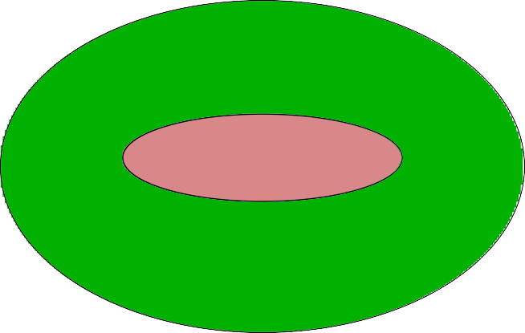
k-Induction is Powerful
Violations get harder as k grows
all states invariant
reachable states initial states

Slide 46
Verification by k-Induction
Looking at an inductive counterexample can help suggest lemmas (idea is to make the initial state infeasible)
sal-bmc -v 3 -d 2 -i smallbakery safety -ice
Here’s a simple lemma
aux: LEMMA system |- G((my_t = 0 => pc1 = idle)
AND (other_t = 0 => pc2 = idle));
Can prove with sal-smc, or with 1-induction
sal-bmc -v 3 -d 1 -i smallbakery aux
Can then verify safety with 2-induction using this lemma
sal-bmc -v 3 -d 2 -i smallbakery safety -l aux

Slide 47
Aside:
BMC Can Also Solve Sudoku

Slide 48
Bounded Model Checking for Infinite State Systems
We can discharge the BMC and k-induction efficiently for Boolean encodings of finite state systems because SAT solvers do efficient search
If we could discharge these formulas over richer theories, we could do BMC and k-induction for state machines over these theories
So how about if we combine a SAT solver with decision procedures for useful theories like arithmetic?
That’s what an SMT solver does (details later)
  Satisfiability Modulo Theories
BMC using an SMT solver yields an infinite bounded model checker
  i.e., a bounded model checker for infinite state systems

Slide 49
SMT Solvers
Ours is called Yices
  Typically does very well in the annual SMT competition
Yices decides formulas in the combined theories of linear arithmetic over integers and reals (including mixed forms), fixed size bitvectors, equality with uninterpreted functions, recursive datatypes (such as lists and trees), extensional arrays, dependently typed tuples and records of all these, lambda expressions, and some quantified formulas
Decides whether formulas are unsatisfiable or satisfiable; in the latter case it can construct an explicit satisfying instance
For unsatisfiable formulas, it can optionally find an assignment that maximizes the weight of satisfied clauses (i.e., MaxSMT) or, dually, find a minimal set of unsatisfiable clauses (the unsat core)

Slide 50
We’ll use sal-inf-bmc
Infinite Bounded Model Checking with SAL
Can repeat the examples we did with BMC using the original specification
sal-inf-bmc | -v | 3 | bakery | bounded -d 3
sal-inf-bmc | -v | 3 | bakery | liveness
sal-inf-bmc | -v | 3 | bakery | liveness -it
sal-inf-bmc | -v | 3 | bakery | unbounded -d | 20
sal-inf-bmc | -v | 3 | -d 1 -i bakery aux
sal-inf-bmc | -v | 3 | -d 2 -i bakery safety -l aux
Infinite BMC and k-induction blur the line between model checking and theorem proving

Slide 51
Analyzing the Specification Using Theorem Proving
We’ll use PVS
PVS is a logic, it does not have a notion of state, nor of concurrent programs, built in—we must specify the program using the transition relation semantics of SAL
bakery: THEORY BEGIN
phase : TYPE = {idle, trying, critical}
state: TYPE = [# pc1, pc2: phase, t1, t2: nat #] s, pre, post: VAR state

Slide 52
P1_transition(pre, post): bool = IF pre‘pc1 = idle
THEN post = pre WITH [(t1) := pre‘t2 + 1, (pc1) := trying] ELSIF pre‘pc1 = trying AND (pre‘t2 = 0 OR pre‘t1 < pre‘t2)
The Transitions in PVS
THEN post = pre WITH [(pc1) := critical] ELSIF pre‘pc1 = critical
THEN post = pre WITH [(t1) := 0, (pc1) := idle] ELSE post = pre
ENDIF
P2_transition(pre, post): bool = ... similar transitions(pre, post): bool =
P1_transition(pre, post) OR P2_transition(pre, post)

Slide 53
init(s): bool = s‘pc1 = idle AND s‘pc2 = idle
AND s‘t1 = 0 AND s‘t2 = 0
Initialization and Invariant in PVS
safe(s): bool = NOT(s‘pc1 = critical AND s‘pc2 = critical)
 To prove that a property P is an invariant, we prove it is *inductive*
 This is similar to Amir Pnueli’s rule for Universal Invariance
 Except we strengthen the actual property rather than have an auxiliary
indinv(inv: pred[state]): bool = FORALL s: init(s) => inv(s)
AND FORALL pre, post:
inv(pre) AND transitions(pre, post) => inv(post)
first_try: LEMMA indinv(safe)

Slide 54
First Attempted Proof: Step 1
Starting the PVS theorem prover gives us this sequent
first_try :
|-------
{1} indinv(safe) Rule?
The proof commands (EXPAND "indinv") and (GROUND) open up the definition of invariant and split it into cases
We are then presented with the first of the two cases
This yields 2 subgoals:
first_try.1 :
|-------
{1} FORALL s: init(s) => safe(s)
This is discharged by the proof command (GRIND), which expands definitions and performs obvious deductions

Slide 55
This completes the proof of first_try.1. first_try.2 :
|-------
First Attempted Proof: Step 2
{1} FORALL pre, post:
safe(pre) AND transitions(pre, post) => safe(post)
The commands (SKOSIMP), (EXPAND "transitions"), and (GROUND) eliminate the quantification and split transitions into separate cases for processes 1 and 2
first_try.2.1 :
{-1}
[-2]
P1_transition(pre!1, post!1) safe(pre!1)
|-------
[1] safe(post!1)
(EXPAND "P1 transition") and (BDDSIMP) split the proof into
four cases according to the kind of step made by the process

Slide 56
The first one is discharged by (GRIND), but the second is not and we are presented with the sequent
first_try.2.1.2 :
First Attempted Proof: Step 3
[-1]
{-2}
[-3]
[-4]
{-5}
pre!1‘t2 = 0 trying?(pre!1‘pc1)
post!1 = pre!1 WITH [(pc1) := critical] safe(pre!1)
critical?(pre!1‘pc2)
|-------
When there are no formulas below the line, a sequent is true if there is a contradiction among those above the line
Here, Process 1 enters its critical section because Process 2’s ticket is zero—but Process 2 is already in its critical section

Slide 57
This is a contradiction because Process 2 must have incremented its ticket (making it nonzero) when it entered its trying phase
First Attempted Proof: Aha!
But contemplation, or experimentation with the prover, should convince you that this fact is not provable from the information provided
Similarly for the other unprovable subgoals
The problem is not that safe is untrue, but that it is not inductive
  It does not provide a strong enough antecedent to support the proof of its own invariance

Slide 58
Second Attempted Proof
The solution is to prove a stronger property than the one we are really interested in
strong_safe(s): bool = safe(s) AND (s‘t1 = 0 => s‘pc1 = idle) AND (s‘t2 = 0 => s‘pc2 = idle)
second_try: LEMMA indinv(strong_safe)

Slide 59
Second Attempted Proof: Aha! Again
The stronger formula deals with the case we just examined, and the symmetric case for Process 2, but still has two unproved subgoals; here’s one of them
second_try.2 :
{-1}
{-2}
{-3}
{-4}
trying?(pre!1‘pc1) pre!1‘t1 < pre!1‘t2
post!1 = pre!1 WITH [(pc1) := critical] critical?(pre!1‘pc2)
|-------
{1} (pre!1‘t1 = 0)
The situation here is that Process 1 has a smaller ticket than
Process 2 and is entering its critical section—even though Process 2 is already in its critical section
But this cannot happen because Process 2 must have had the smaller ticket when it entered (because Process 1 has a nonzero ticket), contradicting formula -2

Slide 60
Third Attempted Proof
Again we need to strengthen the invariant to carry along this fact
inductive_safe(s):bool = strong_safe(s)
AND ((s‘pc1 = critical AND s‘pc2 = trying) => s‘t1 < s‘t2) AND ((s‘pc2 = critical AND s‘pc1 = trying) => s‘t1 > s‘t2)
third_try: LEMMA indinv(inductive_safe)
Finally, we have a invariant that is inductive—and is proved with (GRIND)

Slide 61
To establish an invariant or safety property S (one true of all reachable states) by theorem proving, we invent another property P that implies S and that is inductive (on transition relation T , with initial states I)
Inductive Invariants
Includes all the initial states: I(s) ⊃ P (s)
Is closed on the transitions: P (s) ∧ T (s, t) ⊃ P (t)
The reachable states are the smallest set that is inductive, so inductive properties are invariants
Trouble is, naturally stated invariants are seldom inductive
  The second condition is violated
Need to make them smaller (stronger) to exclude the states that take you outside the invariant

Slide 62



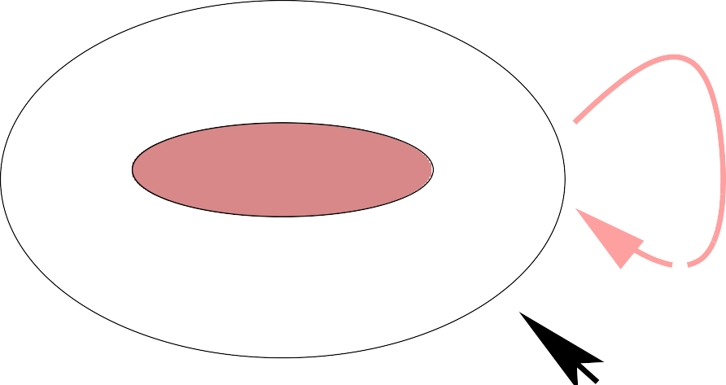
Noninductive Invariants In Pictures
all states
invariant
reachable states initial states
inductive invariant

Slide 63
Strengthening Invariants To Make Them Inductive
Postulate a new invariant that excludes the states (so far discovered) that take you outside the desired invariant
Show that the conjunction of the new and the desired invariant is inductive
Iterate until success or exasperation

Slide 64

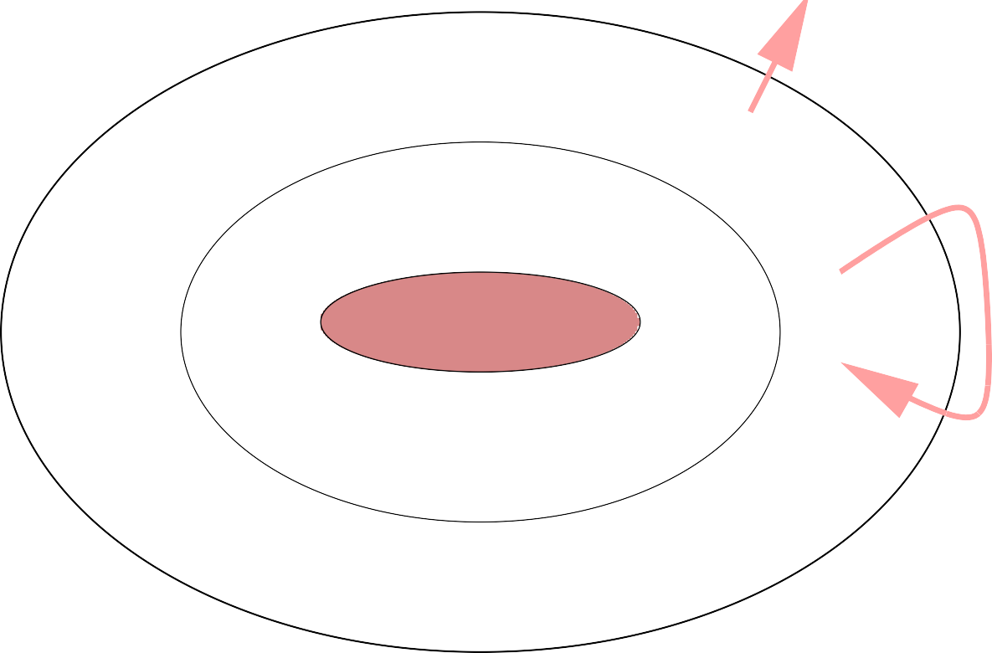

Inductive Invariants In Pictures
all states
invariant
reachable states initial states

Slide 65
Strengthening Invariants To Make Them Inductive
Iterate until success or exasperation
Process can be made systematic
  Each strengthening was suggested by a failed proof But is always tedious
Bounded retransmission protocol required 57 such iterations
  Took a couple of months to complete (Havelund and Shankar)
Notice that each conjunct must itself be an invariant (the very property we are trying to establish)
Disjunctive invariants are an alternative for some problems (see my CAV 2000 paper)

Slide 66
Pros and Cons of Theorem Proving
Theorem proving can handle infinite state systems
And accurate models
  Sometimes less says more–e.g., fault tolerance
And general properties
(not just those expressible in temporal logic)
But it’s hard (and not everyone finds it fun)
  Everything is possible but nothing is easy
  Especially strengthening of invariants
Interaction focuses on proof, and idiosyncrasies of the prover, not on the design being evaluated
  “Interactive theorem proving is a waste of human talent”
It’s all or nothing
  No incremental return for incremental effort

Slide 67
Formal Verification by Theorem Proving:
The Wall
Assurance for system
theorem proving
verification
Effort

Slide 68
Aside: Design Choices in PVS
Aside from the need to strengthen the invariant, PVS did OK on this example (and does so on many more)
We only used a fraction of its linguistic resources
  Higher-order logic with dependent predicate subtyping
  Recursive abstract data types and inductive types
  Parameterized theories and interpretations
  . . . and most of it is efficiently executable
It automatically discharged subgoals by deciding properties over abstract data types (enumeration types are a degenerate case), integer arithmetic, record updates, prop’nl calculus
In larger examples, it also has to choose when to open up a definition, and when to apply a rewrite
What makes PVS (and other verification systems) effective is that it has tightly integrated automation for all of these

Slide 69
Top-Level Design Choices in PVS
Specification language is a higher-order logic with subtyping
  Typechecking is undecidable: uses theorem proving
User supplies top-level strategic guidance to the prover
  Invoking appropriate proof methods (induction etc.)
  Identifying necessary lemmas
  Suggesting case-splits
  Recovering when automation fails
Automation takes care of the details, through a hierarchy of techniques
Decision procedures
Rewriting (automates application of lemmas)
Heuristics (guess at case-splits, instantiations)
User-supplied strategies (cf. tactics in HOL)

Slide 70
Decision Procedures
Many important theories are decidable
Propositional calculus
(a ∧ b) ∨ ¬a = a ⊃ b
Equality with uninterpreted function symbols
x = y ∧ f (f (f (x))) = f (x) ⊃ f (f (f (f (f (y))))) = f (x)
Function, record, and tuple updates
f with [(x) := y](z) = if z = x then y else f (z)
Linear Arithmetic (over integers and rationals)
x ≤ y ∧ x ≤ 1 − y ∧ 2 × x ≥ 1 ⊃ 4 × x = 2
def
But we need to decide combinations of theories
2 × car(x) − 3 × cdr(x) = f (cdr(x)) ⊃
f (cons(4 × car(x) − 2 × f (cdr(x)), y)) = f (cons(6 × cdr(x), y))

Slide 71
Combined Decision Procedures
Some combinations of decidable theories are not decidable
  E.g., quantified theory of integer arithmetic (Presburger) and equality over uninterpreted function symbols
Need to make pragmatic compromises
  E.g., stick to ground (unquantified) theories and leave quantification to heuristics at a higher level
Two basic methods for combining decision procedures
  Nelson-Oppen: fewest restrictions
  Shostak: faster, yields a canonizer for combined theory
Shostak’s method is used in PVS
  Over 20 years from first paper to fully correct treatment
  Now formally verified (in PVS) by Jonathan Ford

Slide 72
Integrated Decision Procedures
It’s not enough to have good decision procedures available to discharge the leaves of a proof
  The endgame: PVS can use Yices for that
They need to be used in simplification, which involves recursive examination of subformulas: repeatedly adding, subtracting, asserting, and denying subformulas
And integrated with rewriting, where they used in matching and (recursively) to decide conditions or top-level
if-then-else’s
So the API to the decision procedures must be quite rich

Slide 73
Disruptive Innovation
Performance
Time
Low-end disruption is when low-end technology overtakes the performance of high-end (Christensen)

Slide 74
SMT Solvers:
Disruptive Innovation in Theorem Proving
SMT stands for Satisfiability Modulo Theories
SMT solvers extend decision procedures with the ability to handle arbitrary propositional structure
  Traditionally, case analysis is handled heuristically in the theorem prover front end
⋆ Have to be careful to avoid case explosion
  SMT solvers use the brute force of modern SAT solving
Or, dually, they generalize SAT solving by adding the ability to handle arithmetic and other decidable theories
Application to verification
  Via bounded model checking and k-induction

Slide 75
SAT Solving
Find satisfying assignment to a propositional logic formula
Formula can be represented as a set of clauses
  In CNF: conjunction of disjunctions
  Find an assignment of truth values to variable that makes at least one literal in each clause TRUE
  Literal: an atomic proposition A or its negation A¯
Example: given following 4 clauses
  A, B
  C, D
  E
◦ A¯, D¯ , E¯
One solution is A, C, E, D¯
(A, D, E is not and cannot be extended to be one)
Do this when there are 1,000,000s of variables and clauses

Slide 76
SAT Solvers
SAT solving is the quintessential NP-complete problem
But now amazingly fast in practice (most of the time)
  Breakthroughs (starting with Chaff) since 2001
⋆ Building on earlier innovations in SATO, GRASP
  Sustained improvements, honed by competition
Has become a commodity technology
  MiniSAT is 700 SLOC
Can think of it as massively effective search
  So use it when your problem can be formulated as SAT
Used in bounded model checking and in AI planning
  Routine to handle 10³⁰⁰ states

Slide 77
SAT Plus Theories
SAT can encode operations and relations on bounded integers
  Using bitvector representation
  With adders etc. represented as Boolean circuits And other finite data types and structures
But cannot do not unbounded types (e.g., reals), or infinite structures (e.g., queues, lists)
And even bounded arithmetic can be slow when large
There are fast decision procedures for these theories
But their basic form works only on conjunctions
General propositional structure requires case analysis
  Should use efficient search strategies of SAT solvers That’s what an SMT solver does

Slide 78
Decidable Theories
Many useful theories are decidable
(at least in their unquantified forms)
Equality with uninterpreted function symbols
x = y ∧ f (f (f (x))) = f (x) ⊃ f (f (f (f (f (y))))) = f (x)
Function, record, and tuple updates
f with [(x) := y](z) = if z = x then y else f (z)
Linear arithmetic (over integers and rationals)
x ≤ y ∧ x ≤ 1 − y ∧ 2 × x ≥ 1 ⊃ 4 × x = 2
Special (fast) case: difference logic
x − y < c
def
Combinations of decidable theories are (usually) decidable
e.g., 2 × car(x) − 3 × cdr(x) = f (cdr(x)) ⊃
f (cons(4 × car(x) − 2 × f (cdr(x)), y)) = f (cons(6 × cdr(x), y))
Uses equality, uninterpreted functions, linear arithmetic, lists

Slide 79
SMT Solving
Individual and combined decision procedures decide conjunctions of formulas in their decided theories
SMT allows general propositional structure
◦ e.g., (x ≤ y ∨ y = 5) ∧ (x < 0 ∨ y ≤ x) ∧ x ƒ= y
. . . possibly continued for 1000s of terms
Should exploit search strategies of modern SAT solvers
So replace the terms by propositional variables
◦ i.e., (A ∨ B) ∧ (C ∨ D) ∧ E
Get a solution from a SAT solver (if none, we are done)
  e.g., A, D, E
Restore the interpretation of variables and send the conjunction to the core decision procedure
  i.e., x ≤ y ∧ y ≤ x ∧ x ƒ= y

Slide 80
SMT Solving by “Lemmas On Demand”
If satisfiable, we are done
If not, ask SAT solver for a new assignment
But isn’t it expensive to keep doing this?
Yes, so first, do a little bit of work to find fragments that explain the unsatisfiability, and send these back to the SAT solver as additional constraints (i.e., lemmas)
  A ∧ D ⊃ E¯ (equivalently, A¯ ∨ D¯ ∨ E¯)
Iterate to termination
◦ e.g., A, C, E, D¯
  i.e., x ≤ y, x < 0, x ƒ= y, y ƒ≤ x (simplifies to x < y, x < 0)
  A satisfying assignment is x = −3, y = 1
This is called “lemmas on demand” (de Moura, Ruess, Sorea) or “DPLL(T)”; it yields effective SMT solvers

Slide 81
Pros and Cons of Model Checking
“Model checking saved the reputation of formal methods”
•
But have to be explicit where we may prefer not to be
E.g., have to specify the ALU (Arithmetic Logic Unit) when we’re really only interested in the pipeline logic
But infinite BMC allows use of uninterpreted functions
Usually have to downscale the model—can be a lot of work
•
Often good at finding bugs, but what if no bugs detected?
Have we achieved verification, or just got too crude a model or property?
Sometimes it’s possible to prove that a small model is a property-preserving abstraction of a large, accurate one
Then not detecting a bug is equivalent to verification

Slide 82
Model Checking:
An Island
Assurance for system
theorem proving
verification
model checking
refutation
Effort

Slide 83
Combining Model Checking and Theorem Proving
Model checking a downscaled instance is a useful prelude to theorem proving the general case
But a more interesting combination is to use model checking as part of a proof for the general case
One approach is to create a finite state property-preserving abstraction of the original protocol
  Theorem proving shows abstraction preserves the property
  Model checking shows abstraction satisfies the property Instead of proving indinv(safe), we invoke a model checker to show abs system |- G(safe) [LTL]
Can actually do all of this within PVS, because it includes a symbolic model checker (for CTL)
  Built on a decision procedure for finite µ-calculus
  We use it to prove init(s) => AG(safe)(s) [CTL]

Slide 84
Want an abstracted state type abstract state
Conditions for Property-Preserving Abstraction
And corresponding transition relation a trans
And initiality predicate a init
Together with abstracted safety property a safe
And an abstraction function abst from state to
abstract state, such that following properties hold
init_simulation: THEOREM
init(s) IMPLIES a_init(abst(s)) trans_simulation: THEOREM
transitions(pre, post) IMPLIES a_trans(abst(pre), abst(post)) safety_preserved: THEOREM
a_safe(abst(s)) IMPLIES safe(s)
abs_invariant_ctl: THEOREM  a_safe is invariant a_init(as) IMPLIES AG(a_trans, a_safe)(as)

Slide 85
Abstracted Model
It doesn’t matter to the protocol what the actual values of the tickets are
All that matters is whether or not each of them is zero, and whether one is less than the other
We can use Booleans to represent these relations
  This is called predicate abstraction
So introduce the abstracted (finite) state type
abstract_state: TYPE =
[# pc1, pc2: phase,
t1_is_0, t2_is_0, t1_lt_t2: bool #]
as, a_pre, a_post: VAR abstract_state

Slide 86
Abstraction Function
And Abstracted Properties in PVS
abst(s): abstract_state =
(# pc1 := s‘pc1, pc2 := s‘pc2,
t1_is_0 := s‘t1 = 0, t2_is_0 := s‘t2 = 0, t1_lt_t2 := s‘t1 < s‘t2 #)
a_init(as): bool =
as‘pc1 = idle AND as‘pc2 = idle AND as‘t1_is_0 AND as‘t2_is_0
a_safe(as): bool =
NOT (as‘pc1 = critical AND as‘pc2 = critical)

Slide 87
a_P1_transition(a_pre, a_post): bool = IF a_pre‘pc1 = idle
THEN a_post = a_pre WITH [(t1_is_0) := false,
More of the Abstracted Specification
(t1_lt_t2) := false, (pc1) := trying]
ELSIF a_pre‘pc1 = trying
AND (a_pre‘t2_is_0 OR a_pre‘t1_lt_t2) THEN a_post = a_pre WITH [(pc1) := critical]
ELSIF a_pre‘pc1 = critical
THEN a_post = a_pre WITH [(t1_is_0) := true,
(t1_lt_t2) := NOT a_pre‘t2_is_0, (pc1) := idle]
ELSE a_post = a_pre ENDIF

Slide 88
a_P2_transition(a_pre, a_post): bool = IF a_pre‘pc2 = idle
THEN a_post = a_pre WITH [(t2_is_0) := false,
The Rest of the Abstracted Specification
(t1_lt_t2) := true, (pc2) := trying]
ELSIF a_pre‘pc2 = trying
AND (a_pre‘t1_is_0 OR NOT a_pre‘t1_lt_t2) THEN a_post = a_pre WITH [(pc2) := critical]
ELSIF a_pre‘pc2 = critical
THEN a_post = a_pre WITH [(t2_is_0) := true,
(t1_lt_t2) := false, (pc2) := idle]
ELSE a_post = a_pre ENDIF

Slide 89
The conditions init simulation and safety preserved are proved by (GRIND)
Proofs to Justify The Abstraction
And abs invariant ctl is proved by (MODEL-CHECK)
  Or could use sal-smc on the SAL equivalent
But trans simulation has 2 unproved cases—here’s the first
trans_simulation.2.6.1 :
[-1]
{-2}
post!1 = pre!1 idle?(pre!1‘pc1)
|-------
{1} critical?(pre!1‘pc2)
[2] pre!1‘t1 = 0
[3] pre!1‘t1 > pre!1‘t2
{4} idle?(pre!1‘pc2)
{5} pre!1‘t1 < pre!1‘t2

Slide 90
The problem here is that when the two tickets are equal but nonzero, the concrete protocol drops through to the ELSE case and requires the pre and post states to be the same
The Problem Justifying The Abstraction
But in the abstracted protocol, this situation can satisfy the condition for Process 2 to enter its critical section
  Because NOT a pre‘t1 lt t2 abstracts pre‘t1 >= pre‘t2
rather than pre‘t1 > pre‘t2
But this situation can never arise, because each ticket is always incremented to be strictly greater than the other
We can prove this as an invariant
not_eq(s): bool = s‘t1 = s‘t2 => s‘t1 = 0
extra: LEMMA indinv(not_eq)
This is proved with (GRIND)

Slide 91
A Justification of the Abstraction
A stronger version of the simulation property allows us to use a known invariant to establish it
strong_trans_simulation: THEOREM
indinv(not_eq)
AND not_eq(pre) AND not_eq(post) AND transitions(pre, post)
IMPLIES a_trans(abst(pre), abst(post))
This is proved by
(SKOSIMP)
(EXPAND "transitions") (GROUND)
(("1" (EXPAND "P1_transition")
(APPLY (THEN (GROUND) (GRIND))))
("2" (EXPAND "P2_transition")
(APPLY (THEN (GROUND) (GRIND)))))

Slide 92
Pros and Cons of Manually-Constructed Abstractions
Justifying the abstraction is usually almost as hard as proving the property directly
And generally requires auxiliary invariants
Bounded retransmission protocol required 45 of the original 57 invariants to justify an abstraction
But there’s the germ of an idea here

Slide 93

Abstraction Is The Bridge
Between Deductive and Algorithmic Methods And Between Refutation and Verification
eorem Proving
straction
mposition
del ecking

Slide 94
Failure-Tolerant Theorem Proving
Model checking is based on search
Safe to do because the search space is bounded, and efficient because we know its structure
Verification systems (theorem provers aimed at verification) tend to avoid search at the top level
  Too big a space to search, too little known about it
  When they do search, they have to rely on heuristics
  Which often fail
Classical verification poses correctness as one “big theorem”
  So failure to prove it (when true) is catastrophic
Instead, let’s try “failure-tolerant” theorem proving
  Prove lots of small theorems instead of one big one
  In a context where some failures can be tolerated

Slide 95
Contexts for Failure-Tolerant Theorem Proving
Extended static checking (see later)
•
Property preserving abstractions
Instead of justifying an abstraction,
Use deduction to calculate it
Given a transition relation tt on S and property P , a property-preserving abstraction yields a transition relation tt^{ˆ} on S^{ˆ} and property P^{ˆ} such that
tt^{ˆ} |= P^{ˆ} ⇒ tt |= P
Where tt^{ˆ} and P^{ˆ} that are simple to analyze (e.g., finite state)
A good abstraction typically (for safety properties) introduces nondeterminism while preserving the property
Note that abstraction is not the inverse of refinement

Slide 96
Calculating an Abstraction
We need to figure out if we need a transition between any pair of abstract states
Given abstraction function φ : [S→S^{ˆ}] we have
tt^{ˆ}(sˆ₁, sˆ₂) ⇔ ∃s₁, s₂ : sˆ₁ = φ(s₁) ∧ sˆ₂ = φ(s₂) ∧ tt(s₁, s₂)
We’ll use highly automated theorem proving on these formulas: include transition iff the formula is proved
  There’s a chance we may fail to prove true formulas
  This will produce unsound abstractions
So turn the problem around and calculate when we don’t need a transition: omit transition iff the formula is proved
¬tt^{ˆ}(sˆ₁, sˆ₂) ⇔ ⊢ ∀s₁, s₂ : sˆ₁ ƒ= φ(s₁) ∨ sˆ₂ ƒ= φ(s₂) ∨ ¬tt(s₁, s₂)
Now theorem-proving failure affects accuracy, not soundness

Slide 97
Automated Abstraction
The method described is automated in InVeSt
  An adjunct to PVS developed in conjunction with Verimag
A different method (due to Sa¨ıdi and Shankar) is implemented in PVS
  Exponentially more efficient
The abstraction is specified in the proof command by giving the concrete function or predicate that defines the value of each abstract state variable

Slide 98
auto_abstract: THEOREM
init(s) IMPLIES AG(transitions, safe)(s)
This is proved by
(abstract-and-mc "state" "abstract_state"
(("t1_is_0" "lambda (s): s‘t1=0")
("t2_is_0" "lambda (s): s‘t2=0")
("t1_lt_t2" "lambda (s): s‘t1 < s‘t2")))
Now let’s see this work in practice
Automated Abstraction in PVS

Slide 99
Other Kinds of Abstraction
We’ve seen predicate abstraction [Graf and Sa¨ıdi]
I’ll briefly sketch data abstraction and hybrid abstraction

Slide 100
Replace concrete variable x over datatype C by an abstract variable x′ over datatype A through a mapping h : [C→A]
Data Abstraction [Cousot & Cousot]
Examples: Parity, mod N , zero-nonzero, intervals, cardinalities, {0, 1, many}, {empty, nonempty}
Syntactically replace functions f on C by abstracted functions f^{ˆ} on A
Given f : [C→C], construct f^{ˆ} : [A→set [A]]:
(observe how data abstraction introduces nondeterminism)
b ∈ f^{ˆ}(a) ⇔ ∃x : a = h(x) ∧ b = h(f (x))
b ƒ∈ f^{ˆ}(a) ⇔
⊢ ∀x : a = h(x) ⇒ b ƒ= h(f (x))
Theorem-proving failure affects accuracy, not soundness

Slide 101
Replace natural numbers by {0, 1, many} Calculate behavior of subtraction on {0, 1, many}
Data Abstraction Example
− | 0 | 1 | many
0 | 0 | − | −
1 | 1 | 0 | −
many | many | {1, many} | {0, 1, many}
0 ∈/ (many − 1) iff
∀x ∈ {2, 3, 4, . . .} : x − 1 ƒ= 0

Slide 102
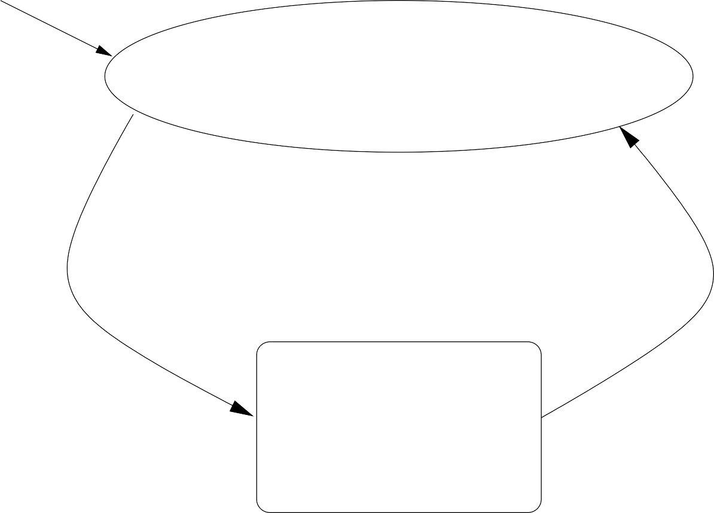
Simulink model
Data Abstraction for Matlab (Hybrid Systems)
Stateflow model
Mixed continuous/discrete (i.e., hybrid) system

Slide 103
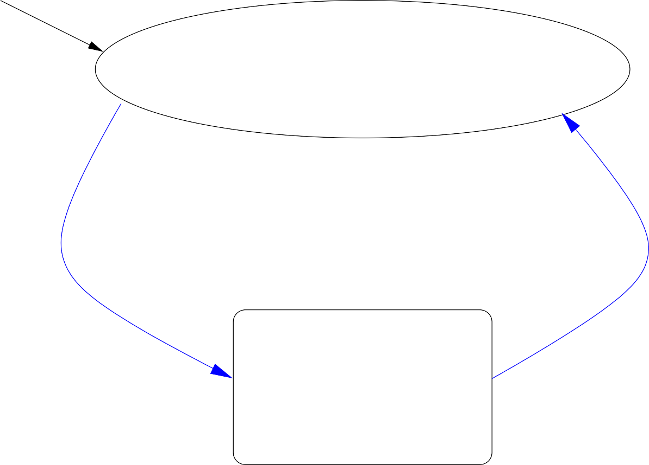
Simulink model
Simulate One Trajectory at a Time
Stateflow model
Just like testing: when have you done enough?

Slide 104
Nondeterministic environment
Model Check With Nondeterministic Environment
Stateflow model
Model check this
Too crude to establish useful properties

Slide 105

Simulink model
Analyze By The Methods Of Hybrid Systems
Stateflow model
OK, but restricted

Slide 106
discrete approximation
Model Check With Sound Discretization Of The Continuous Environment
Stateflow model
Model check all of this
Just right

Slide 107
Data Abstraction for Hybrid Systems
Method developed by Ashish Tiwari
The continuous environment is given by some collection of (polynomial) differential equations on R^{n}
Divide these into regions where the first j derivatives are sign-invariant (m polynomials, (m × j)³ regions)
  I.e., data abstraction from R to {−, 0, +}
  For each mode l ∈ Q: if q_{pi}, q_{pj} abstract p_{i}, p_{j} and p˙_{i} = p_{j}
in mode l, then apply rules of the form:
⋆ if q_{pi} = + & q_{pj} = +, then q′ is +
⋆
⋆
⋆ . . .
pi
if q_{pi} = + & q_{pj} = 0, then q′ is +
pi
if q_{pi} = + & q_{pj} = −, then q′ is either + or 0
pi

Slide 108
Larger choices of j give successively finer abstractions
Data Abstraction for Hybrid Systems
Usually enough to take j = 1 or 2
Method is complete for some (e.g., nilpotent) systems
Parameterized also by selection of polynomials to abstract on
  The eigenvectors are a good start
  Method is then complete for linear systems
Construction is automated using decision procedures for real closed fields (e.g., Cylindric Algebraic Decomposition—CAD)
Also provides a general underpinning to qualitative reasoning as used in AI

Slide 109
Example: Thermostat
Consider a simple thermostat controller with:
Discrete modes: Two modes, q = on and q = off
Continuous variable: The temperature x
Initial State: q = off and x = 75
•
Discrete Transitions:
q = off and x ≤ 70
q = on and x ≥ 80
−→ q′ = on
−→ q′ = off
Continuous Flow:
q = off and x > 68
q = on and x < 82
We want to prove 68 ≤ x ≤ 82
−→ x˙ = −Kx
−→ x˙ = K(h − x)

Slide 110
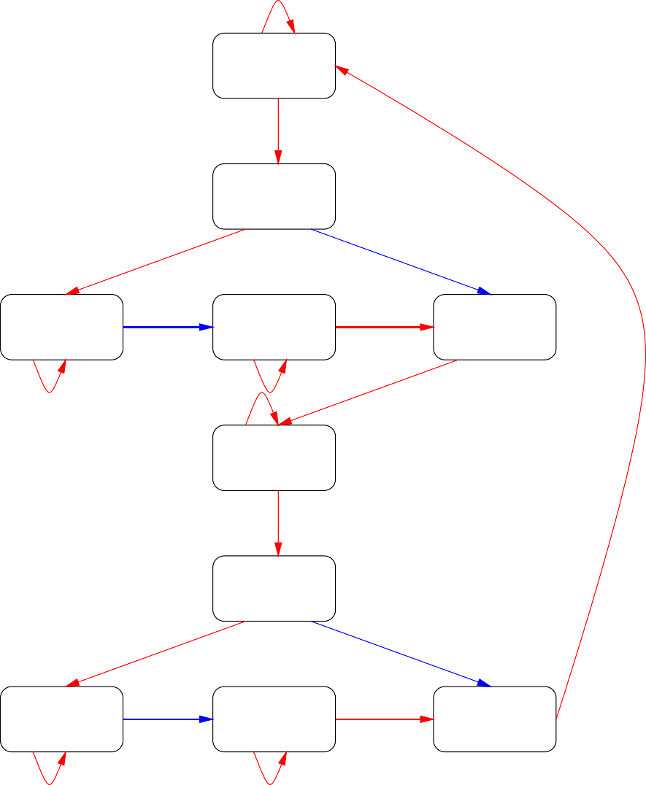
Abstract Thermostat System
70 < x < 80
q = off
x = 70
q = off
68 < x < 70
q = off
68 < x < 70
q = on
x = 70
q = on
70 < x < 80
q = on
x = 80
q = on
80 < x < 82
q = on
80 < x < 82
q = off
x = 80
q = off

Slide 111
Pros and Cons of Automated Abstraction
Good match between local theorem proving, and global model checking
Quality of the abstraction depends on information provided by the user (predicates, polynomials etc.)
  It’s easier to guess useful predicates than invariants
  Can guess additional ones if inadequate
  Or let counterexamples suggest refinements (CEGAR)
⋆ A general approach can be discerned here: find quick solutions and fix them up, rather than deliberate in hope of finding good solutions
And the deductive power applied
  Which may increase if provided with known invariants

Slide 112
Truly Integrated, Iterated Analysis!
Recast the goal as one of calculating and accumulating properties about a design (symbolic analysis)
Rather than just verifying or refuting a specific property
Properties convey information and insight, and provide leverage to construct new abstractions
  And hence more properties
Requires restructuring of verification tools
  So that many work together
  And so that they return symbolic values and properties rather than just yes/no results of verifications
This is what SAL is about: Symbolic Analysis Laboratory
  Next generation will have a tool bus

Slide 113
Integrated, Iterated Analysis

Slide 114
Refutation and Verification
By allowing unsound abstractions
tt^{ˆ} |= P^{ˆ} ƒ⇒ tt |= P
We can do refutation as well as verification
Then, by selecting abstractions (sound/unsound) and properties (little/big) we can fill in the space between refutation and verification
Refutation lowers the barrier to entry
Provides economic incentive: discovery of high value bugs
  Can estimate the cost of each bug found
  And can directly compare with other technologies
Yet allows smooth transition to verification

Slide 115
From Refutation To Verification
Assurance for system
theorem proving
automated
abstraction
& inf−BMC
model checking
verification
refutation
Effort

Slide 116
Filling the Remaining Gap
Model checking for refutation and (via automated abstraction and inf-BMC) for verification imposes a much smaller barrier to adoption than old-style formal verification
But the barrier is still there
What about really low cost/low threat kinds of formal analysis?
Make the formal methods disappear inside traditional tools and methods
  We call these invisible formal methods
  And it’s where a lot of the action and opportunity is

Slide 117
Reward (assurance)
The Formal Methods Wedge
automated theorem proving
interactive
theorem proving
invisible
model
checking
and abstraction
formal methods
SAL
Yices
PVS
Effort
Evidential Tool Bus

Slide 118
Examples of Invisible Formal Methods Stronger Checking in Traditional Tools
Various forms of extended static checking
  Failed proof generates a possibly spurious warning
Static analysis: typestate, shape analysis, abstract interpretation etc.
PVS-like type system (predicate subtypes) for any language
  Traditional type systems have to be trivially decidable
  But can gain enormous error detection by adding a component that requires theorem proving (lots of small theorems, failure generates a spurious warning)
The verifying compiler (aka. verified systems roadmap)

Slide 119
Examples of Invisible Formal Methods Better Tools for Traditional Activities
Statechart/Stateflow property checkers (cf. Reactis, Honeywell, SRI, Mathworks)
  Show me a path that activates this state
  Can this state and that be active simultaneously?
Checker synthesizers (cf. IBM FOCS)
Completeness/Consistency checkers for tabular specifications (cf. Ontario Hydro, RSML, SCR)
Test case generators (cf. Verimag/IRISA TGV and STG, SAL-ATG)
There’s an entire industry in this space, with many companies make a living from modest technology (but very good understanding of their markets)

Slide 120
Static Program Analysis

Slide 121
Real time clock sets days to number of days since 1 Jan 1980
The Bug That Stopped The Zunes
year = ORIGINYEAR; /* = 1980 */
while (days > 365) {
if (IsLeapYear(year)) {
if (days > 366) {
days -= 366;
year += 1;
} else... loops forever on last day of a leap year
} else {
days -= 365;
year += 1;
}
}
Coverage-based testing will find this

Slide 122
while (days > 365) {
if (IsLeapYear(year)) {
A Hasty Fix
if (days > 365) {
days -= 366;
year += 1;
}
} else {
days -= 365;
year += 1;
}
}
Fixes the loop but now days can end up as zero
Coverage-based testing might not find this
Boundary condition testing would
But I think the point is clear. . .

Slide 123
The Problem With Testing
Is that it only samples the set of possible behaviors
And unlike physical systems (where many engineers gained their experience), software systems are discontinuous
There is no sound basis for extrapolating from tested to untested cases
So we need to consider all possible cases. . . how is this possible?
It’s possible with symbolic methods
• Cf. x² − y² = (x − y)(x + y) vs. 5*5-3*3 = (5-3)*(5+3)
Static Analysis is about totally automated ways to do this

Slide 124
[days > 0]
while (days > 365) {
The Zune Example Again
[days > 365]
if (*)) {
if (days > 365) { [days > 365] days -= 366; [days >= 0]
year += 1;
}
} else {
days -= 365;
year += 1;
}
[days > 365]
[days > 0]
}
[days >= 0 and days <= 365]

Slide 125
Automated Analysis of the Zune Example
Ashish Tiwari has an analyzer for C programs that does abstract interpretation over the combination of linear arithmetic and uninterpreted functions
Primarily used to discover invariants
But we can illustrate it on this example
abs-li zune.c
-------------------FINAL Invariants-------------------
days >= 1.000000
loop >= 0.000000
days <= 365.000000
loop <= 1.000000
Monitoring variable loop can equal 1 means program can loop
Now the hastily fixed version
abs-li zune2.c
-------------------FINAL Invariants------------------- days >= 0.000000 days <= 365.000000
loop = 0.000000
Now it does not loop, but days can be 0

Slide 126
Approximations
We were lucky that we could do the previous example with full symbolic arithmetic
Usually, the formulas get bigger and bigger as we accumulate information from loop iterations (we’ll see an example later)
So it’s common to approximate or abstract information to try and keep the formulas manageable
Here, instead of the natural numbers 0, 1, 2, . . . , we could use
  zero, small, big
  Where big abstracts everything bigger than 365, small is everything from 1 to 365, and zero is 0
  Arithmetic becomes nondeterministic
⋆ e.g., small+small = small | big

Slide 127
[days = small | big]
while (days = big) { [days = big] if (*)) {
The Zune Example Abstracted
if (days = big ) { [days = big ]
days -= big; year += 1;
[days = big | small | zero]
}
} else {
days -= small; year += 1;
}
[days = big]
[days = big | small]
}
[days = small | zero]

Slide 128
Suppose we abstracted to {negative, zero, positive}
The Zune Example Abstracted Again
[days = positive]
while (days = positive) {
if (*)) {
[days = positive]
if (days = positive ) { [days = positive ]
days -= positive; [days = negative | zero | positive] year += 1;
}
} else {
days -= positive; year += 1;
} }
[days = positive]
[days = negative | zero | positive]
[days = negative | zero]
We’ve lost too much information: have a false alarm that days
can go negative (pointer analysis is sometimes this crude)

Slide 129
We Have To Approximate, But There’s A Price
It’s no accident that we sometimes lose precision
Rice’s Theorem says there are inherent limits on what can be accomplished by automated analysis of programs
  Sound (miss no errors)
  Complete (no false alarms)
  Automatic
  Allow arbitrary (unbounded) memory structures
  Final results
Choose at most 4 of the 5

Slide 130
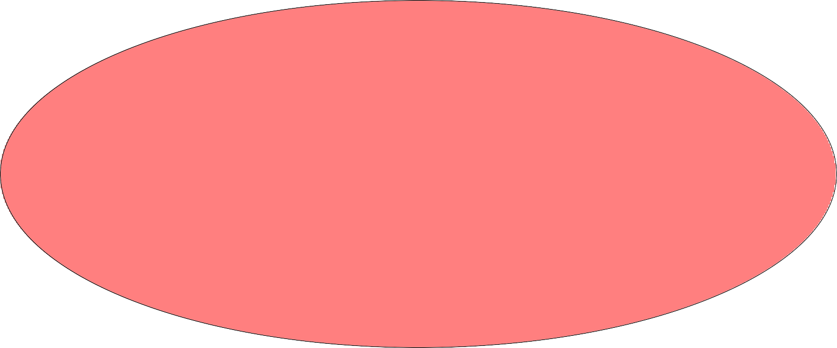
approximation
Approximations
reachable states
Sound approximations include all the behaviors and reachable states of the real system, but are easier to compute

Slide 131
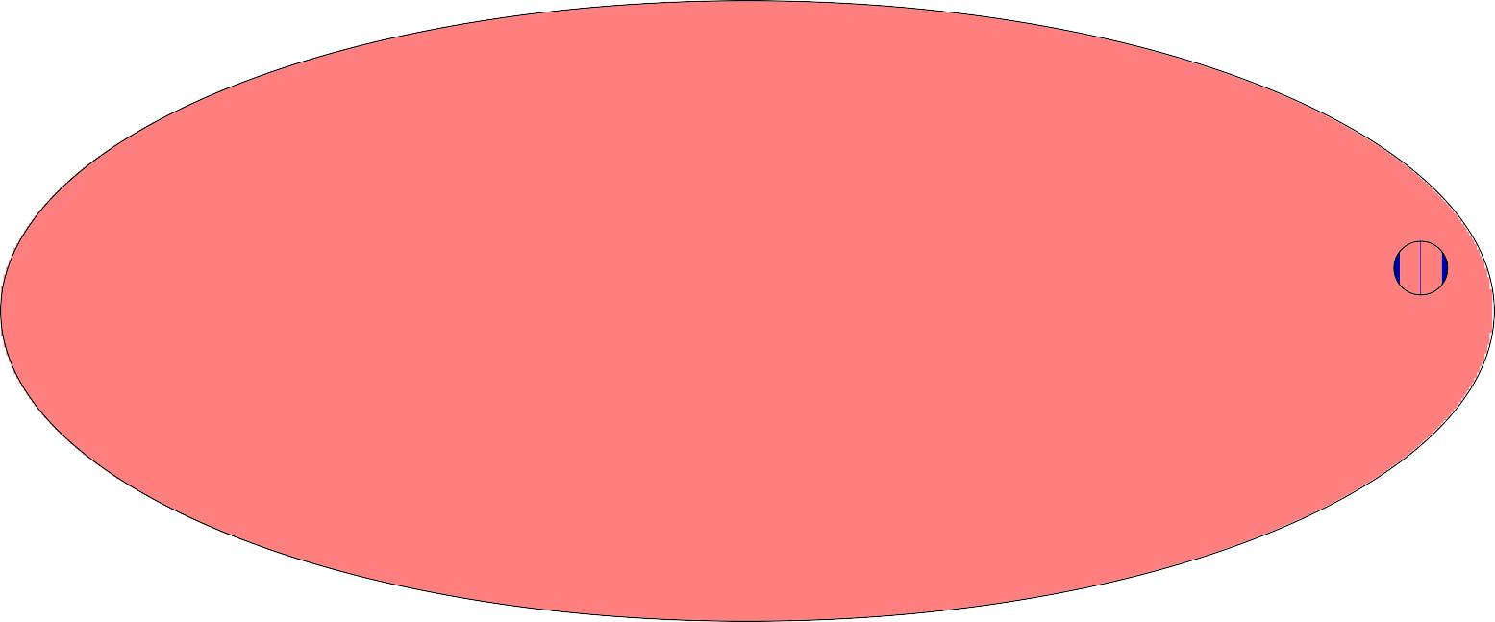
approximation
But Sound Approximations Come with a Price
false alarm
reachable states
May flag an error that is unreachable in the real system: a false positive, or false alarm

Slide 132

underapproximation
Unsound Approximations Come with a Price, Too
false negative
reachable states
Can miss real errors: a false negative

Slide 133
Predicate Abstraction
The Zune example used data abstraction
  A kind of abstract interpretation
Replaces variables of complex data types by simpler (often finite) ones
  e.g., integers replaced by {negative, zero, positive}
But sometimes this doesn’t work
  Just replaces individual variables
  Often its the relationship between variables that matters
Predicate abstraction replaces some relationships (predicates) by Boolean variables

Slide 134
start with r unlocked do {
lock(r) old = new if (*) {
Another Example
unlock(r) new++
}
}
while old != new
want r to be locked at this point unlock(r)

Slide 135
The significant relationship seems to be old == new
Abstracted Example
Replace this by eq, throw away old and new
[!locked] do {
lock(r) eq = true if (*) {
unlock(r)
[locked] [locked, eq]
[!locked, eq]
eq = false [!locked, !eq]
}
} [locked, eq] or [!locked, !eq] while not eq
[locked, eq] unlock(r)

Slide 136
z := n; x := 0; y := 0;
while (z > 0) {
Yet Another Example
if (*) {
x := x+1; z := z-1;
} else {
y := y+1; z := z-1;
}
}
want y!= 0, given x != z, n > 0
The invariant needed is x + y + z = n
But neither this nor its fragments appear in the program or the desired property

Slide 137
Let’s Just Go Ahead
First time into the loop
[n > 0]
z := n; x := 0; y := 0;
while (z > 0) {
if (*) {
x := x+1; z := z-1;
} else {
y := y+1; z := z-1;
[x = 0, y = 0, z = n]
[x = 1, y = 0, z = n-1]
[x = 0, y = 1, z = n-1]
} [x = 1, y = 0, z = n-1] or [x = 0, y = 1, z = n-1]
}
Next time around the loop we’ll have 4 disjuncts, then 8, then 16, and so on
This won’t get us anywhere useful

Slide 138
Widening the Abstraction
We could try eliminate disjuncts
Look for a conjunction that is implied by each of the disjuncts
One such is [x+y = 1, z = n-1]
Then we’d need to do the same thing with [x+y = 1, z = n-1] or [x = 0, y = 0, z = n]
That gives [x + y + z = n]
There are techniques that can do this automatically
This is where a lot of the research action is

Slide 139
Tradeoffs
We’re trying to guarantee absence of errors in a certain class
Equivalently, trying to verify properties of a certain class
Terminology is in terms of finding errors TP True Positive: found a real error FP False Positive: false alarm
TN True Negative: no error, no alarm—OK
FN False Negative: missed error
Then we have
Sound: no false negatives
Recall:
TP/(TP+FN) measures how (un)sound
TP+FN is number of real errors
Complete: no false alarms
Precision:
TP/(TP+FP) measures how (in)complete
TP+FP is number of alarms

Slide 140
Tradeoff Space
Basic tradeoff is between soundness and completeness
•
For assurance, we need soundness
When told there are no errors, there must be none
So have to accept false alarms
But the main market for static analysis is bug finding in general-purpose software, where they aim merely to reduce the number of bugs, not to eliminate them
Their general customers will not tolerate many false alarms, so tool vendors give up soundness
Will consider the implications later
•
Other tradeoffs are possible
Give up full automation: e.g., require user annotation

Slide 141
Tradeoffs In Practice
is complete but unsound
Testing
Spark Ada with its Examiner is sound but not fully automatic
Abstract Interpretation (e.g., PolySpace) is sound but incomplete, and may not terminate
Astr´ee is pragmatically complete for its domain
Pattern matchers (e.g. Lint, Findbugs) are not based on semantics of program execution, neither sound nor complete
But pragmatically effective for bug finding
Commercial tools (e.g., Coverity, Code Sonar, Fortify, KlocWork, LDRA) are neither sound nor complete
Pragmatically effective
Different tools use different methods, have different capabilities, make different tradeoffs

Slide 142
Properties Checked
The properties checked are usually implicit
  e.g., uninitialized variables, divide by zero (and other exceptions), null pointer dereference, buffer overrun
Much of this is compensating for deficiencies of C and C++
  Some tools support Ada, Java, not much for MBD
  But Mathworks has Design Verifier for Simulink
Some tools support user-specified checks, but. . .
•
Some tools look at resources
e.g., memory leaks, locks (not freed, freed twice, use after free)
Some (e.g., AbsInt) can do quantitative analysis
  e.g., worst case execution time, maximum stack height

Slide 143
Real Software
It’s not enough to check individual programs
Need information from calls to procedures, subroutines
  Analyze each in isolation, then produce a procedure summary for use by others
Need summaries for libraries, operating system calls
Analyzer must integrate with the build process
Must present the information in a useful and attractive way
Much of the engineering in commercial tools goes here

Slide 144
So How Good Are Static Analyzers?
Some tool licences forbid benchmarking
Hard to get representative examples
NIST SAMATE study compared several
  Found all had strengths and weaknesses
  Needed a combination to get comprehensive bug detection
This was bug finding, not assurance
Anecdotal evidence is they are very useful for general QA
Need to be tuned to individual environment
e.g., Astr´ee tuned to Airbus A380 SCADE-generated digital filters is sound and pragmatically complete
There are papers by Raoul Jetley and others of FDA applying tools to medical device software

Slide 145
Possible Futures: Combination With Testing
Automated test generation is getting pretty good
Use a constraint solver to find a witness to the path predicate leading to a given state
  e.g., counterexamples from (infinite) bounded model checking using SMT solvers
So try to see if you can generate an explicit test case to manifest a real bug for each positive turned up by static analysis
Throw away those you cannot manifest
Aha! Next generation of tools do this

Slide 146
Automated Test Generation

Slide 147
Test Generation
Observe that a counterexample to an assertion: “control cannot reach this point” is a structural test case
So BMC can be used for automated test generation
Actually, a customized combination of SMC and BMC works best
  Use SMC to reach first control point, then use BMC to extend to further control points
  Get long tests that probe deep into the system
  Can add test purposes that constrain the kinds of tests generated
⋆ e.g., Change the gear input by 1 at every step
  Easily built because checkers are scriptable (in Scheme)

Slide 148
Core Of The SAL-ATG Test Generation Script
(define (extend-search module goal-list
path scan prune innerslice start step stop)
(let ((new-goal-list (if prune (goal-reduce scan goal-list path)
(minimal-goal-reduce scan goal-list path)))) (cond ((null? new-goal-list) (cons ’() path))
((> start stop) (cons new-goal-list path)) (else
(let* ((goal (list->goal new-goal-list module)) (mod (if innerslice
(sal-module/slice-for module goal) module)) (new-path
(let loop ((depth start))
(cond ((> depth stop) ’()) ((sal-bmc/extend-path
path mod goal depth ’ics)) (else (loop (+ depth step)))))))
(if (pair? new-path)
(extend-search mod new-goal-list new-path scan
prune innerslice start step stop) (cons new-goal-list path)))))))

Slide 149
Outer Loop Of The SAL-ATG Test Generation Script
(define (iterative-search module goal-list
scan prune slice innerslice bmcinit start step stop) (let* ((goal (list->goal goal-list module))
(mod (if slice (sal-module/slice-for module goal) module)) (path (if bmcinit
(sal-bmc/find-path-from-initial-state mod goal bmcinit ’ics)
(sal-smc/find-path-from-initial-state mod goal))))
(if path
(extend-search mod goal-list path scan prune innerslice start step stop)
#f)))

Slide 150
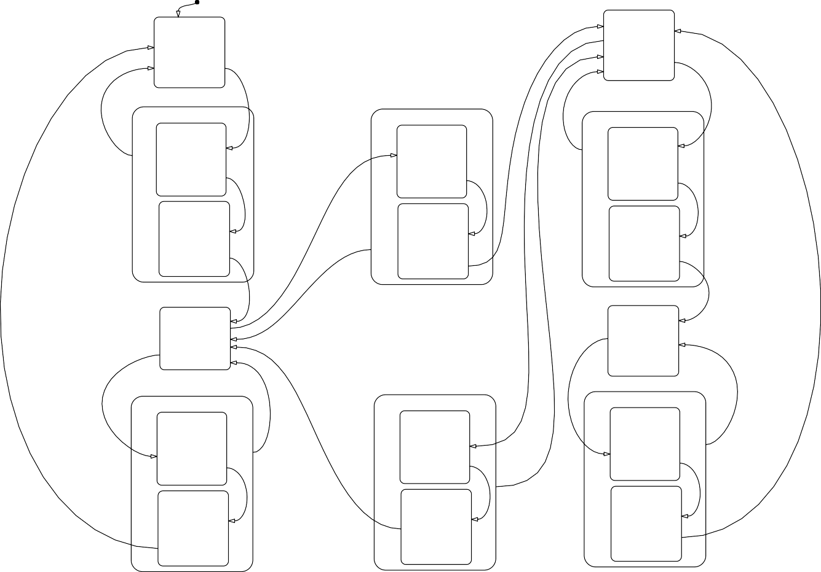
Example:
Shift Scheduler in StateFlow
first_gear
entry: to_gear = 1;
third_gear
entry: to_gear=3;
[gear ==3]
[V <= shift_speed_21]
[V > shift_speed_12]
[V <= shift_speed_43]
transition12
shift_pending_a entry: ctr=0;
to_gear=1;
during: ctr=ctr+1;
transition23
shift_pending2 entry: ctr=0;
to_gear=2;
during: ctr=ctr + 1;
transition34
shift_pending3 entry: ctr=0;
to_gear=3;
during: ctr = ctr+1;
[V > shift_speed_34]
[ctr > DELAY]
[V > shift_speed_23]
[ctr > DELAY]
[ctr > DELAY]
shifting_a
entry: to_gear=2;
shifting2
entry: to_gear=3;
shifting3
entry: to_gear=4;
[gear == 2]
[gear == 4]
[gear == 1]
second_gear entry: to_gear=2;
[V <= shift_speed_23]
fourth_gear entry: to_gear =4;
[V <= shift_speed_32]
[V > shift_speed_34]
[V <= shift_speed_21]
[gear == 2]
[V <= shift_speed_43]
transition21
shift_pending_b entry: ctr=0;
to_gear=2;
during: ctr = ctr+1;
transition32
shift_pending_c entry: ctr=0;
to_gear=3;
during: ctr=ctr+1;
transition43
shift_pending_d entry: ctr=0;
to_gear =4;
during: ctr=ctr+1;
[V > shift_speed_12]
[ctr > DELAY]
[ctr > DELAY]
shifting_b
entry: to_gear=1;
shifting_c
entry: to_gear=2;
[V > shift_speed_23]
shifting_d
entry: to_gear=3;
[ctr > DELAY]
[gear == 3]
Demo: sal-atg -v 3 trans ga monitored system
trans ga goals.scm -ed 15 –incremental –testpurpose

Slide 151
Timed Systems

Slide 152
Verification of Real Time Programs
Continuous time excludes automation by finite state methods
Timed automata methods (e.g., Uppaal)
  Handle continuous time
  But are defeated by the case explosion when (discrete) faults are considered as well
SMT solvers can handle both dimensions
  With discrete time, can have a clock module that advances time one tick at a time
⋆ Each module sets a timeout, waits for the clock to reach that value, then does its thing, and repeats
  Better: move the timeout to the clock module and let it advance time all the way to the next timeout
⋆ These are Timeout Automata (Dutertre and Sorea): and they work for continuous time

Slide 153
Example: Biphase Mark Protocol
Biphase Mark is a protocol for asynchronous communication
transmitter
receiver
how many 1’s?
........
unsynchronized, independent clocks
Clocks at either end may be skewed and have different rates, and jitter
So have to encode a clock in the data stream
Used in CDs, Ethernet
Verification identifies parameter values for which data is reliably transmitted

Slide 154
Example: Biphase Mark Protocol (ctd)
Flip the signal at the begining of every bit cell
For a 1 bit, flip it in the middle, too
For a 0 bit, leave it constant
Original bitsream
1
1
0
1
0
0
1
1
1
0
1
1
BMP encoding
Prove this works provided the sender and reciever clocks run at similar rates

Slide 155
Biphase Mark Protocol Verification
Verified by human-guided proof in ACL2 by J Moore (1994)
Three different verifications used PVS
  One by Groote and Vaandrager used PVS + UPPAAL required 37 invariants, 4,000 proof steps, hours of prover time to check
  Also done by Dand Van Hung

Slide 156
Verification Systems vs.
SMT-Based Model Checkers
PVS
SAL
Backends
SMT Solver
Actually, both kinds will coexist as part of the evidential tool bus—another talk

Slide 157
Biphase Mark Protocol Verification (ctd)
Brown and Pike recently did it with sal-inf-bmc
  Used timeout automata to model timed aspects
  Statement of theorem discovered systematically using disjunctive invariants (7 disjuncts)
  Three lemmas proved automatically with 1-induction,
  Theorem proved automatically using 5-induction
  Verification takes seconds to check
Adapted verification to 8-N-1 protocol (used in UARTs)
  Automated proofs more reusable than step-by-step ones
  Additional lemma proved with 13-induction
  Theorem proved with 3-induction (7 disjuncts)
  Revealed a bug in published application note

Slide 158
Biphase Mark Protocol Verification (demo)
Ideally, use an integrated front end; here we look at raw model-checker input
Integrated front−end development environment
Ideally
AADL, UML2, Matlab
TOPCASED, SSIV etc.
Evidential Tool Bus (ETB)
This example
SAL PVS
Yices

Slide 159
Summary
The challenge faced by formal methods analysis tools is how to search a huge space efficiently
Theorem proving has developed efficient methods of local search (decision procedures etc.)
Model checking showed that efficient global search was possible
Now, methods are emerging that combine insights from both approaches in a promising way
And there a pragmatic focus on finding methods for using the (still limited) capabilities of formal analysis tools to address useful, but partial issues in big, real systems
I have never felt more optimistic about the prospects for formal analysis tools

Slide 160
Acknowledgments
Very little of this is my work
Most of it the work of my colleagues: Bruno Dutertre, Leonardo de Moura, Sam Owre, Shankar, Ashish Tiwari
With valuable contributions from Saddek Bensalem, Pavol Cerny, Judy Crow, Jean-Christophe Filliˆatre, Klaus Havelund, Friedrich von Henke, Yassine Lakhnech, Pat Lincoln, C´esar Mun˜oz, Holger Pfeifer, Lee Pike, Harald Rueß, Vlad Rusu, Hassen Sa¨ıdi, Eli Singerman, Maria Sorea, Dave
Stringer-Calvert, Mike Whalen, and many others

Slide 161
To Learn More
Check out papers and technical reports at
http://fm.csl.sri.com
Information about PVS, and the system itself, is available from http://pvs.csl.sri.com
  Version 4.0 is open source
  Built in Allegro and CMU Lisp for Linux, Mac
Yices: http://yices.csl.sri.com
  Version 2.x is free binary
  Written in C
  Available as a library for C
SAL: http://sal.csl.sri.com
  Version 2.4 is open source
  Written in Scheme, C++

