Slide 1
Distributed File Systems
CSE403 Lehigh University
Spring 2016
Presenter: Yinzhi Cao

Slide 2

Recall: Network-Attached Storage and the CAP Theorem
Network
Consistency:
  Changes appear to everyone in the same serial order
Availability:
  Can get a result at any time
Partition-Tolerance
  System continues to work even when network becomes partitioned
Consistency, Availability, Partition-Tolerance (CAP) Theorem: Cannot have all three at same time
  Otherwise known as “Brewer’s Theorem”

Slide 3
Network File System (NFS)
Three Layers for NFS system
  UNIX file-system interface: open, read, write, close calls + file descriptors
  VFS layer: distinguishes local from remote files
    Calls the NFS protocol procedures for remote requests
  NFS service layer: bottom layer of the architecture
    Implements the NFS protocol
NFS Protocol: RPC for file operations on server
  Reading/searching a directory
  manipulating links and directories
  accessing file attributes/reading and writing files
Write-through caching: Modified data committed to server’s disk before results are returned to the client
  lose some of the advantages of caching
  time to perform write() can be long
  Need some mechanism for readers to eventually notice changes! (more on this later)

Slide 4
NFS Continued
NFS servers are stateless; each request provides all arguments require for execution
  E.g. reads include information for entire operation, such as ReadAt(inumber,position), not Read(openfile)
  No need to perform network open() or close() on file – each operation stands on its own
Idempotent: Performing requests multiple times has same effect as performing it exactly once
  Example: Server crashes between disk I/O and message send, client resend read, server does operation again
  Example: Read and write file blocks: just re-read or re-write file block – no side effects
  Example: What about “remove”? NFS does operation twice and second time returns an advisory error
Failure Model: Transparent to client system
  Is this a good idea? What if you are in the middle of reading a file and server crashes?
  Options (NFS Provides both):
    Hang until server comes back up (next week?)
    Return an error. (Of course, most applications don’t know they are talking over network)

Slide 5
NFS Cache consistency
NFS protocol: weak consistency
  Client polls server periodically to check for changes
    Polls server if data hasn’t been checked in last 3-30 seconds (exact timeout it tunable parameter).
    Thus, when file is changed on one client, server is notified, but other clients use old version of file until timeout.
  What if multiple clients write to same file?
    In NFS, can get either version (or parts of both)
    Completely arbitrary!
cache
F1 still ok?
F1:V2
F1:V1
No: (F1:V2)
Client
Write (RPC)
Server
cache
F1:V2
ACK
cache
F1:V2
Client

Slide 6
Sequential Ordering Constraints
What sort of cache coherence might we expect?
  i.e. what if one CPU changes file, and before it’s done, another CPU reads file?
Example: Start with file contents = “A”
What would we actually want?
  Assume we want distributed system to behave exactly the same as if all processes are running on single system
    If read finishes before write starts, get old copy
    If read starts after write finishes, get new copy
    Otherwise, get either new or old copy
  For NFS:
    If read starts more than 30 seconds after write, get new copy; otherwise, could get partial update
Client 1:
Read: gets A
Write B
Read: parts of B or C
Client 2:
Read: gets A or B
Write C
Client 3:
Read: parts of B or C
Time

Slide 7
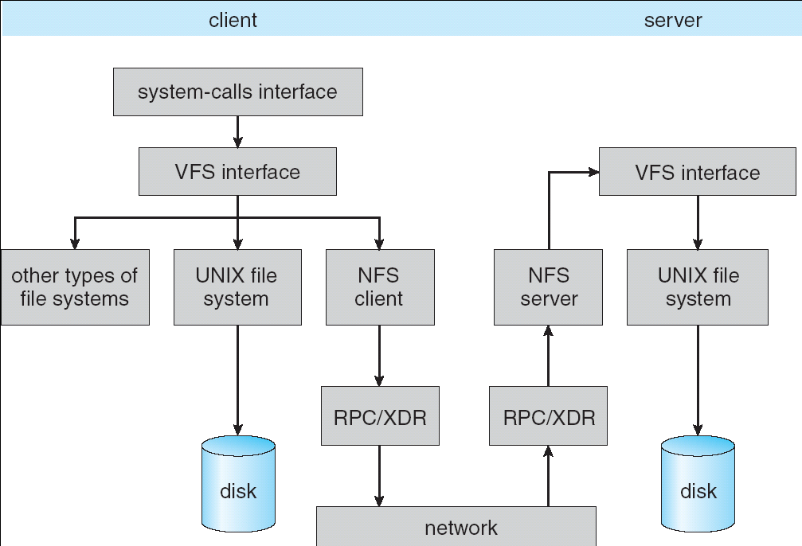
Schematic View of NFS Architecture

Slide 8
Remote Procedure Call
Raw messaging is a bit too low-level for programming
  Must wrap up information into message at source
  Must decide what to do with message at destination
  May need to sit and wait for multiple messages to arrive
Better option: Remote Procedure Call (RPC)
  Calls a procedure on a remote machine
  Client calls:
  remoteFileSystem→Read(“rutabaga”);
  Translated automatically into call on server:
  fileSys→Read(“rutabaga”);
Implementation:
  Request-response message passing (under covers!)
  “Stub” provides glue on client/server
    Client stub is responsible for “marshalling” arguments and “unmarshalling” the return values
    Server-side stub is responsible for “unmarshalling” arguments and “marshalling” the return values.
Marshalling involves (depending on system)
  Converting values to a canonical form, serializing objects, copying arguments passed by reference, etc.

Slide 9
RPC Information Flow
bundle
args
Client
(caller)
call
Client
Stub
send
Packet
Handler
return
receive
unbundle
ret vals
mbox2
Machine A
Network
Network
Machine B
bundle
ret vals
mbox1
Server
(callee)
return
Server
Stub
send
Packet
Handler
call
receive
unbundle
args

Slide 10
RPC Details
Equivalence with regular procedure call
  Parameters ⇔ Request Message
  Result ⇔ Reply message
  Name of Procedure: Passed in request message
  Return Address: mbox2 (client return mail box)
Stub generator: Compiler that generates stubs
  Input: interface definitions in an “interface definition language (IDL)”
    Contains, among other things, types of arguments/return
  Output: stub code in the appropriate source language
    Code for client to pack message, send it off, wait for result, unpack result and return to caller
    Code for server to unpack message, call procedure, pack results, send them off
Cross-platform issues:
  What if client/server machines are different architectures or in different languages?
    Convert everything to/from some canonical form
    Tag every item with an indication of how it is encoded (avoids unnecessary conversions).

Slide 11
RPC Details (continued)
How does client know which mbox to send to?
  Need to translate name of remote service into network endpoint (Remote machine, port, possibly other info)
  Binding: the process of converting a user-visible name into a network endpoint
    This is another word for “naming” at network level
    Static: fixed at compile time
    Dynamic: performed at runtime
Dynamic Binding
  Most RPC systems use dynamic binding via name service
    Name service provides dynamic translation of service→mbox
  Why dynamic binding?
    Access control: check who is permitted to access service
    Fail-over: If server fails, use a different one
What if there are multiple servers?
  Could give flexibility at binding time
    Choose unloaded server for each new client
  Could provide same mbox (router level redirect)
    Choose unloaded server for each new request
    Only works if no state carried from one call to next
What if multiple clients?
  Pass pointer to client-specific return mbox in request

Slide 12
Problems with RPC
Non-Atomic failures
  Different failure modes in distributed system than on a single machine
  Consider many different types of failures
    User-level bug causes address space to crash
    Machine failure, kernel bug causes all processes on same machine to fail
    Some machine is compromised by malicious party
  Before RPC: whole system would crash/die
  After RPC: One machine crashes/compromised while others keep working
  Can easily result in inconsistent view of the world
    Did my cached data get written back or not?
    Did server do what I requested or not?
  Answer? Distributed transactions/Byzantine Commit
Performance
  Cost of Procedure call « same-machine RPC « network RPC
  Means programmers must be aware that RPC is not free
    Caching can help, but may make failure handling complex

Slide 13
Andrew File System
Andrew File System (AFS, late 80’s) → DCE DFS (commercial product)
Callbacks: Server records who has copy of file
  On changes, server immediately tells all with old copy
  No polling bandwidth (continuous checking) needed
Write through on close
  Changes not propagated to server until close()
  Session semantics: updates visible to other clients only after the file is closed
    As a result, do not get partial writes: all or nothing!
    Although, for processes on local machine, updates visible immediately to other programs who have file open
In AFS, everyone who has file open sees old version
  Don’t get newer versions until reopen file

Slide 14
Andrew File System (con’t)
Data cached on local disk of client as well as memory
  On open with a cache miss (file not on local disk):
    Get file from server, set up callback with server
  On write followed by close:
    Send copy to server; tells all clients with copies to fetch new version from server on next open (using callbacks)
What if server crashes? Lose all callback state!
  Reconstruct callback information from client: go ask everyone “who has which files cached?”
AFS Pro: Relative to NFS, less server load:
  Disk as cache ⇒ more files can be cached locally
  Callbacks ⇒ server not involved if file is read-only
For both AFS and NFS: central server is bottleneck!
  Performance: all writes→server, cache misses→server
  Availability: Server is single point of failure
  Cost: server machine’s high cost relative to workstation

Slide 15
More Relaxed Consistency?
Can we get better performance by relaxing consistency?
  More extensive use of caching
  No need to check frequently to see if data up to date
  No need to forward changes immediately to readers
    AFS fixes this problem with “update on close” behavior
  Frequent rewriting of an object does not require all changes to be sent to readers
Issues with relaxed consistency:
  When updates propagated to other readers?
  Consistent set of updates make it to readers?
  Updates lost when multiple simultaneous writers?

Slide 16
Possible approaches to relaxed consistency
Usual requirement: Coherence
  Writes viewed by everyone in the same serial order
Free-for-all
  Writes happen at whatever granularity the system chooses: block size, etc
Update on close
  As in AFS
  Makes sure that writes are consistent
Conflict resolution: Clean up inconsistencies later
  Often includes versioned data solution
    Many branches, someone or something merges branches
  At server or client
  Server side made famous by Coda file system
    Every update that goes to server contains predicate to be run on data before commit
    Provide a set of possible data modifications to be chosen based on predicate

Slide 17
Data Deduplication
Wide Area Network
How to address performance issues with network file systems over wide area? What about caching?
  Files are often opened multiple times
    Caching works
  Files are often changed incrementally
    Caching less works less well
  Different files often share content or groups of bytes
    Caching doesn’t work well at all!
Why doesn’t file caching work well in many cases?
  Because it is based on names rather than data
    Name of file, absolute position within file, etc
Better option? Base caching on contents rather than names
  Called “Data de-duplication”

Slide 18
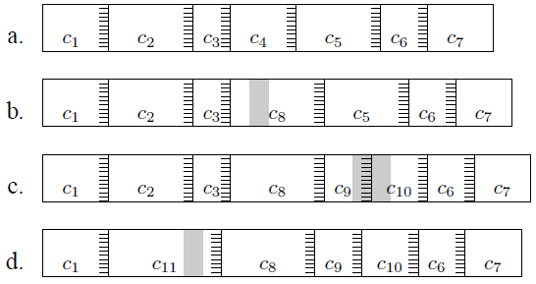
Data-based Caching (Data “De-Duplication”)
Use a sliding-window hash function to break files into chunks
  Rabin Fingerprint: randomized function of data window
    Pick sensitivity: e.g. 48 bytes at a time, lower 13 bits = 0 ⇒ 2⁻¹³ probability of happening, expected chunk size 8192
    Need minimum and maximum chunk sizes
  Now – if data stays same, chunk stays the same
Blocks named by cryptographic hashes such as SHA-1

Slide 19
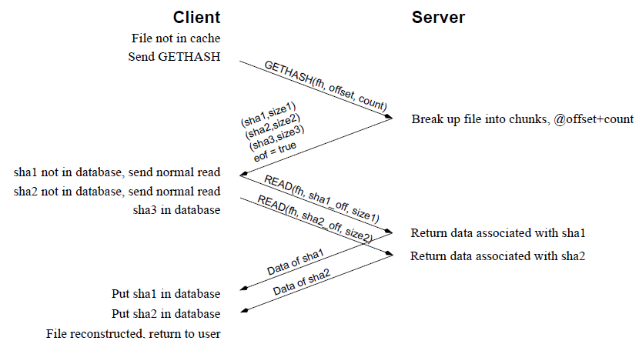
Low Bandwidth File System
LBFS (Low Bandwidth File System)
  Based on NFS v3 protocol
  Uses AFS consistency, however
    Writes made visible on close
  All messages passed through de-duplication process

Slide 20
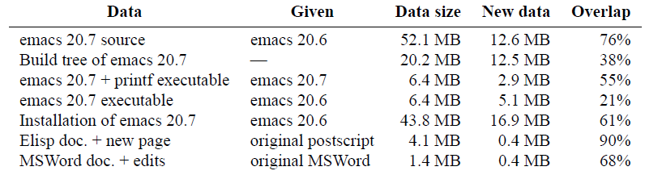
How Effective is this technique?
There is a remarkable amount of overlapping content in typical developer file systems
  Great for source trees, compilation, etc
Less commonality for binary file formats
However, this technique is in use in network optimization appliances
Also works really well for archival backup

Slide 21
A different take: Why Peer-to-Peer ideas for storage?
Incremental Scalability
  Add or remove nodes as necessary
    Systems stays online during changes
  With many other systems:
    Must add large groups of nodes at once
    System downtime during change in active set of nodes
Low Management Overhead (related to first property)
  System automatically adapts as nodes die or are added
  Data automatically migrated to avoid failure or take advantage of new nodes
Self Load-Balance
  Automatic partitioning of data among available nodes
  Automatic rearrangement of information or query loads to avoid hot-spots
Not bound by commercial notions of semantics
  Can use weaker consistency when desired
  Provide flexibility to vary semantics on a per-application basis
  Leads to higher efficiency or performance

Slide 22
Peer-to-Peer: Fully equivalent components
Peer-to-Peer has many interacting components
  View system as a set of equivalent nodes
    “All nodes are created equal”
  Any structure on system must be self-organizing
    Not based on physical characteristics, location, or ownership

Slide 23
Routed queries (Freenet, Chord, Tapestry, etc.)
N₂
N₃
N₁
N₄
N₉
Publisher@
N₅
Key=“title”
Value=MP3 data…
Client
Lookup(“title”)
N₆
N₈
N₇
Can be O(log N) messages per lookup (or even O(1))
Potentially complex routing state and maintenance.
Notes:
Challenge: can we make it robust? Small state? Actually find stuff in a changing system?
Consistent rendezvous point, between publisher and client.

Slide 24
Consistent hashing [Karger 97]
Key 5
K5
Node 105
N105
K20
Circular 160-bit
ID space
N32
N90
K80
A key is stored at its successor: node with next higher ID
Notes:
Ids live in a single circular space.

Slide 25
Lookup with Leaf Set
Assign IDs to nodes
  Map hash values to node with closest ID
Leaf set is successors and predecessors
  All that’s needed for correctness
Routing table matches successively longer prefixes
  Allows efficient lookups
Data Replication:
  On leaf set
Source
111…
0…
110…
Response
10…
Lookup ID
Notes:
Each node is assigned an ID randomly
IDs are arranged into a ring by numerical order, top ID wraps around to 0
Each node maintains two sets of neighbors, its leaf set and routing table
Leaf set is immediate predecessor and successor
Routing table neighbors resolve successively longer matching prefixes of node’s own ID
Lookup queries are routed greedily to node with closest matching ID (numerically, not lexigraphically)
Response is sent directly to querying node
Lookup handled differently in other DHTs; see Gummadi et al.’s SIGCOMM paper for details

Slide 26
Advantages/Disadvantages of Consistent Hashing
Advantages:
  Automatically adapts data partitioning as node membership changes
  Node given random key value automatically “knows” how to participate in routing and data management
  Random key assignment gives approximation to load balance
Disadvantages
  Uneven distribution of key storage natural consequence of random node names ⇒ Leads to uneven query load
  Key management can be expensive when nodes transiently fail
    Assuming that we immediately respond to node failure, must transfer state to new node set
    Then when node returns, must transfer state back
    Can be a significant cost if transient failure common
Disadvantages of “Scalable” routing algorithms
  More than one hop to find data ⇒ O(log N) or worse
  Number of hops unpredictable and almost always > 1
    Node failure, randomness, etc

Slide 27
Dynamo Assumptions
Query Model – Simple interface exposed to application level
  Get(), Put()
  No Delete()
  No transactions, no complex queries
Atomicity, Consistency, Isolation, Durability
  Operations either succeed or fail, no middle ground
  System will be eventually consistent, no sacrifice of availability to assure consistency
  Conflicts can occur while updates propagate through system
  System can still function while entire sections of network are down
Efficiency – Measure system by the 99.9th percentile
  Important with millions of users, 0.1% can be in the 10,000s
Non Hostile Environment
  No need to authenticate query, no malicious queries
  Behind web services, not in front of them

Slide 28
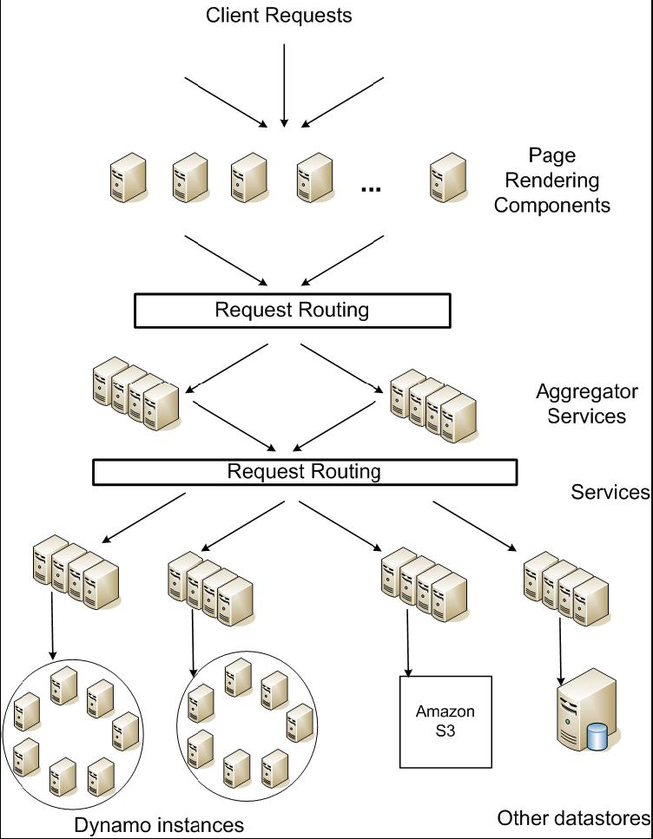
Service Level Agreements (SLA)
Application can deliver its functionality in a bounded time:
  Every dependency in the platform needs to deliver its functionality with even tighter bounds.
Example: service guaranteeing that it will provide a response within 300ms for 99.9% of its requests for a peak client load of 500 requests per second
Contrast to services which focus on mean response time
Service-oriented architecture of Amazon’s platform

Slide 29
Replication
Each data item is replicated
at N hosts
“preference list”: The list of
nodes responsible for storing
a particular key
  Successive nodes not guaranteed
  to be on different physical nodes
  Thus preference list includes physically distinct nodes
Sloppy Quorum
  R (or W) is the minimum number of nodes that must participate in a successful read (or write) operation.
  Setting R + W > N yields a quorum-like system.
  Latency of a get (or put) is dictated by the slowest of the R (or W) replicas. For this reason, R and W are usually configured to be less than N, to provide better latency.
Replicas synchronized via anti-entropy protocol
  Use of Merkle tree for each unique range
  Nodes exchange root of trees for shared key range

Slide 30
Data Versioning
A put() call may return to its caller before the update has been applied at all the replicas
A get() call may return many versions of the same object.
Challenge: an object having distinct version sub-histories, which the system will need to reconcile in the future.
Solution: uses vector clocks in order to capture causality between different versions of the same object
  A vector clock is a list of (node, counter) pairs
  Every version of every object is associated with one vector clock
  If the counters on the first object’s clock are less-than-or-equal to all of the nodes in the second clock, then the first is an ancestor of the second and can be forgotten.

Slide 31
Vector clock example

Slide 32
Conflicts (multiversion data)
Client must resolve conflicts
  Only resolve conflicts on reads
  Different resolution options:
    Use vector clocks to decide based on history
    Use timestamps to pick latest version
  Examples given in paper:
    For shopping cart, simply merge different versions
    For customer’s session information, use latest version
  Stale versions returned on reads are updated (“read repair”)
Vary N, R, W to match requirements of applications
  High performance reads: R=1, W=N
  Fast writes with possible inconsistency: W=1
  Common configuration: N=3, R=2, W=2
When do branches occur?
  Branches uncommon: 0.06% of requests saw > 1 version over 24 hours
  Divergence occurs because of high write rate (more coordinators), not necessarily because of failure

Slide 33
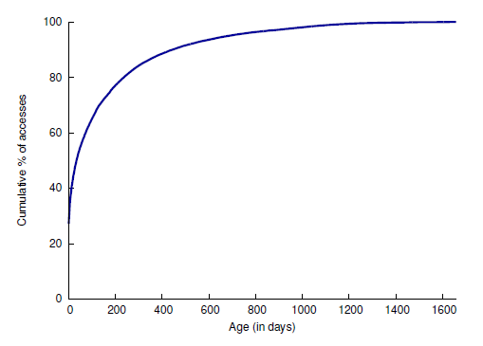
Haystack File System
Does it ever make sense to adapt a file system to a particular usage pattern?
  Perhaps
Good example: Facebook’s “Haystack” filesystem
  Specific application (Photo Sharing)
    Large files!, Many files!
    260 Billion images, 20 PetaBytes (10¹⁵ bytes!)
    One billion new photos a week (60 TeraBytes)
  Presence of Content
  Delivery Network (CDN)
    Distributed caching and
    distribution network
    Facebook web servers return
    special URLs that encode
    requests to CDN
    Pay for service by bandwidth
  Specific usage patterns:
    New photos accessed a
    lot (caching well)
    Old photos accessed little,
    but likely to be requested
    at any time ⇒ NEEDLES
Number of photos
requested in day

Slide 34
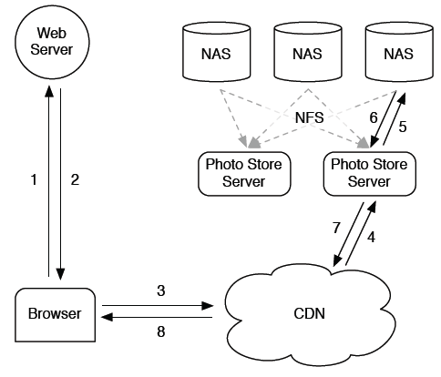
Old Solution: NFS
Issues with this design?
Long Tail ⇒ Caching does not
work for most photos
  Every access to back end storage
  must be fast without benefit of
  caching!
Linear Directory scheme works
badly for many photos/directory
  Many disk operations to find
  even a single photo
  Directory’s block map too big to cache in memory
  “Fixed” by reducing directory size, however still not great
Meta-Data (FFS) requires ≥ 3 disk accesses per lookup
  Caching all iNodes in memory might help, but iNodes are big
Fundamentally, Photo Storage different from other storage:
  Normal file systems fine for developers, databases, etc

Slide 35
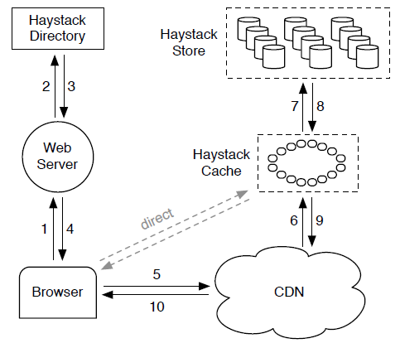
New Solution: Haystack
Finding a needle
(old photo) in Haystack
Differentiate between old
and new photos
  How? By looking at “Writeable”
  vs “Read-only” volumes
  New Photos go to Writeable
  volumes
Directory: Help locate photos
  Name (URL) of photo has
  embedded volume and photo ID
Let CDN or Haystack Cache
Serve new photos
  rather than forwarding them to
  Writeable volumes
Haystack Store: Multiple “Physical Volumes”
  Physical volume is large file (100 GB) which stores millions of photos
  Data Accessed by Volume ID with offset into file
  Since Physical Volumes are large files, use XFS which is optimized for large files

Slide 36
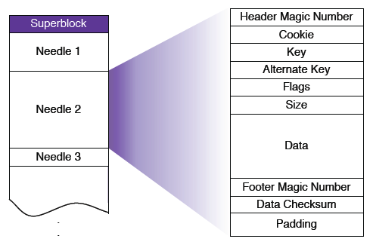
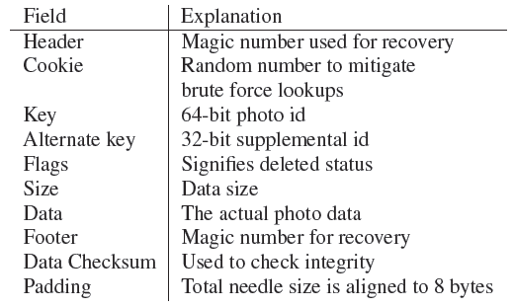
Haystack Details
Each physical volume is stored as single file in XFS
  Superblock: General information about the volume
  Each photo (a “needle”) stored by appending to file
Needles stored sequentially in file
  Naming: [Volume ID, Key, Alternate Key, Cookie]
  Cookie: random value to avoid guessing attacks
  Key: Unique 64-bit photo ID
  Alternate Key: four different sizes, ‘n’, ‘a’, ‘s’, ‘t’
Deleted Needle Simply marked as “deleted”
  Overwritten Needle – new version appended at end

Slide 37
Haystack Details (Con’t)
Replication for reliability
and performance:
  Multiple physical volumes
  combined into logical volume
    Factor of 3
  Four different sizes
    Thumbnails, Small, Medium, Large
Lookup
  User requests Webpage
  Webserver returns URL of form:
    http://<CDN>/<Cache>/<Machine id>/<Logical volume,photo>
    Possibly reference cache only if old image
  CDN will strip off CDN reference if missing, forward to cache
  Cache will strip off cache reference and forward to Store
In-memory index on Store for each volume map:
[Key, Alternate Key] ⇒ Offset

Slide 38
Summary
Distributed File System:
  Transparent access to files stored on a remote disk
  Caching for performance
Data De-Duplication: Caching based on data contents
Peer-to-Peer:
  Use of 100s or 1000s of nodes to keep higher performance or greater availability
  May need to relax consistency for better performance
Application-Specific File Systems (e.g. Haystack):
  Optimize system for particular usage pattern

