Slide 1
File System
Presenter: Song Li

Slide 2
Designing the File System: Access Patterns
How do users access files?
Need to know type of access patterns user is likely to throw at system
Sequential Access: bytes read in order (“give me the next X bytes, then give me next, etc”)
Almost all file access are of this flavor
Random Access: read/write element out of middle of array (“give me bytes i—j”)
Less frequent, but still important. For example, virtual memory backing file: page of memory stored in file
Want this to be fast – don’t want to have to read all bytes to get to the middle of the file
Content-based Access: (“find me 100 bytes starting with KUBIATOWICZ”)
Example: employee records – once you find the bytes, increase my salary by a factor of 2
Many systems don’t provide this; instead, databases are built on top of disk access to index content (requires efficient random access)

Slide 3
Designing the File System: Usage Patterns
Most files are small (for example, .login, .c files)
A few files are big – nachos, core files, etc.; the nachos executable is as big as all of your .class files combined
However, most files are small – .class’s, .o’s, .c’s, etc.
Large files use up most of the disk space and bandwidth to/from disk
May seem contradictory, but a few enormous files are equivalent to an immense # of small files
Although we will use these observations, beware usage patterns:
Good idea to look at usage patterns: beat competitors by optimizing for frequent patterns
Except: changes in performance or cost can alter usage patterns. Maybe UNIX has lots of small files because big files are really inefficient?

Slide 4
How to organize files on disk
Goals:
Maximize sequential performance
Easy random access to file
Easy management of file (growth, truncation, etc)
First Technique: Continuous Allocation
Use continuous range of blocks in logical block space
Analogous to base+bounds in virtual memory
User says in advance how big file will be (disadvantage)
Search bit-map for space using best fit/first fit
What if not enough contiguous space for new file?
File Header Contains:
First sector/LBA in file
File size (# of sectors)
Pros: Fast Sequential Access, Easy Random access
Cons: External Fragmentation/Hard to grow files
Free holes get smaller and smaller
Could compact space, but that would be really expensive
Continuous Allocation used by IBM 360
Result of allocation and management cost: People would create a big file, put their file in the middle

Slide 5
Linked List Allocation
Second Technique: Linked List Approach
Each block, pointer to next on disk
Pros: Can grow files dynamically, Free list same as file
Cons: Bad Sequential Access (seek between each block), Unreliable (lose block, lose rest of file)
Serious Con: Bad random access!!!!
Technique originally from Alto (First PC, built at Xerox)
No attempt to allocate contiguous blocks
File Header
Null

Slide 6
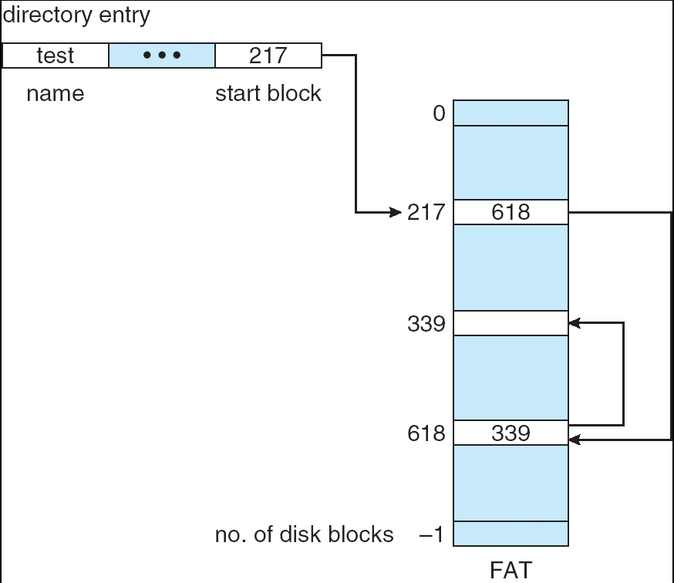
Linked Allocation: File-Allocation Table (FAT)
MSDOS links pages together to create a file
Links not in pages, but in the File Allocation Table (FAT)
FAT contains an entry for each block on the disk
FAT Entries corresponding to blocks of file linked together
Access properies:
Sequential access expensive unless FAT cached in memory
Random access expensive always, but really expensive if FAT not cached in memory

Slide 7
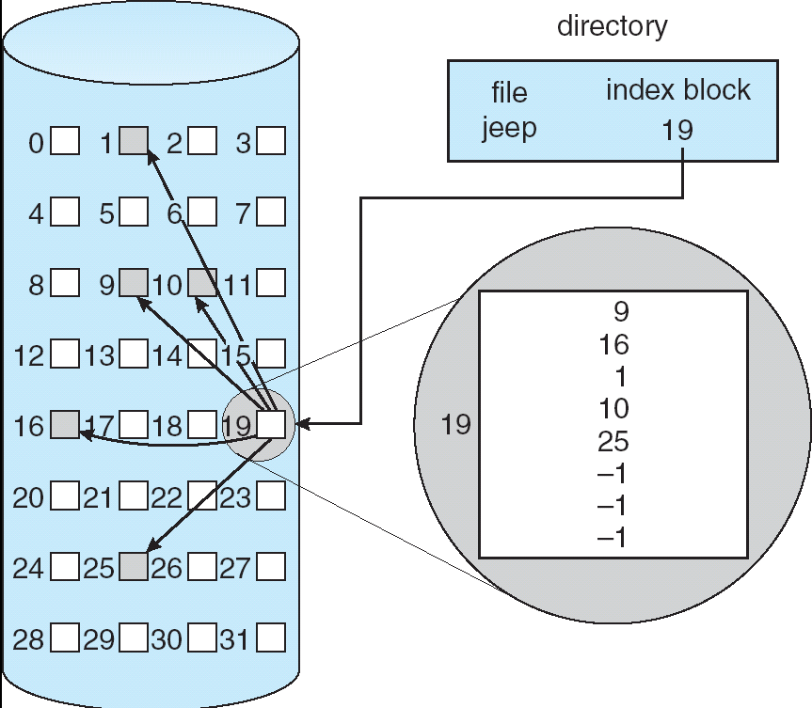
Indexed Allocation
Indexed Files (Nachos, VMS)
System Allocates file header block to hold array of pointers big enough to point to all blocks
User pre-declares max file size;
Pros: Can easily grow up to space allocated for index Random access is fast
Cons: Clumsy to grow file bigger than table size Still lots of seeks: blocks may be spread over disk

Slide 8
Multilevel Indexed Files (UNIX BSD 4.1)
Multilevel Indexed Files: Like multilevel address translation (from UNIX 4.1 BSD)
Key idea: efficient for small files, but still allow big files
File header contains 13 pointers
Fixed size table, pointers not all equivalent
This header is called an “inode” in UNIX
File Header format:
First 10 pointers are to data blocks
Block 11 points to “indirect block” containing 256 blocks
Block 12 points to “doubly indirect block” containing 256 indirect blocks for total of 64K blocks
Block 13 points to a triply indirect block (16M blocks)
Discussion
Basic technique places an upper limit on file size that is approximately 16Gbytes
Designers thought this was bigger than anything anyone would need. Much bigger than a disk at the time…
Fallacy: today, EOS producing 2TB of data per day
Pointers get filled in dynamically: need to allocate indirect block only when file grows > 10 blocks.
On small files, no indirection needed

Slide 9
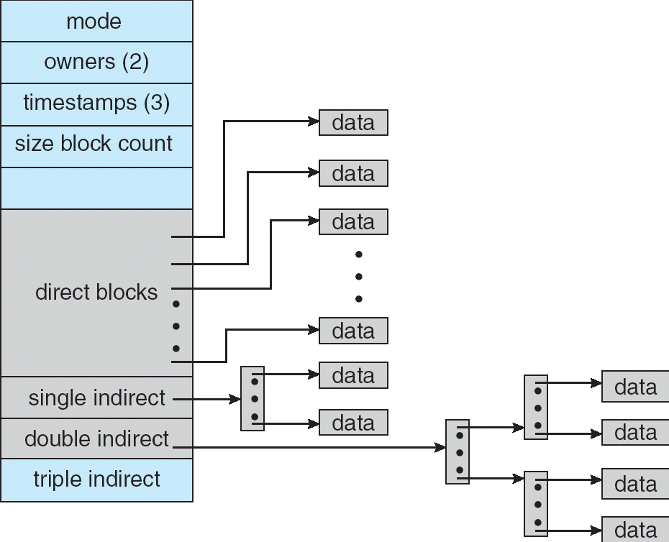
Example of Multilevel Indexed Files
Sample file in multilevel indexed format:
How many accesses for block #23? (assume file header accessed on open)?
Two: One for indirect block, one for data
How about block #5?
One: One for data
Block #340?
Three: double indirect block, indirect block, and data
UNIX 4.1 Pros and cons
Pros: Simple (more or less) Files can easily expand (up to a point) Small files particularly cheap and easy
Cons: Lots of seeks Very large files must read many indirect block (four I/Os per block!)

Slide 10
File Allocation for Cray-1 DEMOS
base
size
disk group
1,3,2
1,3,3
1,3,4
Basic Segmentation Structure:
Each segment contiguous on disk
1,3,5
1,3,6
1,3,7
file header
1,3,8
1,3,9
DEMOS: File system structure similar to segmentation
Idea: reduce disk seeks by
using contiguous allocation in normal case
but allow flexibility to have non-contiguous allocation
Cray-1 had 12ns cycle time, so CPU:disk speed ratio about the same as today (a few million instructions per seek)
Header: table of base & size (10 “block group” pointers)
Each block chunk is a contiguous group of disk blocks
Sequential reads within a block chunk can proceed at high speed – similar to continuous allocation
How do you find an available block group?
Use freelist bitmap to find block of 0’s.

Slide 11
Large File Version of DEMOS
base
size
base
size
disk group
1,3,2
1,3,3
1,3,4
1,3,5
1,3,6
1,3,7
indirect
block group
1,3,8
file header
1,3,9
What if need much bigger files?
If need more than 10 groups, set flag in header: BIGFILE
Each table entry now points to an indirect block group
Suppose 1000 blocks in a block group ⇒ 80GB max file
Assuming 8KB blocks, 8byte entries⇒ (10 ptrs×1024 groups/ptr×1000 blocks/group)*8K =80GB
Discussion of DEMOS scheme
Pros: Fast sequential access, Free areas merge simply Easy to find free block groups (when disk not full)
Cons: Disk full ⇒ No long runs of blocks (fragmentation), so high overhead allocation/access
Full disk ⇒ worst of 4.1BSD (lots of seeks) with worst of continuous allocation (lots of recompaction needed)

Slide 12
How to keep DEMOS performing well?
In many systems, disks are always full
How to fix? Announce that disk space is getting low, so please delete files?
Don’t really work: people try to store their data faster
Sidebar: Perhaps we are getting out of this mode with new disks… However, let’s assume disks full for now
Solution:
Don’t let disks get completely full: reserve portion
Free count = # blocks free in bitmap
Scheme: Don’t allocate data if count < reserve
How much reserve do you need?
In practice, 10% seems like enough
Tradeoff: pay for more disk, get contiguous allocation
Since seeks so expensive for performance, this is a very good tradeoff

Slide 13
UNIX BSD 4.2
Same as BSD 4.1 (same file header and triply indirect blocks), except incorporated ideas from DEMOS:
Uses bitmap allocation in place of freelist
Attempt to allocate files contiguously
10% reserved disk space
Skip-sector positioning (mentioned next slide)
Problem: When create a file, don’t know how big it will become (in UNIX, most writes are by appending)
How much contiguous space do you allocate for a file?
In Demos, power of 2 growth: once it grows past 1MB, allocate 2MB, etc
In BSD 4.2, just find some range of free blocks
Put each new file at the front of different range
To expand a file, you first try successive blocks in bitmap, then choose new range of blocks
Also in BSD 4.2: store files from same directory near each other
Fast File System (FFS)
Allocation and placement policies for BSD 4.2

Slide 14
Attack of the Rotational Delay
Problem: Missing blocks due to rotational delay
Issue: Read one block, do processing, and read next block. In meantime, disk has continued turning: missed next block! Need 1 revolution/block!
Solution1: Skip sector positioning (“interleaving”)
Place the blocks from one file on every other block of a track: give time for processing to overlap rotation
Solution2: Read ahead: read next block right after first, even if application hasn’t asked for it yet.
This can be done either by OS (read ahead)
By disk itself (track buffers). Many disk controllers have internal RAM that allows them to read a complete track
Important Aside: Modern disks+controllers do many complex things “under the covers”
Track buffers, elevator algorithms, bad block filtering
Skip Sector
Track Buffer
(Holds complete track)

Slide 15
How do we actually access files?
All information about a file contained in its file header
UNIX calls this an “inode”
Inodes are global resources identified by index (“inumber”)
Once you load the header structure, all the other blocks of the file are locatable
Question: how does the user ask for a particular file?
One option: user specifies an inode by a number (index).
Imagine: open(“14553344”)
Better option: specify by textual name
Have to map name→inumber
Another option: Icon
Graphical user interfaces. Point to a file and click.
Naming: The process by which a system translates from user-visible names to system resources
In the case of files, need to translate from strings (textual names) or icons to inumbers/inodes
For global file systems, data may be spread over globe⇒need to translate from strings or icons to some combination of physical server location and inumber

Slide 16
Directories
Directory: a relation used for naming
Just a table of (file name, inumber) pairs
How are directories constructed?
Directories often stored in files
Reuse of existing mechanism
Directory named by inode/inumber like other files
Needs to be quickly searchable
Options: Simple list or Hashtable
Can be cached into memory in easier form to search
How are directories modified?
Originally, direct read/write of special file
System calls for manipulation: mkdir, rmdir
Ties to file creation/destruction
Directories organized into a hierarchical structure
Entries in directory can be either files or directories
Files named by “path” through directory structure: e.g. /usr/homes/george/data.txt

Slide 17
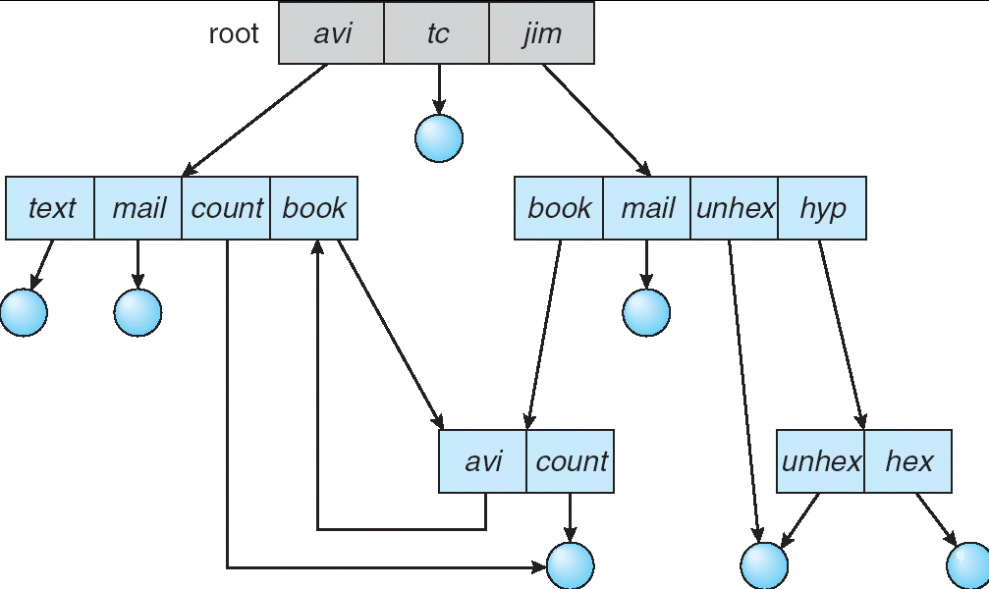
Directory Structure
Not really a hierarchy!
Many systems allow directory structure to be organized as an acyclic graph or even a (potentially) cyclic graph
Hard Links: different names for the same file
Multiple directory entries point at the same file
Soft Links: “shortcut” pointers to other files
Implemented by storing the logical name of actual file
Name Resolution: The process of converting a logical name into a physical resource (like a file)
Traverse succession of directories until reach target file
Global file system: May be spread across the network

Slide 18
Directory Structure (Con’t)
How many disk accesses to resolve “/my/book/count”?
Read in file header for root (fixed spot on disk)
Read in first data block for root
Table of file name/index pairs. Search linearly – ok since directories typically very small
Read in file header for “my”
Read in first data block for “my”; search for “book”
Read in file header for “book”
Read in first data block for “book”; search for “count”
Read in file header for “count”
Current working directory: Per-address-space pointer to a directory (inode) used for resolving file names
Allows user to specify relative filename instead of absolute path (say CWD=“/my/book” can resolve “count”)

Slide 19
Where are inodes stored?
In early UNIX and DOS/Windows’ FAT file system, headers stored in special array in outermost cylinders
Header not stored near the data blocks. To read a small file, seek to get header, seek back to data.
Fixed size, set when disk is formatted. At formatting time, a fixed number of inodes were created (They were each given a unique number, called an “inumber”)

Slide 20
Where are inodes stored?
Later versions of UNIX moved the header information to be closer to the data blocks
Often, inode for file stored in same “cylinder group” as parent directory of the file (makes an ls of that directory run fast).
Pros:
UNIX BSD 4.2 puts a portion of the file header array on each cylinder. For small directories, can fit all data, file headers, etc in same cylinder⇒no seeks!
File headers much smaller than whole block (a few hundred bytes), so multiple headers fetched from disk at same time
Reliability: whatever happens to the disk, you can find many of the files (even if directories disconnected)
Part of the Fast File System (FFS)
General optimization to avoid seeks

Slide 21
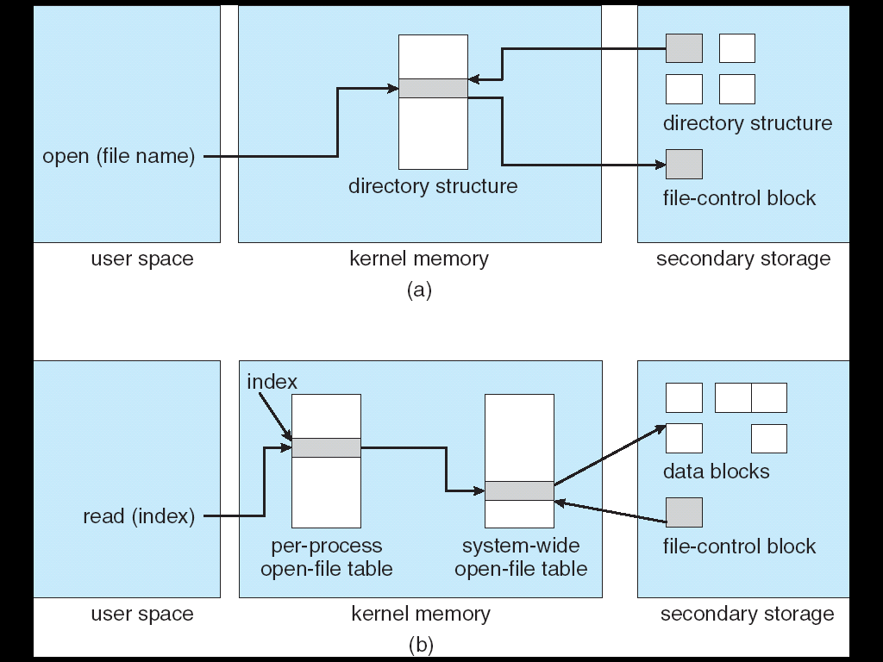
In-Memory File System Structures
Open system call:
Resolves file name, finds file control block (inode)
Makes entries in per-process and system-wide tables
Returns index (called “file handle”) in open-file table
Read/write system calls:
Use file handle to locate inode
Perform appropriate reads or writes

Slide 22
File System Caching
Key Idea: Exploit locality by caching data in memory
Name translations: Mapping from paths→inodes
Disk blocks: Mapping from block address→disk content
Buffer Cache: Memory used to cache kernel resources, including disk blocks and name translations
Can contain “dirty” blocks (blocks yet on disk)
Replacement policy? LRU
Can afford overhead of timestamps for each disk block
Advantages:
Works very well for name translation
Works well in general as long as memory is big enough to accommodate a host’s working set of files.
Disadvantages:
Fails when some application scans through file system, thereby flushing the cache with data used only once
Example: find . –exec grep foo {} \;
Other Replacement Policies?
Some systems allow applications to request other policies
Example, ‘Use Once’:
File system can discard blocks as soon as they are used

Slide 23
File System Caching (con’t)
Cache Size: How much memory should the OS allocate to the buffer cache vs virtual memory?
Too much memory to the file system cache ⇒ won’t be able to run many applications at once
Too little memory to file system cache ⇒ many applications may run slowly (disk caching not effective)
Solution: adjust boundary dynamically so that the disk access rates for paging and file access are balanced
Read Ahead Prefetching: fetch sequential blocks early
Key Idea: exploit fact that most common file access is sequential by prefetching subsequent disk blocks ahead of current read request (if they are not already in memory)
Elevator algorithm can efficiently interleave groups of prefetches from concurrent applications
How much to prefetch?
Too many imposes delays on requests by other applications
Too few causes many seeks (and rotational delays) among concurrent file requests

Slide 24
File System Caching (con’t)
Delayed Writes: Writes to files not immediately sent out to disk
Instead, write() copies data from user space buffer to kernel buffer (in cache)
Enabled by presence of buffer cache: can leave written file blocks in cache for a while
If some other application tries to read data before written to disk, file system will read from cache
Flushed to disk periodically (e.g. in UNIX, every 30 sec)
Advantages:
Disk scheduler can efficiently order lots of requests
Disk allocation algorithm can be run with correct size value for a file
Some files need never get written to disk! (e..g temporary scratch files written /tmp often don’t exist for 30 sec)
Disadvantages
What if system crashes before file has been written out?
Worse yet, what if system crashes before a directory file has been written out? (lose pointer to inode!)

Slide 25
The Linux Page Cache
Goal: Minimize disk I/O by storing data in memory
Caches any page-based objects, including files and memory mappings
Cache consists of many address_space objects
Really misnamed should be a “page_cache_entity” or “physical_pages_of_a_file”
Can hold one or more pages from a file or swapper
Often associated with an inode, but doesn’t have to be
Searching an address_space object for given page is done by offset
Contains a set of address_space operations
For reading/writing pages from disk
An address_space contains a radix tree of all pages
Flusher Threads
Start pushing dirty blocks back to disk when free memory shrinks below a specified hreshold

Slide 26
Important “ilities”
Availability: the probability that the system can accept and process requests
Often measured in “nines” of probability. So, a 99.9% probability is considered “3-nines of availability”
Key idea here is independence of failures
Durability: the ability of a system to recover data despite faults
This idea is fault tolerance applied to data
Doesn’t necessarily imply availability: information on pyramids was very durable, but could not be accessed until discovery of Rosetta Stone
Reliability: the ability of a system or component to perform its required functions under stated conditions for a specified period of time (IEEE definition)
Usually stronger than simply availability: means that the system is not only “up”, but also working correctly
Includes availability, security, fault tolerance/durability
Must make sure data survives system crashes, disk crashes, other problems

Slide 27
How to make file system durable?
Disk blocks contain Reed-Solomon error correcting codes (ECC) to deal with small defects in disk drive
Can allow recovery of data from small media defects
Make sure writes survive in short term
Either abandon delayed writes or
use special, battery-backed RAM (called non-volatile RAM or NVRAM) for dirty blocks in buffer cache.
Make sure that data survives in long term
Need to replicate! More than one copy of data!
Important element: independence of failure
Could put copies on one disk, but if disk head fails…
Could put copies on different disks, but if server fails…
Could put copies on different servers, but if building is struck by lightning….
Could put copies on servers in different continents…
RAID: Redundant Arrays of Inexpensive Disks
Data stored on multiple disks (redundancy)
Either in software or hardware
In hardware case, done by disk controller; file system may not even know that there is more than one disk in use

Slide 28
Redundant Arrays of Disks RAID 1: Disk Mirroring/Shadowing
recovery
group
• Each disk is fully duplicated onto its "shadow"
Very high availability can be achieved
• Bandwidth sacrifice on write:
Logical write = two physical writes
• Reads may be optimized
• Most expensive solution: 100% capacity overhead
Targeted for high I/O rate , high availability environments

Slide 29
Redundant Arrays of Disks RAID 5+: High I/O Rate Parity
D0
D1
D2
D3
P
Increasing
Logical
Disk
Addresses
A logical write
becomes four
physical I/Os
Independent writes
possible because of
interleaved parity
Reed-Solomon
Codes ("Q") for
protection during
reconstruction
D4
D5
D6
P
D7
D8
D9
P
D10
D11
D12
P
D13
D14
D15
Stripe
P
D16
D17
D18
D19
Stripe
Unit
D20
D21
D22
D23
P
.
.
.
.
.
.
.
.
.
.
.
.
.
.
.
Disk Columns

Slide 30
Problems of Disk Arrays: Small Writes
RAID-5: Small Write Algorithm
1 Logical Write = 2 Physical Reads + 2 Physical Writes
D0'
D0
D1
D2
D3
P
new
data
old
data
old
parity
(1. Read)
(2. Read)
+
XOR
+
XOR
(3. Write)
(4. Write)
D0'
D1
D2
D3
P'

Slide 31
Log Structured and Journaled File Systems
Better (write) performance through use of log
Optimized for writes to disk (log is contiguous)
Assume that reads handled through page cache
Better reliability through use of log
All changes are treated as transactions
A transaction is committed once it is written to the log
Data forced to disk for reliability
Process can be accelerated with NVRAM
Although File system may not be updated immediately, data preserved in the log
Difference between “Log Structured” and “Journaled”
In a Log Structured filesystem, data stays in log form
In a Journaled filesystem, Log used for recovery
For Journaled system:
Log used to asynchronously update filesystem
Log entries removed after used
After crash:
Remaining transactions in the log performed (“Redo”)
Modifications done in way that can survive crashes
Examples of Journaled File Systems:
Ext3 (Linux), XFS (Unix), etc.

Slide 32
Log-Structured File System – Motivation
Radically different file system design
Technology motivations:
CPUs outpacing disks: I/O becoming more-and-more of a bottleneck
Large RAM: file caches work well, making most disk traffic writes
Problems with (then) current file systems:
Lots of little writes
Synchronous: wait for disk in too many places – makes it hard to win much from RAIDs, too little concurrency
5 seeks to create a new file: (rough order)
file i-node (create)
file data
directory entry
file i-node (finalize)
directory i-node (modification time)

Slide 33
LFS Basic Idea
Log all data and metadata with efficient, large, sequential writes
Treat the log as the truth, but keep an index on its contents
Rely on a large memory to provide fast access through caching
Data layout on disk has “temporal locality” (good for writing), rather than “logical locality” (good for reading)
Why is this a better? Because caching helps reads but not writes!
Two potential problems:
Log retrieval on cache misses
Wrap-around: what happens when end of disk is reached?
No longer any big, empty runs available
How to prevent fragmentation?

Slide 34
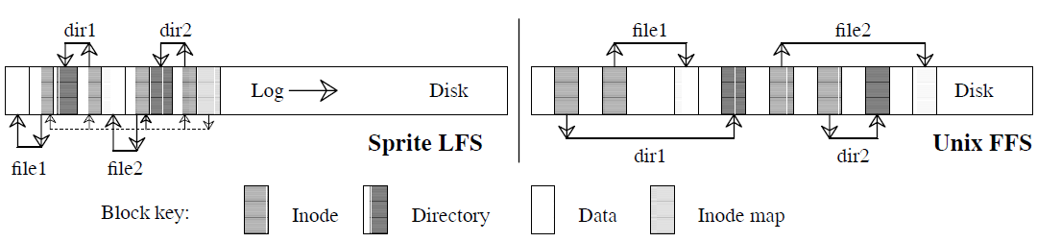
Comparison of LFS and FFS
Comparison of LFS (Sprite) with FFS (Unix)
Creation of two single-block files named dir1/file1 and dir2/file2
Each writes new blocks and inodes for file 1 and file 2
Each writes new data blocks and inodes for directories
FFS Traffic:
Ten non-sequential writes for new information
Inodes each written twice to ease recovery from crashes
LFS Traffic:
Single large write
For both when reading back: same number of disk accesses

Slide 35
LFS Log Retrieval
Keep same basic file structure as UNIX (inode, indirect blocks, data)
Retrieval is just a question of finding a file’s inode
UNIX inodes kept in one or a few big arrays, LFS inodes must float to avoid update-in- place
Solution: an inode map that tells where each inode is (Also keeps other stuff: version number, last access time, free/allocated)
inode map gets written to log like everything else
Map of inode map gets written in special checkpoint location on disk; used in crash recovery

Slide 36
LFS Disk Wrap-Around
Compact live info to open up large runs of free space
Problem: long-lived information gets copied over-and-over
Thread log through free spaces
Problem: disk fragments, causing I/O to become inefficient again
Solution: segmented log
Divide disk into large, fixed-size segments
Do compaction within a segment; thread between segments
When writing, use only clean segments (i.e. no live data)
Occasionally clean segments: read in several, write out live data in compacted form, leaving some fragments free
Try to collect long-lived info into segments that never need to be cleaned
Note there is not free list or bit map (as in FFS), only a list of clean segments

Slide 37
LFS Segment Cleaning
Which segments to clean?
Keep estimate of free space in each segment to help find segments with lowest utilization
Always start by looking for segment with utilization=0, since those are trivial to clean…
How to clean a segment?
Segment summary block contains map of the segment
Must list every i-node and file block
For file blocks you need {i-number, block #}

Slide 38
Analysis and Evolution of Journaling File Systems
Write-ahead logging: commit data by writing it to log, synchronously and sequentially
Unlike LFS, then later moved data to its normal (FFS-like) location – this write is called checkpointing and like segment cleaning, it makes room in the (circular) journal
Better for random writes, slightly worse for big sequential writes
All reads go the the fixed location blocks, not the journal, which is only read for crash recovery and checkpointing
Much better than FFS (fsck) for crash recovery (covered below) because it is much faster
Ext3/ReiserFS/Ext4 filesystems are the main ones in Linux

Slide 39
Three modes for a JFS
Writeback mode:
Journal only metadata
Write back data and metadata independently
Metadata may thus have dangling references after a crash (if metadata written before the data with a crash in between)
Ordered mode:
Journal only metadata, but always write data blocks before their referring metadata is journaled
This mode generally makes the most sense and is used by Windows NTFS and IBM’s JFS
Data journaling mode:
Write both data and metadata to the journal
Huge increase in journal traffic; plus have to write most blocks twice, once to the journal and once for checkpointing

Slide 40
What about remote file systems?
Remote File System:
Storage available over a network
Local storage is only a cache on permanent storage
Advantages?
Someone else worries about keeping data safe
Data Accessible from multiple physical locations
Disadvantages?
Performance – may take one or more network roundtrips to fetch data
Privacy: your data is available over the network, others can possibly see your data
Integrity: without sufficient protections, others can overwrite/delete your data

Slide 41

Network-Attached Storage and the CAP Theorem
Network
Consistency:
Changes appear to everyone in the same serial order
Availability:
Can get a result at any time
Partition-Tolerance
System continues to work even when network becomes partitioned
Consistency, Availability, Partition-Tolerance (CAP) Theorem: Cannot have all three at same time
Otherwise known as “Brewer’s Theorem”

Slide 42
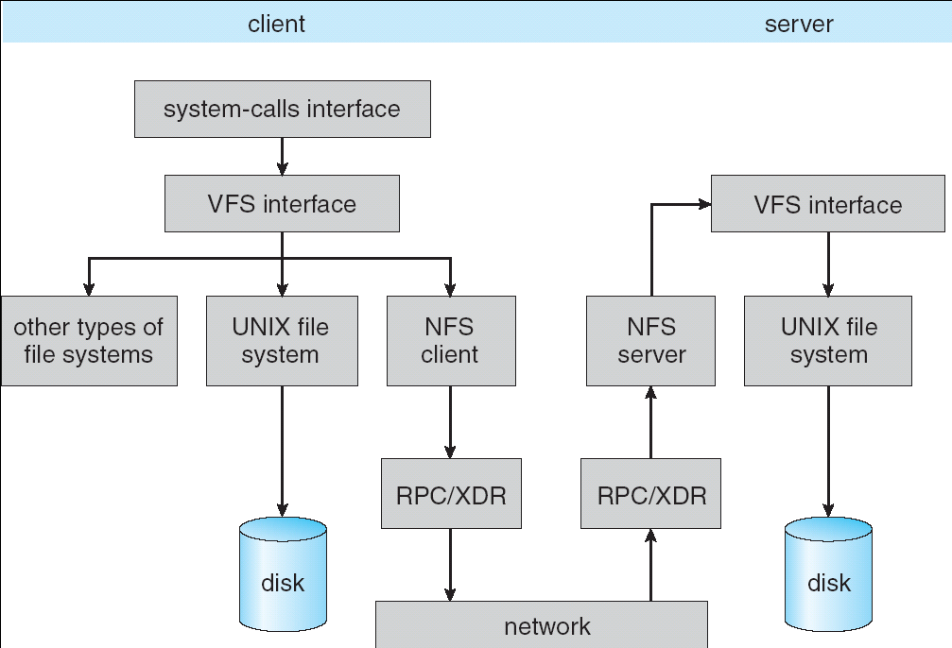
Schematic View of NFS Architecture

Slide 43
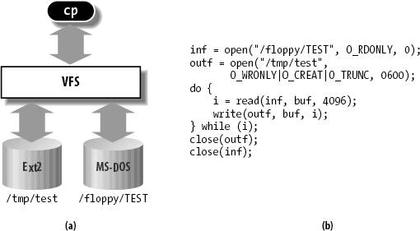
Virtual Filesystem Switch (VFS)
VFS: Virtual abstraction similar to local file system
Provides virtual superblocks, inodes, files, etc
Compatible with a variety of local and remote file systems
provides object-oriented way of implementing file systems
VFS allows the same system call interface (the API) to be used for different types of file systems
The API is to the VFS interface, rather than any specific type of file system

Slide 44
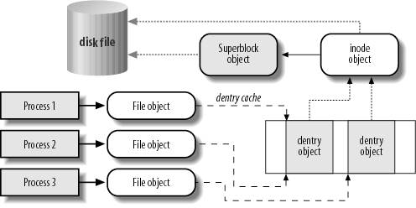
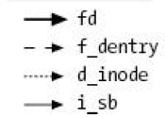
VFS Common File Model
Four primary object types for VFS:
superblock object: represents a specific mounted filesystem
inode object: represents a specific file
dentry object: represents a directory entry
file object: represents open file associated with process
There is no specific directory object (VFS treats directories as files)
May need to fit the model by faking it
Example: make it look like directories are files
Example: make it look like have inodes, superblocks, etc.

Slide 45
Linux VFS
write()
sys_write()
filesystem’s
write method
physical
media
user-space
VFS
filesystem
An operations object is contained within each primary object type to set operations of specific filesystems
“super_operations”: methods that kernel can invoke on a specific filesystem, i.e. write_inode() and sync_fs().
“inode_operations”: methods that kernel can invoke on a specific file, such as create() and link()
“dentry_operations”: methods that kernel can invoke on a specific directory entry, such as d_compare() or d_delete()
“file_operations”: methods that process can invoke on an open file, such as read() and write()

