Slide 1
OS Structure and Kernel
Presenter: Song Li

Slide 2
OS Resources – at the center of it all!
What do modern OSs do?
Control access to resources!
Control of Resources
Access/No Access/ Partial Access
Check every access to see if it is allowed
Resource Multiplexing
When multiple valid requests occur at same time – how to multiplex access?
What fraction of resource can requester get?
Performance Isolation
Can requests from one entity prevent requests from another?
What or Who is a requester?
Process? User? Public Key?
Think of this as a “Principle”
Independent
Requesters
Access Control and Multiplexing

Slide 3
What is a Resource?
Processor, Memory, Cache
Multiplex through: scheduling, Virtual memory
Abstraction: Process, Thread
Need Kernel Level to Multiplex?
Need to Sandbox somehow
Kernel control of memory, prevent certain instructions
Network
Multiplex through: Queues, Input Filters
Abstraction: Sockets API
Need Kernel Level to Multiplex?
Not necessarily – New hardware has on-chip filters
Setup Cost, but not necessarily a per-packet cost
Is network really secure anyway? (Need Crypto!)
Disk
Multiplex through: Buffer Cache
Abstraction: File System API
Need Kernel Level to Multiplex?
Traditionally all access control through kernel
What about assigning unlimited access to partitions?

Slide 4
More Complex Resources: Operating System Services
System Services are really complex resources
File system (Uses Disk Drive)
File API: Create, Read, Write, Delete
Access Control: User, Group, World, Read/Write/Execute
Windows System (Uses Graphics Card)
Windowing API: Write Text, Draw/Fill in figures
Access Control: Per Window (User created)
Data Base (Uses Disk Drive or Memory or Network)
DB API: SQL Queries and Transactions
Access Control: Per user, Group, others
Lock Service (Memory)
Lock API: Acquire (Read, Write), Release
Access Control: By group/per user
Access controlled through syscall interface (Kernel Level)
Funnel all access through trusted (verified) API
Kernel controls access to API, verifies identity
Service controls access to resources using identity
Service decides multiplexing/isolation policies
Often based on first-come-first-serve!

Slide 5
The Protection vs Management Split
Kernels Mix Protection, Performance Isolation, and Management
Protection: Should a principle have access to a given resource?
Yes or No?
Based on local password file? Thumbprint? Cryptographic Key?
Performance Isolation
How Much of Bandwidth-Limited resources should the principle have access to?
Examples:
50% CPU
As much Network as Desired
Fraction of Paging Disk for Virtual memory?
Management: How should the principle use this resource?
Scheduling, Policies
Examples:
Use my CPU resources to meet realtime deadlines vs highest throughput scheduling
Keep certain pages in memory
Problem with putting all three of these together is that APIs limited, complex, or insufficient…

Slide 6
Traditional Approach to Handling Resource
Example: Send message from one processor to another
Check Permissions, Format Message
Enforce forward progress, Handle interrupts
Prevent Denial Of Service (DOS) and/or Deadlock
Traditional Approach: Use a system call+OS Service
Source Program
Dest Program
User-Level Code (With Libraries)
SysCall
SysCall
Message Service
Kernel (OS)
Code
Message Service
OS Service
Device Driver
Device Driver
Hardware Interface
Network
Hardware Interface
Hardware

Slide 7
Alternative: Mechanisms in HW
Source Program
Dest Program
User-Level Code (With Libraries)
QoS Specs
Hardware Interface
(User-level)
Network
QoS Specs
Hardware Interface
(User-level)
Hardware
OS Policy
Permit user-level code to send messages
Have hardware check permission and/or rate
Have hardware enforce format/consistency
Have hardware guarantee forward progress
Have Hardware deliver messages/interrupts to usercode
OS sets registers to control behavior based on policy

Slide 8
Push Access Control to Hardware: User-Level Alewife Messaging
Send message
write words to special network interface registers
Execute atomic launch instruction
Receive
Generate interrupt/launch user-level thread context
Examine message by reading from special network interface registers
Execute dispose message
Exit atomic section

Slide 9
Sharing of Network Interface
What if user in middle of constructing message and must context switch?
Need Atomic Send operation!
Message either completely in network or not at all
Can save/restore user’s work if necessary (think about single set of network interface registers
Receive Atomicity
If want to allow user-level interrupts or polling, must give user control over network reception
Allow atomicity: way for good user to select when their message handlers get interrupted
Polling: ultimate receive atomicity – never interrupted
Fine as long as user keeps absorbing messages

Slide 10
System Calls: Details
Challenge: Interaction Despite Isolation
How to isolate processes and their resources…
While still permitting them to request help from the kernel
Letting them interact with resources while maintaining usage policies such as security, QoS, etc
Letting processes interact with one another in a controlled way
Through messages, shared memory, etc
Enter the System Call interface
Layer between the hardware and user-space processes
Programming interface to the services provided by the OS
Mostly accessed by programs via a high-level Application Program Interface (API) rather than directly
Get at system calls by linking with libraries in glibc
Three most common APIs are:
Win32 API for Windows
POSIX API for POSIX-based systems (including virtually all versions of UNIX, Linux, and Mac OS X)
Java API for the Java virtual machine (JVM)
Call to printf()
Printf() in the C library
Write() system call

Slide 11
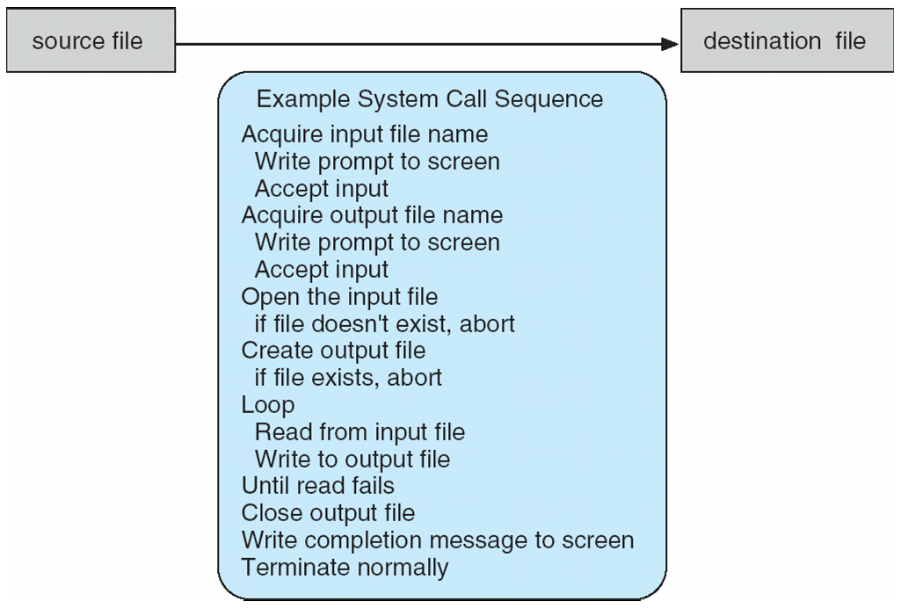
Example of System Call usage
System call sequence to copy the contents of one file to another file:
Many crossings of the User/Kernel boundary!
The cost of traversing this boundary can be high

Slide 12
Example: Use strace to trace syscalls
prompt% strace wc production.log
execve("/usr/bin/wc", ["wc", "production.log"], [/* 52 vars */]) = 0
brk(0) = 0x1987000
mmap(NULL, 4096, PROT_READ|PROT_WRITE, MAP_PRIVATE|MAP_ANONYMOUS, -1, 0) = 0x7ff24b8f7000
access("/etc/ld.so.preload", R_OK) = -1 ENOENT (No such file or directory)
open("/etc/ld.so.cache", O_RDONLY) = 3
fstat(3, {st_mode=S_IFREG|0644, st_size=137151, ...}) = 0
mmap(NULL, 137151, PROT_READ, MAP_PRIVATE, 3, 0) = 0x7ff24b8d5000
close(3) = 0
open("/lib64/libc.so.6", O_RDONLY) = 3
read(3, "\177ELF\2\1\1\3\0\0\0\0\0\0\0\0\3\0>\0\1\0\0\0\360\355\241,0\0\0\0"..., 832) = 832
fstat(3, {st_mode=S_IFREG|0755, st_size=1922112, ...}) = 0
mmap(0x302ca00000, 3745960, PROT_READ|PROT_EXEC, MAP_PRIVATE|MAP_DENYWRITE, 3, 0) = 0x302ca00000
mprotect(0x302cb89000, 2097152, PROT_NONE) = 0
mmap(0x302cd89000, 20480, PROT_READ|PROT_WRITE, MAP_PRIVATE|MAP_FIXED|MAP_DENYWRITE, 3, 0x189000) = 0x302cd89000
mmap(0x302cd8e000, 18600, PROT_READ|PROT_WRITE, MAP_PRIVATE|MAP_FIXED|MAP_ANONYMOUS, -1, 0) = 0x302cd8e000
close(3) = 0
mmap(NULL, 4096, PROT_READ|PROT_WRITE, MAP_PRIVATE|MAP_ANONYMOUS, -1, 0) = 0x7ff24b8d4000
mmap(NULL, 4096, PROT_READ|PROT_WRITE, MAP_PRIVATE|MAP_ANONYMOUS, -1, 0) = 0x7ff24b8d3000
mmap(NULL, 4096, PROT_READ|PROT_WRITE, MAP_PRIVATE|MAP_ANONYMOUS, -1, 0) = 0x7ff24b8d2000
arch_prctl(ARCH_SET_FS, 0x7ff24b8d3700) = 0
mprotect(0x302cd89000, 16384, PROT_READ) = 0
mprotect(0x302c81f000, 4096, PROT_READ) = 0
munmap(0x7ff24b8d5000, 137151) = 0
brk(0) = 0x1987000
brk(0x19a8000) = 0x19a8000
open("/usr/lib/locale/locale-archive", O_RDONLY) = 3
fstat(3, {st_mode=S_IFREG|0644, st_size=99158576, ...}) = 0
mmap(NULL, 99158576, PROT_READ, MAP_PRIVATE, 3, 0) = 0x7ff245a41000
close(3) = 0
stat("production.log", {st_mode=S_IFREG|0644, st_size=526550, ...}) = 0
open("production.log", O_RDONLY) = 3
read(3, "# Logfile created on Fri Dec 28 "..., 16384) = 16384
open("/usr/lib64/gconv/gconv-modules.cache", O_RDONLY) = 4
fstat(4, {st_mode=S_IFREG|0644, st_size=26060, ...}) = 0
mmap(NULL, 26060, PROT_READ, MAP_SHARED, 4, 0) = 0x7ff24b8f0000
close(4) = 0
read(3, "m: cannot remove `/tmp/fixrepo/g"..., 16384) = 16384
read(3, "a36de93203e0b4972c1a3c81904e': P"..., 16384) = 16384
read(3, "xrepo/git-tess/gitolite-admin/.g"..., 16384) = 16384
Many repetitions of these reads
read(3, "ixrepo/git-tess/gitolite-admin\n "..., 16384) = 16384
read(3, "ite/redmine/vendor/plugins/redmi"..., 16384) = 16384
read(3, "ited with positive recursionChec"..., 16384) = 16384
read(3, "ting changes to gitolite-admin r"..., 16384) = 2262
read(3, "", 16384) = 0
fstat(1, {st_mode=S_IFCHR|0620, st_rdev=makedev(136, 3), ...}) = 0
mmap(NULL, 4096, PROT_READ|PROT_WRITE, MAP_PRIVATE|MAP_ANONYMOUS, -1, 0) = 0x7ff24b8ef000
write(1, " 4704 28993 526550 production."..., 36 4704 28993 526550 production.log) = 36
close(3) = 0 close(1) = 0
munmap(0x7ff24b8ef000, 4096) = 0
close(2) = 0
exit_group(0)

Slide 13
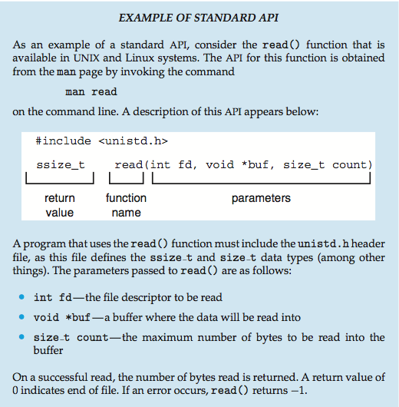
Example of Standard API

Slide 14
System Call Implementation
Typically, a number associated with each system call
System-call interface maintains a table indexed according to these numbers
The system call interface invokes intended system call in OS kernel and returns status of the system call and any return values
Return value: often a long (integer)
Return of zero is usually a sign of success, but not always
Return of -1 is almost always reflects an error
On error – return code placed into global “errno” variable
Can translate into human-readable errors with the “perror()” call
The caller need know nothing about how the system call is implemented
Just needs to obey API and understand what OS will do as a result call
Most details of OS interface hidden from programmer by API
Managed by run-time support library (set of functions built into libraries included with compiler)

Slide 15
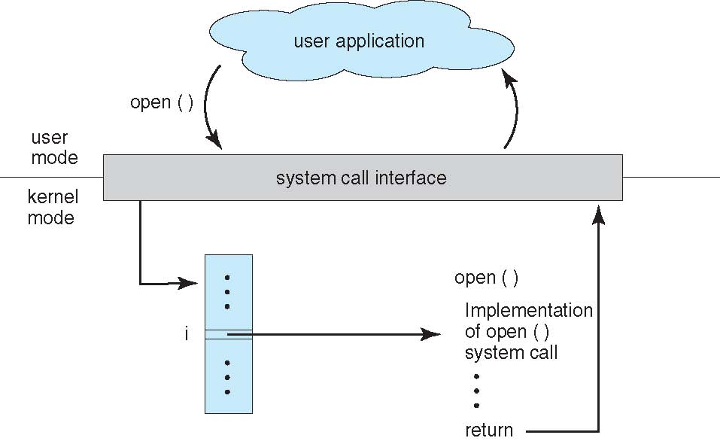
API – System Call – OS Relationship

Slide 16
System Call Parameter Passing
Often, more information is required than simply identity of desired system call
Exact type and amount of information vary according to OS and call
Three general methods used to pass parameters to the OS
Simplest: pass the parameters in registers
In some cases, may be more parameters than registers
Parameters stored in a block, or table, in memory, and address of block passed as a parameter in a register
This approach taken by Linux and Solaris
Parameters placed, or pushed, onto the stack by the program and popped off the stack by the operating system
Block and stack methods do not limit the number or length of parameters being passed

Slide 17
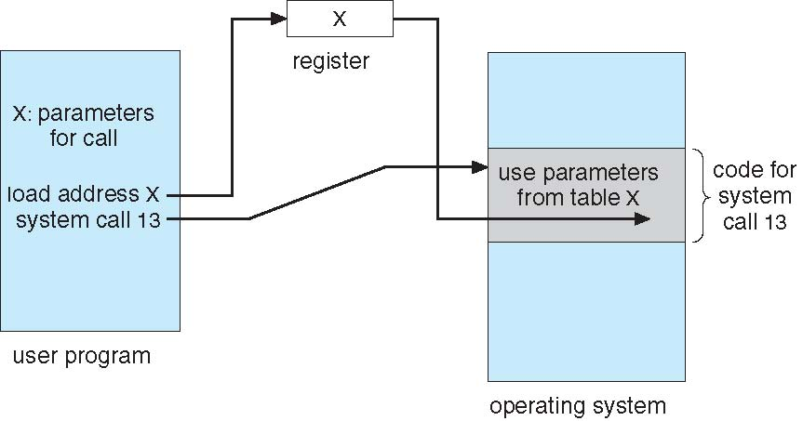
Parameter Passing via Table
Kernel must always verify parameters passed to it by the user
Are parameters in a reasonable range?
Are memory addresses actually owned by the calling user (rather than bogus addresses)

Slide 18
Types of System Calls
Process control
end, abort
execute, load
create process, terminate process
get process attributes, set process attributes
wait for time
wait event, signal event
allocate and free memory
Dump memory if error
Debugger for determining bugs, single step execution
Locks for managing access to shared data between processes

Slide 19
Types of System Calls (Con’t)
File management
create file, delete file
open, close file
read, write, reposition
get and set file attributes
Device management
request device, release device
read, write, reposition
get device attributes, set device attributes
logically attach or detach devices
Information maintenance
get time or date, set time or date
get system data, set system data
get and set process, file, or device attributes

Slide 20
Types of System Calls (Cont.)
Communications
create, delete communication connection
send, receive messages if message passing model to host name or process name
From client to server
Shared-memory model create and gain access to memory regions
transfer status information
attach and detach remote devices
Protection
Control access to resources
Get and set permissions
Allow and deny user access

Slide 21
POSIX standard
Portable Operating System Interface for UNIX
An attempt to standardize a “UNIXy” interface
Conformance: IEEE POSIX 1003.1 and ISO/IEC 9945
Latest version from 2008
Originally one document consisting of a core programming interface – now 19 separate docs
Many OSes provide “partial conformance” (including Linux)
What does POSIX define?
POSIX.1: Core Services
Process Creation and Control
Signals
Floating Point Exceptions, Segmentation/memory violations, illegal instructions, Bus Erors
Timers
File and Directory Operations
Pipes
C Library (Standard C)
I/O Port Interface and Control
Process Triggers
POSIX.1b: Realtime Extensions
POSIX.2: Shell and Utilities

Slide 22
POSIX (cont)
Process Primitives:
fork, execl, execlp, execv, execve, execvp, wit, waitpid
_exit, kill, sigxxx, alarm, pause, sleep….
Example file access primitives:
opendir, readdir, rewinddir, closedir, chdir, getcwd, open, creat, umask, link, mkdir, unlink, rmdir, rename, stat, fstat, access, fchmod, chown, utime, ftruncate,pathconf,fpathconf
I/O primitives:
pipe, dup, dup2, close, read, write, fcntl, lseek, fsync
C-Language primitives:
abort, exit, fclose, fdopen, fflush, fgetc, fgets, fileno, fopen, fprintf, fputc, fputs, fread, freopen, fscanf, fseek, ftell, fwrite, getc, getchar, gets, perror, printf, putc, putchar, puts, remove, rewind, scanf, setlocale, siglongjmp, sigsetjmp, tmpfile, tmpnam, tzset
Synchronization:
sem_init, sem_destroy, sem_wait, sem_trywait, sem_post, pthread_mutex_init, pthread_mutex_destroy, pthread_mutex_lock, pthread_mutex_trylock, pthread_mutex_unlock
Memory Management
mmap, mprotect, msync, munmap
How to get information on a system call?
Type “man callname”, i.e. “man open”
System calls are in section “2” of the man pages

Slide 23
Portability
POSIX does provide some portability
But is still pretty high level
Does not specify file systems, network interfaces, power management, other important things
Many variations in compilers, user programs, libraries, other build environment aspects
UNIX Portability:
C-preprocessor conditional compilation
Conditional and multi-target Makefile Rules
GNU configure scripts to generate Makefiles
Shell environment variables (LD_LIBRARY_PATH, LD_PRELOAD, others)

Slide 24
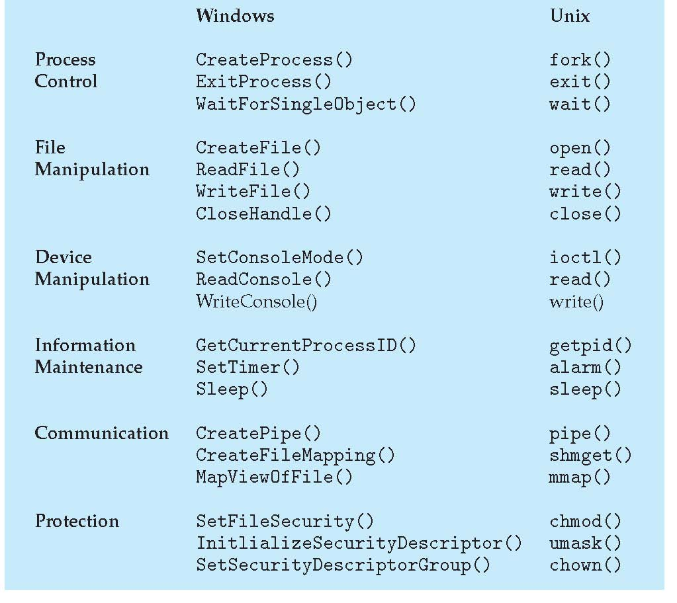
Examples of Windows and Unix System Calls

Slide 25
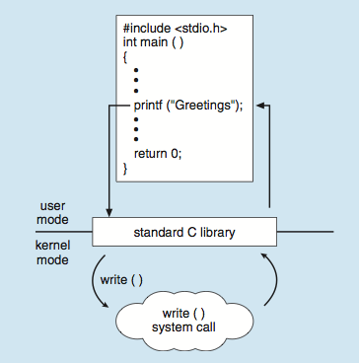
Standard C Library Example
C program invoking printf() library call, which calls write() system call

Slide 26
Operating Systems Structure (What is the organizational Principle?)
Simple
Only one or two levels of code
Layered
Lower levels independent of upper levels
Microkernel
OS built from many user-level processes
Modular
Core kernel with Dynamically loadable modules
ExoKernel

Slide 27
Implementation Issues (How is the OS implemented?)
Policy vs. Mechanism
Policy: What do you want to do?
Mechanism: How are you going to do it?
Should be separated, since both change
Algorithms used
Linear, Tree-based, Log Structured, etc…
Event models used
threads vs event loops
Backward compatibility issues
Very important for Windows 2000/XP
System generation/configuration
How to make generic OS fit on specific hardware

Slide 28
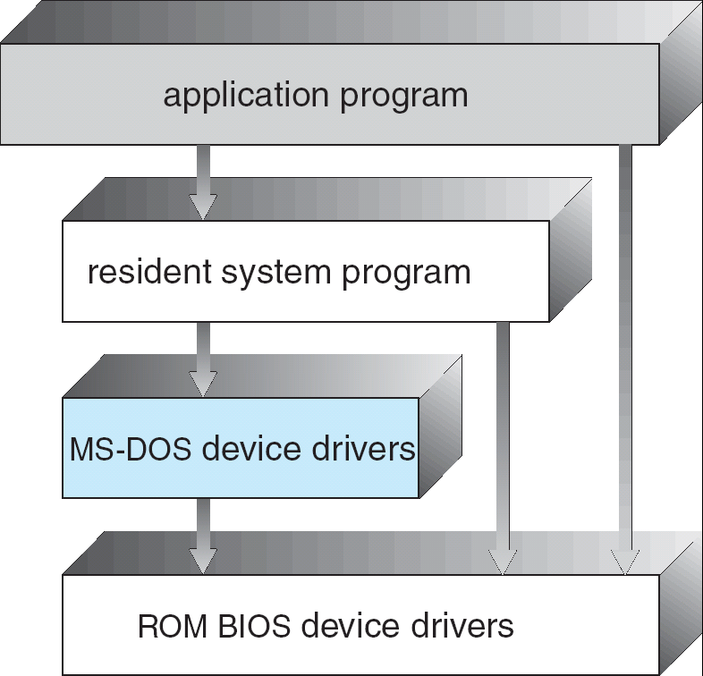
Simple Structure
All aspects of the OS linked together in one binary
APIs not carefully designed (and/or lots of global variables)
Interfaces and levels of functionality not well separated
No address protection
Example: MS-DOS
provide the most functionality in the least space
Made sense in early days of personal computers with limited processors (e.g. 6502)
Advantages?
Low memory footprint
Disadvantages?
Very fragile, no enforcement of structure/boundaries

Slide 29
Layered Structure
Operating system is divided many layers (levels)
Each built on top of lower layers
Bottom layer (layer 0) is hardware
Highest layer (layer N) is the user interface
Each layer uses functions (operations) and services of only lower-level layers
Advantage: modularity ⇒ Easier debugging/Maintenance
Not always possible: Does process scheduler lie above or below virtual memory layer?
Need to reschedule processor while waiting for paging
May need to page in information about tasks
Important: Machine-dependent vs independent layers
Easier migration between platforms
Easier evolution of hardware platform

Slide 30
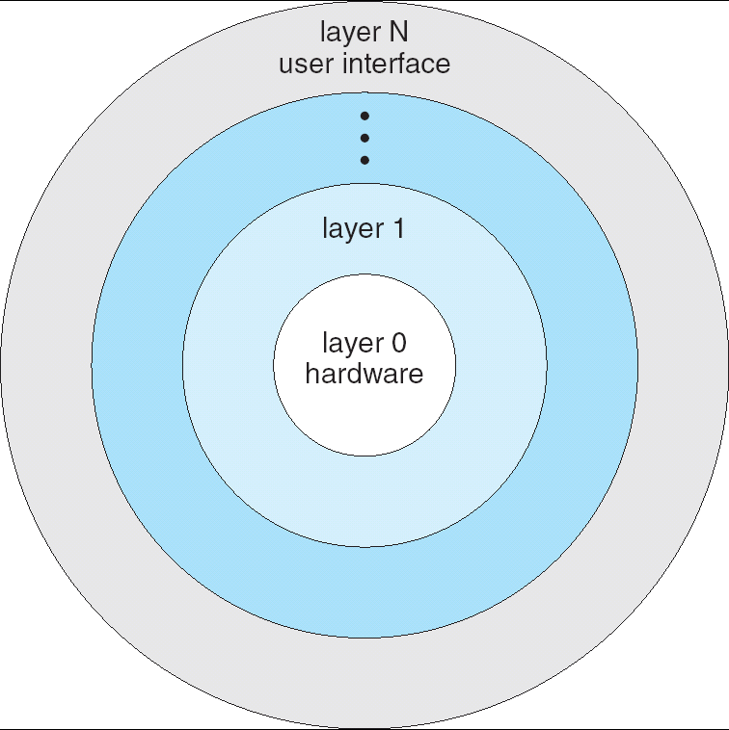
Layered Operating System

Slide 31
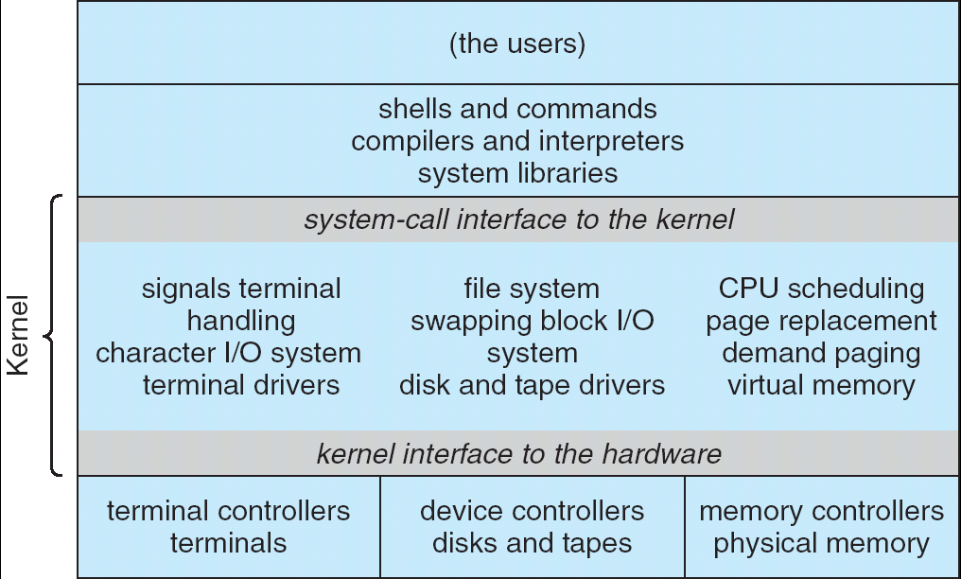
Monolithic Structure: UNIX System Structure
Applications
User Mode
Standard Libs
Kernel Mode
Hardware
Two-Layered Structure: User vs Kernel
All code representing protection and management of resources placed in same address space
Compromise of one component can compromise whole OS
Clear division of labor?
The producer of the OS and the User of the OS

Slide 32
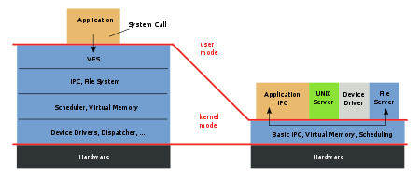
Microkernel Structure
Figure ©Wikipedia
Monolithic
Kernel
Microkernel
Moves functionality from the kernel into “user” space
Small core OS running at kernel level
OS Services built from many independent user-level processes
Communication between modules with message passing
Benefits:
Easier to extend a microkernel
Easier to port OS to new architectures
More reliable (less code is running in kernel mode)
Fault Isolation (parts of kernel protected from other parts)
More secure
Detriments:
Performance overhead can be severe for naïve implementation

Slide 33
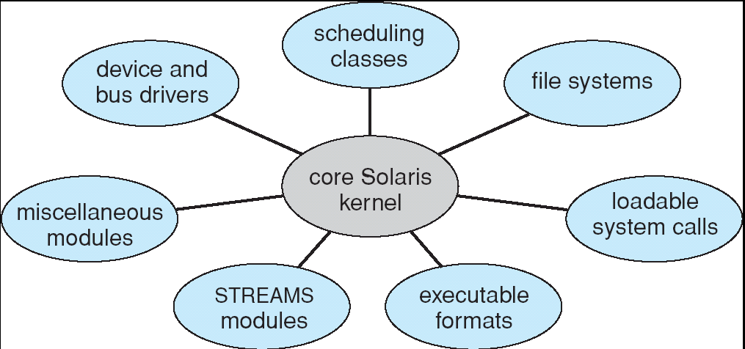
Modules-based Structure
Most modern operating systems implement modules
Uses object-oriented approach
careful API design/Few if any global variables
Each core component is separate
Each talks to the others over known interfaces
Each is loadable as needed within the kernel
Overall, similar to layers but with more flexible
May or may not utilize hardware enforcement

Slide 34
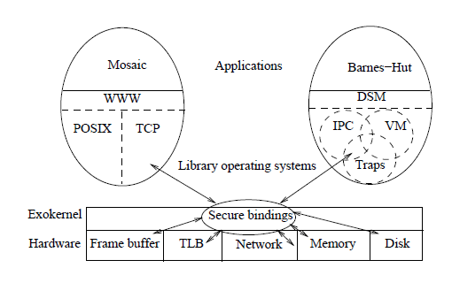
ExoKernel: Separate Protection from Management
Thin layer exports hardware resources directly to users
As little abstraction as possible
Secure Protection and Multiplexing of resources
LibraryOS: traditional OS functionality at User-Level
Customize resource management for every application
Is this a practical approach?
Very low-level abstraction layer
Need extremely specialized skills to develop LibraryOS

Slide 35
Separating Security from Management
Secure bindings – securely bind machine resources
Visible revocation – allow libOSes to participate in resource revocation
Abort protocol – break bindings of uncooperative libOSes

Slide 36
Secure Bindings
Decouple authorization from use
Authorization performed at bind time
Protection checks are simple operations performed by the kernel
Allows protection without understanding
Operationally – set of primitives needed for applications to express protection checks

Slide 37
Secure Bindings Techniques
Hardware: TLB entry, Packet Filters
Software caching: Software TLB stores
Downloaded Code: invoked on every resource access or event to determine ownership and kernel actions

Slide 38
Downloaded Code Example: (DPF) Downloaded Packet Filter
Eliminates kernel crossings
Can execute when application is not scheduled
Written in a type safe language and compiled at runtime for security
Uses Application-specific Safe Handlers which can initiate a message to reduce round trip latency

Slide 39
Visible Resource Revocation
Traditionally resources revoked invisibly
Allows libOSes to guide de-allocation and have knowledge of available resources – ie: can choose own ‘victim page’
Places workload on the libOS to organize resource lists

Slide 40
Abort Protocol
Forced resource revocation
Uses ‘repossession vector’
Raises a repossession exception
Possible relocation depending on state of resource

Slide 41
Aegis and ExOS
Aegis exports the processor, physical memory, TLB, exceptions, interrupts and a packet filter system
ExOS implements processes, virtual memory, user-level exceptions, interprocess abstractions and some network protocols
Only used for experimentation

Slide 42
Aegis Implementation Overview
Multiplexes the processor
Dispatches Exceptions
Translates addresses
Transfers control between address spaces
Multiplexes the network

Slide 43
Processor Time Slices
CPU represented as a linear vector of time slices
Round robin scheduling
Position in the vector
Timer interrupts denote beginning and end of time slices and is handled like an exception

Slide 44
Aegis Exceptions
All hardware exceptions passed to applications
Save scratch registers into ‘save area’ using physical addresses
Load exception program counter, last virtual address where translation failed and the cause of the exception
Jumps to application specified program counter where execution resumes

Slide 45
Address Translation
Bootstrapping through ‘guaranteed mapping’
Virtual addresses separated into two segments: (1) Normal data and code (2) Page tables and exception code

Slide 46
TLB Misses
Check which segment: if standard user then dispatch to application - otherwise check if guaranteed mapping to forward
Look up virtual address in page table
Check given capability corresponds to access rights requested
If allowed then construct TLB entry with associated capability and invoke system routine
If not allowed then raise exception (‘segment fault’)
TLB entries are cached in a STLB to absorb capacity

Slide 47
Protected Control Transfer
Changes program counter to value in the callee
Asynchronous calling process donates remainder of time slice to callee’s process environment – Synchronous calls donate all remaining time slices
Installs callee’s processor context (address-context identifier, address-space tag, processor status word)
Transfer is atomic to processes
Aegis will not overwrite application visible registers

Slide 48
Dynamic Packet Filter (DPF)
Message demultiplexing determines which application a message should be delivered to
Dynamic code generation is performed by VCODE
Generates one executable instruction in 10 instructions

Slide 49
ExOS: A Library Operating System
Manages operating system abstractions at the application level within the address space of the application using it
System calls can perform as fast as procedure calls

Slide 50
IPC Abstractions
Pipes in ExOS use a shared memory circular buffer
Pipe’ uses inline read and write calls
Shm shows times of two processes to ‘ping-pong’ – simulated on Ultrix using signals
Lrpc is single threaded, does not check permissions and assumes a single function is of interest

Slide 51
Application-level Virtual Memory
Does not handle swapping
Page tables are implemented as a linear vector
Provides aliasing, sharing, enabling disabling caching on a per page basis, specific page-allocation and DMA

Slide 52
Application-Specific Safe Handlers (ASH)
Downloaded into the kernel
Made safe by code inspection, sandboxing
Executes on message arrival
Decouples latency critical operations such as message reply from scheduling of processes

