Slide 1
What is Docker
The world’s leading software containerization platform.

Slide 2
What is Docker
Overview
Platform

Slide 3
Overview
Docker is the company driving the container movement
True independence between applications and infrastructure and developers and IT ops

Slide 4
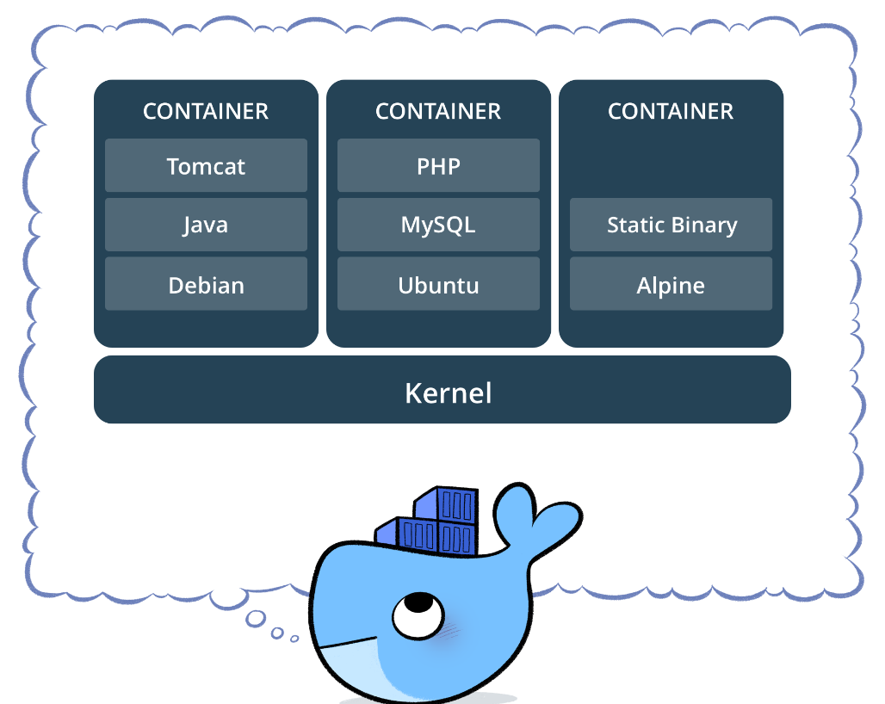
Container
container image
a lightweight, stand-alone, executable package of a piece of software that includes everything needed to run it: code, runtime, system tools, system libraries, settings.
isolate software from its surrounding.

Slide 5
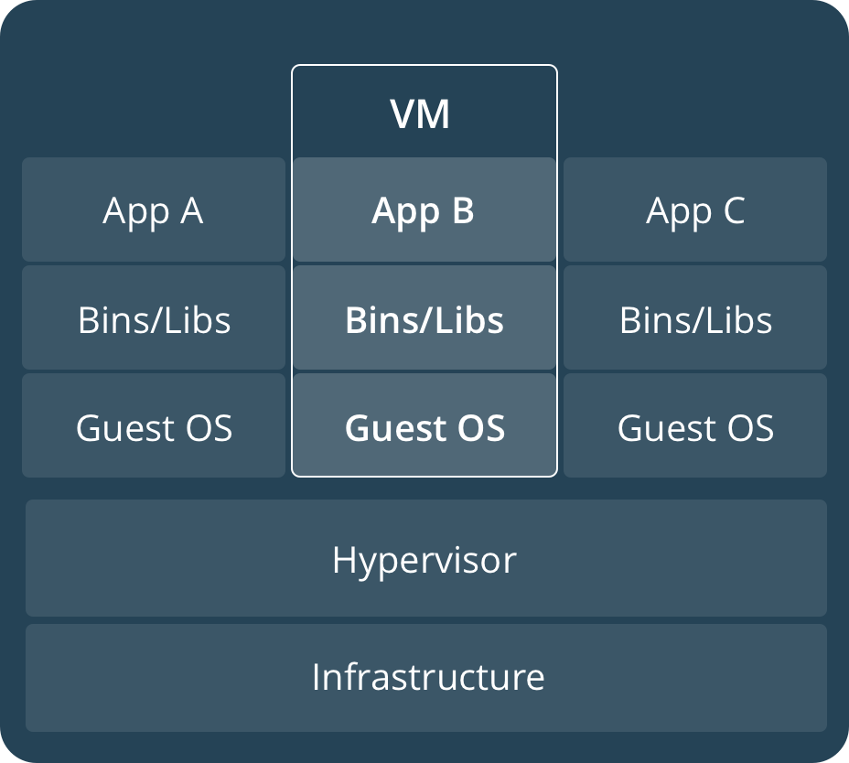
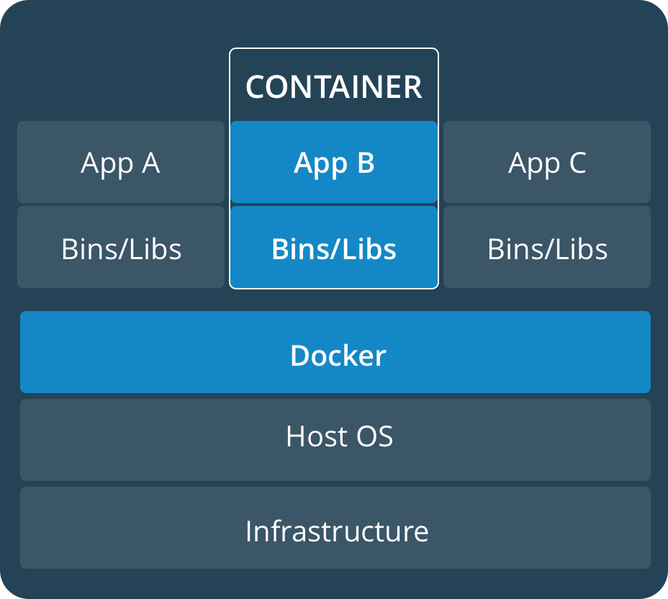
Container
Containers are an abstraction at the app layer that packages code and dependencies together
Virtual machines (VMs) are an abstraction of physical hardware turning one server into many servers

Slide 6
Platform
Docker Community Edition [CE] empowers developers with tools to build applications
Docker Enterprise Edition [EE] provides IT with multi-architecture operations at scale

Slide 7
Get Docker

Slide 8
Get Docker
Desktops
Cloud Providers
Servers

Slide 9
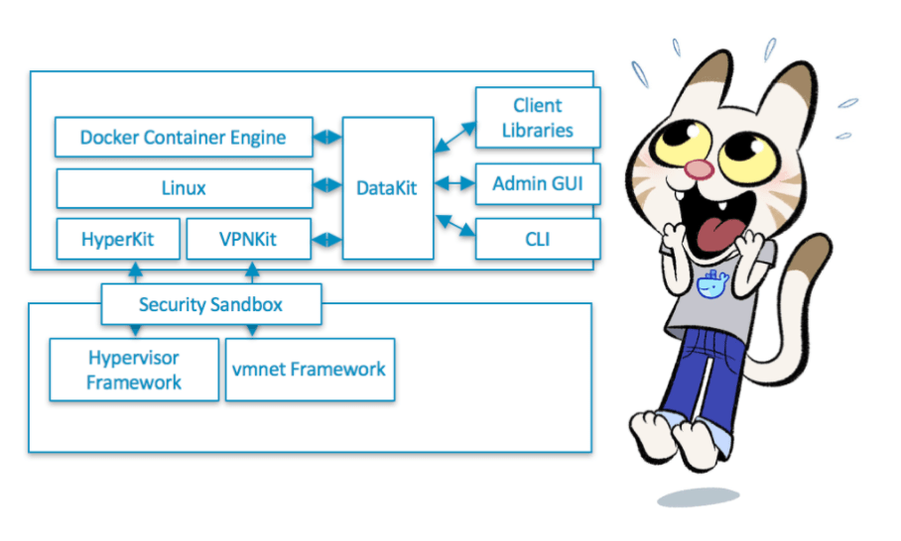
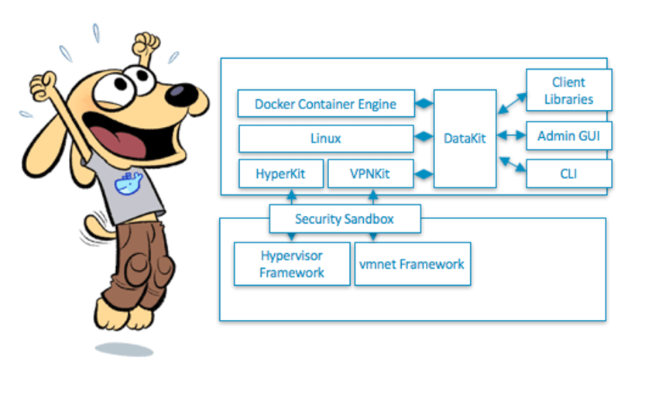
Desktops
Mac
Windows

Slide 10
Cloud Providers
Amazon EC2
Azure
1. Create web app on Linux + MySQL
2. Deploy image with Azure Cloud Shell
https://docs.microsoft.com/en-us/azure/cloud-shell/quickstart
az account set --subscription antps10
https://docs.microsoft.com/en-us/cli/azure/webapp/config/container?view=azure-cli-latest#az_webapp_config_container_set
az webapp config container set --name
--resource-group
[--docker-custom-image-name]

Slide 11
Cloud Providers - Azure
3. Configure application settings
a. WEBSITES_ENABLE_APP_SERVICE_STORAGE = true
b. DATABASE_TYPE = local
i. Enable local mariadb and create default phpMyAdmin user
4. Create database “wordpress” with phpMyAdmin(Pic 1)
a. http://dockerapm100902.azurewebsites.net/phpmyadmin
b. User/password: phpmyadmin/MS173m_QN
5. Connect ssh host and download wordpress
a. https://dockerapm100902.scm.azurewebsites.net/webssh/host
b. cd /home/site/wwwroot
c. apt-get update && apt-get install -y wget
d. wget https://wordpress.org/latest.tar.gz
&& tar -zxvf latest.tar.gz –strip-components=1

Slide 12
Servers
Windows Server
CentOS
Ubuntu…

Slide 13
Install Docker CE Ubuntu
Install Docker
#add gpg key
curl -fsSL https://download.docker.com/linux/ubuntu/gpg | sudo apt-key add -
#add repository
sudo add-apt-repository "deb [arch=amd64] https://download.docker.com/linux/ubuntu `lsb_release -cs` stable"
#resynchronize the package index files from their sources
sudo apt-get update
#install docker
sudo apt-get install -y docker-ce
#verify docker
docker version
#add docker to current user group, omit sudo
sudo usermod -aG docker ${USER}

Slide 14
Docker Documentation
Docker provides a way to run applications securely isolated in a container, packaged with all its dependencies and libraries.

Slide 15
Editions
Community Edition (CE)
developers and small teams looking to get started with Docker and experimenting with container-based apps
Enterprise Edition (EE)True independence between applications and infrastructure and developers and IT ops

Slide 16
Get started
Orientation and setup
An image is a lightweight, stand-alone, executable package that includes everything needed to run a piece of software, including the code, a runtime, libraries, environment variables, and config files.
A container is a runtime instance of an image—what the image becomes in memory when actually executed.

Slide 17
Common Command
https://docs.docker.com/engine/reference/run/
Sample
docker --help
docker build -t songgs/apache-php-mysql:20m .
docker run -d -p 8080:80 -u 0:0 --name wplocal -v /var/LWASFiles/Sites/new2/home:/home -e PORT="80" appsvc/apps:wordpress
docker exec -it containerid bash
docker push songgs/apache-php-mysql:20m
docker rmi –f $(docker images -q -f dangling=true)
docker rm -f $(docker ps -aq -f status=exited)

Slide 18
Common Command
docker login --username=yourhubusername --email=youremail@company.com
docker build -t songgs/apache-php-mysql:20m .
Docker run -t -p 80:80 songgs/apache-php-mysql:20m
Docker exec -it containerid bash
docker push songgs/apache-php-mysql:20m
Docker rmi $(docker images -q -f dangling=true)
Docker rmi imageiddo
docker rm -v $(docker ps -aq -f status=exited)
Docker run -d -p 8080:80 -u 0:0 --name wplocal -v /var/LWASFiles/Sites/new2/home:/home -e PORT="80" appsvc/apps:wordpress

Slide 19
Referrence
中文版
https://yeasy.gitbooks.io/docker_practice/content/install/ubuntu.html
Commandline
https://docs.docker.com/engine/reference/commandline/cp/
Docker and azure linux
https://docs.microsoft.com/en-us/azure/app-service-web/app-service-linux-faq
Support ssh for image on azure
https://docs.microsoft.com/en-us/azure/app-service-web/app-service-linux-ssh-support
Install OS:ubuntu16.04
https://www.digitalocean.com/community/tutorials/how-to-install-and-use-docker-on-ubuntu-16-04

Slide 20
Referrence
https://dzone.com/articles/5-docker-utilities-you-should-know
Docker-machine vs docker compose vs swarm
https://blog.docker.com/2015/02/orchestrating-docker-with-machine-swarm-and-compose/
Docker machine
https://docs.docker.com/machine/install-machine/#installing-machine-directly
Install virtual box 5.0
https://tecadmin.net/install-oracle-virtualbox-on-ubuntu/
Compose
https://docs.docker.com/compose/overview/
Swarm
https://docs.docker.com/engine/swarm/key-concepts/
https://docs.docker.com/engine/swarm/swarm-tutorial/create-swarm/

Slide 21
Thanks

