Slide 1

ML Prediction as a Service
IMAGE CLASSIFICATION
hAN bao

Slide 2



Test Strategy
Functional Testing. Eg: HTTP Status code, response payload, different scenario and flow etc..
Load testing with Locust, Usability testing
Security and Authentication

Slide 3
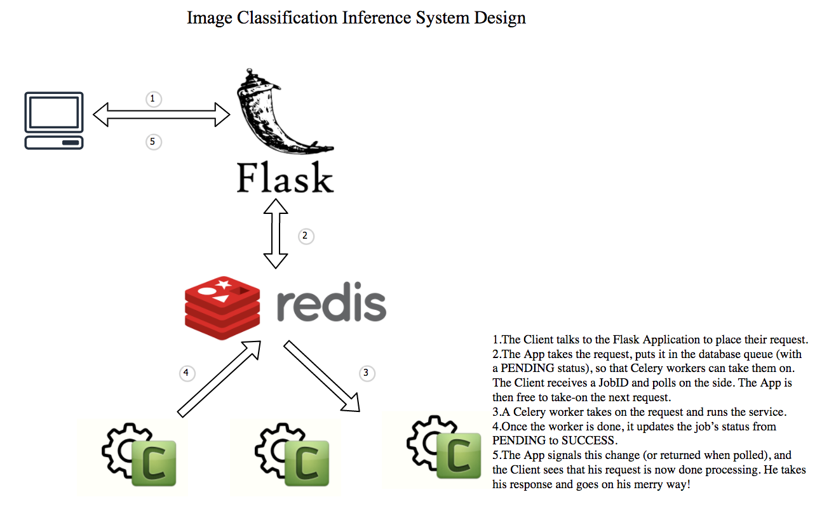
System architecture

Slide 4
Scalability and performance metrics
Scalability Metrics:
The ability of the application to respond to all requests even if it becomes very popular and the number of users and requests goes up exponentially
The ability of the web framework to accept more features when you come up with new ones.
Then we use load balancer, cache and database to help with the scalability. Use celery with the asynchronous as example:
The big feature with Celery is that it is asynchronous. More workers can always be added to listen on the queue and do the work in parallel if the tasks are taking too long. Celery allows for many, many long-running tasks to run at the same time.
For this reason, Celery helps make systems more robust and supports high availability and horizontal scaling
Performance metrics in web server level:
Use tools like Locus to help with performance testing, metrics are as below:
The average number of sustained requests, errors and latencies were provided
High CPU and memory usage

Slide 5

future CONSIDERATION
Service Testing
Performance testing
Celery
Redis QUEUE
Scalability
Functional testing
Security and authentication

Slide 6
Thank You!

