Slide 1

PFC SONG, JONGBEEN
HHB S6 25B
2026.11.12.

Slide 2
Places
Dongducheon
Goyang
Namyangju
Seoul
Torrance, CA

Slide 3
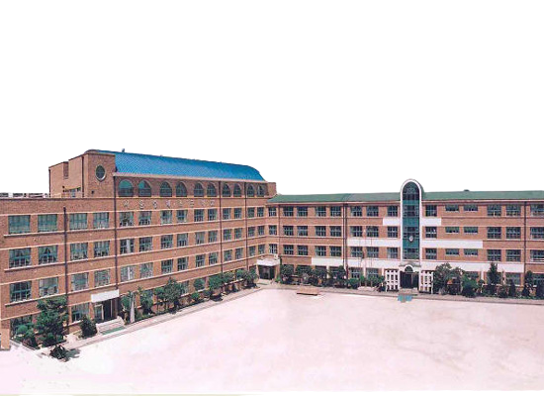


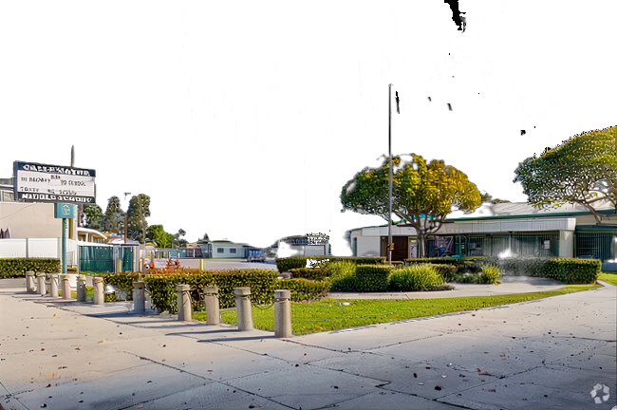



Education
Sungnye Elementary School, Seoul
From 2008 to 2013
Calle Mayor Middle School, Torrance, CA
From 2013 to 2014
Seoul National University Middle School, Seoul
From 2014 to 2016

Slide 4
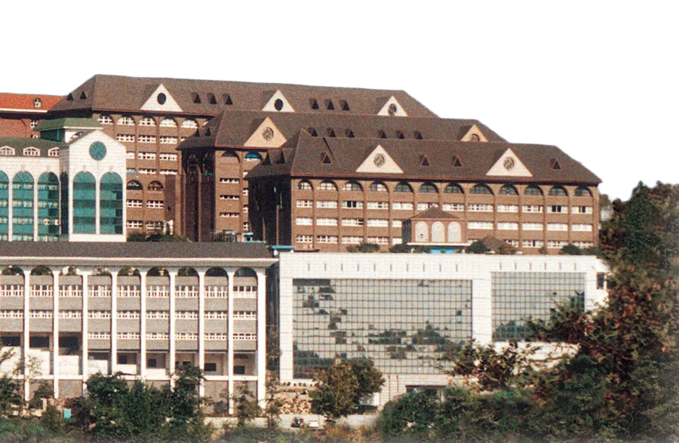

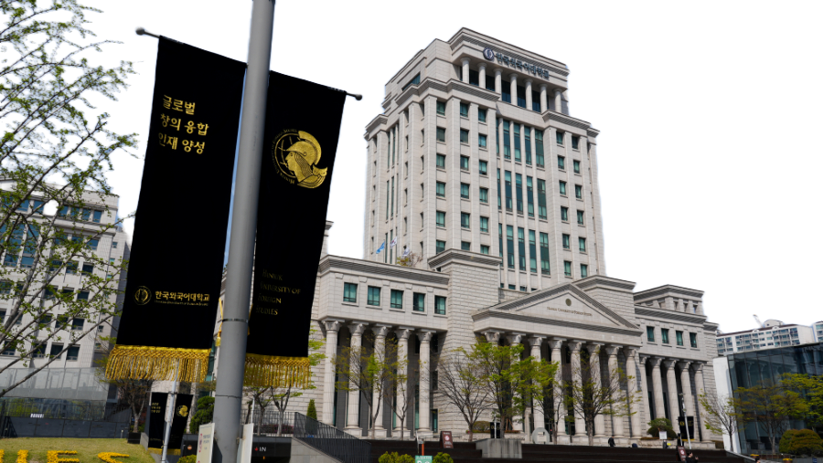
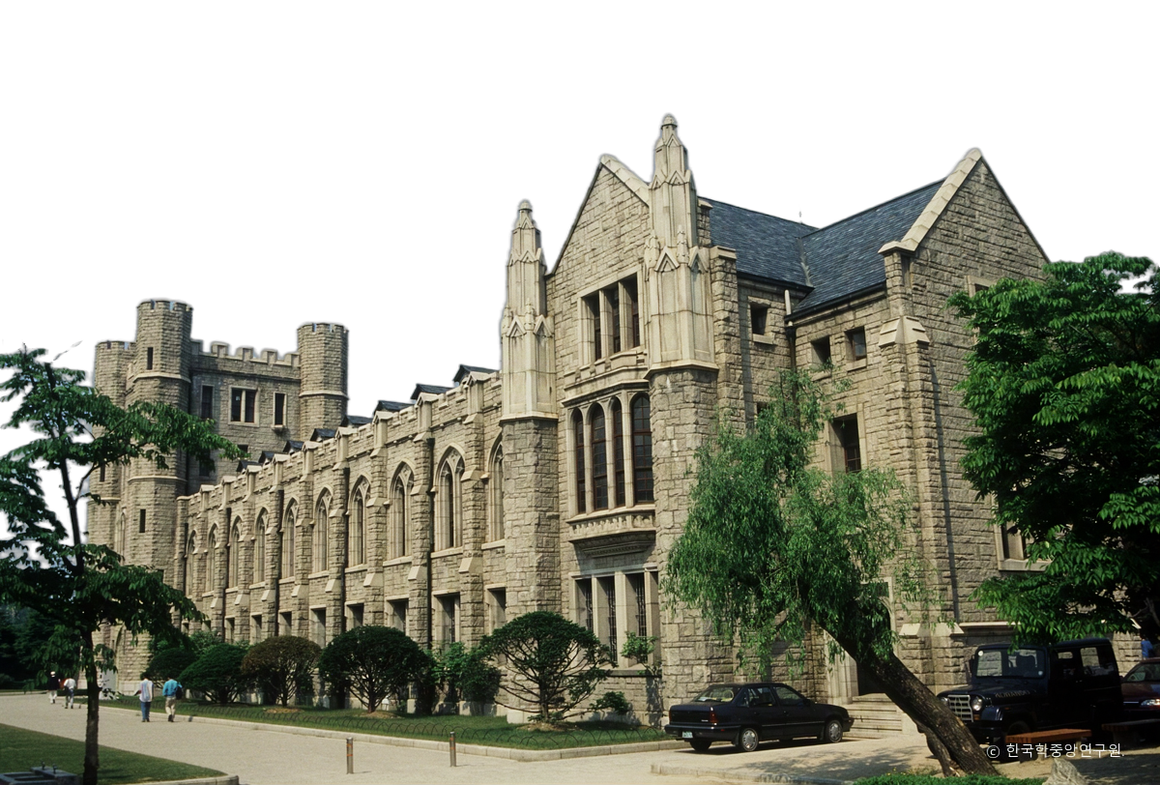
Education
Daeil Foreign Language High School, Seoul
From 2017 to 2019
1st Major: English / 2nd Major: Spanish
Hankuk University of Foreign Studies, Seoul
From 2020 to 2024
BLS in English Linguistics & Language Technology
BE in Computer & Electronic Systems Engineering
Korea University, Seoul
From 2025
MA in Science & Technology Studies (3rd Semester)

Slide 5




Career Experience
Megastudy, Seoul
From Mar. 2020 to Jul. 2022
Head Director at SON Social-Culture Research Center
YTN, Seoul
From May. 2020 to Aug. 2023
Intern at Department of Media Business
KIDICO, Seoul
From Jul. 2022 to Dec. 2022
Assistant Researcher at Bio/Medical AI Team
Letsur, Seoul
From Jun. 2024 to Dec. 2024
Researcher/Developer at AI Team

Slide 6



Research Experience
HCNLP, Hankuk University of Foreign Studies, Seoul
From Jun. 2023 to Nov. 2023
Undergraduate Research under Prof. Juae Kim
DAVIAN, KAIST, Seongnam
From Jun. 2024 to Dec. 2024
Undergraduate Research under Prof. Jaegul Choo
AIBL Lab, Korea University, Seoul
From . Mar. 2025
Full-time Research under Prof. Kihwan Nam

Slide 7


National Projects
With Ministry of Science and ICT
From Jul. 2022 to Dec. 2022
AI Customized Professional Training for the Activation of the Bio-Health Industry
With National Institute of Korean Language
From Jun. 2025 to Nov. 2025
Contextual Inference Corpus Enhancement

Slide 8
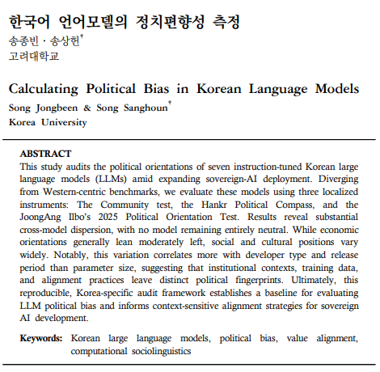
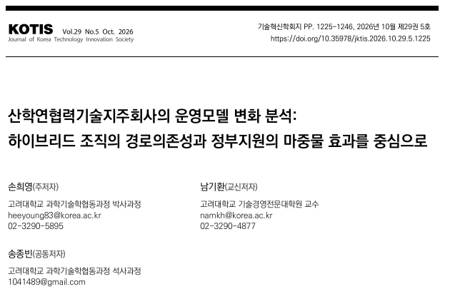
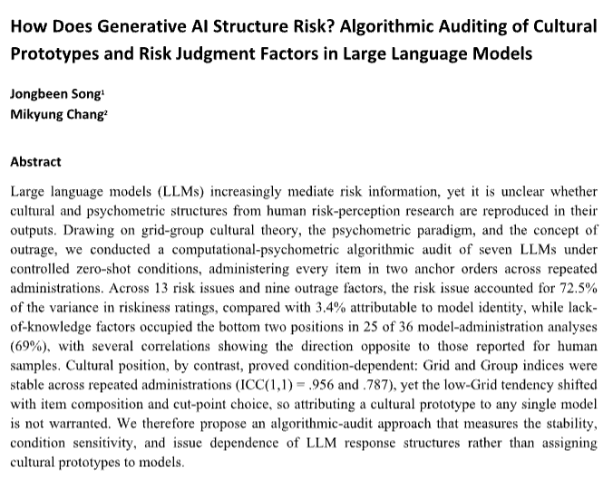
Publications
An Analysis of Changes in the Operating Models of University Technology Holding Companies:
Focusing on Path Dependence in Hybrid Organizations and the Seed Effect of Government Support
Journal of Korea Technology Innovation Society (KCI)
Son, Nam, and Song (2026)
How Does Generative AI Structure Risk?
Algorithmic Auditing of Cultural Prototypes and Risk Judgement Factors in Large Language Models
Social Science Computer Review (SSCI, SCIE & Scopus Q1)
Song & Chang (n.d.)
Calculating Political Bias in Korean LLMs
Language Research (KCI Q1)
Song & Song (2026)

Slide 9

Army Training
at Korea Army Training Center, Nonsan
From Aug. 2026 to Sep. 2026
ROKA version of Basic Combat Training including
(a) Rifle Marksmanship, (b) CBRN, (c) Individual Combat Tactics, (d) First Aid & CASEVAC, (e) Grenade, (f) Ruck March
at KATUSA Training Academy, Camp Humphreys
From Sep. 2026 to Oct. 2026
KATUSA version of Advanced Individual Training including
(a) American Language Course Placement Test, (b) English Language Test*, (c) Warrior Task Training**, (d) Army Fitness Test
* includes (a) courtesy, (b) abbreviation, (c) code of justice etc.
** includes (a) map reading, (b) CBRN, (c) CASEVAC, (d) rifle marksmanship etc.

Slide 10

Army Unit
2nd FA Bn Support Det,
1st KSC* Co,
KSC Battalion,
EUSA**,
ROKA Personnel Command
HHB S6,
RFAS,
3CR,
III Corps
* Korean Service Corps
** Eighth US Army

Slide 11
Thank you

