Slide 1
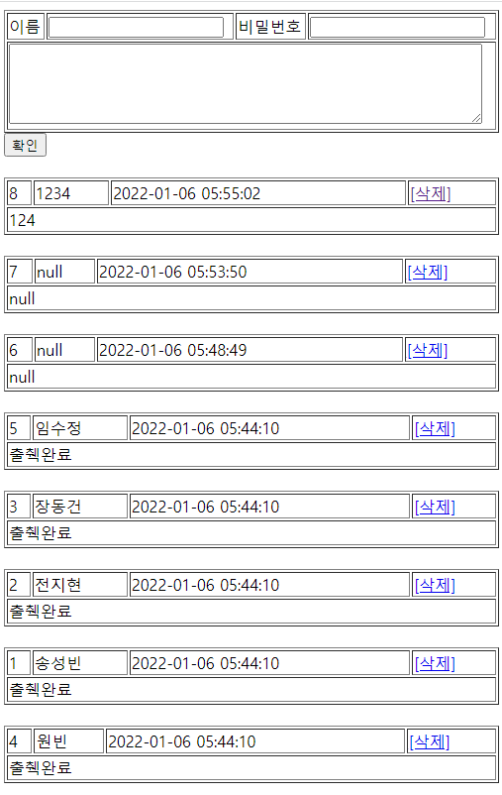
guestbook2 개요 및 분석
01
Rqeust(요청)
분석-리스트
Request header
파라미터: action=addList
Request body
Tomcat
phonebook2
http://localhost:8088/phonebook2/pbc?action
=addList
contoller(servlet)객체
guestbookDao 객체
rquest
addList일때
guestbookList
insert일때
delete일때
..
getList()
Response(응답)
response
Response header
Response body
(html)
*포워드
rquest
addList.jsp
객체
response
Rqeust(요청)
Request header
파라미터: action=addList
Request body
어트리뷰트: “gList”, guestbookList
DB
Response(응답)
Response header
Response body
(html)

Slide 2
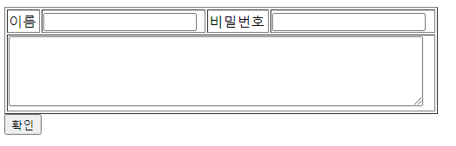
guestbook2 개요 및 분석
01
분석-삭제입력
http://localhost:8088/phonebook2/pbc?action=add
Tomcat
Rqeust(요청)
phonebook2
Request header
Request body
(파라미터)
Contoller(servlet)
객체
phoneDao 객체
rquest
add일때
GuestInsert()
response
리스트 요청
Response(응답)
Response header
Response body
(리다이렉트코드)
DB
http://localhost:8088/phonebook2/pbc?action=addList

Slide 3
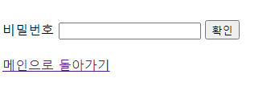
guestbook2 개요 및 분석
01
분석-삭제폼
Tomcat
Rqeust(요청)
phonebook2
Request header
Request body
Contoller(servlet)
객체
phoneDao 객체
deleteform일때
http://localhost:8088/phonebook2/pbc?action=deleteForm
rquest
deleteform
response
포워드
deleteForm.jsp
객체
Response(응답)
Response header
Response body
(html)
DB

Slide 4
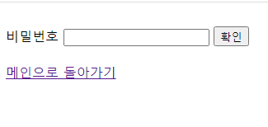
guestbook2 개요 및 분석
01
분석-삭제입력
http://localhost:8088/phonebook2/pbc
Rqeust(요청)
Tomcat
phonebook2
Request header
Request body
(파라미터)
Contoller(servlet)
객체
phoneDao 객체
rquest
delete일때
Guestbook
Delete()
response
리스트 요청
Response(응답)
Response header
Response body
(리다이렉트코드)
DB
http://localhost:8088/phonebook2/pbc?action=addList

