Slide 1
Training-Course Kaggle Dogs vs. Cats
2021/09/14

Slide 2
實驗設定
實驗測試
optimizer | SGD
learning rate | 0.01
batch size | 16
momentum | 0.9
weight decay | 0.001
training set size | 20000(0.8)
validation set size | 5000(0.2)
ResNet152 | highest validation accurse
原始的 | 0.871
修改輸入層64->256 | 0.953
修改輸入尺寸+凍結pretrain參數 | 0.977

Slide 3
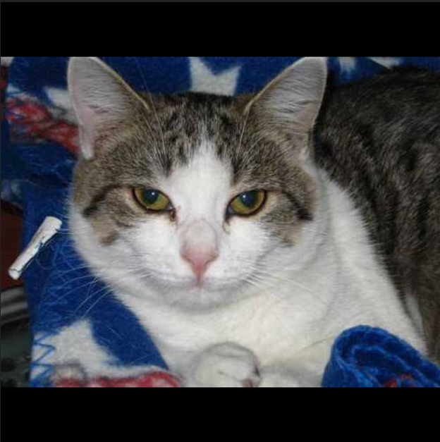
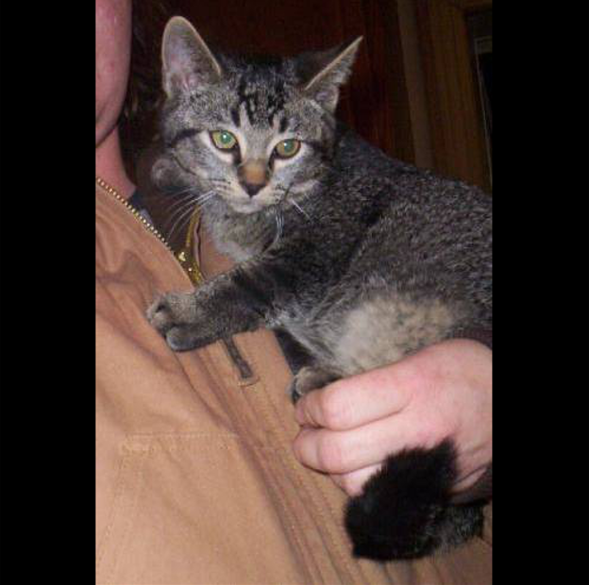
Image padding

Slide 4
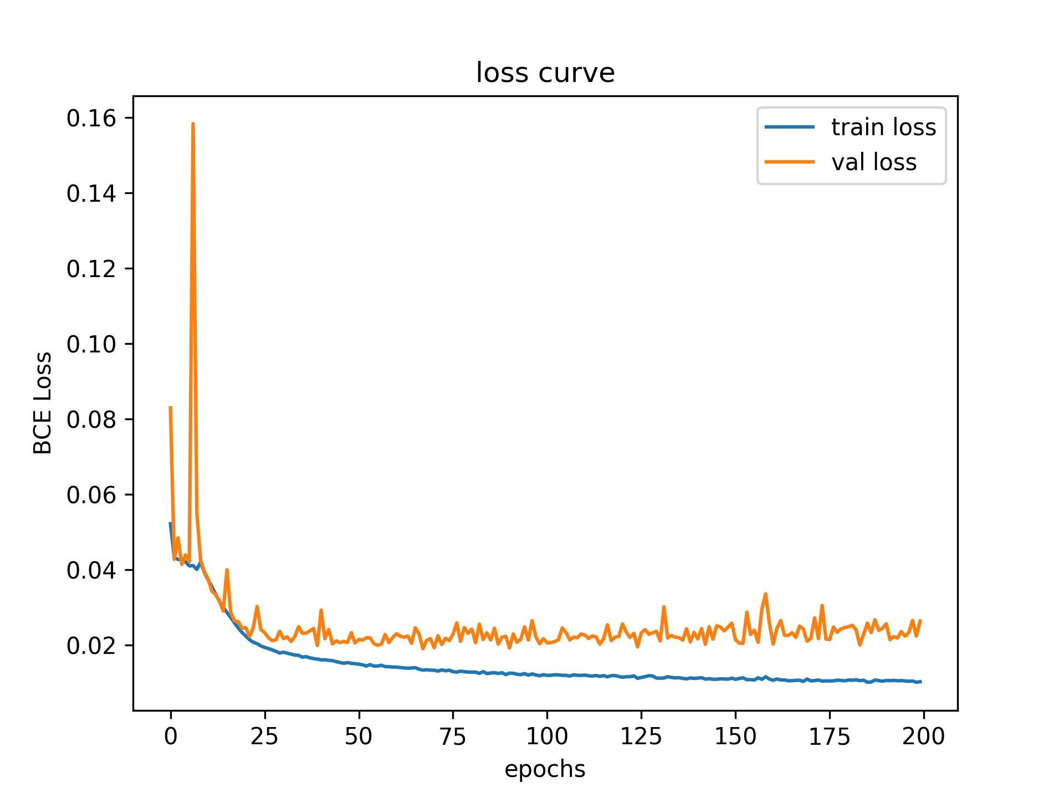
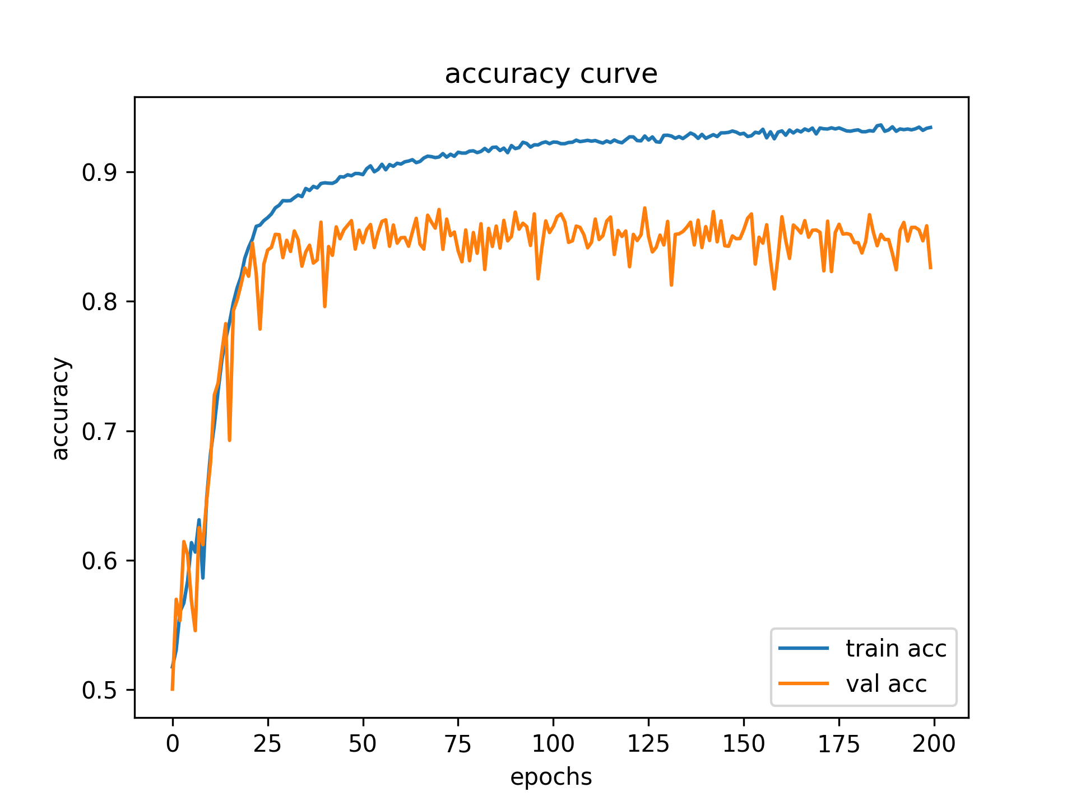
Training curve
原始的ResNet152

Slide 5
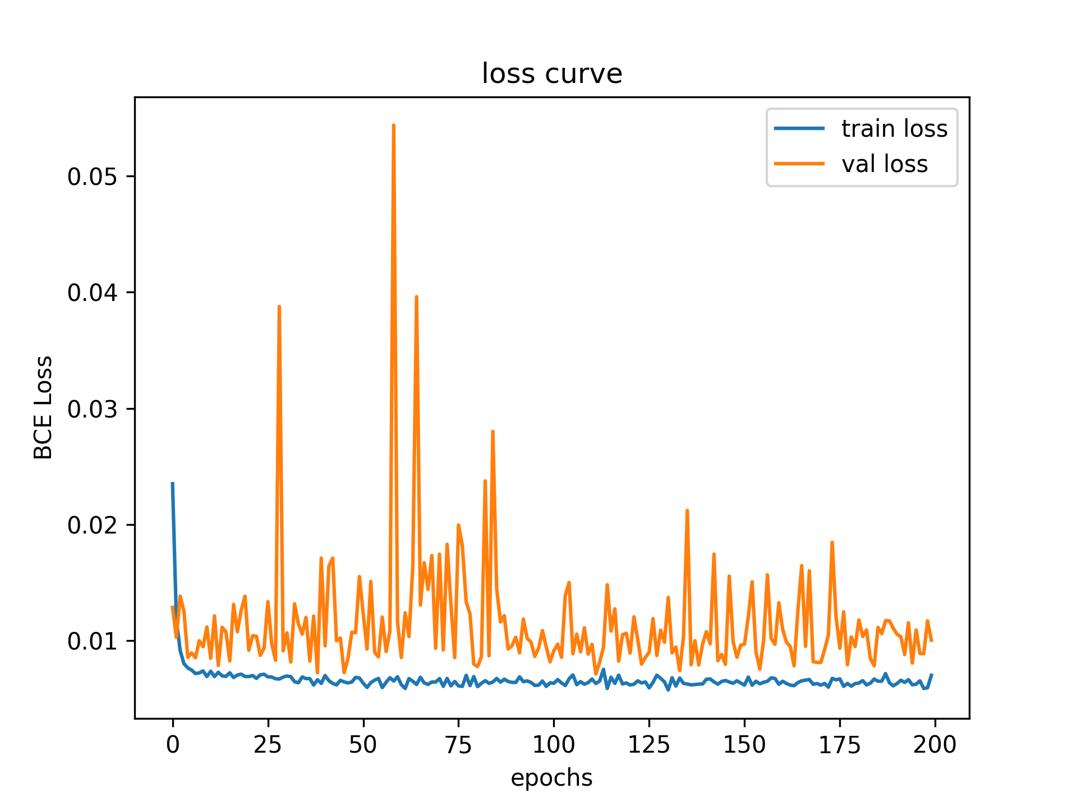
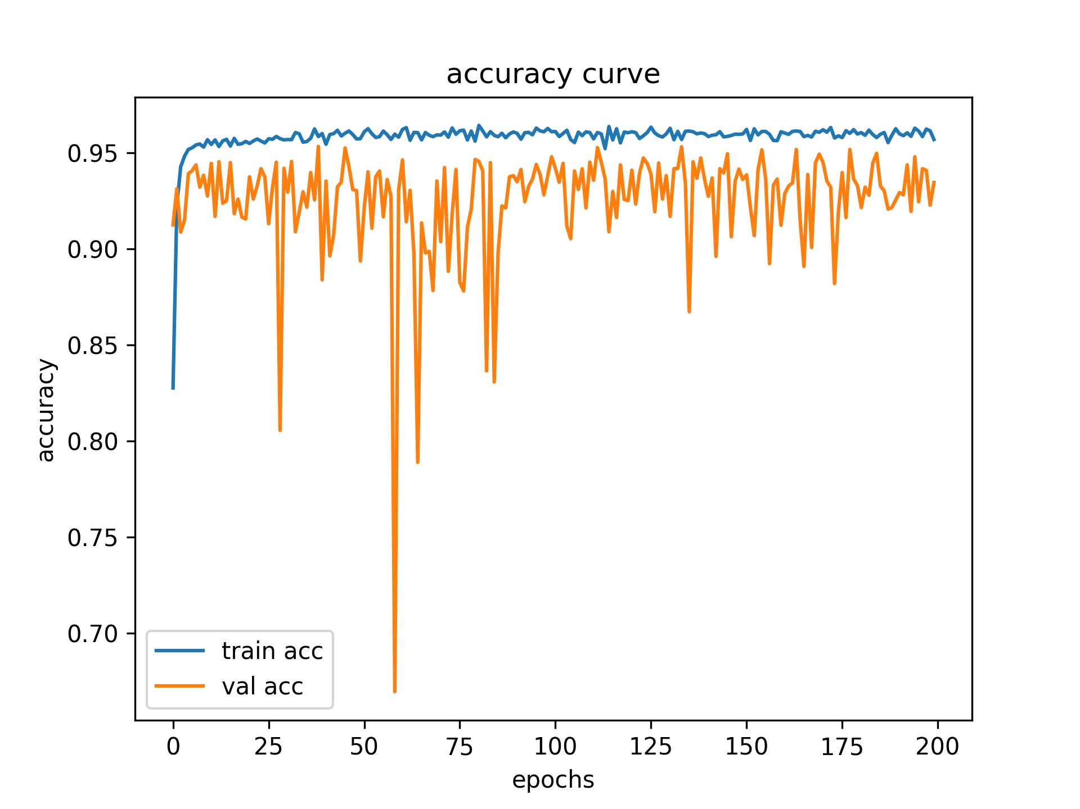
Training curve
ResNet152修改輸入尺寸64->256

Slide 6
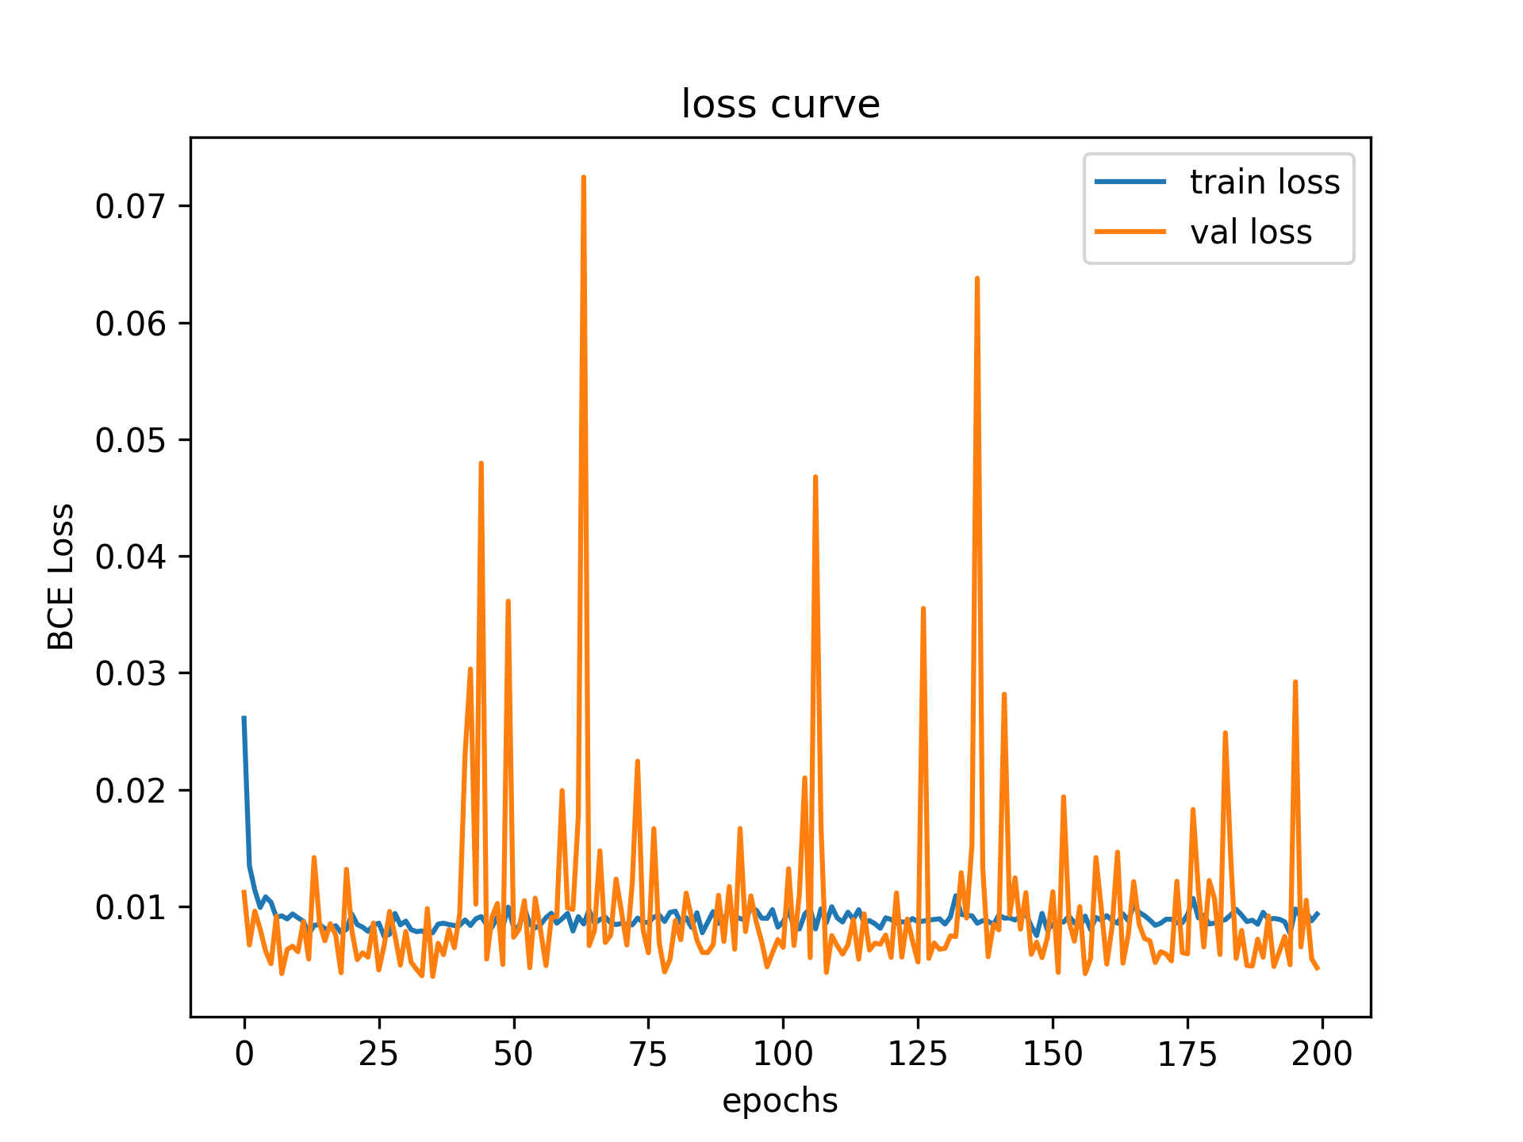
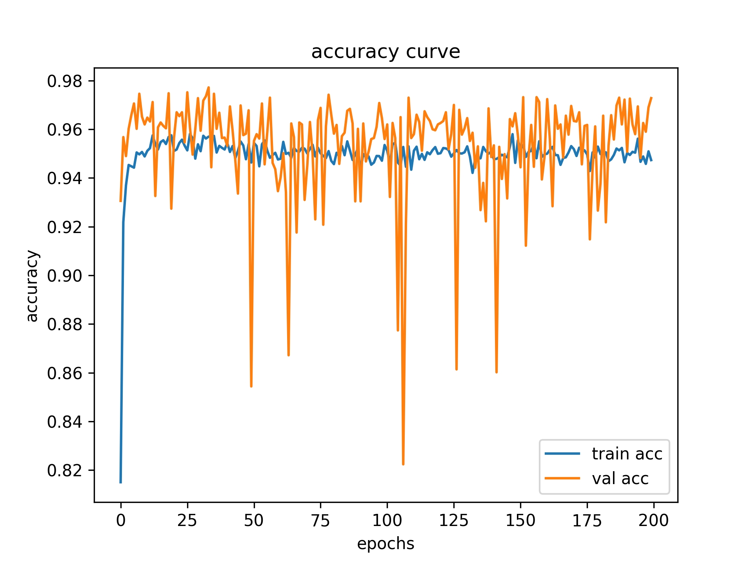
Training curve
ResNet152修改輸入尺寸+凍結pretrain參數

Slide 7
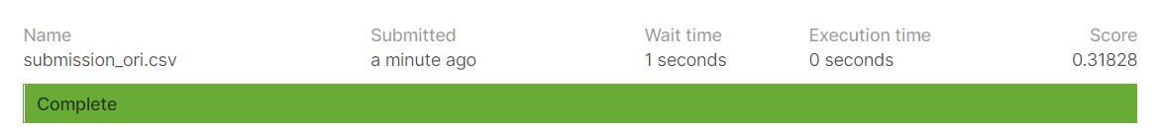
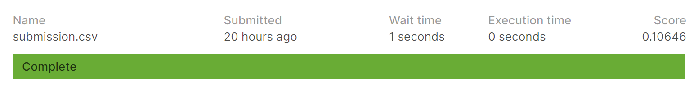
上傳分數

Slide 8
Reference
https://pytorch.org/tutorials/beginner/finetuning_torchvision_models_tutorial.html
https://pytorch.org/vision/stable/models.html
https://pytorch.org/docs/stable/optim.html
https://www.kaggle.com/c/dogs-vs-cats-redux-kernels-edition/leaderboard

