Slide 1
ID_BuildingType
Non-residential
IDs according to IWU classification
match of subsector-building type (and consequently, the share of building types within the subsectoral total) is based on FORECAST

Slide 2
Stock per building type [Scenario_Building]
Residential
directly from Census 2011 (on NUTS3)
linear interpolation from 2010 to 2020 using the growth rate per NUTS3 from BUILT-S (GHSL)
for differentiation of the growth rate per building type, use the dena gebäudereport 2022
we link building type and height: relation table (Relation_BuildingType_Height)
Non-residential
number of non-residential buildings on national level from IWU_NWG (2015)
built-up surface of NRES on hectare level from Global Human Settlement Layer (2023 release)
BUILT-S has (records at 5 year intervals from 1975-2030, at 100m resolution)
number of employees in NRES subsectors on NUTS2 level from Eurostat (2011)
floor area/employee assumptions per subsector from FORECAST
floor area share of building types within each subsector (FORECAST)
interpolate between 2010 (IWU data summing the before 1978 & 1978-2010) & 2015 at the level of NUTS2
NUTS2->NUTS3 approach based on BUILT-S for 2010
extrapolate to 2020

Slide 3
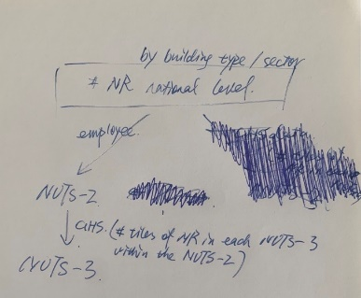
Stock per building type: Non-residential Buildings
number of non-residential buildings on national level from IWU (2022)
number of NRES buildings per NUTS3 region
built-up surface of NRES on hectare level from Global Human Settlement Layer [aggregated for NUTS3 regions]
floor area per employee according to subsector: from FORECAST
floor area/ subsector per NUTS2 region
number of employees in NRES subsectors on NUTS2 level from Eurostat
assumption on floor area/building for each building type: IWU
floor area/building type/subsector per NUTS2 region
number of buildings according tp type (from IWU)
number of buildings/subsector/building type per NUTS2 region
share of building types within each subsector (from FORECAST)
number of buildings/subsector/building type per NUTS3 region

Slide 4
Stock per location (degree of urbanization) [Scenario_Building_Location]
Residential
BuiltS and SMOD data → id_region and id_sector and id_location
Added id_building_type with Zensus data (Geb100m)
Tertiary
BuiltS and SMOD data → id_region and id_sector and id_location
Then, by assuming the tertiary building types distribute uniformly across locations, we added the column of id_building_type, when we add Zensus data for building types in residential
GHSL has projection until 2030, which can be used to understand the pace of urbanization. It would also be educated guess on the years following 2030.
GHSL-BUILT-S & GHS-SMOD: put the data dating back to 1975 in the Stock_Building_Location table
interpolate the 5-year in between the original data

Slide 5
Stock per construction period [Scenario_Building_ConstructionPeriod]
Residential
Census (on NUTS3-level) for 10 year periods: before 1919, 1919-1949, 1950-1959, 1960-1969, 1970-1979, 1980-1989, 1990-1999, 2000-2005, 2006 and later
allocation of construction period according to building type from IWU. (assumption to linearly divide Construction year category of 1861-1918 from IWU to before 1900, 1901-1910 and 1911-1920 to align with TABULA U-values.)
Combine Census and IWU construction years between <1860-1919 for the number of buildings in different building types
calculate fractions for building construction period 13 as of 2016: from IWU Datenerhebung 2016
shares differentiated between EZFH/MFH
shares differentiated between Nord, Süd, Ost
demolition not taken into account!
Non-residential
On national-level IWU/DENA (2022, pg. 19) periods: before 1859, 1860-1918, 1919-1948, 1949-1957, 1958-1968, 1969-1978, 1979-1983, 1984-1994, 1995-2001, 2002-2009, 2010-2014, after 2015
linearly allocate to each decade
Per 5 building types: dena 2023, pg. 12 Abb. 10 (IWU 2022): https://www.gebaeudeforum.de/wissen/zahlen-daten/gebaeudereport-2023/interaktive-diagramme/kapitel-1/
no distribution on NUTS3-level: national shares are assumed for each region

Slide 6
Stock per building size [Scenario_Building_Height]
Residential & Non-residential
GHSL BuiltS, BuiltC data matched with SMOD and aggregated on NUTS3-level
height of 1 storey is assumed and number of storeys are calculated

Slide 7
Ranges of height and unit number
Residential
number of units for each building type: min, max and mean (esp. types from 3-5)
height: min, max and mean from GHS
Non-residential
height: min, max and mean from GHS

Slide 8
Stock per building component [Scenario_BuildingComponent_Option]
Residential
IWU Datenbasis 2010, national
“91% der Gebäude besitzen ein Steildach, der Rest ein Flachdach.„
Non-residential
IWU report (E 4.2 - Teilbericht Strukturdaten), national
2015 survey
per 3 construction period ranges, per 2 subsector bulk

Slide 9
Buildings‘ Efficiency/Renovation [Scenario_BuildingComponent_Availability]
assigning the U-value to a component when the building is initialized
based on construction year + considering lifetime distribution of the component & assigning the latest year that the component is renovated
TODO: fill the table from TABULA component-specific U-value tables
action=2 (renovation) follows the new construction standards by 10 years behind
TODO: copy building type=1 values for all building types
how do we “ban„ below certain threshold efficiency classes? at which point? (at least in new buildings) → from FORECAST for new and retrofit & ~10 year lag for retrofit

Slide 10
Building Units [Scenario_Building_UnitArea]
Average floor area per unit
below are the approaches for national values. Do we need NUTS3/NUTS2/NUTS1-specification?
Residential:
average value = total floor area / total number of dwellings within building type from IWU data
we do construction period differentiation
there‘s also data from DENA gebäudereport 2016:
combining the two for the most detailed output
Non-residential:
assumption on floor area/building for each building type (IWU_NWG dataset)
we do construction period differentiation

Slide 11
Heating Systems and Technologies I: Residential [Scenario_HeatingSystem] and [Scenario_HeatingTechnology]
Based on Geb100m dataset, we connected id_building_location and id_heating_system
Census: 6 types (District heating, floor unit heater, CHP-local grid, central heating, single- or multiple-room ovens, no heating) on NUTS3 [NO INDICATION ON ENERGY CARRIER except DH]
Then, based on IWU (Datenerhebung 2016): id_heating_technology are linked to
id_building_type – Single-/Two-Family House, MFH [Tabelle 51]
id_construction_period – Altbauten bis Baujahr 1978, Baujahr 1979–2009, Neubauten ab Bau-jahr 2010 [Tabelle 52]
IWU (Datenerhebung 2016): share of heating system types/energy carriers in buildings whose main heat generator was retrofitted after 2010 (i.e. the age of heating is less than 6 years as of 2016.) → can be used for validation once the model assigned the building stock with corresponding heaters [Tabelle 55]
[Assumption_HeatingSystem_ConstructionPeriod] table: implement air/ground-source HP distribution according to market shares

Slide 12
Heating Systems and Technologies I: Tertiary [Scenario_HeatingSystem] and [Scenario_HeatingTechnology]
We need: Building-type-dependent heater data
Available data:
national non-residential buildings from building observatory: on building basis
building type-dependent from IWU: energy-related area basis
Assume: all central heating, just distinguish between energy carriers.

Slide 13
DH and Gas Infrastructure Availability [Scenario_Stock_Infrastructure_DistrictHeating / GasGrid]
Note: the stock is developed together with [Scenario_HeatingSystem] and [Scenario_HeatingTechnology], and this slide is only about availability.
Gas Infrastructure
Stella models gas distribution grids. Contact her
District Heating Infrastructure
PETA has estimation on possible grid extensions based on costs https://s-eenergies-open-data-euf.hub.arcgis.com/datasets/b62b8ad79f0e4ae38f032ad6aadb91a0_0/explore
https://fernwaerme-atlas.hawk.de/
Pia‘s dataset: existing DH connection from Census + can be matched with ID_location for the inital years→ in July Scenario-based expansion → mid-August

Slide 14
Radiators (Heizkörper) [Scenario_Stock_Technology_Radiator]
TODO: further research. what‘s relevant
monitoring/field study measurements that link radiator supply temperature to building load
study of radiator sizes within the building stock
outside temperature
building envelope
useful heating demand
radiator surface size
target indoor temperature
required supply temperature (decides if HP or low-temperature district heating is feasible)

Slide 15
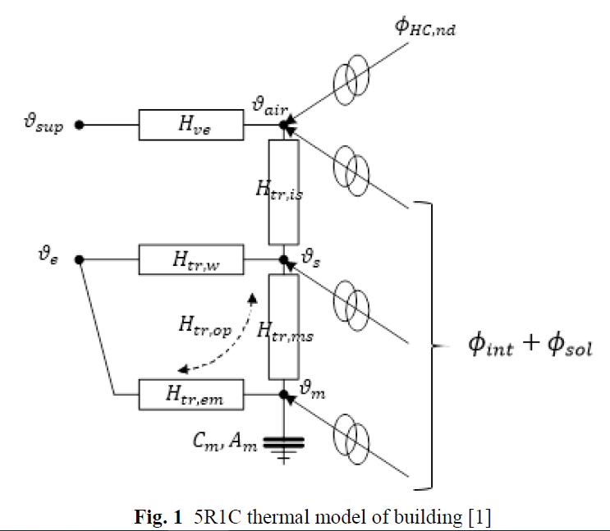
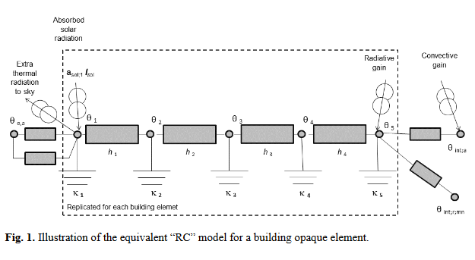
Hourly heating & cooling demand calculation
ISO 13790 (2008)
ISO 52016 (2018)
three-node method (5R1C)
FLEX, master thesis from Kamal
danger in overestimation due to low design load temperature & high internal temperature
The method reported in the standard is a review of the three-node method (5R1C) from EN ISO 13790. The main difference is that the construction elements are not aggregated to the concentrated parameters zone, instead they are considered separately.
Fh IEG in the “energy districts model„ - Kai George
Notes:
ISO 13790 (2008)
https://github.com/H2020-newTRENDs/FLEX/blob/master/flex_operation/model_base.py
https://newtrends2020.eu/wp-content/uploads/2022/12/newTRENDs_D5.2_Modeling-of-prosumagers-and-energy-communities-in-energy-demand-models.pdf
ISO 52016 (2018)
https://epb.center/support/documents/demo-en-iso-52016-1/
https://www.e3s-conferences.org/articles/e3sconf/pdf/2021/88/e3sconf_ati2021_06003.pdf
https://www.e3s-conferences.org/articles/e3sconf/pdf/2020/57/e3sconf_ati2020_02012.pdf

Slide 16
Heating & cooling demand calculation - function parameters [Parameter_Building_Envelope_ComponentArea/Orientation]
Residential Buildings
Non-Residential Buildings
Inputs such as area of building components that face different directions, thermal bridges etc. are needed
source 1: TABULA (& norm standard params), based on which we estimate the “factors” for different component areas
Inputs such as area of building components that face different directions, thermal bridges etc. are needed
source 1: IWU‘s working paper on non-residential building typologies in Germany (11 building types, typical values of outer wall area, av. heat transfer coefficient of outer wall etc.)
source 2: FORECAST (SIA norm, annual)
Notes:
https://datanwg.de/home/aktuelles/
https://www.researchgate.net/publication/364715234_Typologie_der_Nichtwohngebaude_in_Deutschland_-_Methodik_Anwendung_und_Ausblick#fullTextFileContent

Slide 17
Heating & cooling demand calculation – simulation management
hourly simulations can be managed smartly: if the hourly demand calculation is not needed at each run, they could be saved intermediately and the “down-stream„ part can be started directly with these intermediate results.

Slide 18
Heating System Costs
Cost curves from FORECAST:
Scenario_HeatCost_Parameter, Scenario_HeatCost_CountryIndex, Scenario_HeatCost_OM_Parameter
Cost curve equations are under file:///P:\FORECAST_Projects\Methodology%20FORECAST%20heating%20system%20cost%20calculation.docx file:///C:\Forecast4\elib\FORECAST%20description\TertiaryModel_Documentation_v2_inprogress.docx
CODE: The heating costs will be calculated and prepared in the scenario object, probably stored in a new class instead of render_dict.
Songmin prepares Parameter tables for cost curve parameters (such as m_share, e_share etc.)

Slide 19
Heating system efficiency
Heat System Efficiencies from FORECAST, to be confirmed/updated if necessary
Building_Eta
Stored in Scenario_Technology_Heater_EfficiencyCoefficient

Slide 20
PV/Solar thermal
IWU (Datenerhebung 2016): share of buildings; buildings constructed up to 1978, between 1979-2009, and after 2010; E-/ZFH and MFH buildings; buildings in north, south and east states that has solar thermal and/or PV [Tabelle 58]

Slide 21
Ventilation
IWU (Datenerhebung 2016): share of buildings; buildings constructed up to 1978, between 1979-2009, and after 2010; E-/ZFH and MFH buildings; that has ventilation with/without heat recovery [Tabelle 61]

