Slide 1

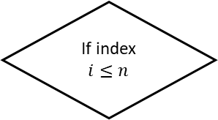
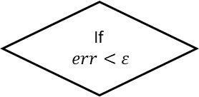
Start
Initializing starting point and sampling radius r and number of samples n
Shuffle
No
If index $i≤n$
Yes
Sampling n points along single direction within
$[x_{i}−r,x_{i}+r]$
Call Alamopy
Build surrogate model
Decrease r;
Increase n
No
Call Baron
Get optimal point
If
$err<ε$
Yes
Increase r;
Decrease n
Update optimal point
End
If
termination is satisfied
Yes
No

