Slide 1
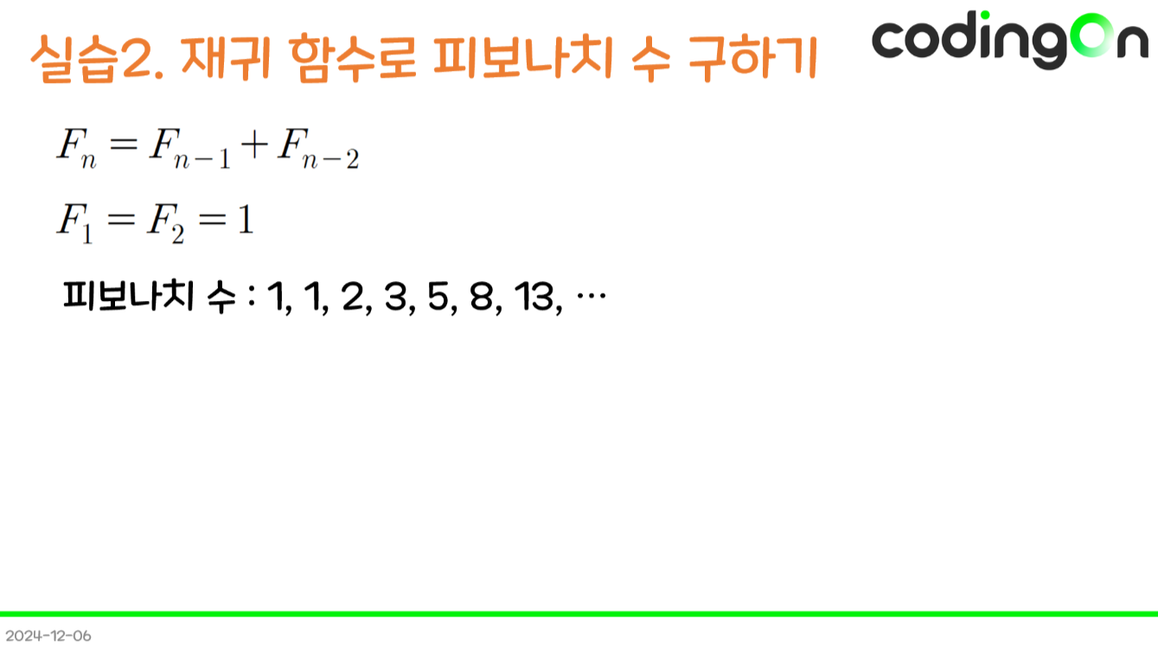

Slide 2
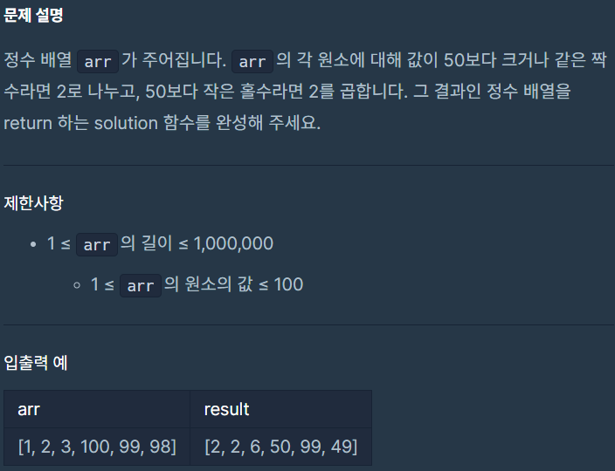
https://school.programmers.co.kr/learn/courses/30/lessons/181882

Slide 3
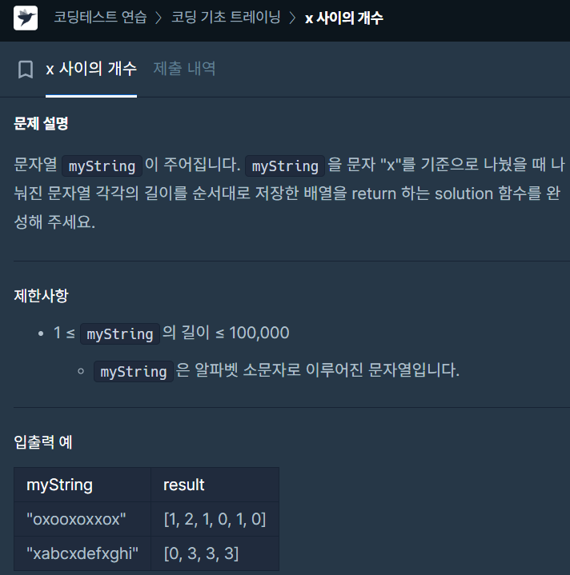
https://school.programmers.co.kr/learn/courses/30/lessons/181867

Slide 4
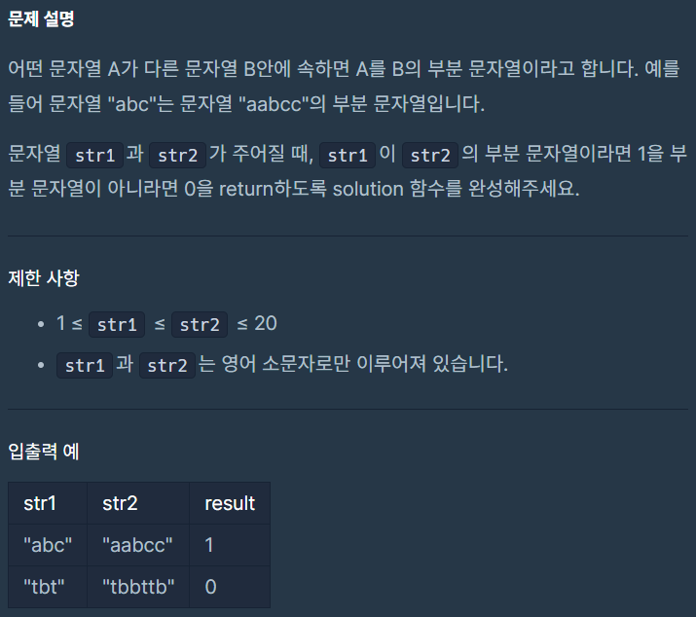
https://school.programmers.co.kr/learn/courses/30/lessons/181842

