Slide 1

Immigrant Assistance Tool Empowering Communities Through Mentorship and Resources
Songul Celik
December 5,2024

Slide 2
Introduction: Problem Statement
Introduction:
Immigrants face a multitude of challenges when transitioning to a new country, often making the experience overwhelming.
Key Challenges:
Language Barriers: These affect access to healthcare, employment opportunities, and day-to-day interactions.
Access to Resources: Immigrants often lack awareness of available resources like legal aid, childcare, or cultural programs.
Limited Social Support: Difficulty finding mentorship or guidance to integrate into new communities.
The Problem:
Without proper support, immigrants may experience isolation, reduced access to opportunities, and slower adaptation to their new environment.

Slide 3
The Solution : Immigrant Assistance Toolkit
Addressing the Challenges:
A centralized system designed to provide comprehensive support for immigrants, tackling the key barriers identified.
Key Features of the Toolkit:
Personalized Mentorship Matching: (Connects immigrants with mentors based on )
Language needs.
Professional expertise (e.g., career, cultural integration, legal, health support).
Personal goals and preferences.
Access to Curated Resource : (Location-specific resources categorized by)
Health.
Legal aid.
Childcare.
Education and cultural programs.
Goal Setting and Progress Tracking: (Enables immigrants to)
Define their short-term and long-term goals.
Log and monitor their progress in areas like language learning, career advancement, or cultural adaptation.
User-Friendly Interface
Easy navigation for both immigrants and mentors.
Modular and scalable system for future enhancements.
Notes:
The Immigrant Assistance Toolkit is our proposed solution to address these issues

Slide 4

Impact of Immigrant Assistance Toolkit
Empowers immigrants to overcome language barriers and access critical resources.
Promotes faster integration and community involvement.
Fosters inclusivity and strengthens immigrant-community relations.
Together, Stronger!

Slide 5
Technical Features and Architecture: General Structure
Our program design is structured around three core components:
Object-Oriented Programming (OOP) classes,
role-specific menus,
a centralized main menu.
This structure was deliberately chosen to achieve:
Modularity: Each component is responsible for a distinct functionality, making the program easy to maintain and extend.
User Role Customization: Tailored menus cater to the specific needs of immigrants, volunteers, and resource managers.
Scalability: New features, such as additional roles, can be added seamlessly without disrupting the existing system.
Efficiency: OOP ensures clean, reusable code, while the menu-driven interface keeps the program intuitive and easy to navigate.
This design strikes a balance between simplicity for users and complexity for developers, ensuring long-term usability

Slide 6
I. OOP
Our program uses Object-Oriented Programming (OOP) to organize core functionalities into reusable and scalable components. Here are the key classes:
Immigrant Class:
Manages user data like goals, progress logs, and mentor matching.
Provides methods for updating goals and tracking progress.
Volunteer Class (Base Class) and Subclasses:
Language Mentor, Career Mentor, Health Advisor, etc.
Store mentor expertise, availability, and language skills.
Subclasses represent different mentor types.
MentorManager Class:
Manages all mentors and handles mentor-immigrant matching.
Ensures immigrants are paired with mentors who align with their needs.
Resource Class:
Handles categorized resources (e.g., Health, Education, Legal) organized by location.
Supports searching and adding new resources dynamically.

Slide 7
UML Class Diagram
.
Immigrant Class
+ name: str + email: str + native_language: str + desired_language: str + location: str + goals: list + progress_log: list
+ update_progress(session_type: str, details: str): None + view_progress(): None + update_goals(new_goals: list): None | + __str__(): str
Volunteer class
+ name: str + email: str + expertise: str + available_languages: List[str] + availability: bool
+ set_availability(status: bool): None + __str__(): str
LanguageMentor(Volunteeer)
(inherits from Volunteer)
CareerMentor(Volunteer)
(inherits from Volunteer)
←-------------
◇________
HealthMentor(Volunteer)
(inherits from Volunteer)
Resources class
+ resource_db: dict
+ add_resource(location: str, category: str, name: str): None +search_resources_by_location(location: str): None +search_resources_by_category(location: str, category: str): None
Mentor Manager Class
+ mentors: list
+ add_mentor(mentor: Volunteer): None + find_mentor(immigrant: Immigrant, expertise: str): Volunteer + remove_mentor(mentor_email: str): bool + list_mentors(): None
CulturalIntegrationMentor(Volunteer)
(inherits from Volunteer)
LegalMentor(Volunteer)
(inherits from Volunteer)

Slide 8
II. Role-Specific Menus: Tailored Interactions for Users
Immigrant Menu
Allows immigrants to:
Set and update personal goals.
Request mentorship based on specific expertise.
Access resources tailored to their location and needs.
Track progress with detailed logs.
Focus: Simplified, user-centric navigation for achieving integration goals.
Volunteer Menu
Empowers volunteers to:
Log in or register as mentors with specific expertise.
Update availability status to accept new mentees.
View mentee details for effective mentoring.
Focus: Structured tools to help volunteers provide timely and impactful support.
Resource Menu
Open to all users to:
Explore categorized resources by location (e.g., healthcare, education).
Search resources based on specific needs.
Add new resources (for admin or authorized users).
Focus: Comprehensive resource discovery for community support.

Slide 9
III. Main Menu: Central Hub of Interaction
The Main Menu is the entry point for users, guiding them to features based on their role—Immigrant or Volunteer.
How It Works:
Users choose their role from the menu.
The system validates their data (email, name, or location) or prompts for new input.
Once validated, users are redirected to role-specific menus:
Immigrants: Access resources, update goals, or find mentors.
Volunteers: Register, manage availability, or view mentees.
Key Features:
Role-Specific Access: Only relevant options are shown.
Data Validation: Ensures accurate and consistent information.
Simplified Interaction: Focuses users on their tasks without exposing technical details.
This design keeps the system intuitive, modular, and easy to extend.

Slide 10
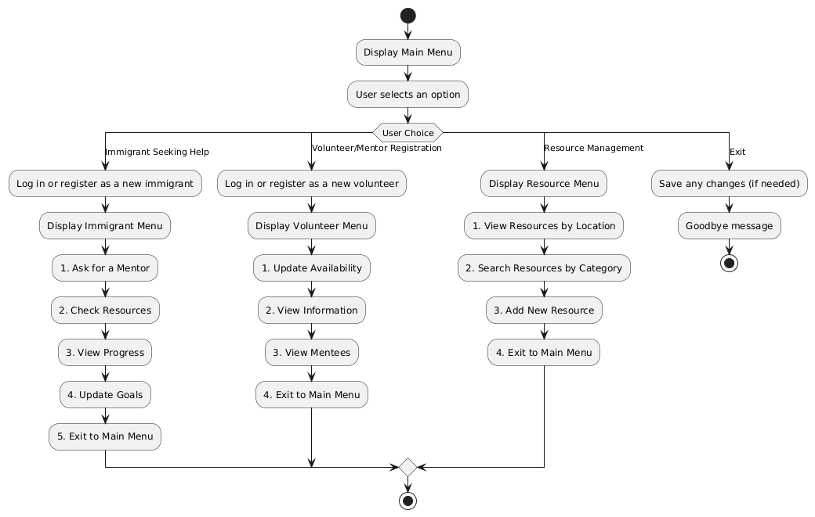
III. Main Menu Workflow Diagram

Slide 11
Blind Spots and Future Enhancements
Blind Spots
Future Enhancements
Real-Time Communication:
Lack of live messaging or scheduling options for users to interact effectively.
Security and Privacy:
No encryption for sensitive information like emails or personal details.
Users may not know how their data is used or stored, risking trust issues.
Resource Scalability and Relevance:
Resource retrieval may slow down as the database grows.
Resources may become outdated or irrelevant over time, affecting user trust.
Mentor Specialization:
Mentors can only choose one area of expertise, which limits flexibility.
Enhanced User Interface:
Build a graphical user interface (GUI) for a better user experience.
Implement a Secure Communication System:
Direct Messaging (DM): Allow users to message each other through the platform securely.
SMS/Email Notifications: Notify users through the system without exposing personal contact details.
Feedback and Ratings:
Allow users to rate mentors, resources, and interactions to ensure quality.
Dynamic Locations and Categories:
Enable flexible management of resource locations and categories.
Mentor Multi-Specialization:
Allow mentors to select multiple areas of expertise for more accurate matching.

