Slide 1

Project Title – Seasonal Agriculture Performance Analysis
Student Name – Aditya Prasad Soni
College Name – Bikaner Technical University
AICTE STU ID : STU684934dd8fe771749628125

Slide 2

Problem Statement
Seasonal variations in environmental conditions, farming practices, resource availability and market conditions can affect agricultural performance.
Raw agricultural data does not clearly reveal how yield, profitability and resource usage vary across different seasons and farming conditions.
The project aims to analyse the agricultural dataset and identify meaningful patterns, relationships, variations and performance differences across seasons, crops and farming practices.

Slide 3
Project Description
The project focuses on analysing agricultural data to understand how crop performance varies across different seasons and farming conditions. The dataset contains farm-level information about crops, seasons, locations, environmental conditions, resource usage, yield, revenue, cost and profit.
The analysis involves data cleaning, descriptive statistics, data visualization and exploratory analysis to identify patterns and variations in the data. The project mainly examines seasonal and crop performance, irrigation and water efficiency, environmental factors, resource usage and profitability.
The main outcome of the project is to identify important patterns and relationships in agricultural performance and generate useful insights that can support better agricultural planning.

Slide 4

Who Are The End Users?
Farmers / Farm Managers Use crop, season and irrigation performance insights for better planning.
Agricultural Planners Compare seasonal and crop performance to support agricultural planning.
Agricultural Analysts / Researchers Study relationships between yield, environmental conditions, resources and profitability.
Students / Data Analysts Use the analysis as an example of applying data analysis and visualization to agricultural data.

Slide 5

Technology Used
Python — Programming & Analysis
Pandas — Data Cleaning & Manipulation
NumPy — Numerical Analysis
Matplotlib — Data Visualization
Seaborn — Statistical Visualization
Google Colab — Development & Execution Environment

Slide 6
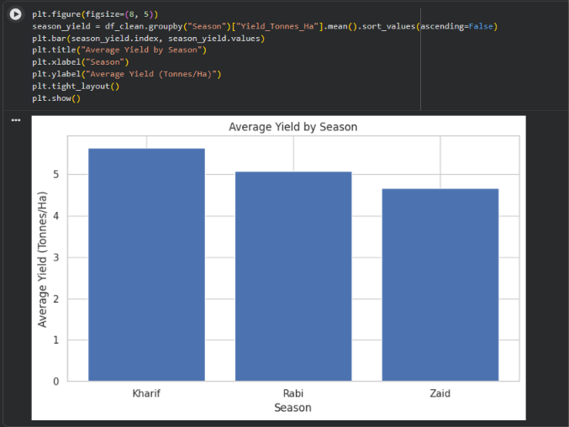
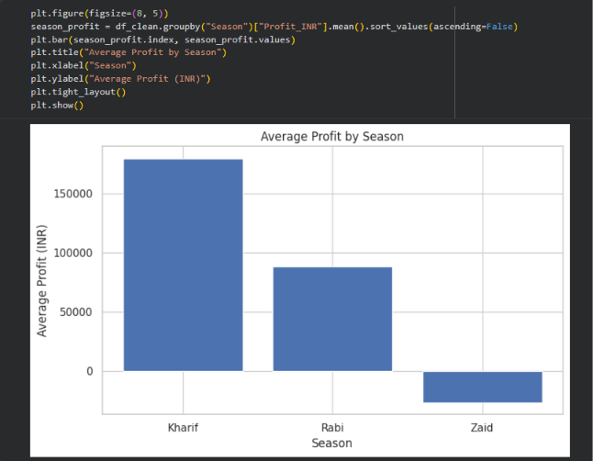
Result 1 — Seasonal Performance
Key Findings
Kharif recorded the highest average yield of 5.64 tonnes/ha.
Kharif recorded the highest average profit of ₹179,367
Kharif outperformed Rabi and Zaid in both average yield and profit.

Slide 7
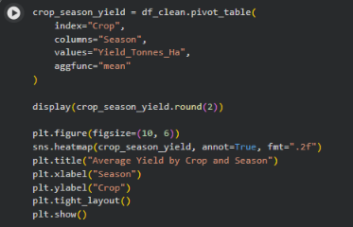
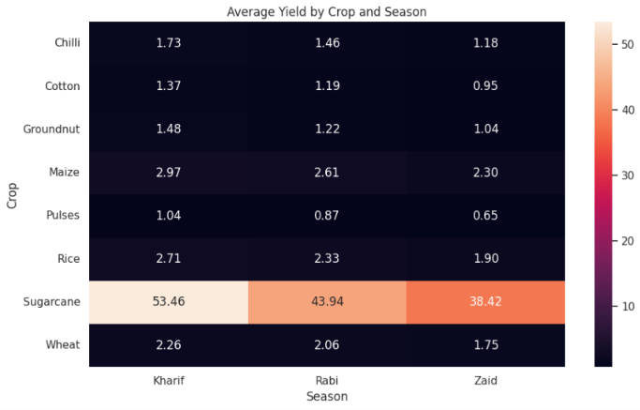
Result 2 — Crop & Season Performance
Key Findings
Sugarcane showed the highest average yield across all three seasons.
Sugarcane yield was highest in Kharif (53.46 tonnes/ha).
Crop performance varies across seasons, highlighting the importance of crop-season comparison.

Slide 8
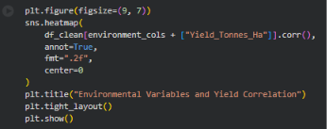
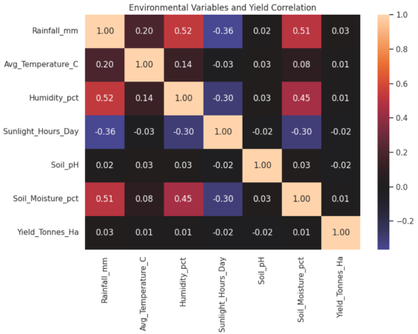
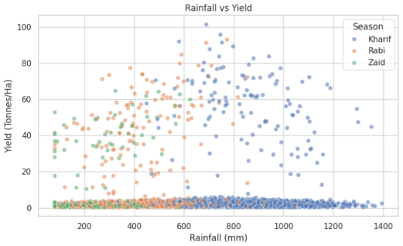
Result 3 — Environmental Conditions & Yield
Key Findings
Environmental variables show weak correlations with yield in the observed dataset.
Rainfall shows the strongest positive correlation with yield among the environmental variables (r ≈ 0.03).
The observed relationships indicate association, not causation.

Slide 9
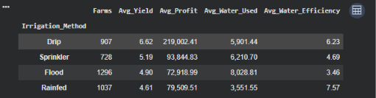
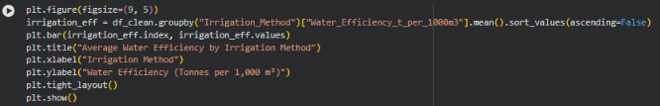
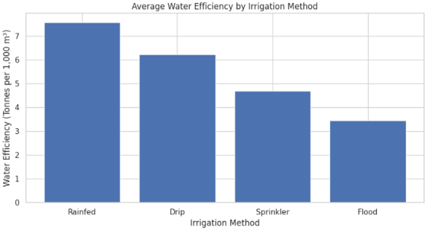
Result 4 — Irrigation & Water Efficiency
Key Findings
Drip irrigation recorded the highest average yield (6.62 tonnes/ha).
Rainfed farming recorded the highest average water efficiency (7.57 tonnes/1,000 m³).
Drip irrigation showed the highest average yield, while rainfed farming showed the highest water efficiency.

Slide 10
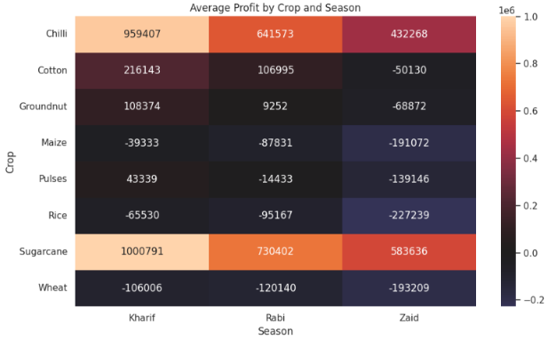
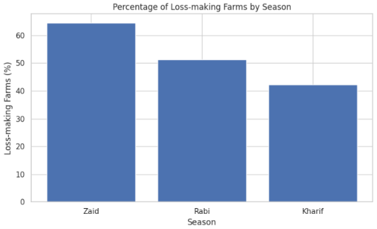
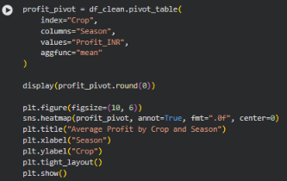
Result 5 — Profitability & Loss Analysis
Key Findings
Sugarcane recorded the highest average profit across all seasons.
Sugarcane in Kharif recorded the highest average profit of ₹10.01 lakh.
Zaid had the highest percentage of loss-making farms (64.52%).
Several crop-season combinations showed negative average profitability.

Slide 11
Future Scope
Larger and more diverse datasets Include data from more regions, farms and multiple years for broader analysis.
More detailed environmental data Include detailed weather, soil and climate information to better understand agricultural performance.
Cost and market analysis Include changes in input prices, crop prices and market conditions for deeper profitability analysis.
Farm-level resource analysis Study fertilizer, water, labour and other resource usage in greater detail.
Real-time agricultural data Future analysis can incorporate sensor or real-time field data for more detailed monitoring.

Slide 12
GitHub Repository
Seasonal Agriculture Performance Analysis
View Project on GitHub →
Repository includes:
Jupyter Notebook
Dataset
Project Report (PDF)
Project Presentation (PPT)

Slide 13
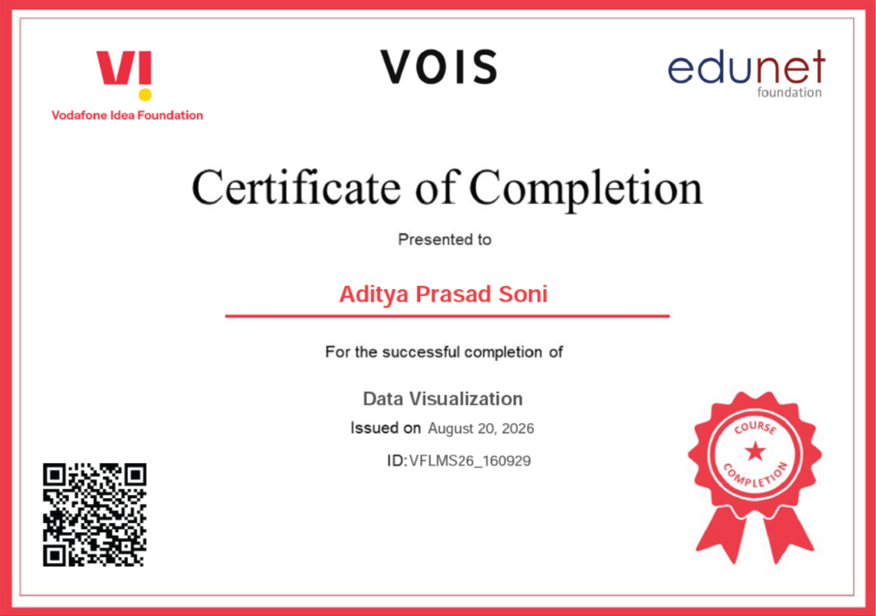
VOIS Course Completion Certificate Course name- Data Visualization

Slide 14
Thank you!
Thank you for your time and attention.
Seasonal Agriculture Performance Analysis Presented by Aditya Prasad Soni
.
.

