Slide 1
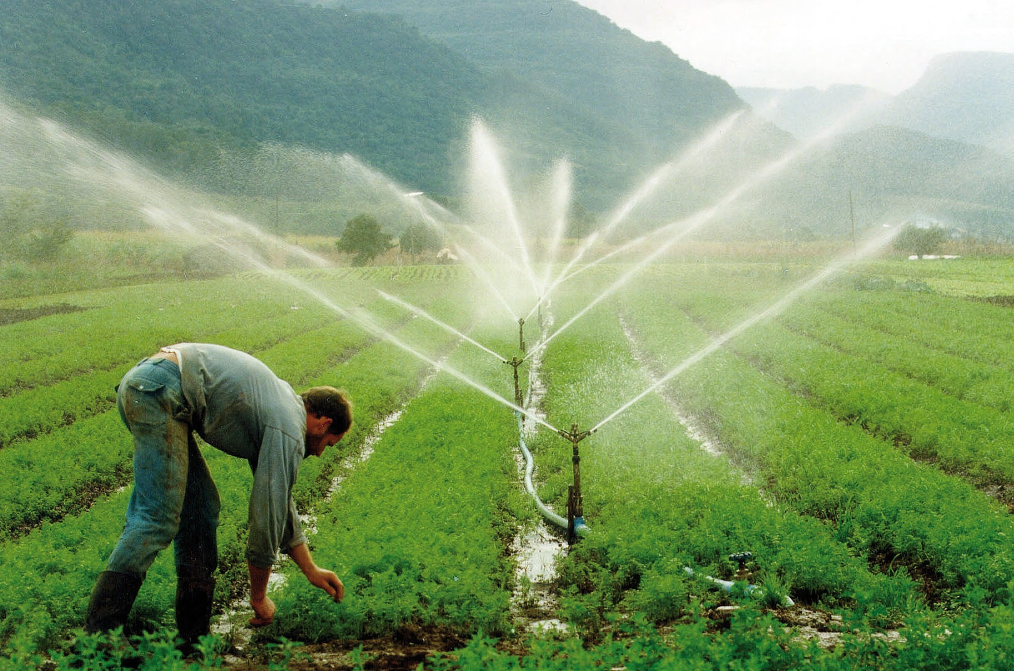
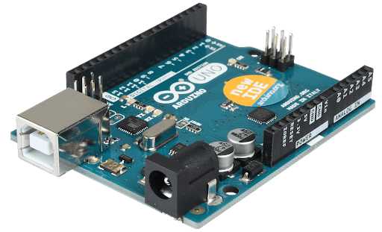
Smart Water Irrigation System Model
+
Submitted by-
Kuldeep Soni 9917103166
Abhimanyu Kaushik 9917103140
Mani Shrivastava 9917103137
Rabab Zaidi 9917103138

Slide 2
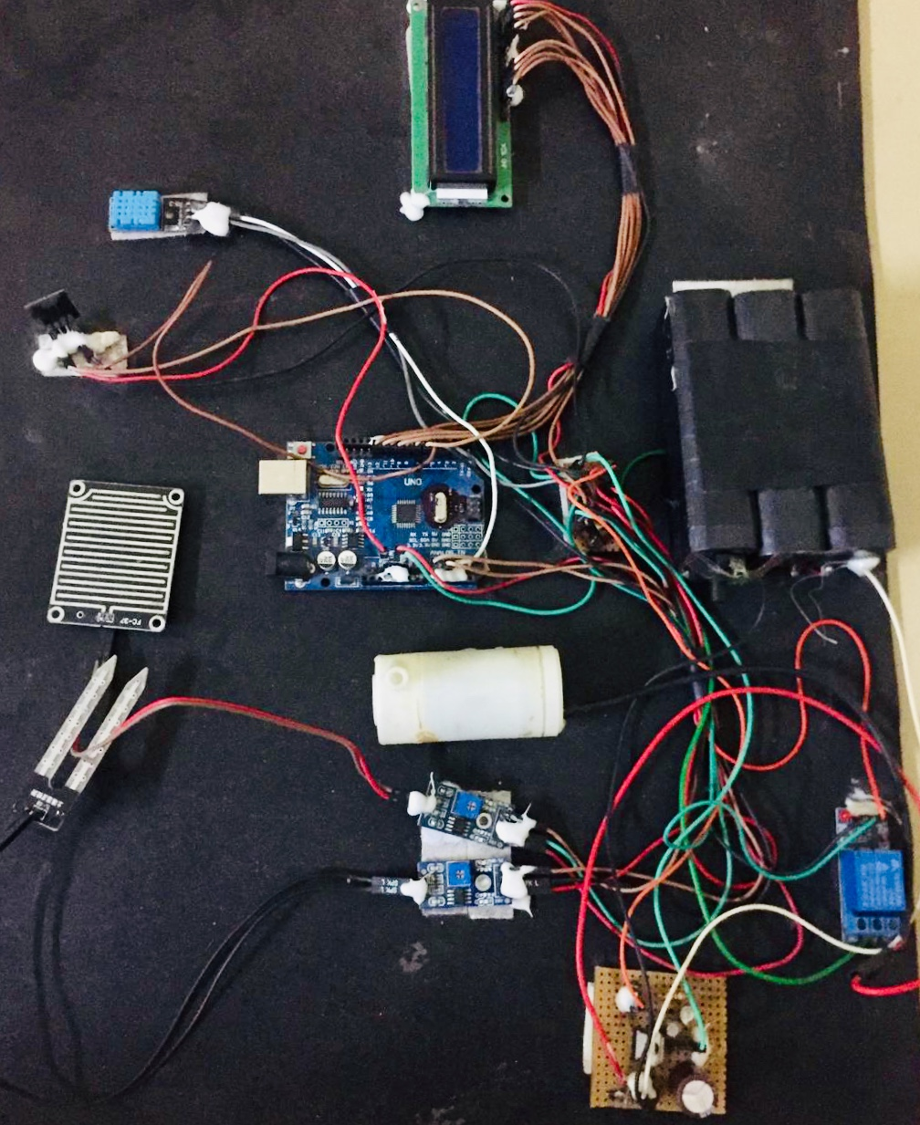
Smart Water Irrigation System Model

Slide 3
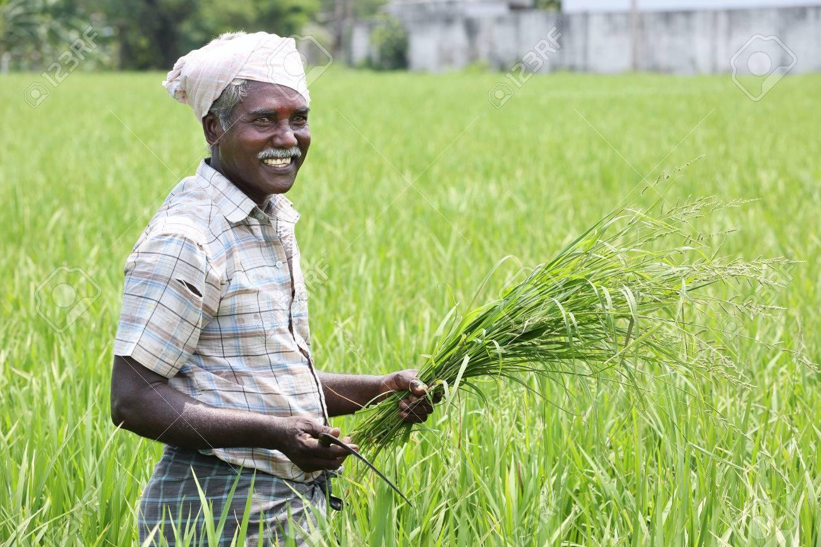
Aim:
=
+

Slide 4
Problem Statement
In India, agriculture sector is the largest sector to its economy. Our work basically is focused on eradicating the problems faced by the farmers due to irrigation of the fields like-
Lack of rain
Over watering which is harmful for the crop
How to schedule the process of irrigation
To deal with these problems we came up with this project idea in which our main aim is to focus on minimizing the workload and maximizing the crop productivity by building a smart irrigation system which senses data from the surroundings such as soil moisture, humidity and rainfall and decide for itself if the field required to be irrigated or not.

Slide 5
Why Do we need Smart Water Irrigation System?
In India, agriculture sector is the largest sector to its economy, but when it comes to technology we find that it is still very deficient. This is because of the high cost it takes then the presently used conventional methods.
Now a day’s there is huge enhancement in technology which plays a vital impact on various fields like healthcare, education, etc. The problem with Agriculture is that most farmers are unable to afford these technology from big brands due to their large price marks.
This result into a devastating fact that most of the irrigation systems are operated manually. This is a risky method as it may give rise to problems of wasting water, over watering, lack of watering.

Slide 6
Reason to choose KNN, SVM & Logistic regression
These models are capable of producing accurate and robust classification results, even when input data are non-monotone and non-linearly separable. So they can help to evaluate more relevant information in a convenient way.
By properly setting the value of C-regularisation parameter one can easily suppress the outliers and hence they are robust to noise.
With some key actual training vectors embedded in the models as support vectors, the SVM has the potential to trace back historical events so that future predictions can be improved with the lessons learnt from the past.

Slide 7
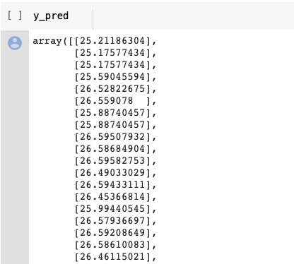
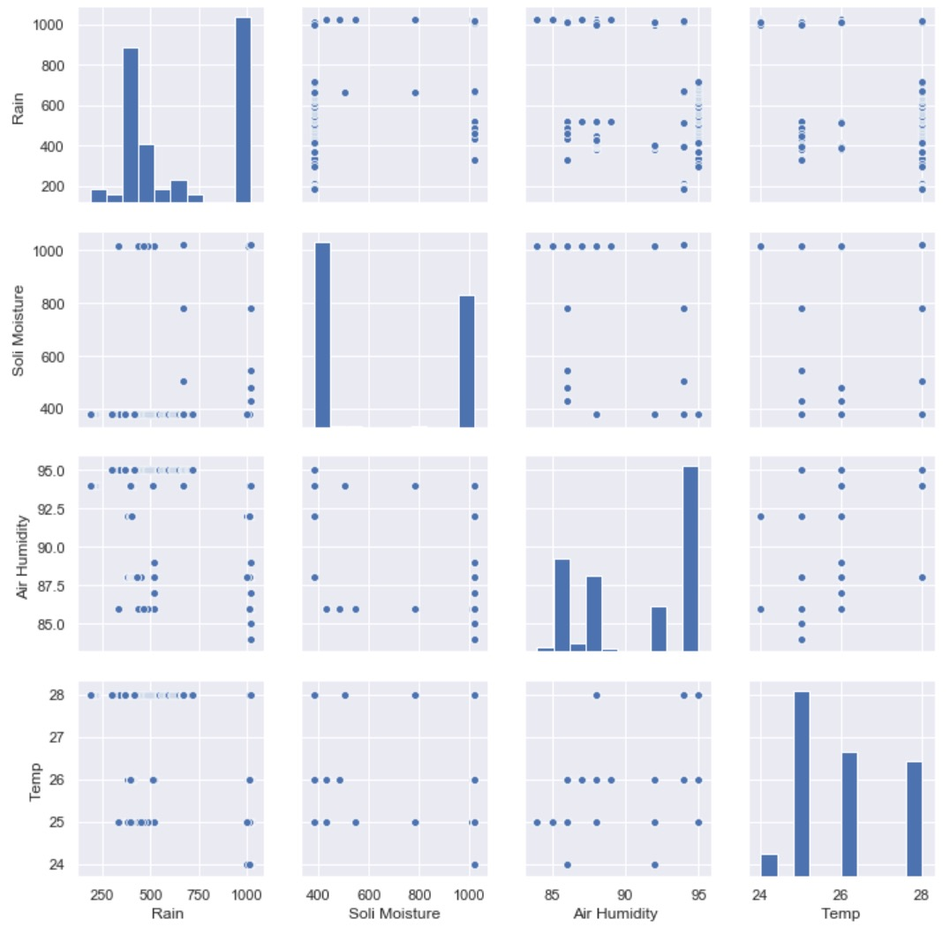
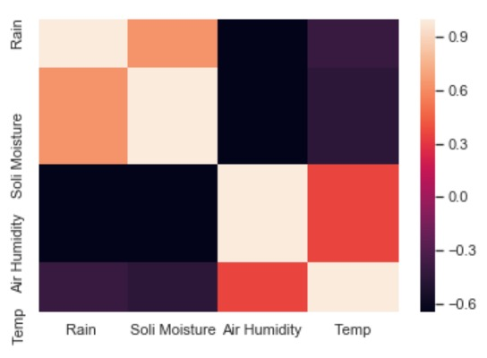
Logistic regression with LLE:
Logistic regression is a supervised classification algorithm.
In a classification problem, we propose Logistic regression based irrigation prediction control system..
Accuracy :78.97%
Result Logistic regression

Slide 8
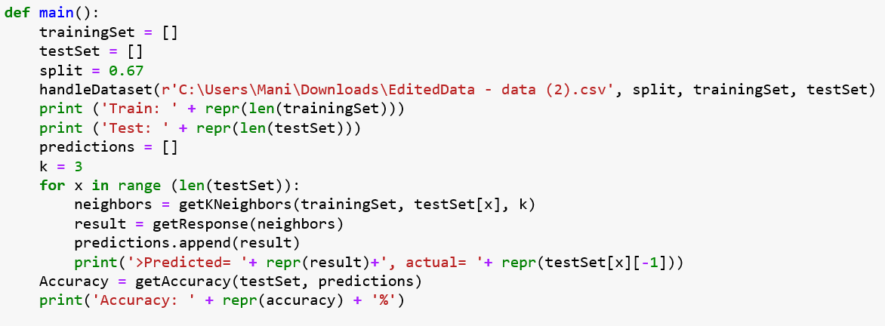
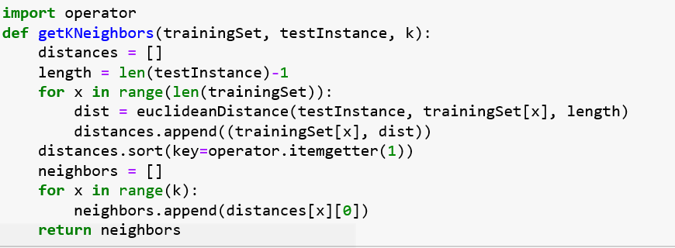
K Nearest neighbour
The algorithm is based on learning by analogy, i.e. by comparing the given test example with the training examples that are similar to it.
When a new data is fed to the algorithm, it searches for the k training examples that are closest to this new data point.
Closeness is defined in terms of a distance metric. We are considering Euclidean distance to have the closeness.
This algorithm is powerful and easy to use.

Slide 9

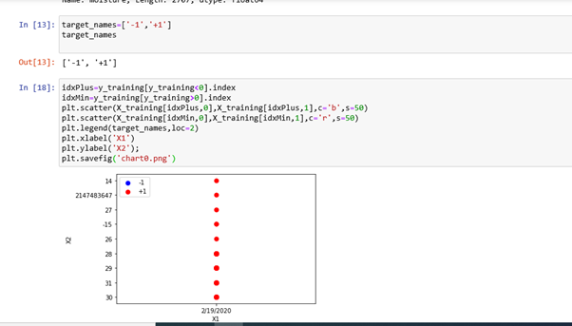
Support Vector Machine
SVM is one of the best recognition method of learning model.
Training vectors embedded in the models as support vectors.
SVM has the potential to trace back historical events so that future predictions can be improved with the lessons learnt from the past.
SVM automatically identifies and incorporates support vectors during the training process and prevents the influence of the non-support vectors over the model.

Slide 10
ACCURACY
Machine Learning Technique | Logistic Regression | K Nearest neighbour (KNN) | Support Vector Machine (SVM)
Accuracy | 76.46% | 66.66% | 78.88%

Slide 11
Conclusion
The automated irrigation system has been designed and implemented in this paper.
The system developed is beneficial and works in cost effective manner. It reduces the water consumption to a greater extent.
It needs minimal maintenance .The power consumption has been reduced very much.
The system can be used in green houses.
The System is very useful in areas where water scarcity is major problem .The crop productivity increases and the wastage of crops is very much reduced using this irrigation system.

Slide 12

Thank you

